Slide 2
The Ascension of the Lord – June 1, 2025
CYCLE C – YEAR I

Slide 3
Context:
Jesus tells His disciples that His suffering, death, and resurrection fulfilled Scripture, and that repentance and forgiveness should now be preached to all nations, starting from Jerusalem. He promises the coming of the Holy Spirit, blesses them, and ascends into heaven. The disciples respond with worship and joy, returning to Jerusalem to praise God in the temple.
Message:
Jesus died and came back to life to save us. Now He wants us to share His love and forgiveness with everyone. He went back to heaven, but He promised to send the Holy Spirit to help us. We can be happy and tell others about Jesus!
Lesson:
Jesus wants us to share His message of love, forgiveness, and new life with others. He doesn’t leave us alone—He gives us the Holy Spirit to help us. Just like the disciples, we are called to be joyful and faithful in spreading His Good News.

Slide 4
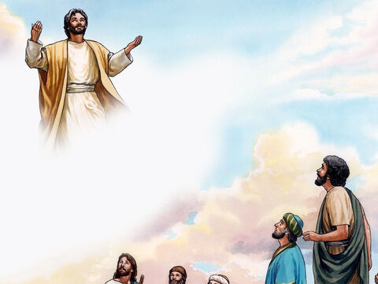
Jesus is Taken Up to Heaven
Luke 24: 46-53

Slide 5
Leader: A reading from
the Holy Gospel
according to Luke.
All: Glory to You, Oh Lord.

Slide 6
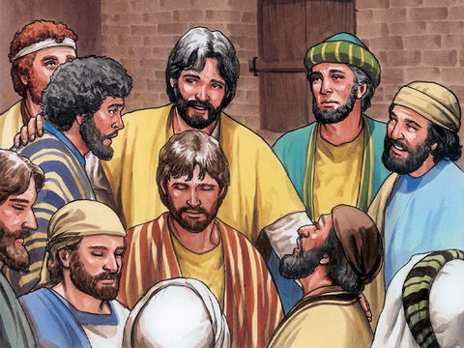
46
and said to them, “This is what is written: the Messiah must suffer and must rise from death three days later,

Slide 7
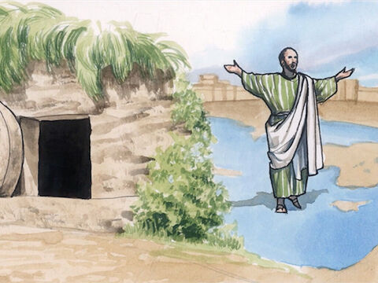
47
and in his name the message about repentance and the forgiveness of sins must be preached to all nations, beginning in Jerusalem.

Slide 8
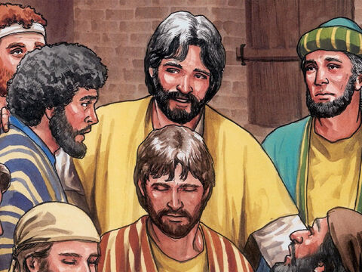
48
You are witnesses of these things.

Slide 9
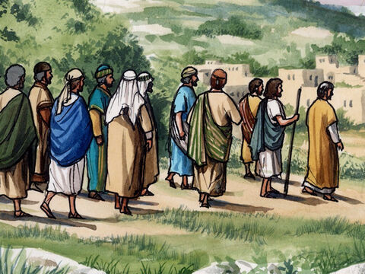
49
And I myself will send upon you what my Father has promised. But you must wait in the city until the power from above comes down upon you.”

Slide 10
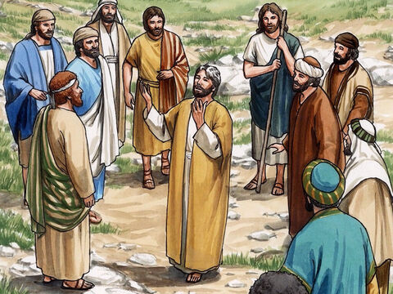
50
Then he led them out of the city as far as Bethany, where he raised his hands and blessed them.

Slide 11
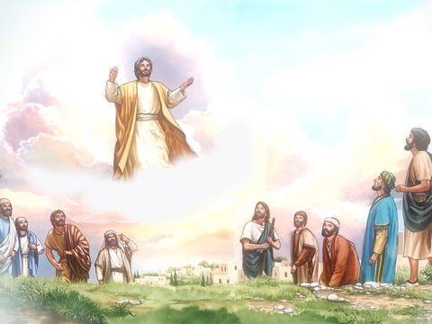
51
As he was blessing them, he departed from them and was taken up into heaven.

Slide 12
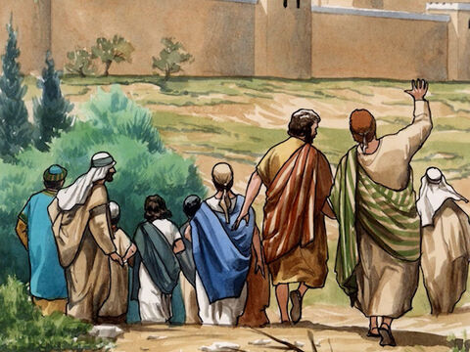
52
They worshiped him and went back into Jerusalem, filled with great joy,

Slide 13
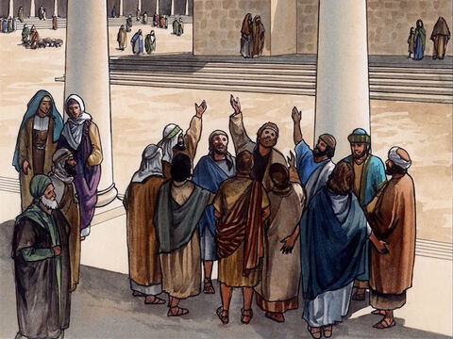
53
and spent all their time in the Temple giving thanks to God.

Slide 14
Leader: The Gospel of the Lord.
All: Praise to You,
Lord Jesus Christ.

Slide 15
GOSPEL MESSAGE

Slide 16
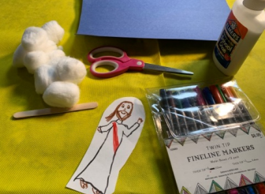
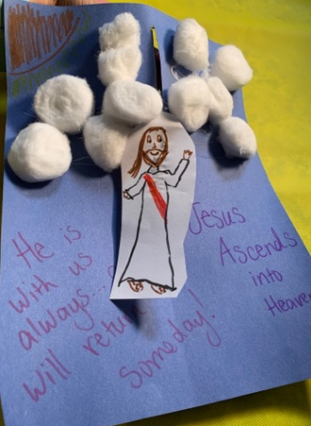
Activity:
“Jesus Ascends” Poster
• Construction paper or card stock
• Markers, stickers, or other decorating materials
• Cotton balls
• Glue
• Scissors

Slide 17
Instructions:
1. Decorate the paper with a sky scene, adding a hill and stick figure “disciples” or “angels,” as desired. Add verses or captions
2. Cut a vertical line down the center of the paper, leaving about 1-2 inches on each side.
3. Glue cotton balls for clouds at the top of the paper.
4. Color and cut a small paper picture of Jesus. Attach to a stick for ease of movement.
5. Carefully poke “Jesus” through the paper slit and lift up and down while you teach
the story elements

Slide 18
Closing Prayer
Dear Jesus,
Thank You for rising from the dead and going back to heaven. Help me to remember Your love and share it with others. Thank You for the Holy Spirit. I will praise You always!
Amen.

Slide 19
The Ascension of the Lord – June 1, 2025
CYCLE C – YEAR I

