Slide 1


Slide 2

Third Sunday in Ordinary Time – January 26, 2025
CYCLE C – YEAR I

Slide 3
CONTEXT:
Luke 1:1-4 - These verses serve as the prologue to the Gospel of Luke. Luke addresses his Gospel to Theophilus, explaining that he has carefully investigated everything about Jesus and is writing an orderly account to strengthen the faith of believers. Luke 4:14-21 - This passage occurs at the beginning of Jesus’ public ministry. After His baptism and His time of fasting and temptation in the wilderness, Jesus, filled with the power of the Spirit, returns to Galilee. He visits the synagogue in Nazareth, His hometown, and reads from the scroll of Isaiah (Isaiah 61:1-2). This prophecy speaks of the Messiah who will bring good news to the poor, liberty to captives, sight to the blind, and freedom for the oppressed. Jesus boldly declares that this Scripture is fulfilled in their hearing, essentially claiming to be the Messiah.
GOSPEL MESSAGE:
Jesus is the fulfillment of prophecy, as He boldly identifies Himself as the one foretold in Isaiah's writings, emphasizing that He has come to bring spiritual liberation and healing. His mission is universal, extending to the poor, the outcast, and the marginalized, highlighting the inclusivity of God’s love and salvation. Beginning His ministry in the power of the Holy Spirit, Jesus demonstrates that God’s work is accomplished through divine guidance and empowerment, showing us the importance of relying on the Spirit in our own lives.
LESSON:
We are called to respond to God’s call with faith, just as Jesus did, even when His neighbors in Nazareth struggled to accept Him because they saw Him only as the carpenter’s son. This teaches us to remain open to seeing God’s work through unexpected people or circumstances. Jesus’ mission to bring hope and healing inspires us to live a life of love and service, caring for the poor, the suffering, and the outcast. Even when faced with rejection or misunderstanding, Jesus stayed faithful to His mission, reminding us to persevere in our faith and trust God’s plan for our lives.

Slide 4
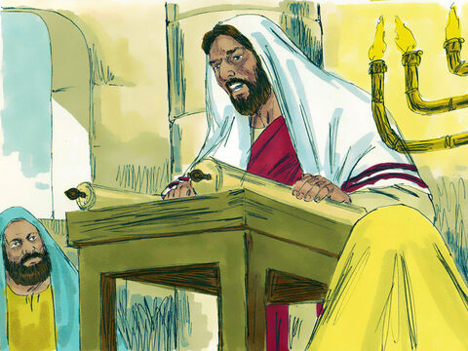
Jesus Is Rejected at Nazareth
Luke 1:1-4; 4:14-21

Slide 5
Leader: A reading from
the Holy Gospel
according to Luke.
All: Glory to You, Oh Lord.

Slide 6
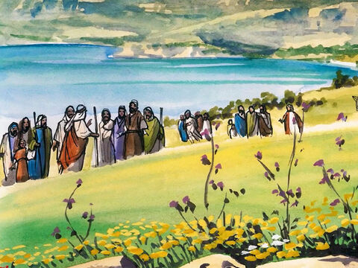
1
Many people have done their best to write a report of the things that have taken place among us.

Slide 7
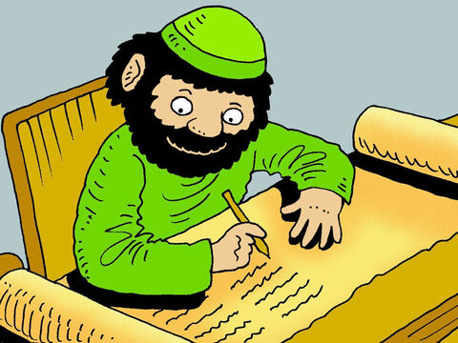
2
They wrote what we have been told by those who saw these things from the beginning and who proclaimed the message.

Slide 8
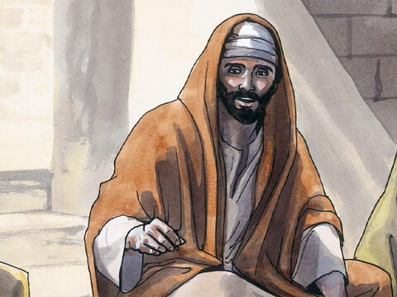
3
And so, Your Excellency, because I have carefully studied all these matters from their beginning, I thought it would be good to write an orderly account for you.

Slide 9
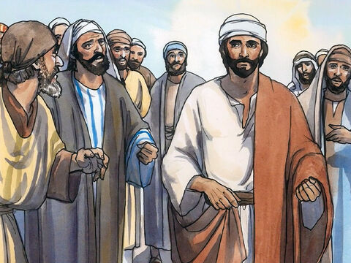
4
I do this so that you will know the full truth about everything which you have been taught.

Slide 10
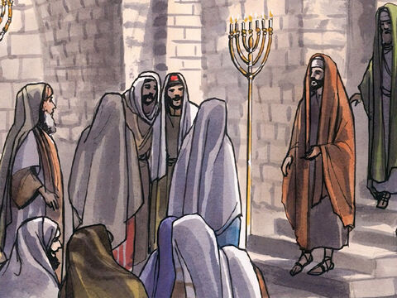
14
Then Jesus returned to Galilee, and the power of the Holy Spirit was with him. The news about him spread throughout all that territory.

Slide 11
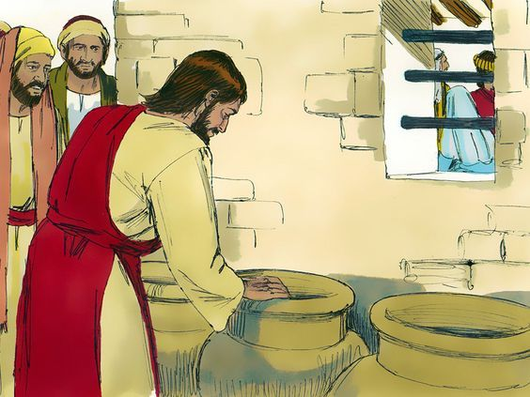
15
The Jews have rules about ritual washing, and for this purpose six stone water jars were there, each one large enough to hold between twenty and thirty gallons.

Slide 12
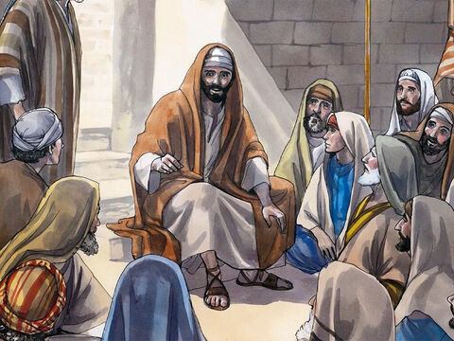
15
He taught in the synagogues and was praised by everyone.

Slide 13
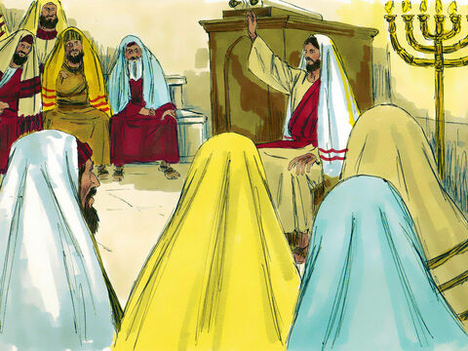
16
Then Jesus went to Nazareth, where he had been brought up, and on the Sabbath he went as usual to the synagogue. He stood up to read the Scriptures

Slide 14
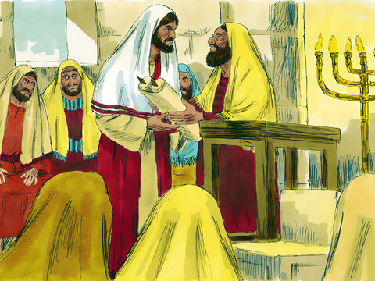
17
and was handed the book of the prophet Isaiah. He unrolled the scroll and found the place where it is written,

Slide 15
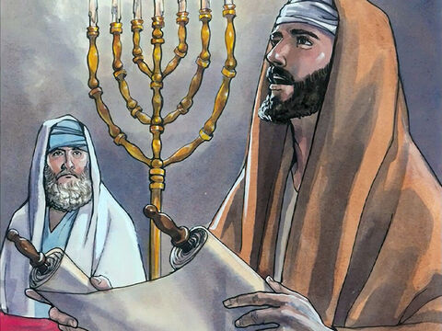
18
“The Spirit of the Lord is upon me, because he has chosen me to bring good news to the poor. He has sent me to proclaim liberty to the captives and recovery of sight to the blind, to set free the oppressed

Slide 16
19
and announce that the time has come when the Lord will save his people.”

Slide 17
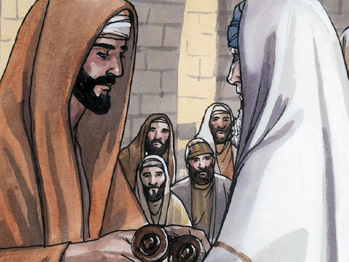
20
Jesus rolled up the scroll, gave it back to the attendant, and sat down. All the people in the synagogue had their eyes fixed on him,

Slide 18
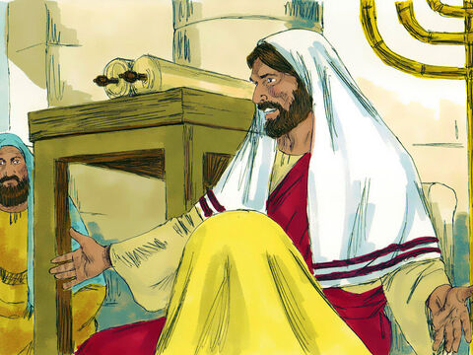
21
as he said to them, “This passage of scripture has come true today, as you heard it being read.”

Slide 19
Leader: The Gospel of the Lord.
All: Praise to You,
Lord Jesus Christ.

Slide 20

GOSPEL
MESSAGE

Slide 21
Activity:
“Prophetic Scroll”
Materials:
• Markers/Crayons
• Construction Paper
• Scissors
• Paper towel rolls
• Tape, glue, or staples
• Tea bag (optional)
Notes:
Explain to the kids that their giving pail can be use to save money for church, missionaries, and to remind them of ways to give to others without money.

Slide 22
Instructions:
1. Decorate long paper or card stock with verses, captions, or pictures.
2. If desired (to increase “old” look), soak tea bags and add to crinkled paper.
3. Attach the scroll paper to paper towel tubes with staples or tape.
4. Add extra decorations as desired.
5. Roll like a “scroll” and hang or read as a reminder of the story and proclamation of Christ!
Notes:
Explain to the kids that their giving pail can be use to save money for church, missionaries, and to remind them of ways to give to others without money.

Slide 23

Closing Prayer
Heavenly Father, Thank You for the gift of Your Word that reminds us of Jesus’ mission to bring hope, healing, and salvation to all. We are grateful for the example of His steadfast faith and love, even in the face of rejection. Fill our hearts with the courage to respond to Your call, the compassion to serve others, and the trust to follow Your plans. Empower us with Your Spirit, so we may bring Your light to those in need. Bless each one of us as we go forth, and help us to live as true witnesses of Your love. In Jesus’ name, we pray. Amen.

Slide 24
Third Sunday in Ordinary Time – January 26, 2025
CYCLE C – YEAR I

