Slide 2
Second Sunday in Ordinary Time – January 19, 2025
CYCLE C – YEAR I

Slide 3
General Context:
The story of the Wedding at Cana takes place at a wedding celebration in Cana of Galilee, where Jesus, His mother Mary, and His disciples are present as guests. During the celebration, the hosts run out of wine, a situation that would have caused significant embarrassment and social disgrace in Jewish culture. Mary brings the issue to Jesus, and though He initially seems reluctant, He performs His first public miracle by turning water into wine. This act not only saves the hosts from shame but also marks the beginning of Jesus’ public ministry, revealing His divine glory and leading His disciples to deepen their belief in Him.
Message:
1. Jesus Cares About Our Needs - The story shows Jesus’ concern not just for spiritual matters but also for practical human needs. His intervention saved the couple from potential shame, reflecting His compassion and care for our daily struggles.
2. Mary’s Role in Intercession - Mary notices the problem and brings it to Jesus. Her words, "Do whatever He tells you," exemplify trust in Jesus and provide guidance for all believers: listen to and obey Him.
3. Jesus Reveals His Divinity - The miracle is more than a simple act of kindness—it is a sign of Jesus’ divine nature and power. It also points forward to the ultimate transformation He will bring through His mission: turning the ordinary (our lives) into something extraordinary (full of grace and purpose).
Moral Lessons:
1. Faith and Obedience Lead to Miracles - The servants obey Jesus’ instructions, even when they don’t fully understand them. Their act of faith allowed them to witness the miracle. This teaches us to trust God even when we don’t see the full picture.
2. Jesus Brings Abundance - Jesus didn’t just provide enough wine—He provided the best wine. This reminds us that God’s blessings are abundant and far surpass our expectations.
3. Involve God in Every Part of Life - Just as Jesus was present at the wedding, we should invite Him into all areas of our lives, big or small. With Him, even ordinary moments can become extraordinary.

Slide 4
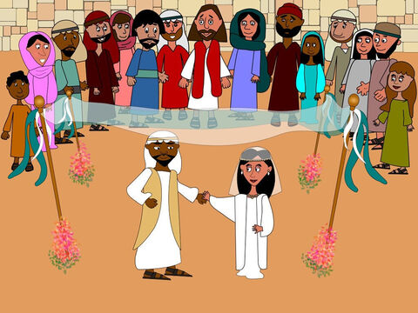
The Wedding at Cana
John 2:1-11

Slide 5
Leader: A reading from
the Holy Gospel
according to John.
All: Glory to You, Oh Lord.

Slide 6
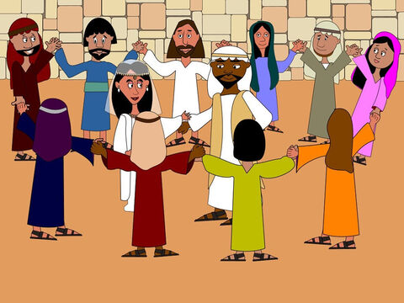
1
Two days later there was a wedding in the town of Cana in Galilee. Jesus' mother was there,

Slide 7
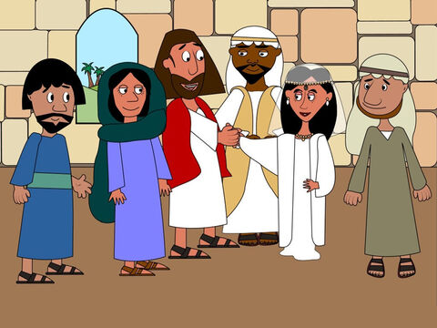
2
and Jesus and his disciples had also been invited to the wedding.

Slide 8
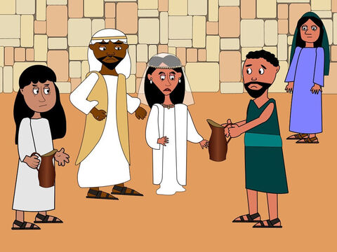
3
When the wine had given out, Jesus' mother said to him, “They are out of wine.”

Slide 9
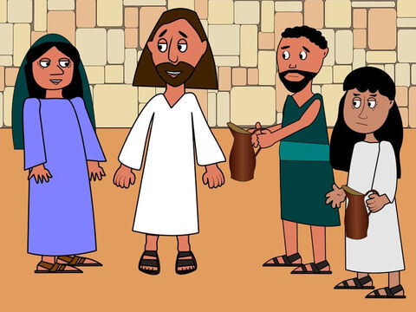
4
“You must not tell me what to do,” Jesus replied. “My time has not yet come.”

Slide 10
5
Jesus' mother then told the servants, “Do whatever he tells you.”

Slide 11
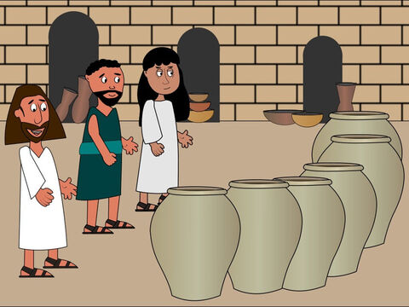
6
The Jews have rules about ritual washing, and for this purpose six stone water jars were there, each one large enough to hold between twenty and thirty gallons.

Slide 12
7
Jesus said to the servants, “Fill these jars with water.” They filled them to the brim,

Slide 13
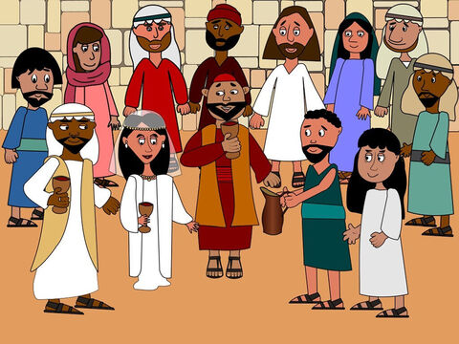
8
and then he told them, “Now draw some water out and take it to the man in charge of the feast.” They took him the water,

Slide 14
9
which now had turned into wine, and he tasted it. He did not know where this wine had come from (but, of course, the servants who had drawn out the water knew); so he called the bridegroom

Slide 15
10
and said to him, “Everyone else serves the best wine first, and after the guests have drunk a lot, he serves the ordinary wine. But you have kept the best wine until now!”

Slide 16
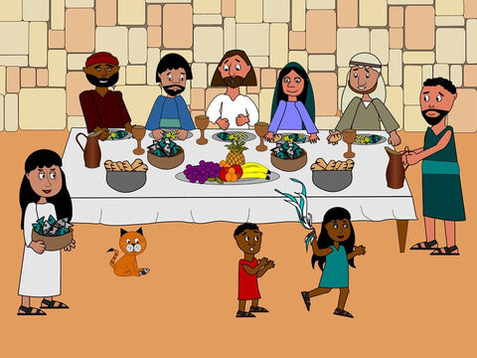
11
Jesus performed this first miracle in Cana in Galilee; there he revealed his glory, and his disciples believed in him.

Slide 17
Leader: The Gospel of the Lord.
All: Praise to You,
Lord Jesus Christ.

Slide 18
GOSPEL MESSAGE

Slide 19
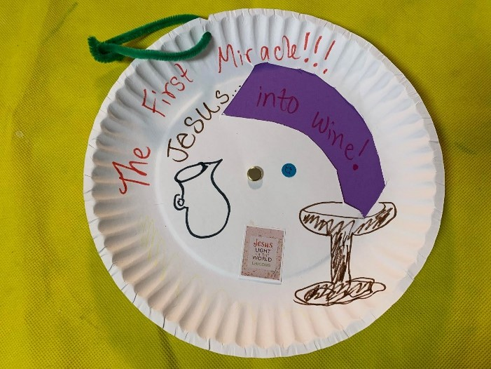
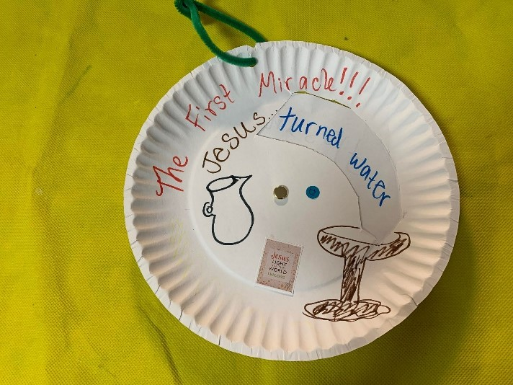
Activity:
“Water to Wine Wheel”
Materials:
• Markers/Crayons
• Construction Paper
• Scissors
• Paper Plate
• Brad Fastener
Notes:
Explain to the kids that their giving pail can be use to save money for church, missionaries, and to remind them of ways to give to others without money.

Slide 20
Instructions:
1. Cut a large slit in the paper plate.
2. Decorate the plate with Bible verses, captions, and pictures that describe Jesus’ first miracle at the wedding in Cana. Add extra decorations as desired.
3. Cut a circle from a piece of paper. Color half of the circle purple or red, or attach two half-circle pieces of paper together.
Notes:
Explain to the kids that their giving pail can be use to save money for church, missionaries, and to remind them of ways to give to others without money.

Slide 21
Instructions:
4. Use a brad fastener to attach the paper circle behind the plate.
5. Spin the paper circle to watch the "water" transform into "wine" as shown in the image. You can attach a pipe cleaner or magnet to hang the decorated plate.
Notes:
Explain to the kids that their giving pail can be use to save money for church, missionaries, and to remind them of ways to give to others without money.

Slide 22
Closing Prayer
Heavenly Father, Thank You for gathering us today to reflect on the story of the Wedding at Cana. We are reminded of Your love and care for every detail of our lives. Thank You for showing us through Jesus’ first miracle that You bring abundance, joy, and transformation to all who trust in You. Help us to have faith like Mary and obedience like the servants, so we may always follow Your will. May we invite You into every moment of our lives, knowing that with You, all things are made new. Bless us as we go forth, and may we always be vessels of Your love and grace. In Jesus’ name, we pray. Amen.

Slide 23
Second Sunday in Ordinary Time – January 19, 2025
CYCLE C – YEAR I

