Slide 2
January 12, 2025
Feast of the Baptism of the Lord

Slide 3
Reflection:
The baptism of Jesus signals the end of the Christmas season. It is celebrated as a great feast especially in Eastern churches where it is called theophany because it is the first public revelation of triune God – the Father, the Son and the Holy Spirit. On this particular moment, heaven and earth, the human and the divine are reunited. Heaven is opened and the Holy Spirit descended and the voice of the Father is heard.
John witnessed a spectacular moment. The coming of God’s spirit upon God’s only son. The spirit that was sensed ever since he was a baby till at his last moment on the Cross. Like what happened, the spirit gives us energy that will always remind us that, we’re not alone. The spirit came upon us but we’re not the only one and we have a mission to fulfil. To spread the word of God and express his love for the world.

Slide 4
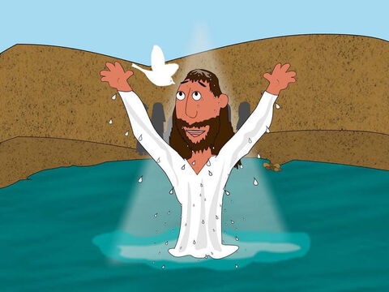
The Baptism of Jesus
Luke 3:15-16.21-22

Slide 5
Leader: A reading from
the Holy Gospel
according to Luke.
All: Glory to You, Oh Lord.

Slide 6
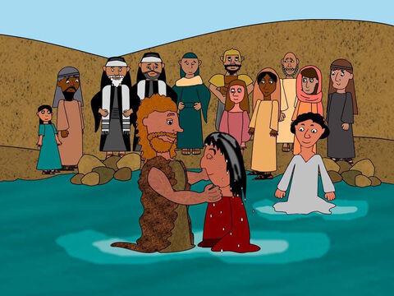
15
People's hopes began to rise, and they began to wonder whether John perhaps might be the Messiah.

Slide 7
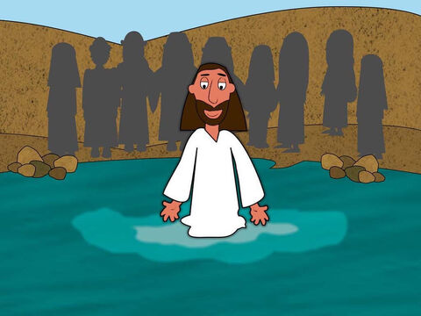
16
So John said to all of them, “I baptize you with water, but someone is coming who is much greater than I am. I am not good enough even to untie his sandals. He will baptize you with the Holy Spirit and fire.

Slide 8
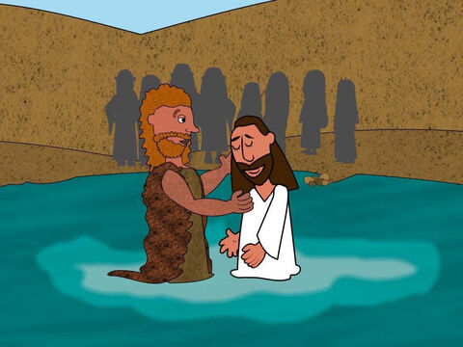
21
After all the people had been baptized, Jesus also was baptized. While he was praying, heaven was opened,

Slide 9
22
and the Holy Spirit came down upon him in bodily form like a dove. And a voice came from heaven, “You are my own dear Son. I am pleased with you.”

Slide 10
Leader: The Gospel of the Lord.
All: Praise to You,
Lord Jesus Christ.

Slide 11
GOSPEL MESSAGE

Slide 12
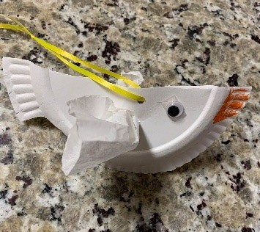
Activity:
Holy Spirit Dove
Materials:
• Pipe Cleaners or string
• Scissors
• Paper plates
• Markers or decorating materials
• Google eyes
• Paper or coffee filters
Notes:
Explain to the kids that their giving pail can be use to save money for church, missionaries, and to remind them of ways to give to others without money.

Slide 13
Instructions:
1. Cut or fold the paper plate into a bird-like shape.
2. Decorate the bird with color (if desired), a “beak”, and eyes.
3. Cut a slit into the side of the bird.
4. Carefully place a coffee filter or paper “wings” into the slit to serve as wings.
5. Attach a string if you would like to hang your dove, and a verse caption on the side.
Notes:
Explain to the kids that their giving pail can be use to save money for church, missionaries, and to remind them of ways to give to others without money.

Slide 14
Closing Prayer
Dear God,
Thank you for giving us Jesus
Thank you that He died in our place and takes away our sins
Thank you for letting us start fresh
And “clean up” again and again
We know we make mistakes,
But you always forgive!
Thank you for your love
We love you, God!
In Jesus name, Amen!

Slide 15
January 12, 2025
Feast of the Baptism of the Lord

