Slide 2
Fifth Sunday in Ordinary Time – February 9, 2025
CYCLE C – YEAR I

Slide 3
Context:
This story narrates the calling of Jesus’ first disciples. After fishing all night without success, Jesus instructs them to cast their nets on the other side of the boat. They obey, and to their amazement, they make a miraculous catch of fish. In that moment, they recognize that it is Jesus calling them from the shore. Overwhelmed, Simon, along with his partners James and John, decides to leave everything behind and follow Him. Jesus then tells Simon, “From now on, you will be catching people.”
Message:
Just as Jesus called His first disciples, He calls each of us to follow Him in our daily lives. His words—*“Don’t be afraid; from now on you will be catching people”*—remind us that responding to His call requires courage and trust. The disciples left behind their great catch of fish because they were drawn to something far greater—Jesus Himself.
Lesson:
God often calls us to simple acts of faith that, while small in our eyes, are significant to Him. The disciples’ obedience in casting their nets led to an incredible revelation of who Jesus was. Likewise, when we obey God, even in the smallest ways, we open ourselves to His blessings and deeper faith. Just as Simon, James, and John saw themselves differently after encountering Jesus, we too are transformed when we recognize Him in our lives. When we follow and obey, we become true fishers of men, bringing others to Christ—a far greater catch than any earthly reward.

Slide 4
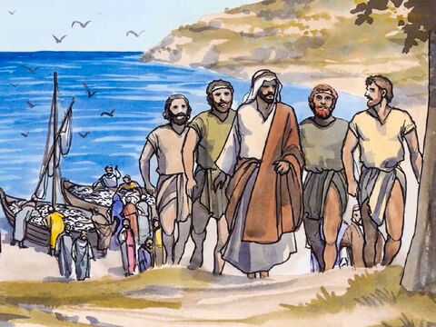
Jesus Calls the First Disciples
Luke 5:1-11

Slide 5
Leader: A reading from
the Holy Gospel
according to Luke.
All: Glory to You, Oh Lord.

Slide 6
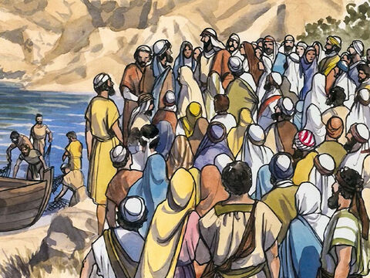
1
One day Jesus was standing on the shore of Lake Gennesaret while the people pushed their way up to him to listen to the word of God.

Slide 7
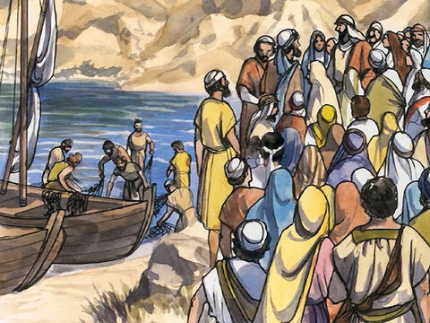
2
He saw two boats pulled up on the beach; the fishermen had left them and were washing the nets.

Slide 8
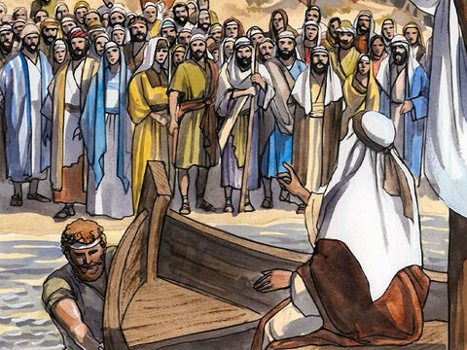
3
Jesus got into one of the boats – it belonged to Simon – and asked him to push off a little from the shore. Jesus sat in the boat and taught the crowd.

Slide 9
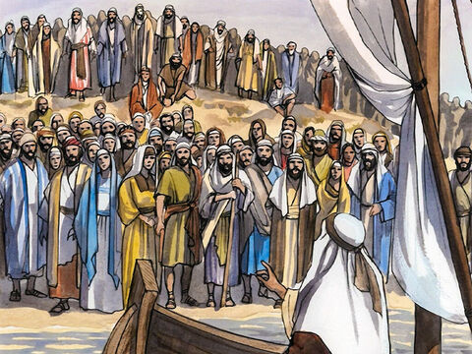
4
When he finished speaking, he said to Simon, “Push the boat out further to the deep water, and you and your partners let down your nets for a catch.”

Slide 10
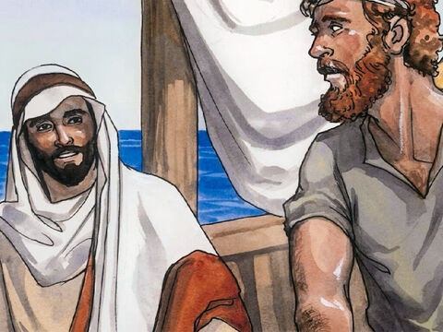
5
“Master,” Simon answered, “we worked hard all night long and caught nothing. But if you say so, I will let down the nets.”

Slide 11
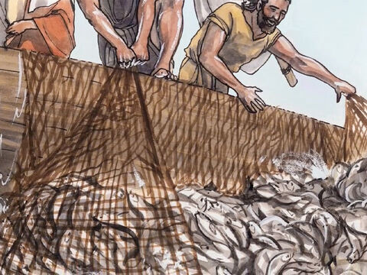
6
They let them down and caught such a large number of fish that the nets were about to break.

Slide 12
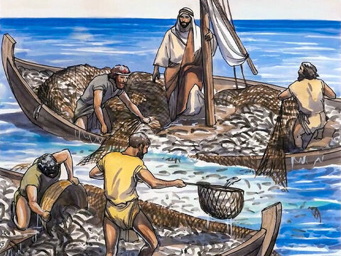
7
So they motioned to their partners in the other boat to come and help them. They came and filled both boats so full of fish that the boats were about to sink.

Slide 13
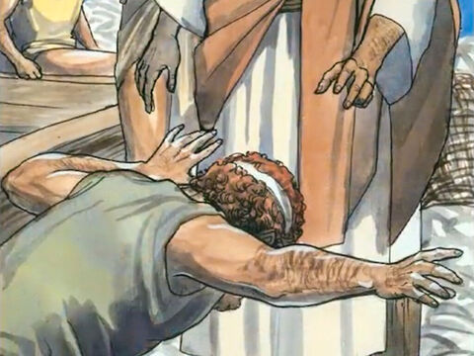
8
When Simon Peter saw what had happened, he fell on his knees before Jesus and said, “Go away from me, Lord! I am a sinful man!”

Slide 14
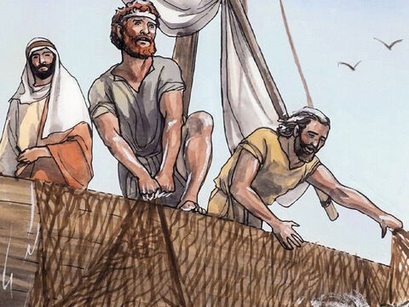
9
He and the others with him were all amazed at the large number of fish they had caught.

Slide 15
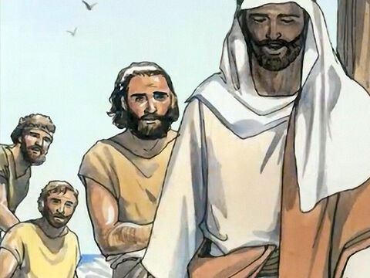
10
The same was true of Simon’s partners, James and John, the sons of Zebedee. Jesus said to Simon, “Don’t be afraid; from now on you will be catching people.”

Slide 16
11
They pulled the boats up on the beach, left everything, and followed Jesus.

Slide 17
Leader: The Gospel of the Lord.
All: Praise to You,
Lord Jesus Christ.

Slide 18
GOSPEL MESSAGE

Slide 19
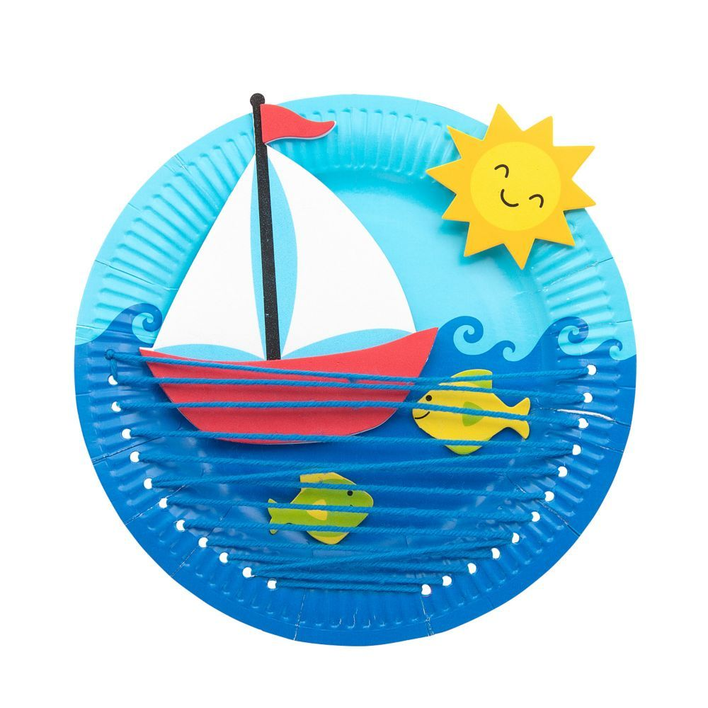
Activity:
My First Catch
Materials:
• Construction Paper
• Scissors
• Markers or Crayons
• Yarn
• Puncher (Optional)
• Paper Plates

Slide 20
Instructions:
Color your paper plate blue to resemble the sea.
Draw a wave and a boat on top of the water. Add a few fish as well.
3. Punch two holes on opposite sides of the lower part of the paper plate.
4. Thread a piece of yarn through the holes and tie it at the back to secure it—this will represent a fishing net.
5. Feel free to add more designs and colors to make your artwork unique!

Slide 21
Closing Prayer
Heavenly Father, Thank You for speaking to us through Your Word today. Just as You called Simon, James, and John to follow You, we know that You are calling each of us to trust in You and share Your love with others. Give us the courage to say "yes" to Your call, even when we feel unworthy or afraid. Help us to obey You in both the big and small things, knowing that Your plans for us are always greater than we can imagine. May our hearts be open to Your guidance, and may we become true fishers of men, bringing others closer to You. Bless us as we go forth, and may we always walk in faith, hope, and love. We ask this in Jesus' name. Amen.

Slide 22
Fifth Sunday in Ordinary Time – February 9, 2025
CYCLE C – YEAR I

