Slide 2
Seventh Sunday in Ordinary Time – February 23, 2025
CYCLE C – YEAR I

Slide 3
Context:
In the Gospel, Jesus mean about loving one's enemies and showing kindness to others. He encourages his followers to love their enemies, do good to those who hate them, bless those who curse them, and pray for those who mistreat them. Jesus advises not to seek revenge but to turn the other cheek, give freely, and lend without expecting anything in return. He emphasizes that love should be unconditional, just as God’s love is. Ultimately, the passage calls for a life of radical compassion, humility, and grace, which mirrors the way God interacts with humanity.
Message:
The message of the Gospel lies in the radical call to love beyond what is natural or expected, reflecting God’s unconditional love. Jesus challenges us to love and do good to those who may harm or mistreat us, showing that true love is not based on reciprocity but on selfless generosity. The passage teaches that forgiveness is essential, not just for our own peace, but as a reflection of God's mercy toward us. By urging us to not judge others, Jesus invites us to recognize our own flaws and show grace instead of condemnation.
Lesson:
Jesus urges us to treat others the way we would want to be treated, with compassion and fairness. Jesus also emphasizes the importance of not judging others, but instead forgiving them, as we too seek forgiveness from God. Ultimately, He encourages us to live with an open heart, offering love and generosity, knowing that what we give will come back to us in abundance. The lesson highlights that genuine love and kindness are transformative, and when we give selflessly—whether in love, forgiveness, or generosity—we open ourselves to receiving even greater blessings, reinforcing the idea that God's love and justice are abundant and overflowing.

Slide 4
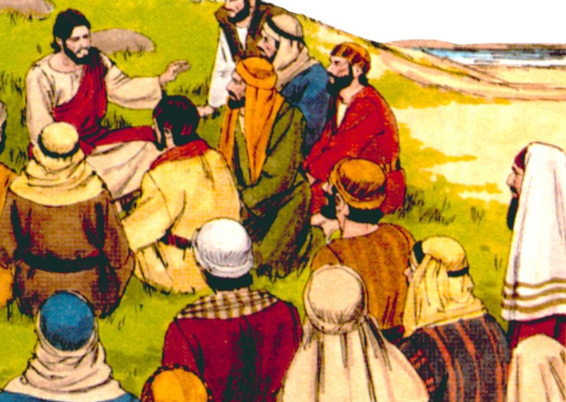
Radical Love and Mercy
Luke 6:27-38

Slide 5
Leader: A reading from
the Holy Gospel
according to Luke.
All: Glory to You, Oh Lord.

Slide 6
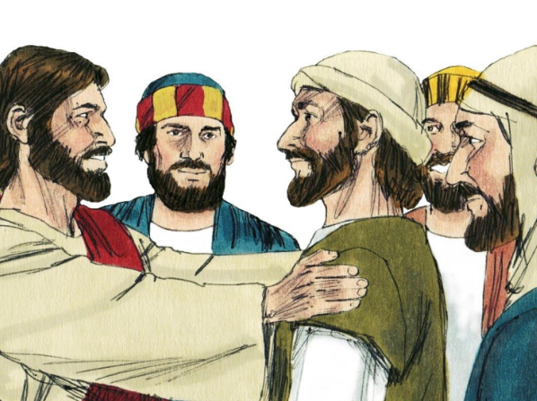
27
“But I tell you who hear me: Love your enemies, do good to those who hate you,

Slide 7
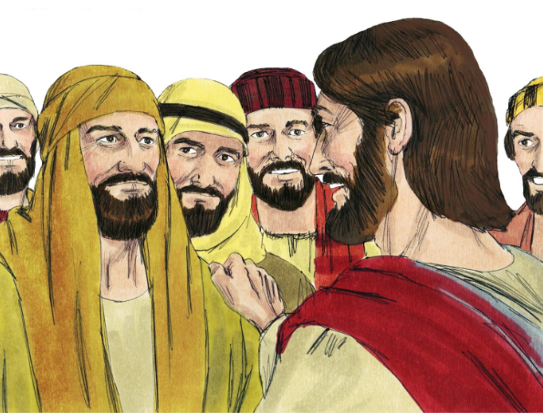
28
bless those who curse you, and pray for those who mistreat you.

Slide 8
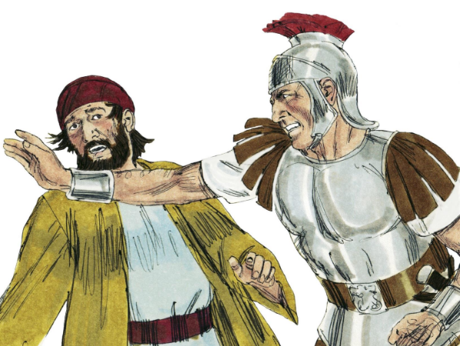
29
If anyone hits you on one cheek, let him hit the other one too; if someone takes your coat, let him have your shirt as well.

Slide 9
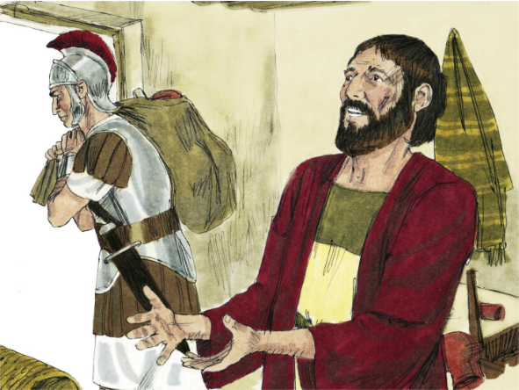
30
Give to everyone who asks you for something, and when someone takes what is yours, do not ask for it back.

Slide 10
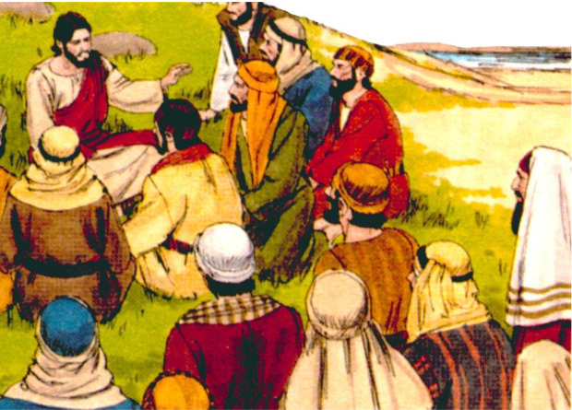
31
Do for others just what you want them to do for you.

Slide 11
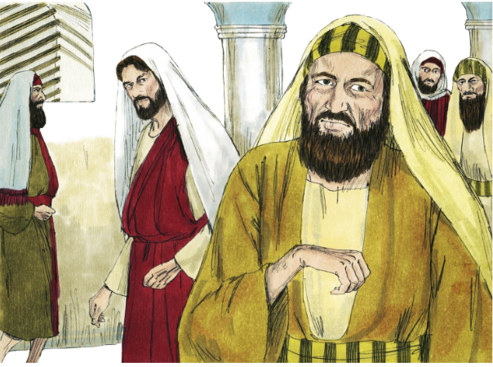
32
“If you love only the people who love you, why should you receive a blessing? Even sinners love those who love them!

Slide 12
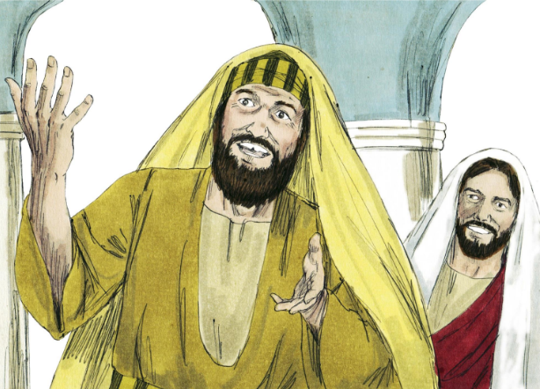
33
And if you do good only to those who do good to you, why should you receive a blessing? Even sinners do that!

Slide 13
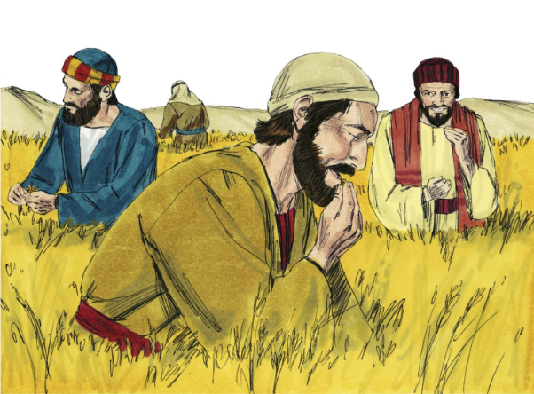
34
And if you lend only to those from whom you hope to get it back, why should you receive a blessing? Even sinners lend to sinners, to get back the same amount!

Slide 14
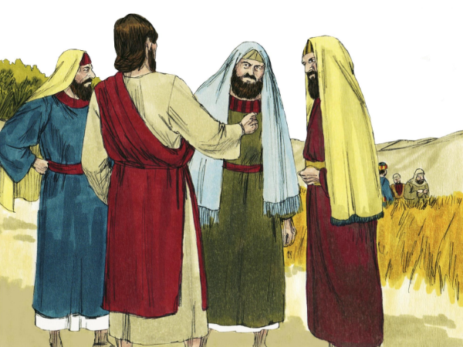
35
No! Love your enemies and do good to them; lend and expect nothing back. You will then have a great reward, and you will be children of the Most High God. For he is good to the ungrateful and the wicked.

Slide 15
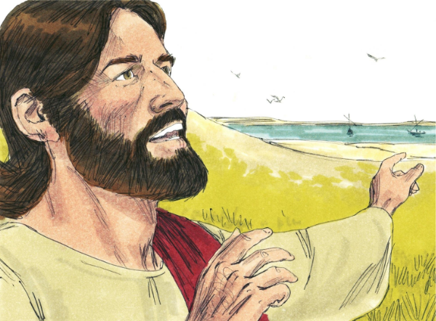
36
Be merciful just as your Father is merciful.

Slide 16
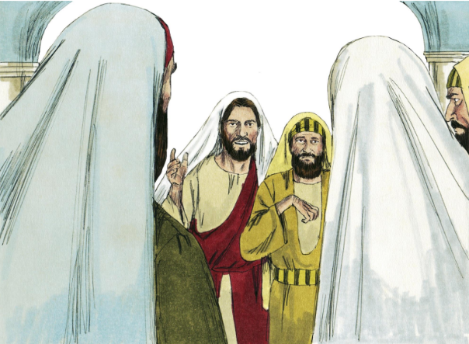
37
“Do not judge others, and God will not judge you; do not condemn others, and God will not condemn you; forgive others, and God will forgive you.

Slide 17
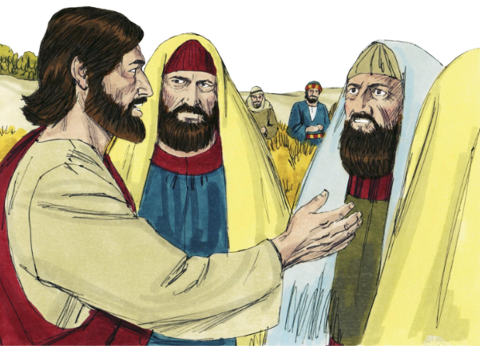
38
Give to others, and God will give to you. Indeed, you will receive a full measure, a generous helping, poured into your hands—all that you can hold. The measure you use for others is the one that God will use for you.”

Slide 18
Leader: The Gospel of the Lord.
All: Praise to You,
Lord Jesus Christ.

Slide 19
GOSPEL MESSAGE

Slide 20
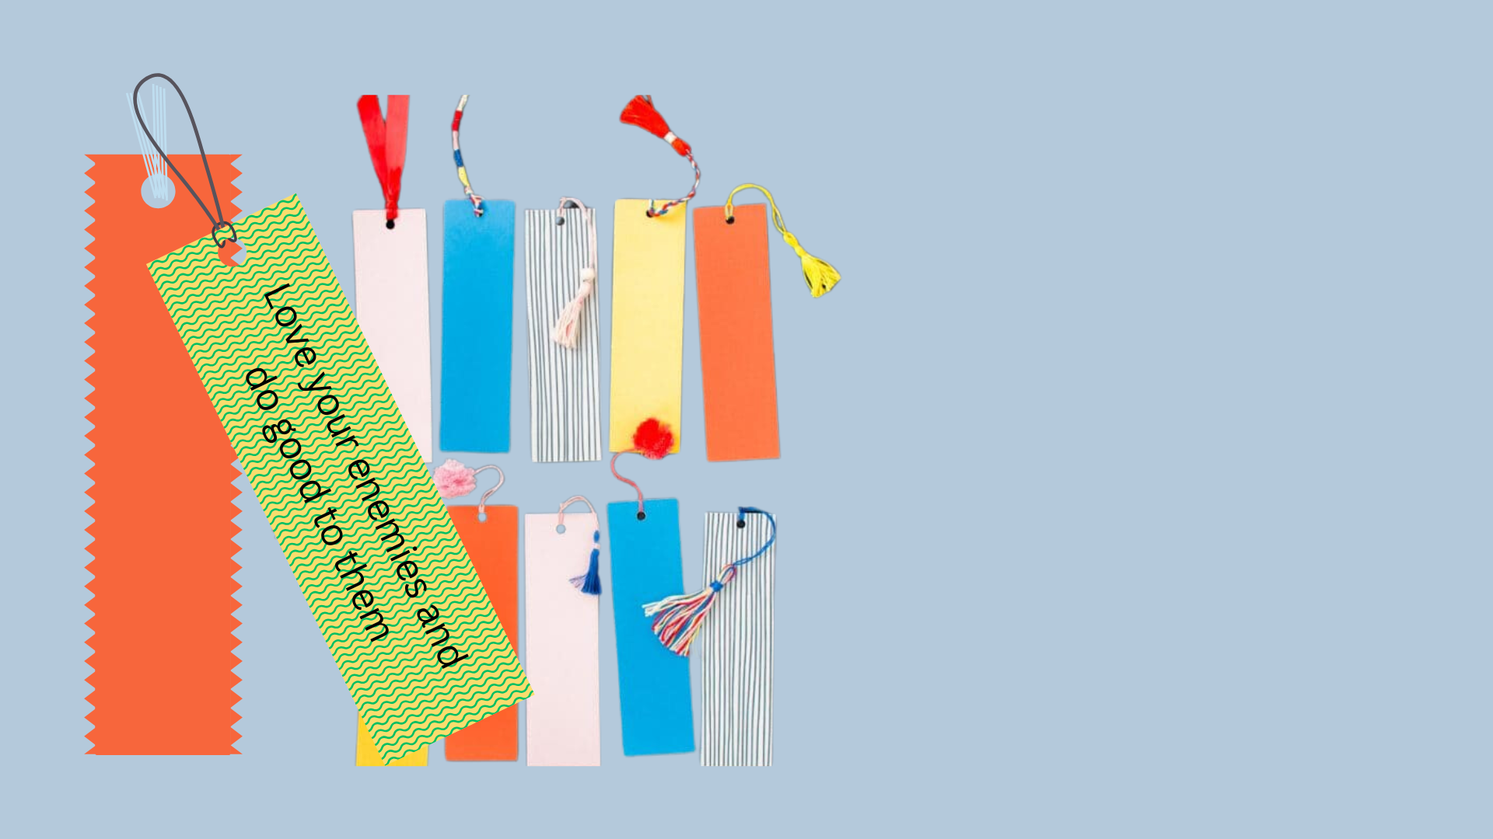
Activity:
DIY Bookmark Bliss
Materials:
• Construction Paper
• Markers or Crayons
• Yarn/Ribbon
• Design/Stickers (Optional)

Slide 21
Instructions: 1. Take a piece of paper and cut it into a rectangular shape. A standard bookmark size is about 2 inches by 6 inches, but feel free to choose any size you prefer!
2. Use markers, pens, or colored pencils to decorate your bookmark. Write the phrase “Love your enemies and do good to them.” You can also add designs, patterns, or any creative elements you like.
3. To personalize your bookmark further, use a hole punch to make a small hole at the top. Then, thread a ribbon or string through the hole for a decorative touch.

Slide 22
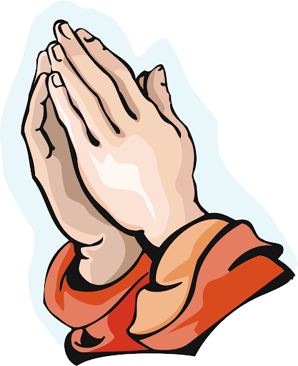
Closing Prayer
Dear Heavenly Father, we thank You for the powerful lessons You teach us through Your Word. We come before You with humble hearts, asking for Your help to love as You have loved us. Lord, empower us to love our enemies and to forgive those who wrong us. Help us to treat others with the same compassion and kindness that we desire for ourselves. Teach us to be generous, not seeking anything in return, but trusting that You will bless us abundantly. Father, we ask for the strength to avoid judgment and to extend grace to those around us. May we reflect Your love in every action, showing the world what it means to live with a heart full of forgiveness and generosity. We trust in Your promises, Lord, and pray that Your love will continue to guide us in all that we do. In Jesus’ name, we pray. Amen.

Slide 23
Seventh Sunday in Ordinary Time – February 23, 2025
CYCLE C – YEAR I

