Slide 2
February 2, 2025
Feast of the Presentation of the Lord

Slide 3
Context:
This gospel tells the story of when Mary and Joseph brought baby Jesus to the temple in Jerusalem, following the Jewish law. They presented Him to God, as was the custom for firstborn sons. At the temple, they met two holy people—Simeon and Anna—who recognized Jesus as the promised Savior. After this, Mary and Joseph returned to Nazareth, and the passage ends by saying that Jesus grew in wisdom, strength, and in favor with God and others.
Message:
This gospel teaches us important truths about Jesus and God's plan. Simeon’s prophecy tells us that Jesus is not only the Savior of Israel but also the Light for all people, bringing salvation to the whole world. Simeon and Anna’s faithfulness shows that God always keeps His promises and blesses those who patiently trust in Him. Simeon also tells Mary that she will experience great sorrow because of Jesus, hinting at the suffering she will go through, especially during His crucifixion. Lastly, we learn that even though Jesus is the Son of God, He fully lived as a human, growing in wisdom and holiness, setting an example for us to follow.
Lesson:
Simeon and Anna remind us that sometimes we have to wait to see God’s plans come true, but the wait is always worth it. God blesses those who trust in Him, and like Simeon and Anna, we can joyfully hope in Jesus, knowing that God’s plans for our lives are good, even if we don’t fully understand them yet. This Gospel assures us that God always keeps His promises. Simeon and Anna waited patiently, and in God’s perfect time, they saw His promise fulfilled. It also reminds us that Jesus is the Light of the World—just as Simeon recognized Him as the Savior, we should see Jesus as our guide and follow Him. Lastly, we are called to grow like Jesus, who increased in wisdom and favor with God and others. We can do this by praying, being kind, and learning more about God, trusting that His plans for us are always worth waiting for.

Slide 4
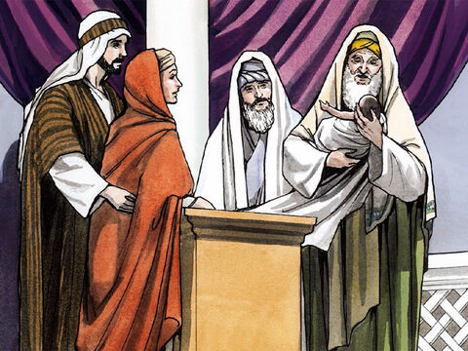
Jesus Is Presented in the Temple
Luke 2:22-40

Slide 5
Leader: A reading from
the Holy Gospel
according to Luke.
All: Glory to You, Oh Lord.

Slide 6
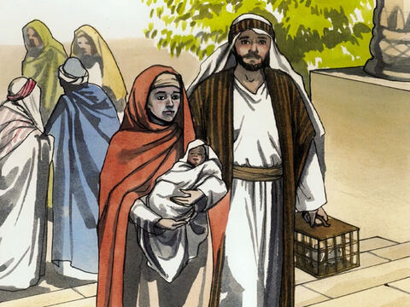
22
The time came for Joseph and Mary to perform the ceremony of purification, as the Law of Moses commanded. So they took the child to Jerusalem to present him to the Lord,

Slide 7
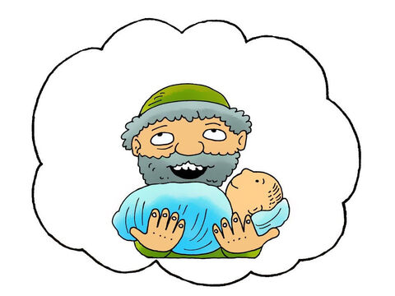
23
as it is written in the law of the Lord: “Every first-born male is to be dedicated to the Lord.”

Slide 8
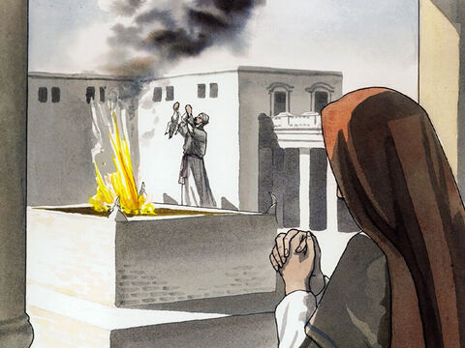
24
They also went to offer a sacrifice of a pair of doves or two young pigeons, as required by the law of the Lord.

Slide 9
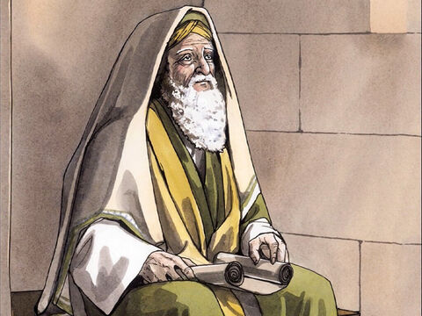
25
At that time there was a man named Simeon living in Jerusalem. He was a good, God-fearing man and was waiting for Israel to be saved. The Holy Spirit was with him

Slide 10
26
and had assured him that he would not die before he had seen the Lord's promised Messiah.

Slide 11
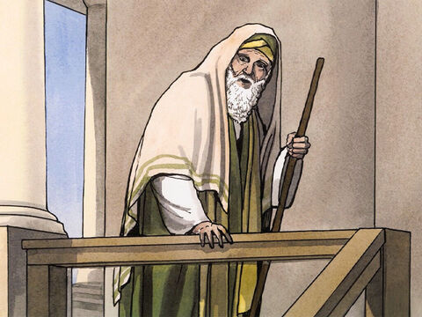
27
Led by the Spirit, Simeon went into the Temple. When the parents brought the child Jesus into the Temple to do for him what the Law required,

Slide 12
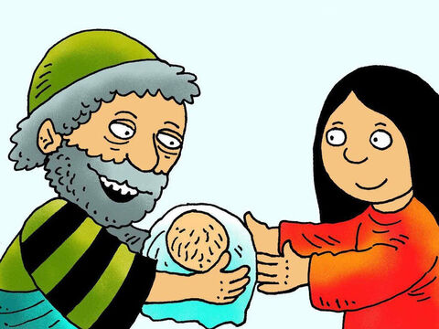
28
Simeon took the child in his arms and gave thanks to God:

Slide 13
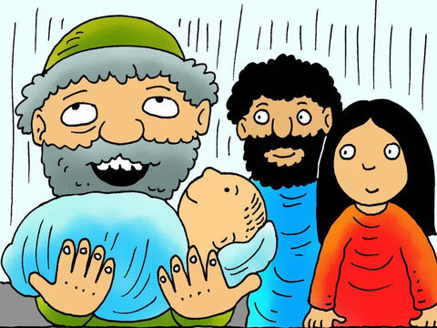
29
“Now, Lord, you have kept your promise, and you may let your servant go in peace.

Slide 14
30
With my own eyes I have seen your salvation,

Slide 15
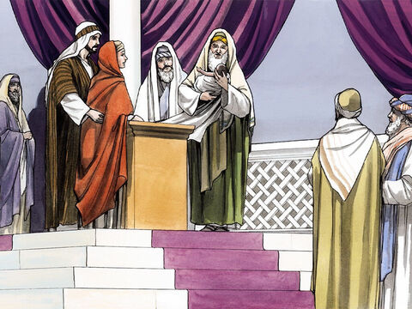
31
which you have prepared in the presence of all peoples:

Slide 16
32
A light to reveal your will to the Gentiles and bring glory to your people Israel.”

Slide 17
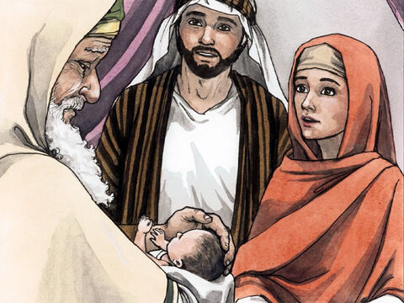
33
The child's father and mother were amazed at the things Simeon said about him.

Slide 18
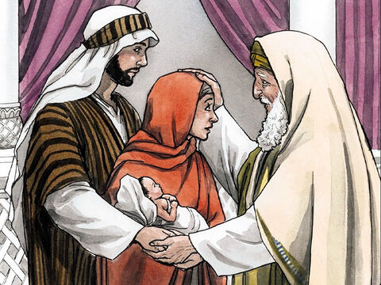
34
Simeon blessed them and said to Mary, his mother, “This child is chosen by God for the destruction and the salvation of many in Israel. He will be a sign from God which many people will speak against

Slide 19
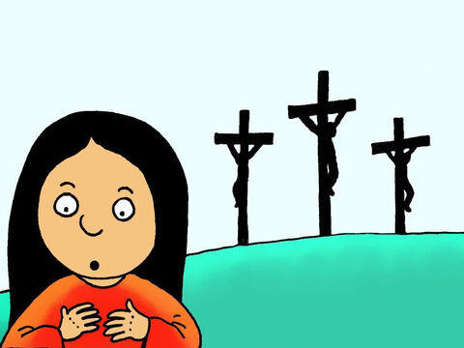
35
and so reveal their secret thoughts. And sorrow, like a sharp sword, will break your own heart.”

Slide 20
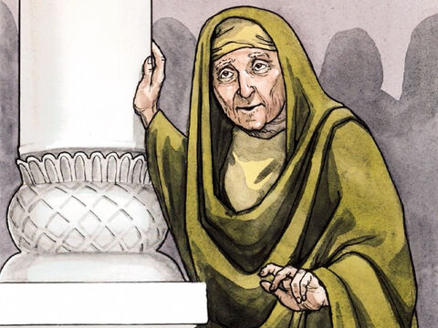
36
There was a very old prophet, a widow named Anna, daughter of Phanuel of the tribe of Asher. She had been married for only seven years and was now eighty-four years old.

Slide 21
37
She never left the Temple; day and night she worshiped God, fasting and praying.

Slide 22
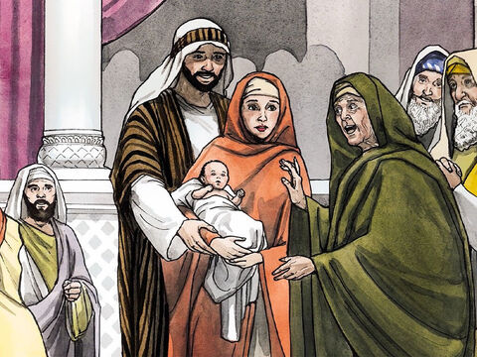
38
That very same hour she arrived and gave thanks to God and spoke about the child to all who were waiting for God to set Jerusalem free.

Slide 23
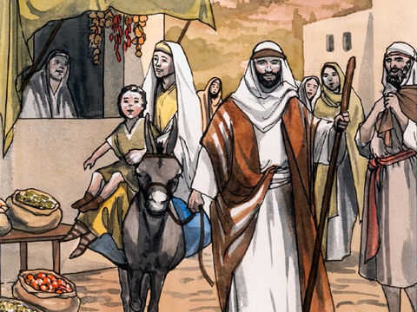
39
When Joseph and Mary had finished doing all that was required by the Law of the Lord, they returned to their hometown of Nazareth in Galilee.

Slide 24
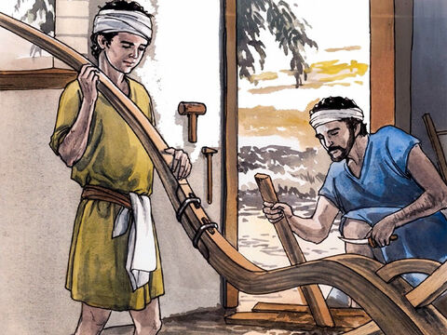
40
The child grew and became strong; he was full of wisdom, and God's blessings were upon him.

Slide 25
Leader: The Gospel of the Lord.
All: Praise to You,
Lord Jesus Christ.

Slide 26
GOSPEL MESSAGE

Slide 27
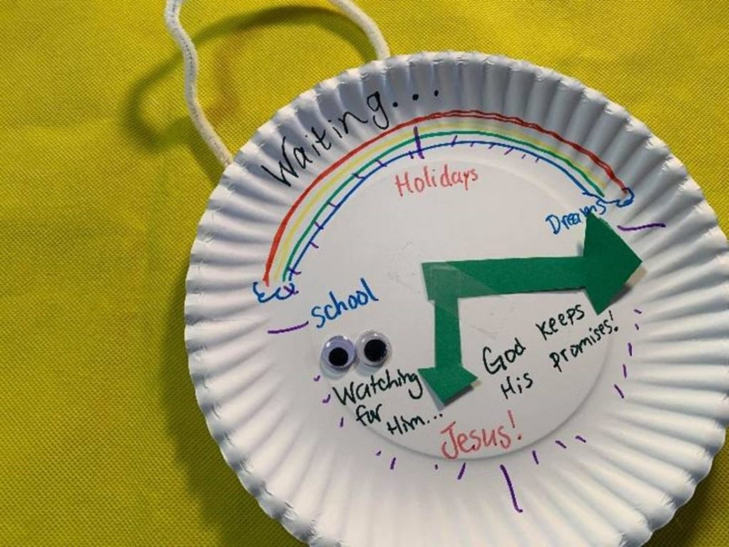
Activity:
Waiting Clock
Materials:
• Paper or Card stock
• Scissors
• Markers or Crayons
• Ribbon or Pipe Cleaner
• Tape, glue, or staples
• Paper Plates
Notes:
Explain to the kids that their giving pail can be use to save money for church, missionaries, and to remind them of ways to give to others without money.

Slide 28
Instructions:
1. Decide how you would like to decorate your "clock plate." You can add cut paper "hands" and other embellishments as desired.
2. Use markers or crayons to add labels, captions, and decorations.
3. Personalize your clock by adding stickers, googly eyes, or other decorations to enhance its look. Remember, this clock serves as a reminder to wait patiently for Jesus.
4. If you'd like to hang your clock, attach a string or pipe cleaner to the back of the plate.
Notes:
Explain to the kids that their giving pail can be use to save money for church, missionaries, and to remind them of ways to give to others without money.

Slide 29
Closing Prayer
Heavenly Father, thank You for this time we spent learning about Jesus’ presentation in the temple. Just as Simeon and Anna waited patiently and trusted in Your promises, help us to trust in You always. May we see Jesus as the light of our lives and follow Him with hearts full of love and faith. Lord, just as Jesus grew in wisdom and favor, help us to grow in kindness, obedience, and love for You and others. Bless our families, our friends, and our teachers, and guide us each day to walk in Your light. We offer all this in Jesus’ name. Amen.

Slide 30
February 2, 2025
Feast of the Presentation of the Lord

