Slide 2
Sixth Sunday in Ordinary Time – February 16, 2025
CYCLE C – YEAR I

Slide 3
Context:
The Gospel reading begins with Jesus surrounded by a large crowd. He then delivers His Sermon on the Plain, challenging the legalistic worldview of His listeners. In this sermon, Jesus offers a glimpse into the Kingdom of God—a reality that seems upside-down by earthly standards. He teaches that spiritual fulfillment, and divine rewards do not necessarily align with worldly success.
Message:
This passage highlights the reversal of values in God's kingdom. Jesus blesses those who are poor, hungry, weeping, hated, rejected, and insulted, promising that they will be rewarded in the Kingdom of God. In contrast, He pronounces woes upon the rich, the well-fed, those who laugh, and those who are praised by others, warning that they have already received their comfort and will face hardships in the future. This passage reminds us that earthly success and comfort are not what matter most to God. Instead, He values humility, faith, and compassion and promises justice to those who suffer for righteousness.
Lesson:
The passage teaches that God's kingdom favors the humble and assures justice for those who suffer. It encourages us to focus on eternal rewards rather than temporary earthly comforts.

Slide 4
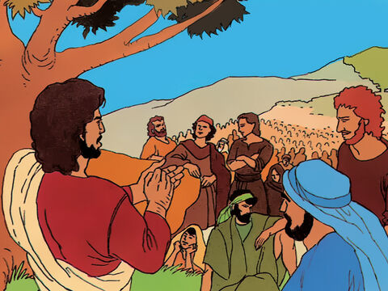
The Sermon on the Plain
Luke 6:17, 20-26

Slide 5
Leader: A reading from
the Holy Gospel
according to Luke.
All: Glory to You, Oh Lord.

Slide 6
17
When Jesus had come down from the hill with the apostles, he stood on a level place with a large number of his disciples. A large crowd of people was there from all over Judea and from Jerusalem and from the coast cities of Tyre and Sidon.

Slide 7
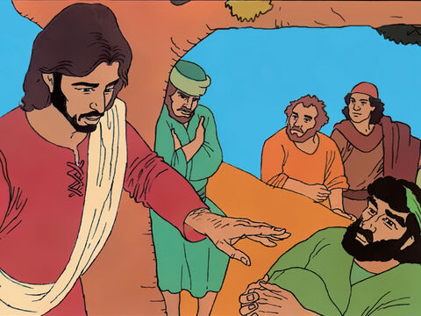
20
Jesus looked at his disciples and said, “Happy are you poor; the Kingdom of God is yours!

Slide 8
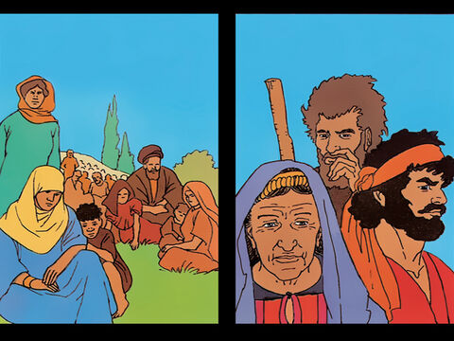
21
“Happy are you who are hungry now; you will be filled! Happy are you who weep now; you will laugh!

Slide 9
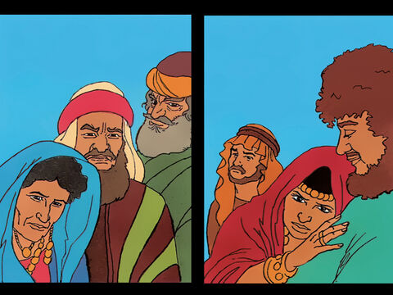
22
“Happy are you when people hate you, reject you, insult you, and say that you are evil, all because of the Son of Man!

Slide 10
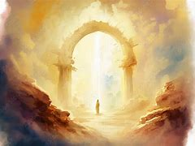
23
Be glad when that happens and dance for joy, because a great reward is kept for you in heaven. For their ancestors did the very same things to the prophets.

Slide 11
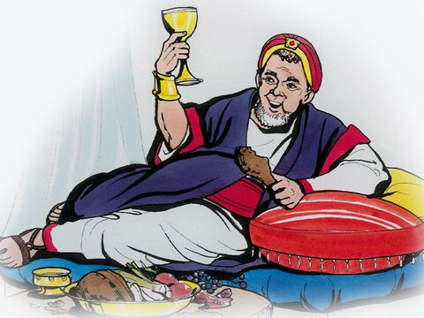
24
But how terrible for you who are rich now; you have had your easy life!

Slide 12
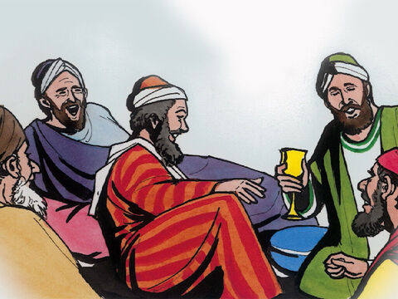
25
“How terrible for you who are full now; you will go hungry!
“How terrible for you who laugh now; you will mourn and weep!

Slide 13
26
“How terrible when all people speak well of you; their ancestors said the very same things about the false prophets.

Slide 14
Leader: The Gospel of the Lord.
All: Praise to You,
Lord Jesus Christ.

Slide 15
GOSPEL MESSAGE

Slide 16
Activity:
My BEE-Attitudes Hive
Materials:
• Construction Paper
• Markers or Crayons
• Yarn/Thread/String
• Design/Stickers (Optional)

Slide 17
Instructions:
1. Draw a beehive on your paper and color it yellow. At the top, write “My BEE-Attitudes.”
2. On each layer of the hive, write the following words:
- Be Humble
- Be Kind
- Be Loving
- Be Gentle
3. Punch two holes on the top corners of your hive and tie a string through them.
4. Decorate your artwork with stickers and other designs to make it more creative!
5. Hang your beautiful artwork on your door for everyone to see.

Slide 18
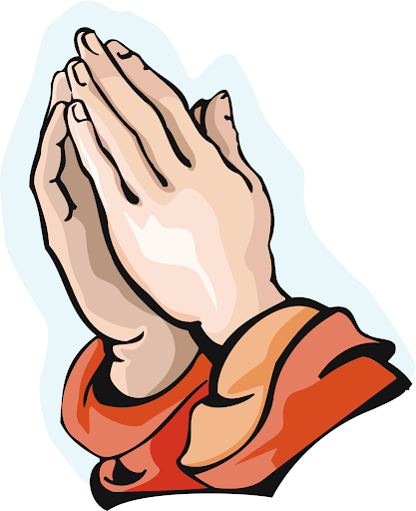
Closing Prayer
Heavenly Father, Thank You for speaking to us through Your Word today. Just as Jesus spoke to the crowds, help us to listen and understand the blessings You give to those who are poor, hungry, and hurting. Teach us to trust in Your love and care for us. Help us to love our enemies and be kind to those who hurt us, just as Jesus showed compassion and mercy. Give us forgiving hearts, knowing that You always forgive us. Guide us to live with humility, to avoid judging others, and to treat everyone with kindness and respect. May we build our lives on Your Word, so we can stand strong through any challenges. Fill our hearts with generosity, forgiveness, and love. Help us follow Jesus’ example and share His light with the world. We ask this in Jesus' name. Amen.

Slide 19
Sixth Sunday in Ordinary Time – February 16, 2025
CYCLE C – YEAR I

