Slide 1






Live the Word
Kids

Slide 2





2nd Sunday of Advent
December 7, 2025 | Cycle A Year 2

Slide 3

The Preaching of John the Baptist
Mathew 3:1-12

Slide 4



Leader: A reading from
the Holy Gospel
according to Mathew.
All: Glory to You, Oh Lord.

Slide 5


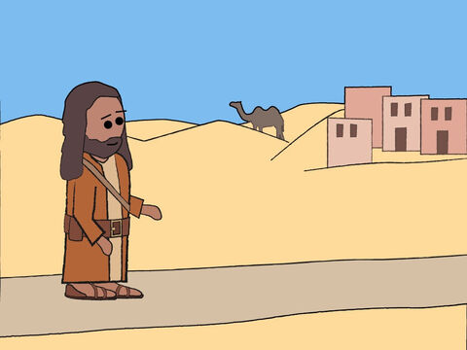
1
At that time John the Baptist came to the desert of Judea and started preaching.

Slide 6
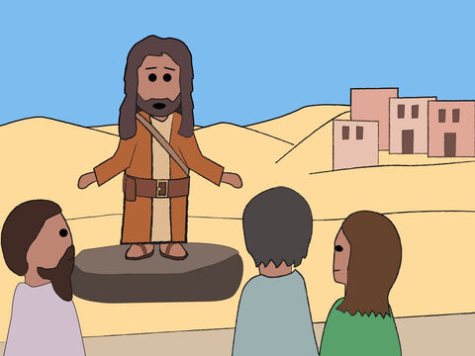
2
“Turn away from your sins,” he said, “because the Kingdom of heaven is near!”

Slide 7
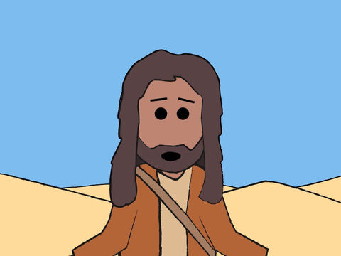
3
John was the man the prophet Isaiah was talking about when he said,
“Someone is shouting in the desert,
‘Prepare a road for the Lord;
make a straight path for him to travel!’”

Slide 8
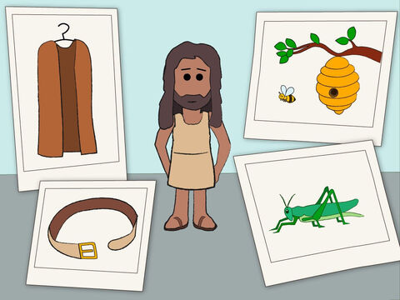
4
John's clothes were made of camel's hair; he wore a leather belt around his waist, and his food was locusts and wild honey.

Slide 9
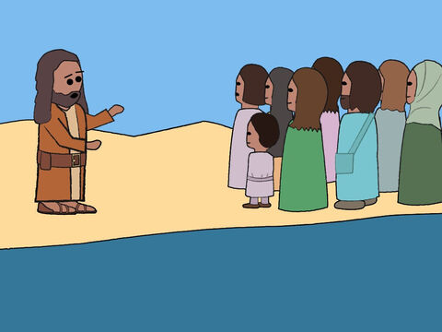
5
People came to him from Jerusalem, from the whole province of Judea, and from all over the country near the Jordan River.

Slide 10
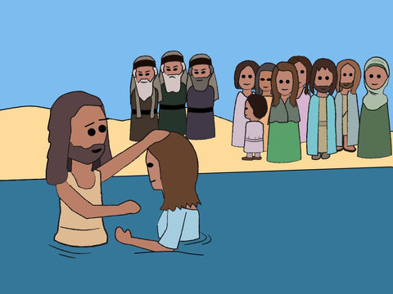
6
They confessed their sins, and he baptized them in the Jordan.

Slide 11
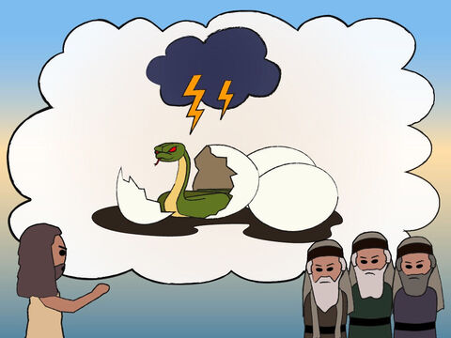
7
When John saw many Pharisees and Sadducees coming to him to be baptized, he said to them, “You snakes—who told you that you could escape from the punishment God is about to send?

Slide 12
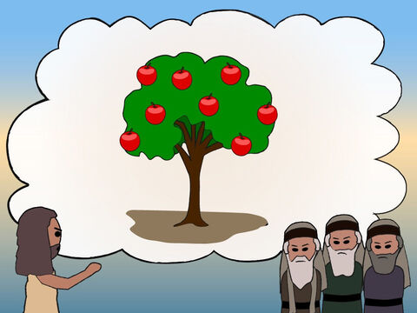
8
Do those things that will show that you have turned from your sins.

Slide 13
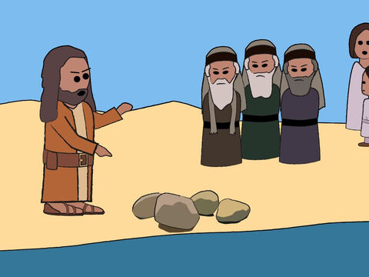
9
  And don't think you can escape punishment by saying that Abraham is your ancestor. I tell you that God can take these rocks and make descendants for Abraham!

Slide 14
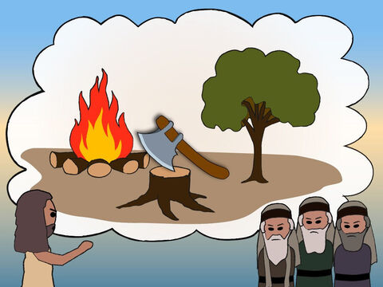
10
The ax is ready to cut down the trees at the roots; every tree that does not bear good fruit will be cut down and thrown in the fire.

Slide 15
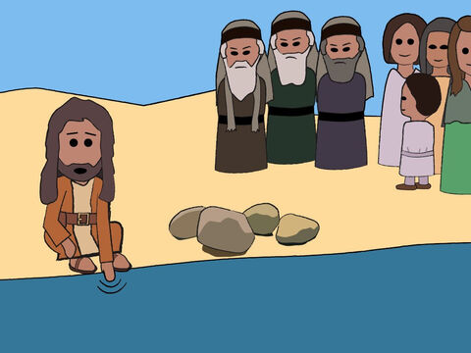
11
  I baptize you with water to show that you have repented, but the one who will come after me will baptize you with the Holy Spirit and fire. He is much greater than I am; and I am not good enough even to carry his sandals.

Slide 16
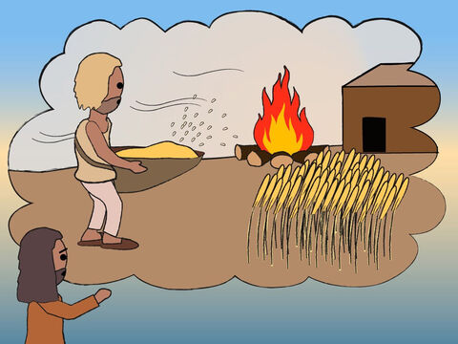
12
He has his winnowing shovel with him to thresh out all the grain. He will gather his wheat into his barn, but he will burn the chaff in a fire that never goes out.”

Slide 17
Leader: The Gospel of the Lord
All: Praise to You,
Lord Jesus Christ

Slide 18


Gospel Message

Slide 19


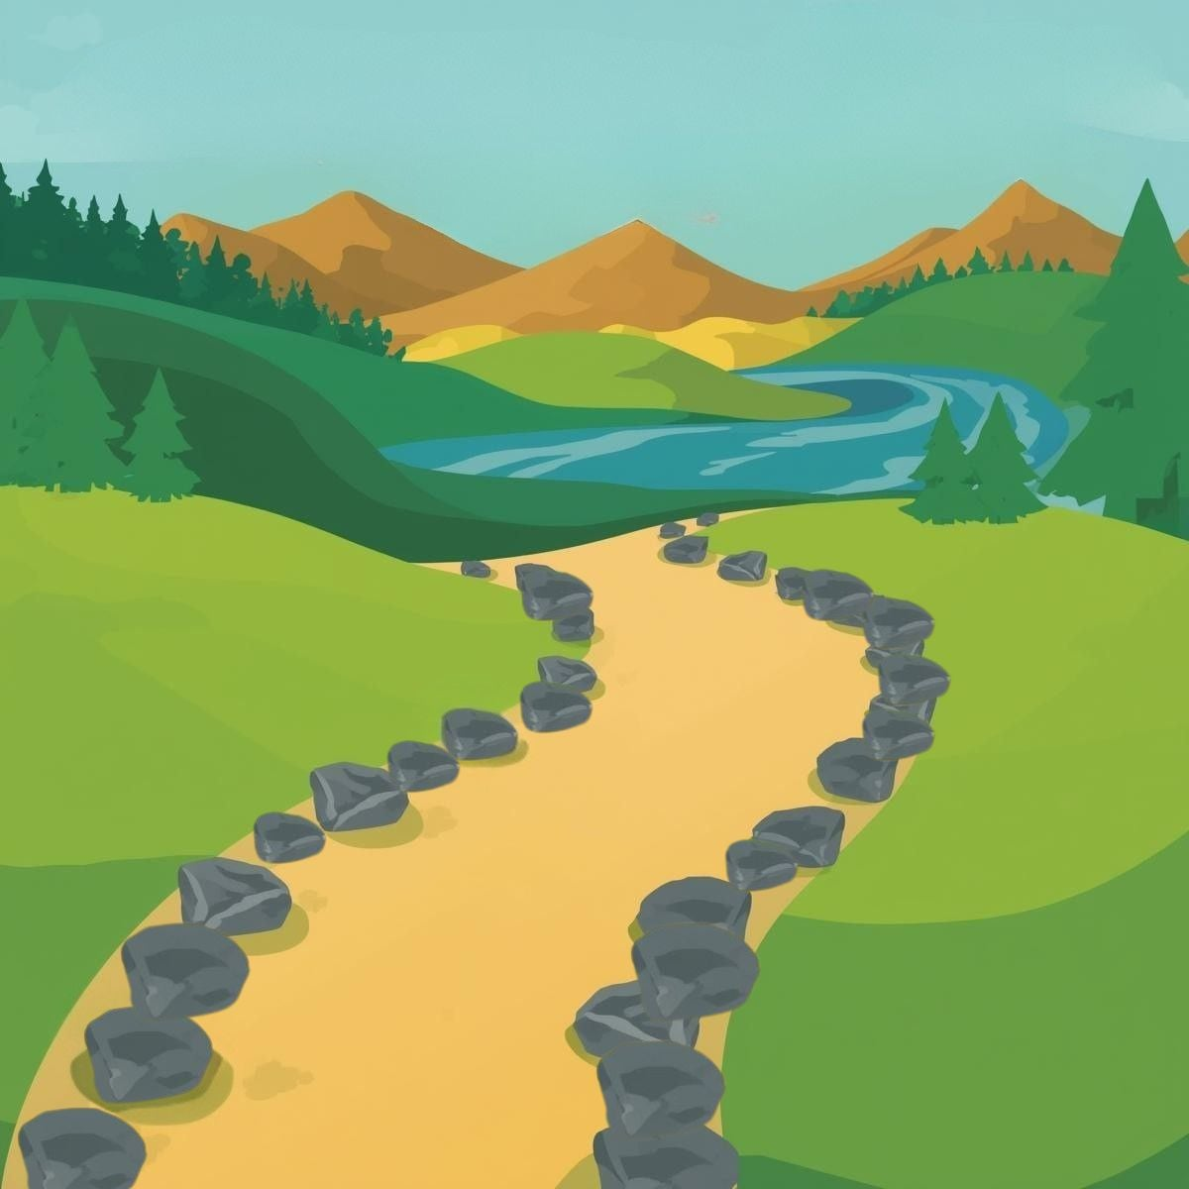
Activity: “Prepare the Way of Jesus” Path Craft
Materials Needed:
•Bond Paper
•Pencil
•Coloring Materials
•Glue
•Small Stones

Slide 20
Instructions:
  Create the Wilderness Background (Draw hills, trees, and a river)
  Draw a path, then glue the stones outside the path
  Color the background

Slide 21



Closing Prayer
Dear God,
Thank You for sending John the Baptist to prepare the way for Jesus.
Help us to listen to Your word and keep our hearts clean and ready for You.
Teach us to say sorry when we do wrong,
to be kind, to share, and to love others just like Jesus taught us.
May our lives show Your goodness every day.
We want to prepare the way for You in our hearts.
Amen.

Slide 22
Live the Word
Kids

