Slide 1






Live the Word
Kids

Slide 2





4th Sunday of Advent
December 21, 2025 | Cycle A Year 2

Slide 3

The Birth of Jesus Christ
Mathew 1:18-24

Slide 4



Leader: A reading from
the Holy Gospel
according to Mathew.
All: Glory to You, Oh Lord.

Slide 5


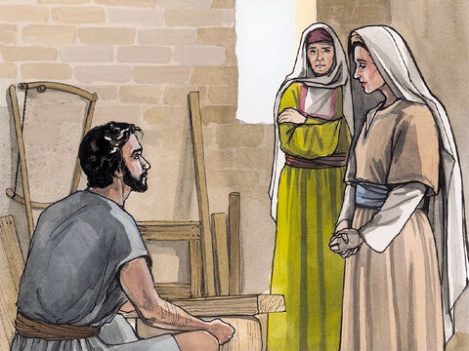
18
This was how the birth of Jesus Christ took place. His mother Mary was engaged to Joseph, but before they were married, she found out that she was going to have a baby by the Holy Spirit.

Slide 6
19
Joseph was a man who always did what was right, but he did not want to disgrace Mary publicly; so he made plans to break the engagement privately.

Slide 7
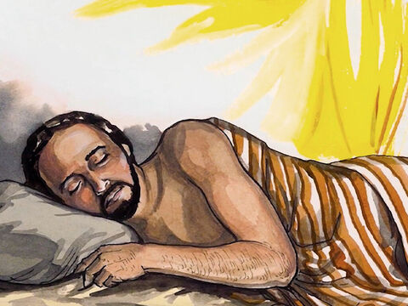
20
While he was thinking about this, an angel of the Lord appeared to him in a dream and said, “Joseph, descendant of David, do not be afraid to take Mary to be your wife. For it is by the Holy Spirit that she has conceived.

Slide 8
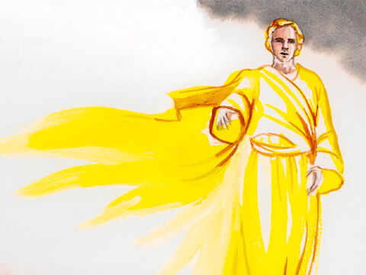
21
She will have a son, and you will name him Jesus—because he will save his people from their sins.”

Slide 9
22
Now all this happened in order to make come true what the Lord had said through the prophet,

Slide 10
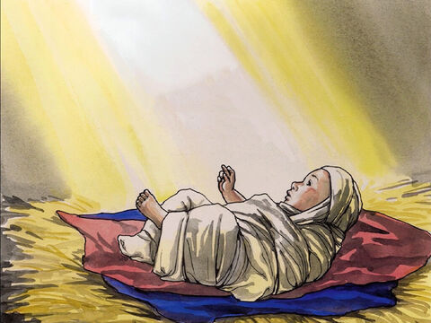
23
“A virgin will become pregnant and have a son, and he will be called Immanuel” (which means, “God is with us”).

Slide 11
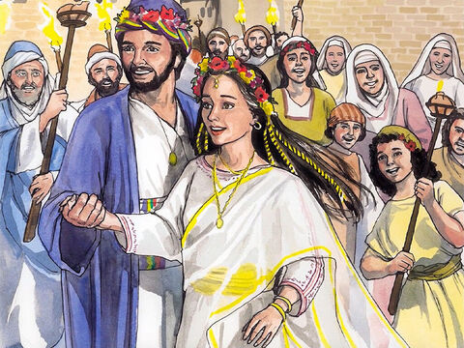
24
So when Joseph woke up, he married Mary, as the angel of the Lord had told him to.

Slide 12
Leader: The Gospel of the Lord
All: Praise to You,
Lord Jesus Christ

Slide 13


Gospel Message

Slide 14


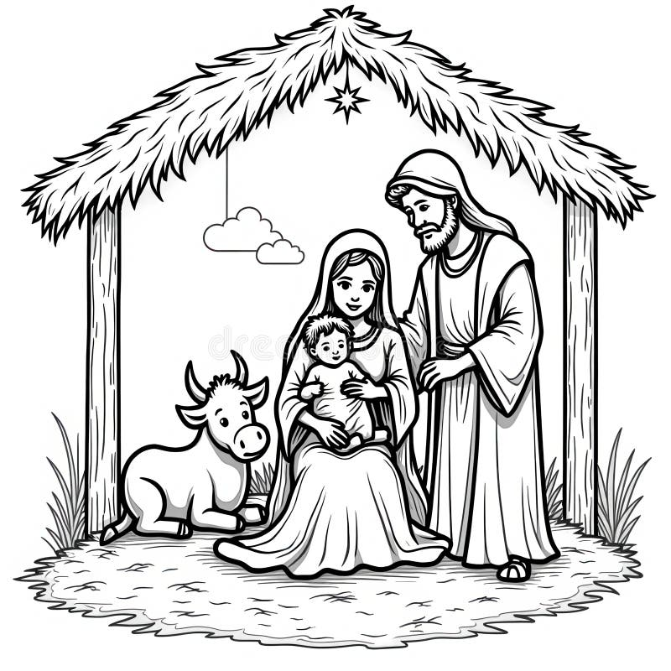
Activity: “Joseph Obedient House”
Materials Needed:
•Bond Paper
•Pencil
•Coloring Materials

Slide 15
Instructions:
  Draw a small house on bond paper.
  On the roof write: “Joseph trusted and obeyed God”.
  Inside the house, draw Joseph, Mary, and baby Jesus together.
  Decorate and color the house and the background.

Slide 16



Closing Prayer
Dear God,
Thank You for Joseph’s example of faith and obedience.
Help us listen to You and follow Your will with loving hearts.
Amen.

Slide 17
Live the Word
Kids

