Slide 1




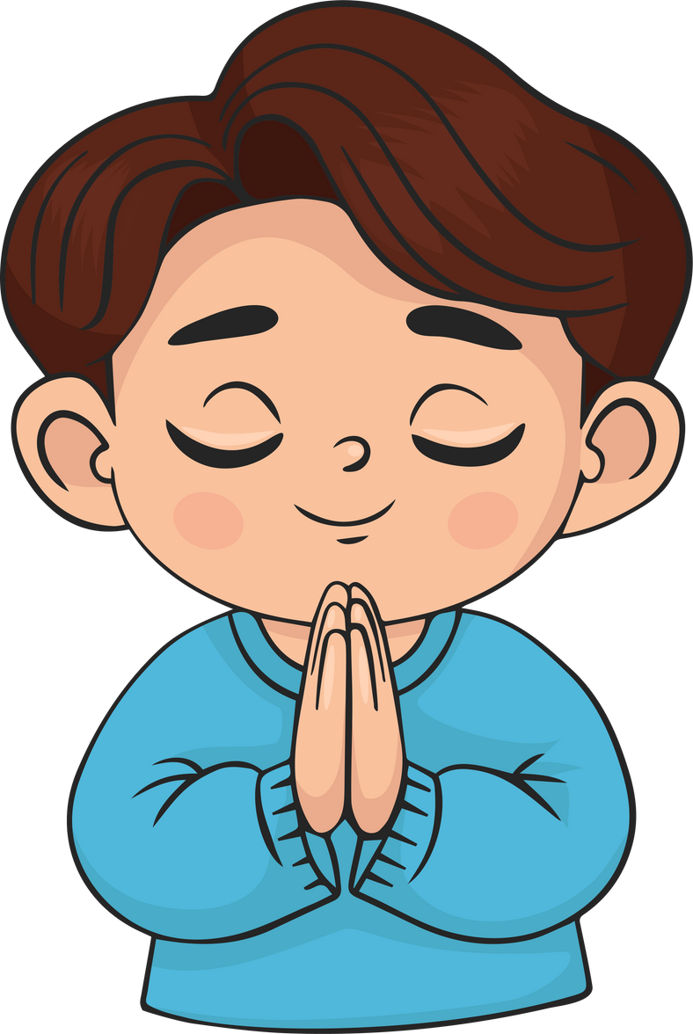

Live the Word
Kids

Slide 2



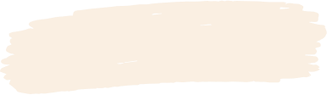

3rd Sunday of Advent
December 14, 2025 | Cycle A Year 2

Slide 3

The Messengers of John the Baptist
Mathew 11:2-11

Slide 4



Leader: A reading from
the Holy Gospel
according to Mathew.
All: Glory to You, Oh Lord.

Slide 5


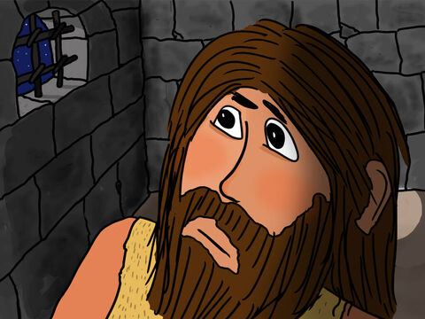
2
When John the Baptist heard in prison about the things that Christ was doing, he sent some of his disciples to him.

Slide 6
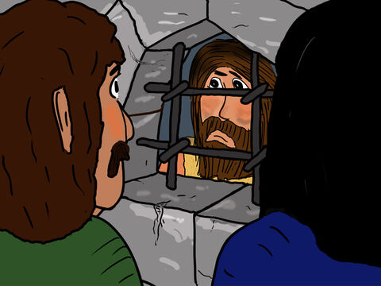
3
“Tell us,” they asked Jesus, “are you the one John said was going to come, or should we expect someone else?”

Slide 7
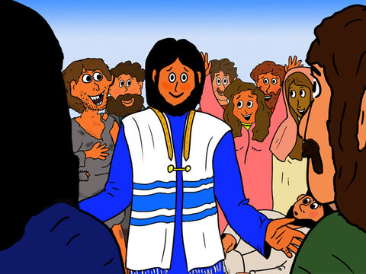
4
Jesus answered, “Go back and tell John what you are hearing and seeing:

Slide 8
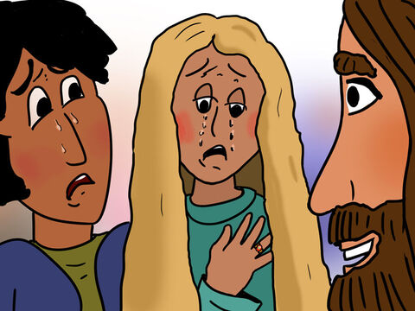
5
the blind can see, the lame can walk, those who suffer from dreaded skin diseases are made clean,^{[a]} the deaf hear, the dead are brought back to life, and the Good News is preached to the poor.

Slide 9
6
How happy are those who have no doubts about me!”

Slide 10
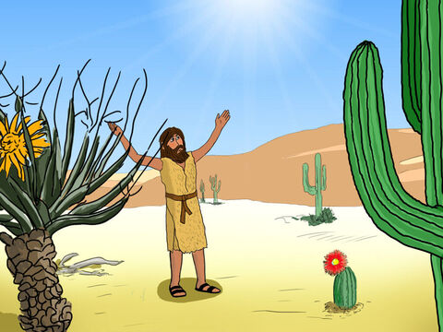
7
While John's disciples were leaving, Jesus spoke about him to the crowds: “When you went out to John in the desert, what did you expect to see? A blade of grass bending in the wind

Slide 11
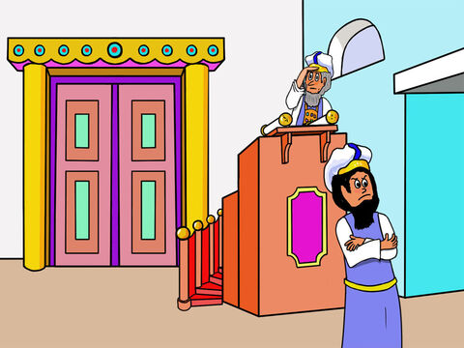
8
What did you go out to see? A man dressed up in fancy clothes? People who dress like that live in palaces!

Slide 12
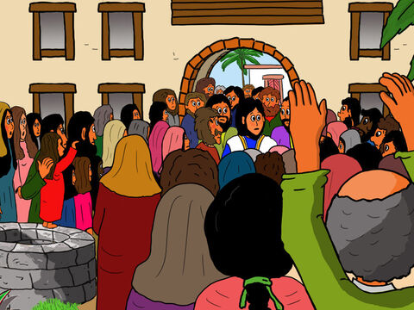
9
Tell me, what did you go out to see? A prophet? Yes indeed, but you saw much more than a prophet.

Slide 13
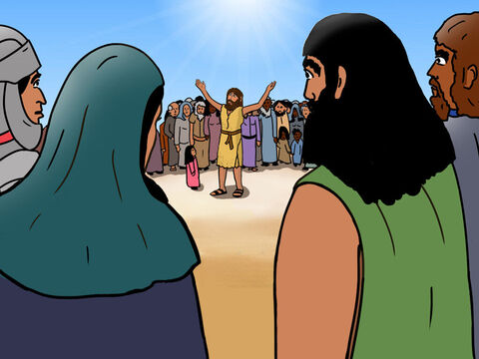
10
  For John is the one of whom the scripture says: ‘God said, I will send my messenger ahead of you to open the way for you.’

Slide 14
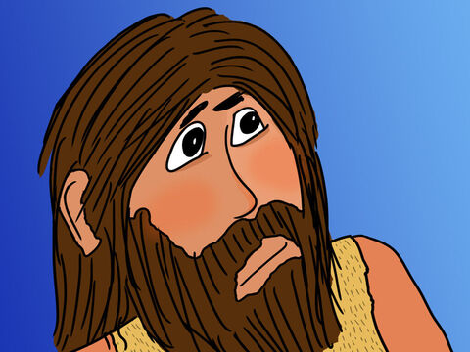
11
I assure you that John the Baptist is greater than anyone who has ever lived. But the one who is least in the Kingdom of heaven is greater than John.

Slide 15
Leader: The Gospel of the Lord
All: Praise to You,
Lord Jesus Christ

Slide 16


Gospel Message

Slide 17



Activity: “Messenger of Jesus” Scroll Craft
Materials Needed:
•Bond Paper
•Pencil
•Coloring Materials
•Tape
•Sticks
•String

Slide 18
Instructions:
  Roll the top and bottom of the paper around the sticks and tape them.
  Write what Jesus did (heal the blind, help the poor, raise the dead, etc.).
  Color and decorate the background.
  Tie it with a string.

Slide 19



Closing Prayer
Dear Jesus,
Help us prepare the way for You
by being kind, loving, and good every day.
We believe You are our Savior and Friend.
Amen.

Slide 20
Live the Word
Kids

