Slide 2
Fifth Sunday of Lent – April 06, 2025
CYCLE C – YEAR I

Slide 3
Context:
In the Old Testament, God gave His people rules that said they should punish the poeple who sinned. That’s why in today’s Gospel, the Pharisees and the scribes brought a sinful woman to Jesus to see what He had to say about the law. Instead of telling them that they should punish her according to the law, Jesus told told that they themselves had never sinned. Jesus told the woman to go and not sin again. That means that she did sin, but He was giving her another chance. (Kids Bulletin)
Message:
This story tells us that Jesus shows mercy instead of judgment. None of us are perfect, and Jesus offers forgiveness to everyone. It reminds us to be kind and forgiving to others, just as Jesus is with us. Jesus gives us a chance to start fresh, and He calls us to do the same for others.
Lesson:
n this passage, Jesus shows us that instead of judging others, we should offer compassion and understanding. When the woman caught in adultery is brought before Him, Jesus doesn’t condemn her but challenges those who are without sin to cast the first stone. Jesus not only forgives the woman but also encourages her to leave her life of sin, offering her a chance for a fresh start. This teaches us that God’s love and grace are available to everyone, and we should extend that same grace to others, choosing mercy over judgment. The story calls us to look at ourselves first, recognize our own faults, and treat others with the same kindness and forgiveness that Jesus shows us.

Slide 4
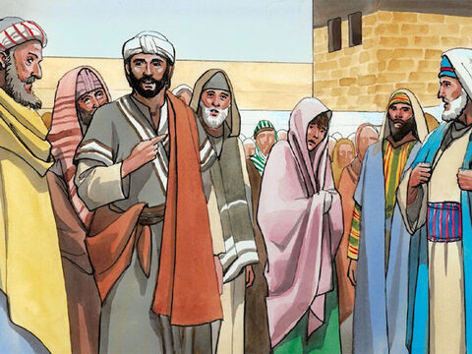
Jesus Treats A Sinner
John 8:1-11

Slide 5
Leader: A reading from
the Holy Gospel
according to John.
All: Glory to You, Oh Lord.

Slide 6
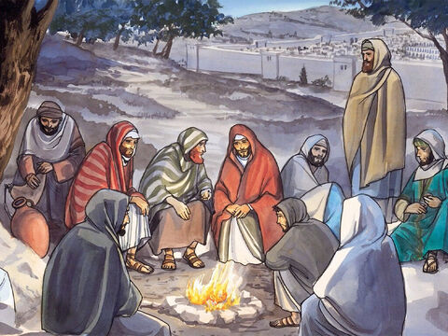
1
Then everyone went home, but Jesus went to the Mount of Olives.

Slide 7
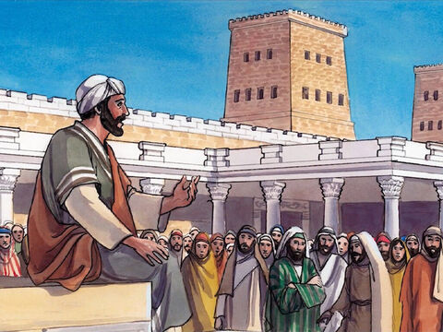
2
Early the next morning he went back to the Temple. All the people gathered around him, and he sat down and began to teach them.

Slide 8
3
The teachers of the Law and the Pharisees brought in a woman who had been caught committing adultery, and they made her stand before them all.

Slide 9
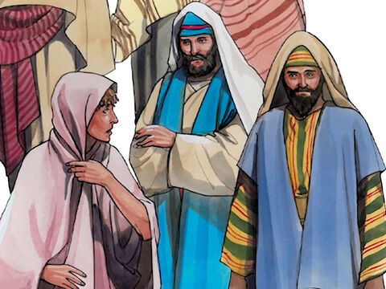
4
“Teacher,” they said to Jesus, “this woman was caught in the very act of committing adultery.

Slide 10
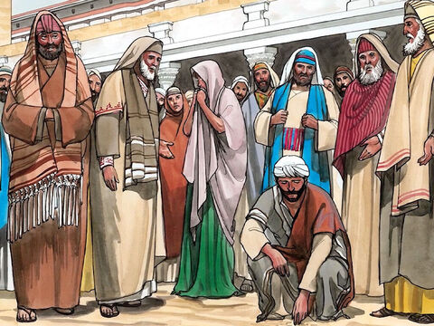
5
In our Law Moses commanded that such a woman must be stoned to death. Now, what do you say?”

Slide 11
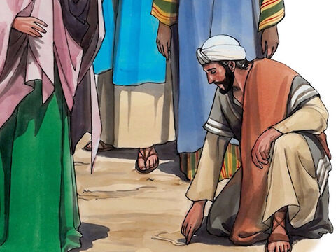
6
They said this to trap Jesus, so that they could accuse him. But he bent over and wrote on the ground with his finger.

Slide 12
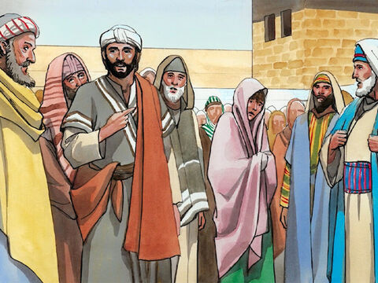
7
As they stood there asking him questions, he straightened up and said to them, “Whichever one of you has committed no sin may throw the first stone at her.”

Slide 13
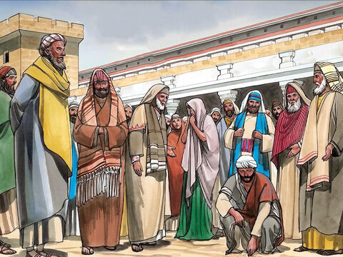
8
Then he bent over again and wrote on the ground.

Slide 14
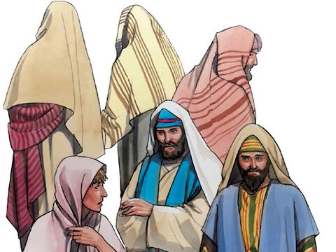
9
When they heard this, they all left, one by one, the older ones first. Jesus was left alone, with the woman still standing there.

Slide 15
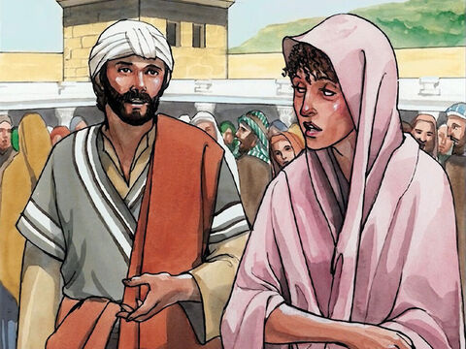
10
He straightened up and said to her, “Where are they? Is there no one left to condemn you?”

Slide 16
11
“No one, sir,” she answered. “Well, then,” Jesus said, “I do not condemn you either. Go, but do not sin again.”

Slide 17
Leader: The Gospel of the Lord.
All: Praise to You,
Lord Jesus Christ.

Slide 18
GOSPEL MESSAGE

Slide 19
Activity:
Finger Point of Forgiveness
Materials:
• Construction Paper
• Pencil or Marker
POINTED AT YOU.
POINTED AT ME.
“I will forgive others just as Jesus forgives.”

Slide 20
Instructions: 1. Trace your pointing hand on a piece of colored paper.
2. On your pointed finger, you write “Pointed at you. Pointed at me.”
3. And, on the back portion of your hand you write, “I will forgive others just as Jesus forgives.” This is a reminder to us not to point fingers at other people, and to learn to forgive others just as Jesus has forgiven the woman.
POINTED AT YOU.
POINTED AT ME.
“I will forgive others just as Jesus forgives.”

Slide 21
Closing Prayer
Dear God,
Thank You for teaching us about love, kindness, and forgiveness through Jesus. Just like Jesus forgave the woman in the story, help us to be kind and forgiving to others. Teach us not to judge others but to show them love and understanding.
We are thankful for Your mercy and for always being there for us. Help us to remember to treat others the way You want us to.
In Jesus' name, we pray.
Amen.

Slide 22
Fifth Sunday of Lent – April 06, 2025
CYCLE C – YEAR I

