Slide 2
Divine Mercy Sunday, Second Sunday of Easter – April 27, 2025
CYCLE C – YEAR I

Slide 3
Context:
John 20:19–31 takes place on the evening of the first Easter Sunday, shortly after Jesus' resurrection. The disciples are gathered behind locked doors, fearful of the Jewish authorities. Suddenly, Jesus appears among them, offering peace and showing them his hands and side to confirm his identity. Overjoyed, the disciples witness the risen Lord. Jesus then commissions them, saying, “As the Father has sent me, I am sending you,” and breathes on them, symbolically giving them the Holy Spirit and the authority to forgive sins. However, Thomas, one of the disciples, is not present during this appearance. When the others tell him about it, he doubts their testimony, insisting that he must see and touch Jesus’ wounds himself to believe. A week later, Jesus appears again, this time with Thomas present. He invites Thomas to touch his wounds, leading Thomas to proclaim Jesus as “My Lord and my God.” Jesus responds by blessing those who believe without seeing.
Message:
The message of the passage centers on the power of Christ’s resurrection to bring peace, faith, and new life. Jesus appears to his fearful disciples and transforms their despair into joy, offering them peace and commissioning them to continue his mission in the world. His gift of the Holy Spirit signifies a new beginning, empowering them to forgive and carry out God's work. The encounter with Thomas highlights the reality of doubt and the importance of personal faith. Jesus meets Thomas in his uncertainty, showing that genuine faith can grow even through questions.
Lesson:
Jesus brings peace, hope, and purpose, even when we are afraid or unsure. When the disciples were scared and hiding, Jesus came to them and gave them peace. He also gave them the Holy Spirit and sent them to share his message. The passage encourages believers to trust in the risen Christ, even if they have not seen him physically, and assures them that faith without sight is deeply blessed. It also teaches that true belief leads to a transformed life—one filled with peace, purpose, and the presence of the Holy Spirit.

Slide 4
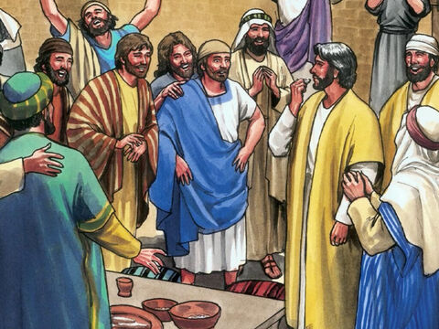
Jesus Appears to His Disciples
John 20:19-31

Slide 5
Leader: A reading from
the Holy Gospel
according to John.
All: Glory to You, Oh Lord.

Slide 6
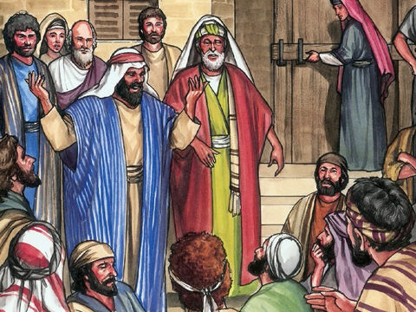
19
It was late that Sunday evening, and the disciples were gathered together behind locked doors, because they were afraid of the Jewish authorities. Then Jesus came and stood among them. “Peace be with you,” he said.

Slide 7
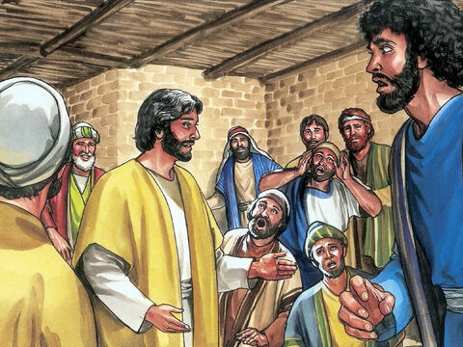
20
After saying this, he showed them his hands and his side. The disciples were filled with joy at seeing the Lord.

Slide 8
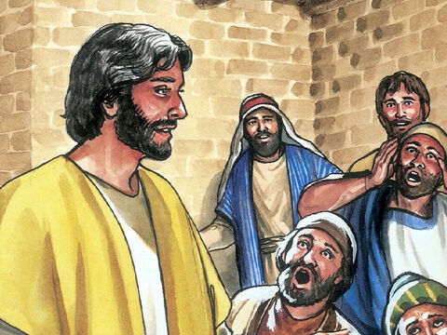
21
Jesus said to them again, “Peace be with you. As the Father sent me, so I send you.”

Slide 9
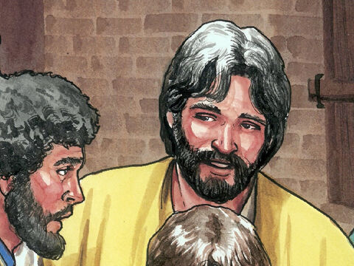
22
Then he breathed on them and said, “Receive the Holy Spirit.

Slide 10
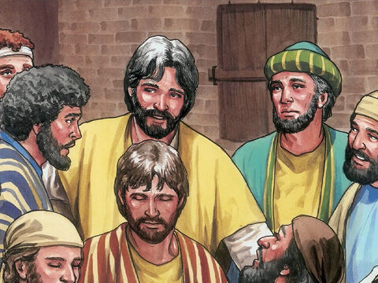
23
If you forgive people's sins, they are forgiven; if you do not forgive them, they are not forgiven.”

Slide 11
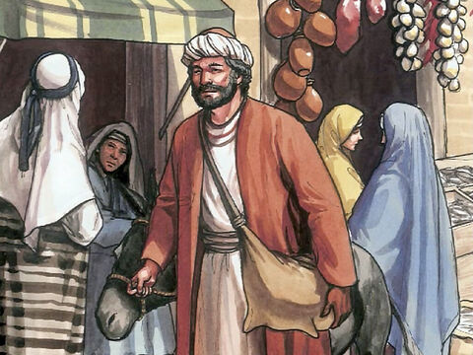
24
One of the twelve disciples, Thomas (called the Twin), was not with them when Jesus came.

Slide 12
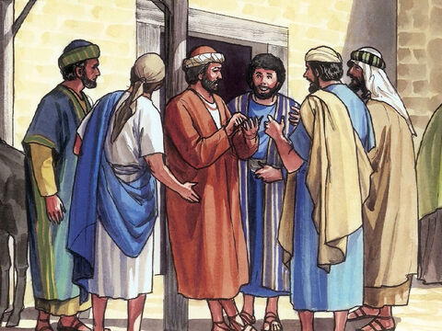
25
So the other disciples told him, “We have seen the Lord!” Thomas said to them, “Unless I see the scars of the nails in his hands and put my finger on those scars and my hand in his side, I will not believe.”

Slide 13
26
A week later the disciples were together again indoors, and Thomas was with them. The doors were locked, but Jesus came and stood among them and said, “Peace be with you.”

Slide 14
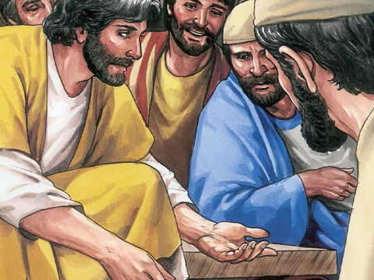
27
Then he said to Thomas, “Put your finger here, and look at my hands; then reach out your hand and put it in my side. Stop your doubting, and believe!”

Slide 15
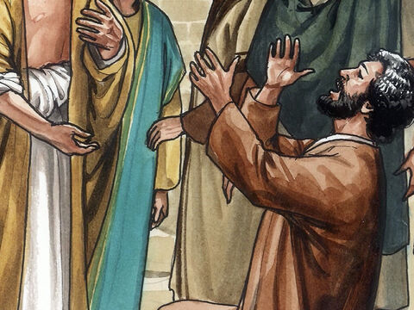
28
Thomas answered him, “My Lord and my God!”

Slide 16
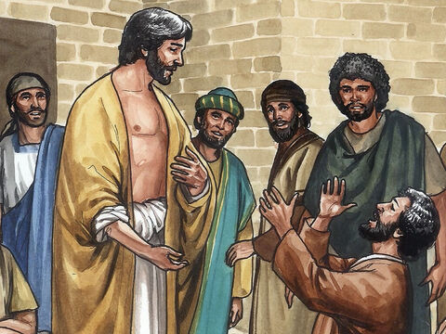
29
Jesus said to him, “Do you believe because you see me? How happy are those who believe without seeing me!”

Slide 17
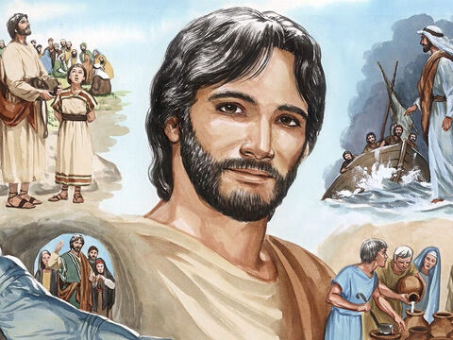
30
In his disciples' presence Jesus performed many other miracles which are not written down in this book.

Slide 18
31
But these have been written in order that you may believe that Jesus is the Messiah, the Son of God, and that through your faith in him you may have life.

Slide 19
Leader: The Gospel of the Lord.
All: Praise to You,
Lord Jesus Christ.

Slide 20
GOSPEL MESSAGE

Slide 21
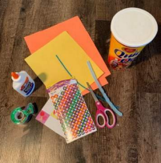
Activity:
Pierced Kaleidoscope
Materials:
• Construction Paper or tissue paper
• Glue, tape, or staples
• Empty container (tissue box, oats container, etc.)
• Scissors
• Small scraps of paper or beads (optional)
• Markers, crayons, or decorative supplies
• Stickers or pipe cleaners (optional)

Slide 22
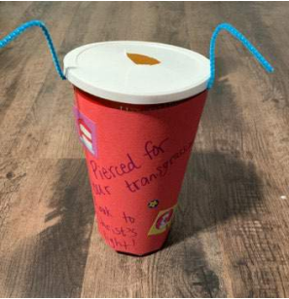
1. On one side of the container, poke holes into a design, using scissors or a sharp pencil. On the other side, cut a hole in the lid to create an eye hole.
2. Decorate your container by covering it
with paper, inside and out.
3. Add verse caption: “Stop your doubting, and believe!”
4. Add extra flair with papers, beads, or glitter. If using this strategy,
cover the eye hole with some plastic.
5. Hold your tool up to the light, peek
through the hole, and admire your design!

Slide 23
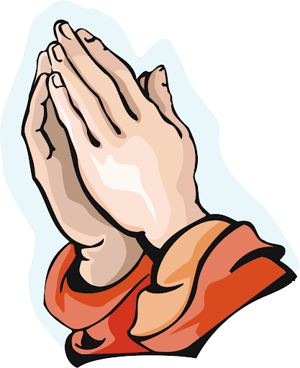
Closing Prayer
Dear Jesus,
Thank You that You rose from the dead and are alive! Thank You for coming to Your friends and saying, “Peace be with you.” Even when they were scared, You showed them love.
Sometimes we feel scared or unsure too. Help us to remember that You are always with us. Help us to believe in You, even when we can't see You. Thank You for loving us and giving us peace.
In Jesus’ name we pray,
Amen.

Slide 24
Divine Mercy Sunday, Second Sunday of Easter – April 27, 2025
CYCLE C – YEAR I

