Slide 2
Palm Sunday – April 13, 2025
CYCLE C – YEAR I

Slide 3
This Sunday marks the start of Holy Week—Palm or Passion Sunday—leading us into the Triduum: Holy Thursday, Good Friday, and the Easter Vigil, the Church's most sacred days. At Mass, we hear two Gospels. The first recalls Jesus’ triumphant entry into Jerusalem, riding a borrowed colt as crowds hailed him. Only Luke notes Jesus’ exchange with the Pharisees, showing that all unfolding events follow God’s plan.
The Passion reading today comes from Luke. His account shows Jesus fully in control, even as he approaches death. At the Last Supper, Jesus speaks of betrayal and hands over the Kingdom to his disciples, who still misunderstand its meaning. Jesus teaches them that true leadership in God’s Kingdom is service. He predicts Peter’s denial and urges the disciples to pray as they head to the Mount of Olives. In Gethsemane, Jesus prays, is strengthened by an angel, and then takes charge of the coming trials.
Unique to Luke: Jesus heals the high priest’s servant during his arrest and speaks of God’s power to the Sanhedrin. On the cross, he forgives his executioners, welcomes the good thief, and dies not with a cry of abandonment, but by entrusting his spirit to the Father. This week, we reflect deeply on Jesus’ suffering and death. Through it, he reveals himself as the Son of God and brings the Kingdom to fulfillment.

Slide 4
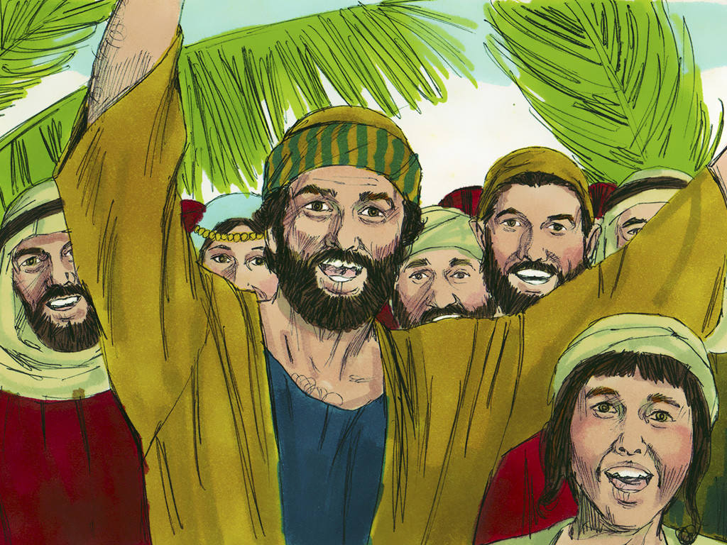
The Triumphant Approach to Jerusalem
Gospel at the Procession with Palms | Luke 19:28-40

Slide 5
Leader: A reading from
the Holy Gospel
according to Luke.
All: Glory to You, Oh Lord.

Slide 6
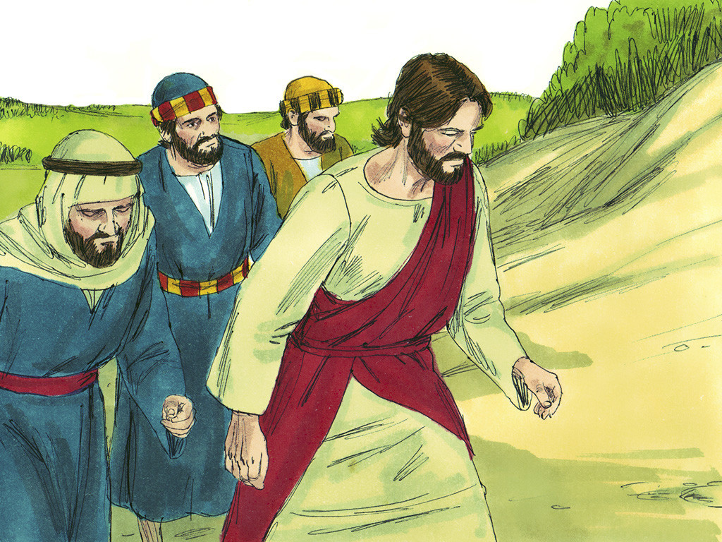
28
After Jesus said this, he went on in front of them toward Jerusalem.

Slide 7
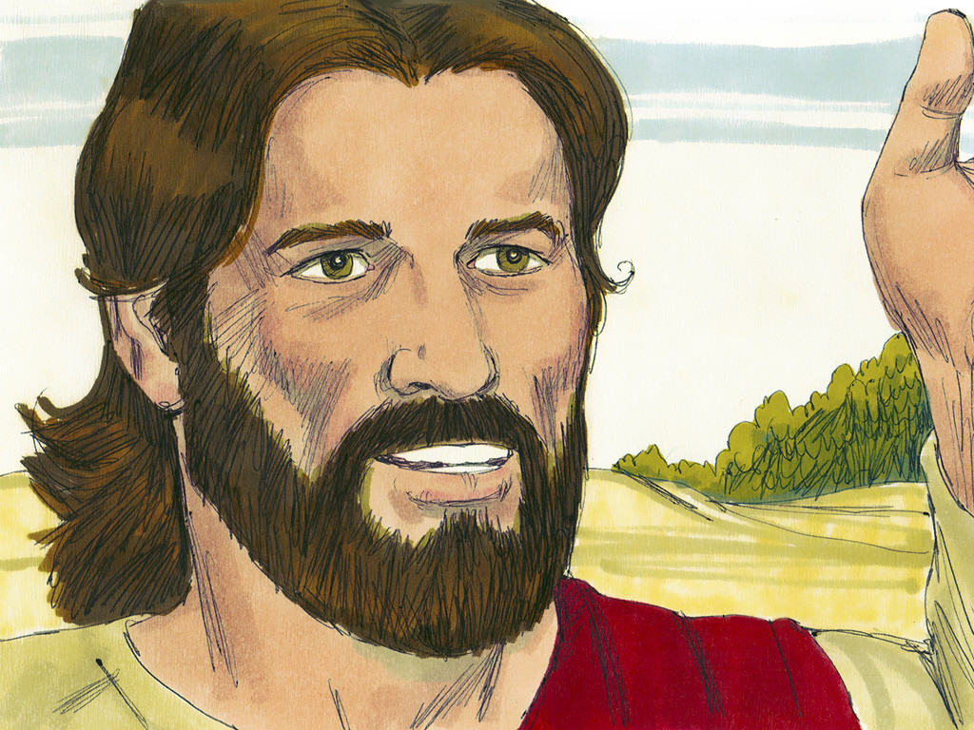
29
As he came near Bethphage and Bethany at the Mount of Olives, he sent two disciples ahead

Slide 8
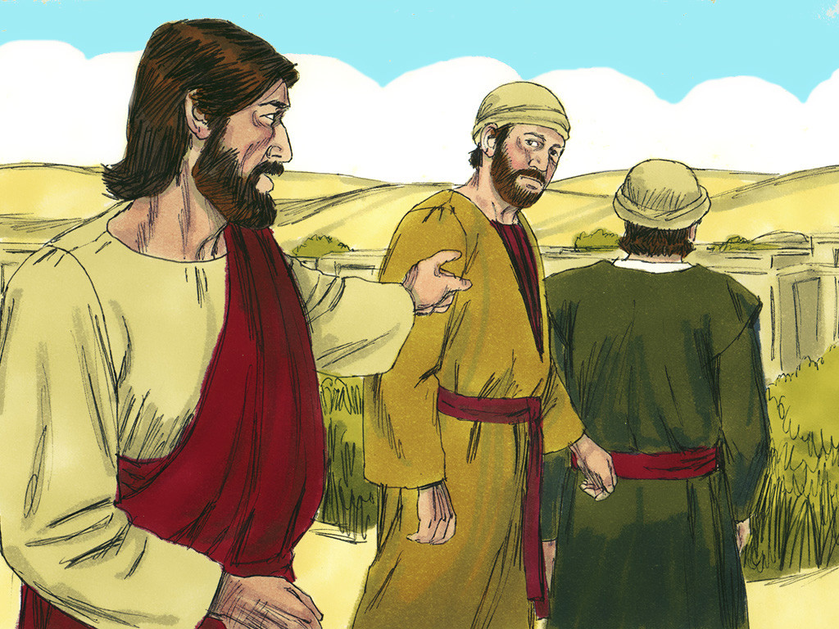
30
with these instructions: “Go to the village there ahead of you; as you go in, you will find a colt tied up that has never been ridden. Untie it and bring it here.

Slide 9
31
If someone asks you why you are untying it, tell him that the Master needs it.”

Slide 10
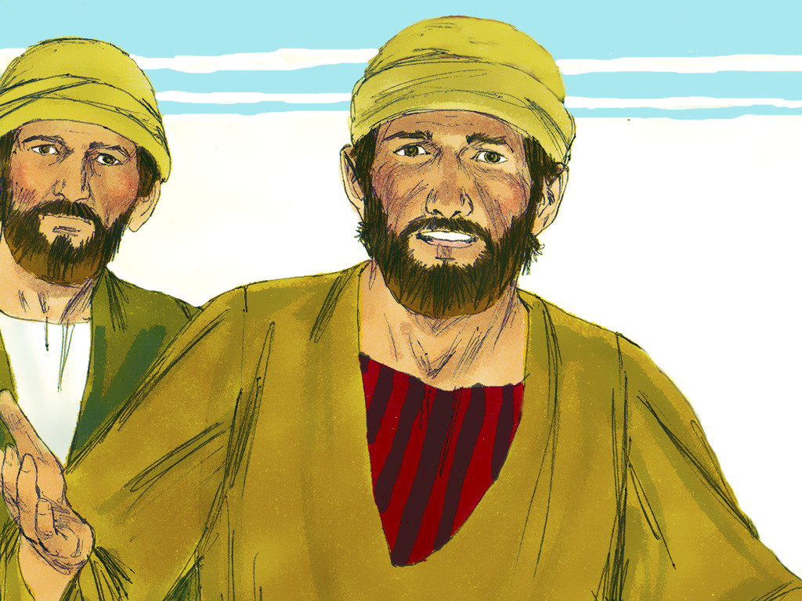
32
They went on their way and found everything just as Jesus had told them.

Slide 11
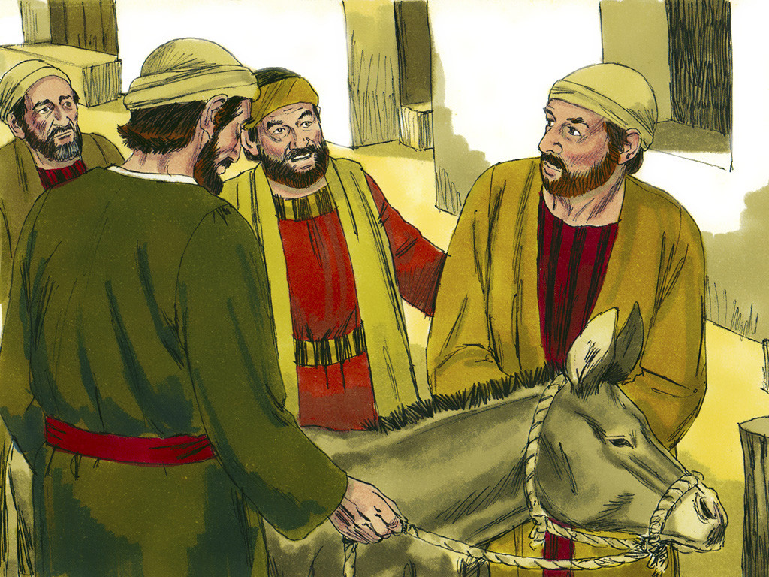
33
As they were untying the colt, its owners said to them, “Why are you untying it?”

Slide 12
34-35
The Master needs it,” they answered, and they took the colt to Jesus. Then they threw their cloaks over the animal and helped Jesus get on.

Slide 13
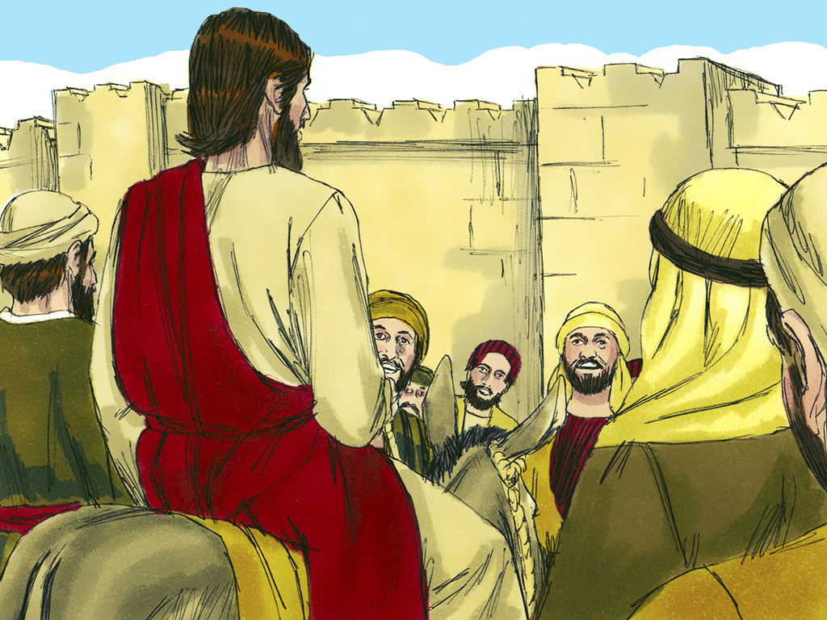
36
As he rode on, people spread their cloaks on the road.

Slide 14
37
When he came near Jerusalem, at the place where the road went down the Mount of Olives, the large crowd of his disciples began to thank God and praise him in loud voices for all the great things that they had seen:

Slide 15
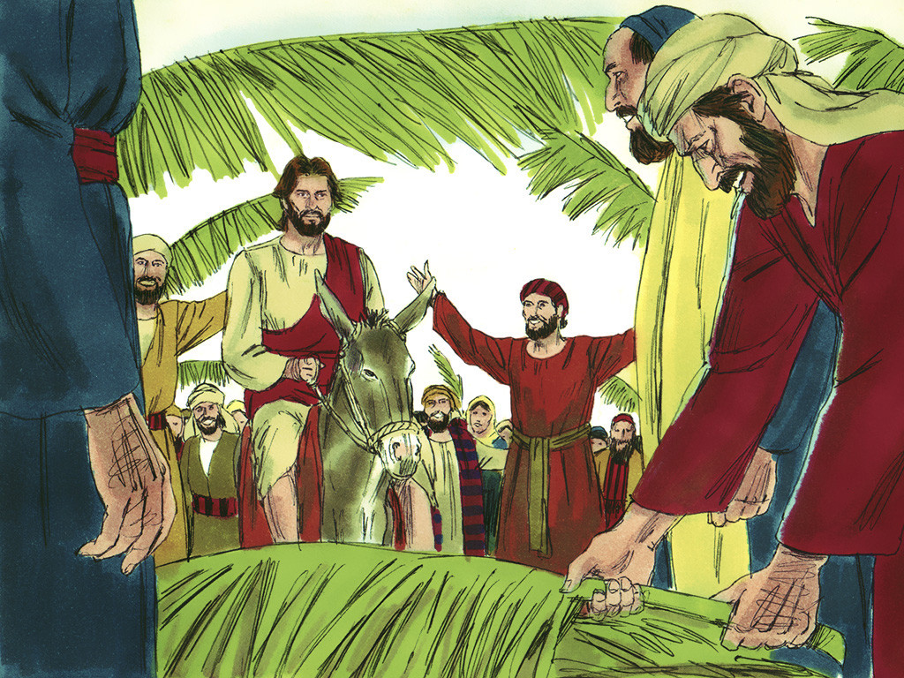
38
“God bless the king who comes in the name of the Lord! Peace in heaven and glory to God!”

Slide 16
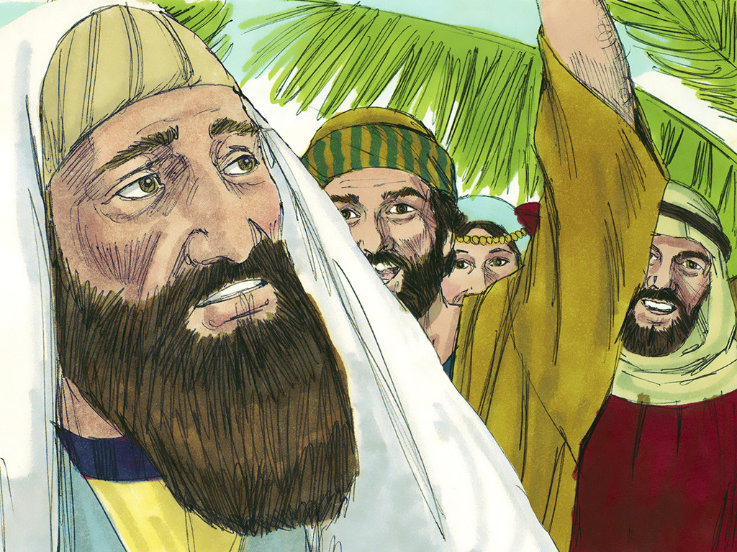
39
Then some of the Pharisees in the crowd spoke to Jesus. “Teacher,” they said, “command your disciples to be quiet!”

Slide 17
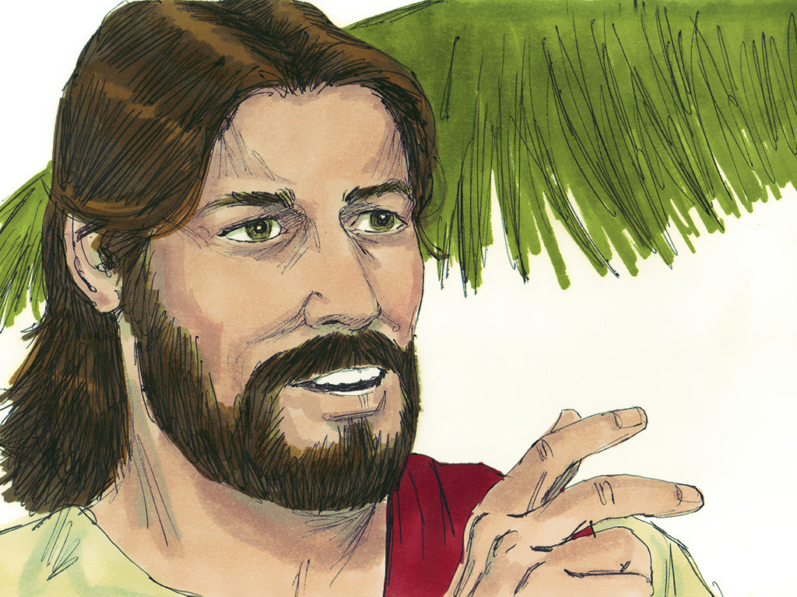
40
Jesus answered, “I tell you that if they keep quiet, the stones themselves will start shouting.”

Slide 18
Leader: The Gospel of the Lord.
All: Praise to You,
Lord Jesus Christ.

Slide 19
GOSPEL MESSAGE

Slide 20
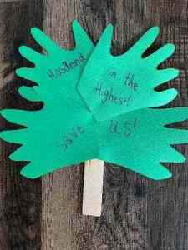
Activity:
Palm Palm Stick
Scissors
Construction paper (green)
Markers or decorating materials
Glue or tape
Toilet Paper tube or popsicle stick

Slide 21
Activity:
Palm Palm Stick
Trace handprints onto green paper.
Carefully cut the hands out of the paper.
Decorate the hands with words, phrases, or verses.
Glue the handprints onto the sides of the stick or tube.

Slide 22
Closing Prayer
Thank you, Jesus, for coming into our lives. Thank you for assuring us that there is nothing to be afraid because you are always with us. May we praise your name Jesus and say Hallelujah in everything that we do.
In Jesus’ name we pray, Amen.

Slide 23
Palm Sunday – April 13, 2025
CYCLE C – YEAR I

