Slide 2
27ᵗʰ Sunday in Ordinary Time | October 6, 2024
CYCLE B – YEAR II

Slide 3
UNDERSTANDING THE GOSPEL (for facilitators only)
This week's gospel explains to us the beauty of family and the humanity for the Kids.
In the first part of our Gospel, Jesus reminds us the beauty and sanctity of marriage that whoever commits on it shall hold and embody their commitment, and all of the moments where they promised to be together, forever. He also reminds us the beauty of God’s creation where we are made equally as man and woman, and who is united together by God shall not separate since the two of them become one.
On the latter part of the Gospel, this is where our identity as MFC-Kids rooted, we believe that “No One is Too Young to know Christ” and that’s why Jesus reminds us that every kid deserves to know who He is, how great, loving, strong, and mighty He is. It takes humility to accept the responsibility on leading the children closer to God, so we must not stop them, instead, we must inspire them to know, love, and serve God more.
Amen

Slide 4
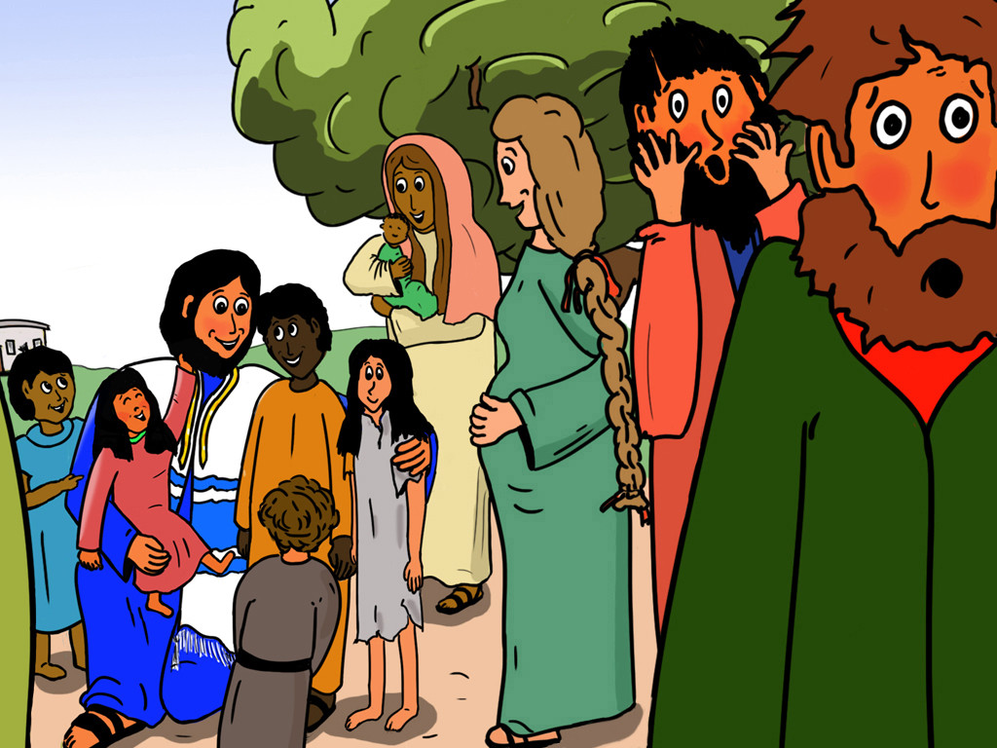
An Inseparable Bond
Mark 10:2-16

Slide 5
Leader: A reading from
the Holy Gospel
according to Mark.
All: Glory to You, Oh Lord.

Slide 6
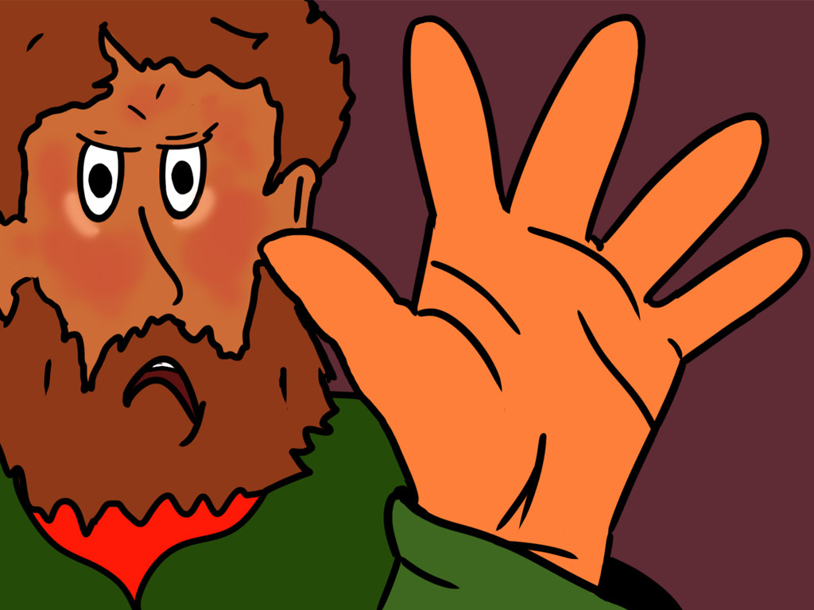
2
Some Pharisees came to him and tried to trap him. “Tell us,” they asked, “does our Law allow a man to divorce his wife?”

Slide 7
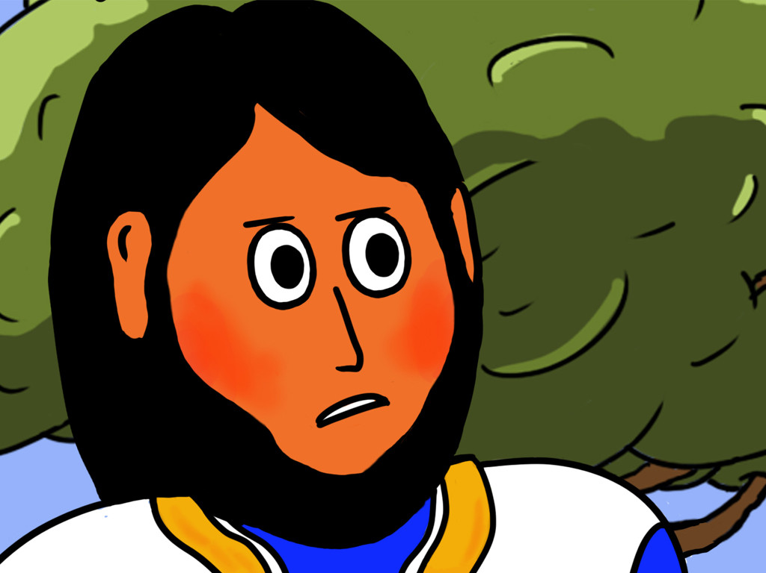
3
Jesus answered with a question, “What law did Moses give you?”

Slide 8
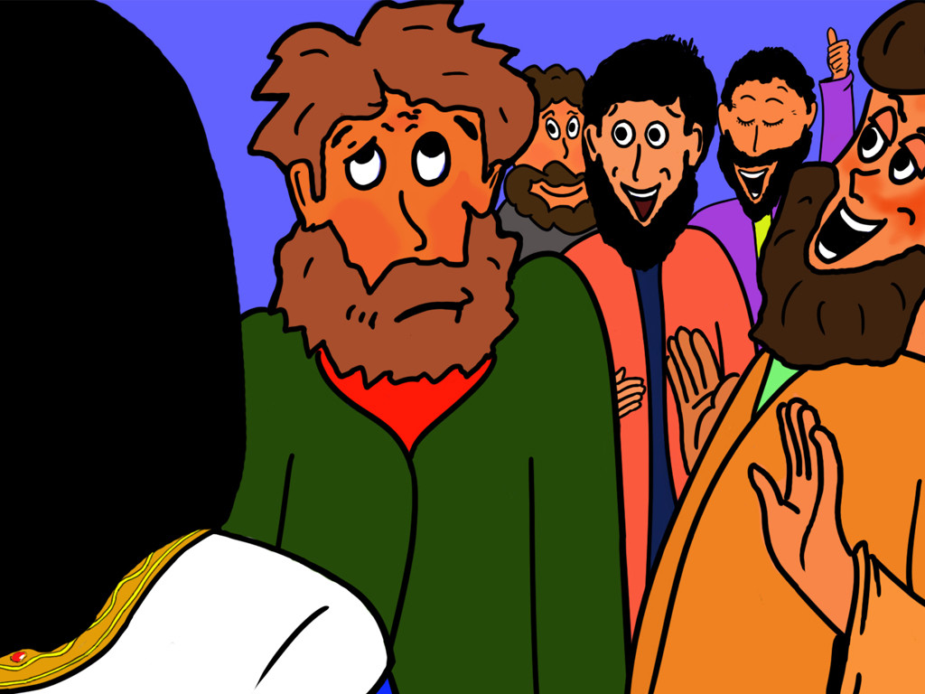
4
Their answer was, “Moses gave permission for a man to write a divorce notice and send his wife away.”

Slide 9
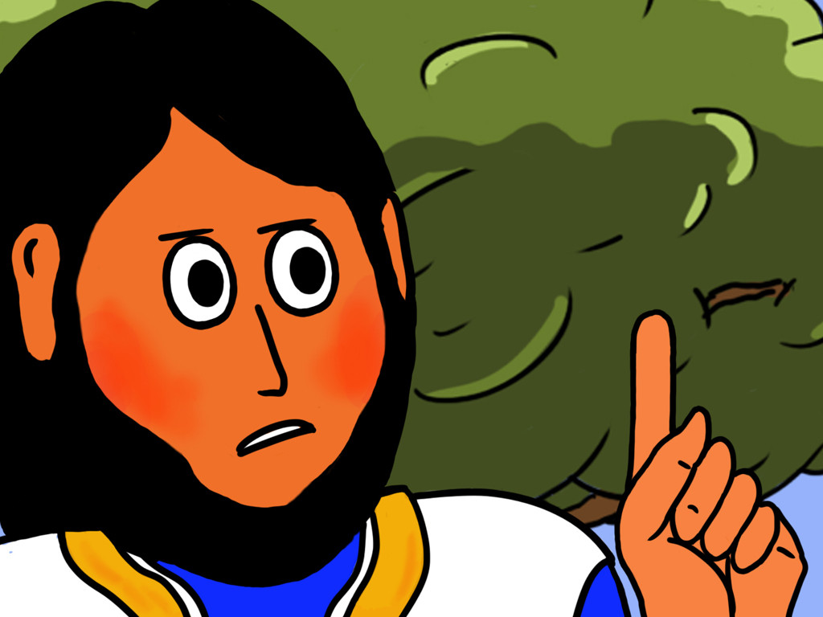
5
Jesus said to them, “Moses wrote this law for you because you are so hard to teach.

Slide 10
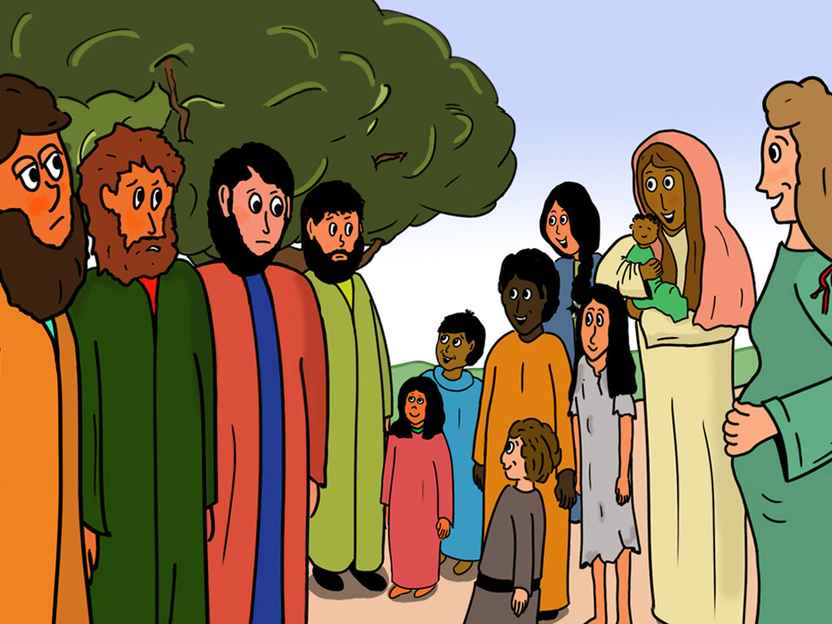
6
But in the beginning, at the time of creation, ‘God made them male and female,’ as the scripture says

Slide 11
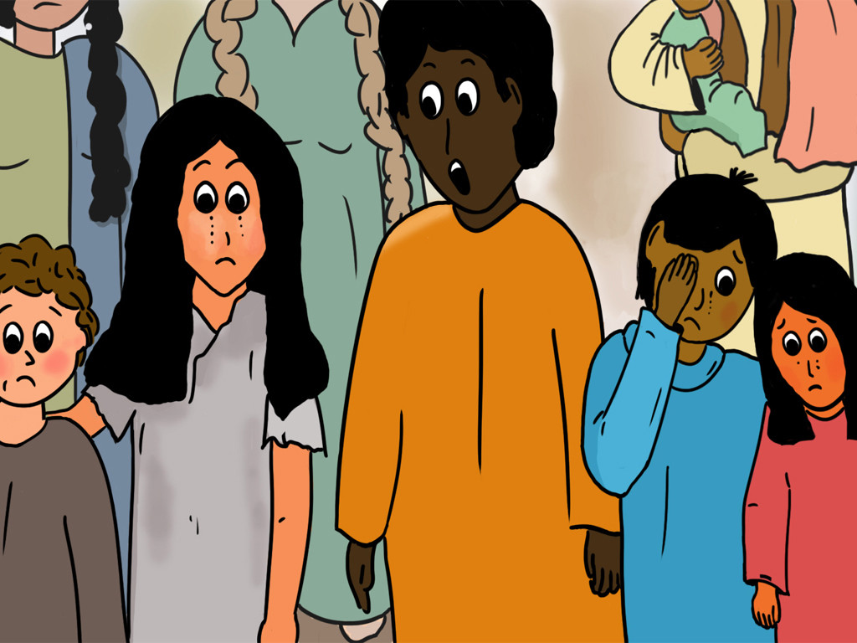
7-8
‘And for this reason a man will leave his father and mother and unite with his wife, and the two will become one.’ So they are no longer two, but one.

Slide 12
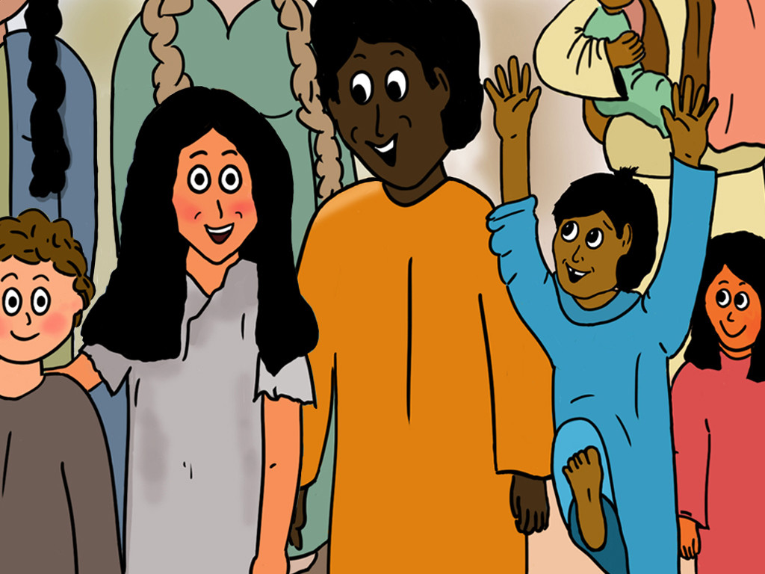
9
No human being must separate, then, what God has joined together.”

Slide 13
10
When they went back into the house, the disciples asked Jesus about this matter.

Slide 14
11
He said to them, “A man who divorces his wife and marries another woman commits adultery against his wife.

Slide 15
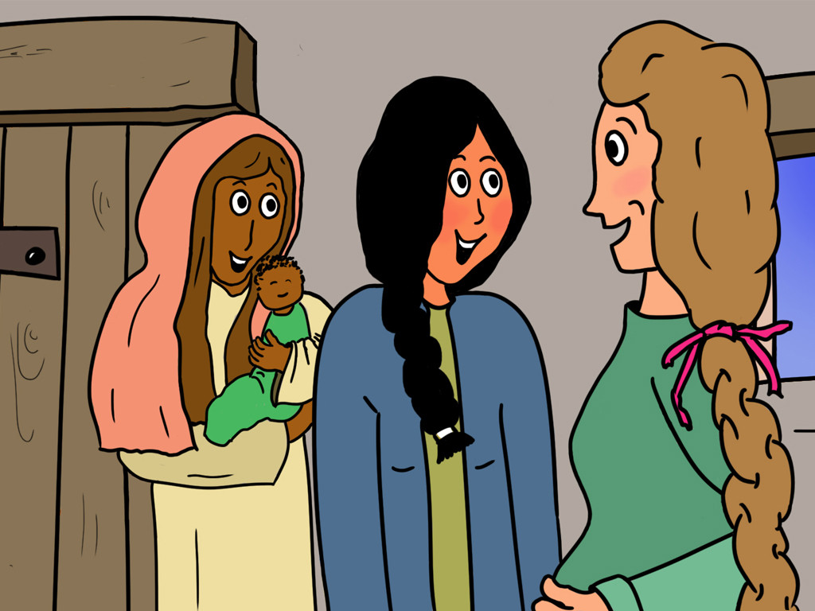
12
In the same way, a woman who divorces her husband and marries another man commits adultery.”

Slide 16
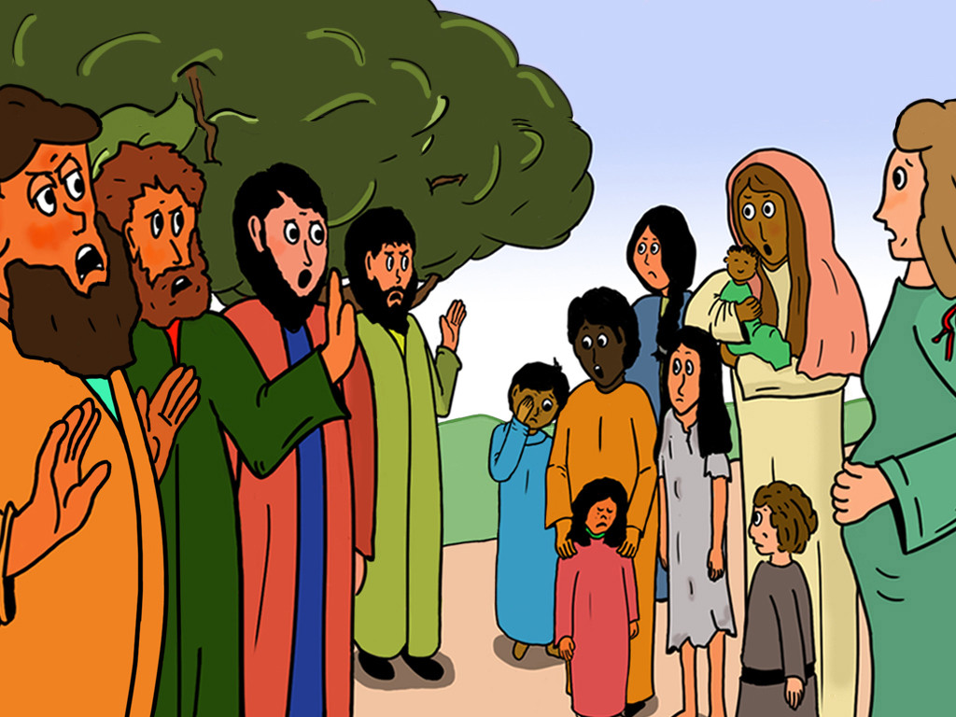
13
Some people brought children to Jesus for him to place his hands on them, but the disciples scolded the people.

Slide 17
14
When Jesus noticed this, he was angry and said to his disciples, “Let the children come to me, and do not stop them, because the Kingdom of God belongs to such as these.

Slide 18
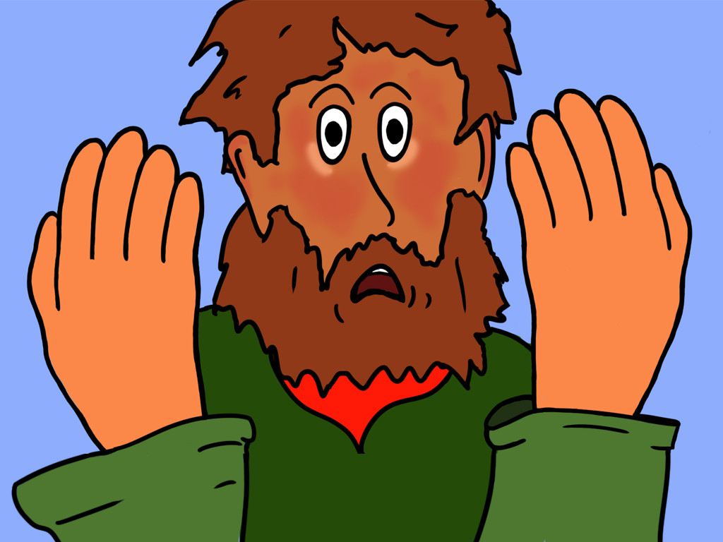
15
I assure you that whoever does not receive the Kingdom of God like a child will never enter it.”

Slide 19
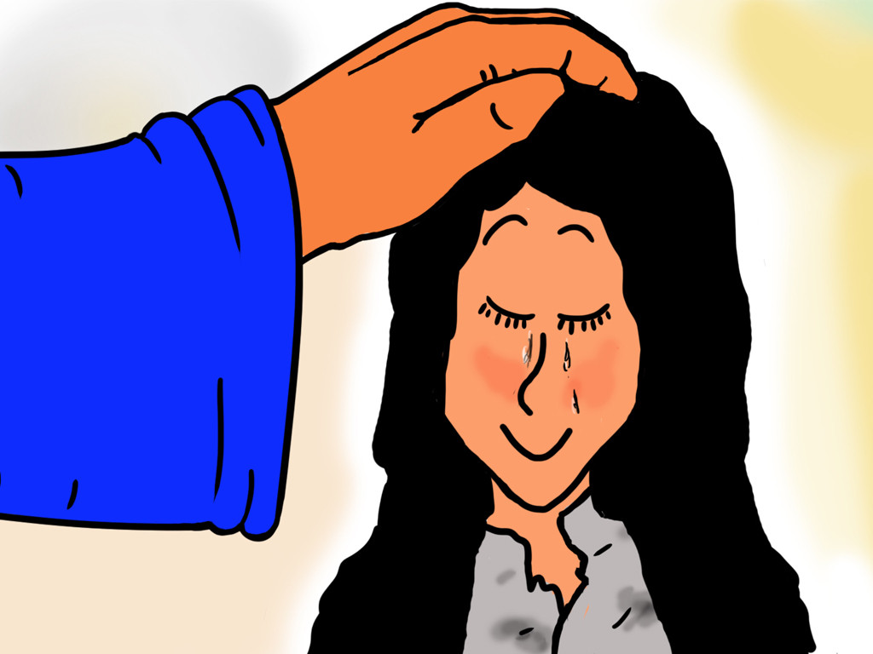
16
Then he took the children in his arms, placed his hands on each of them, and blessed them.

Slide 20
Leader: The Gospel of the Lord.
All: Praise to You,
Lord Jesus Christ.

Slide 21
GOSPEL MESSAGE

Slide 22
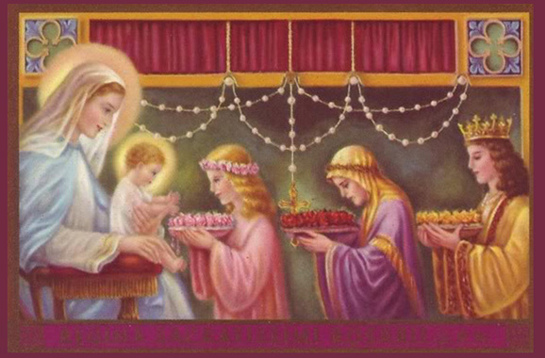
Activity: Praying of the Holy Rosary
As we celebrate the feast day of Our Lady of the Rosary and celebrate the Holy Rosary Mass, let us all together pray the Holy Rosary.

Slide 23
Closing Prayer
Dear God,
Thank you for the gift of Your mother, Mama Mary, being one with us today. We pray that we may have the grace of Mama Mary as we continue to strive for holiness daily. May we move closer to You, O, Jesus, with the intercession of your Mother, Amen.

Slide 24
27ᵗʰ Sunday in Ordinary Time | October 6, 2024
CYCLE B – YEAR II

