Slide 2
30ᵗʰ Sunday in Ordinary Time | October 27, 2024
CYCLE B – YEAR II

Slide 3
UNDERSTANDING THE GOSPEL (for facilitators only)
For this week’s gospel, we are reminded that our low points, disappointments, sad moments, illnesses, diseases, and weaknesses are not reasons for us to have faith and believe in God. These things are part of the challenges that hinder us from giving back the glory to God. It stops us from being faithful, we are being blinded by the hardship. But it takes an act of courage to speak and accept our weaknesses and ask help from our lord Jesus. In the same way that this blind man, Bartimaeus, takes the courage to ask for Jesus's help.
But, it was never an easy thing to do, because this may result in rejection. Similarly, in the gospel, people discourage him and ask him to stop. In our lives, there will be bad influencers and people who will stop us from speaking and being faithful to Jesus. Despite that, Bartimaeus stood still and continuously begged for Jesus’s help, and Jesus healed him.
May we be courageous to proclaim our Faith to Jesus, because our faith can heal us. This can make impossible things possible.

Slide 4
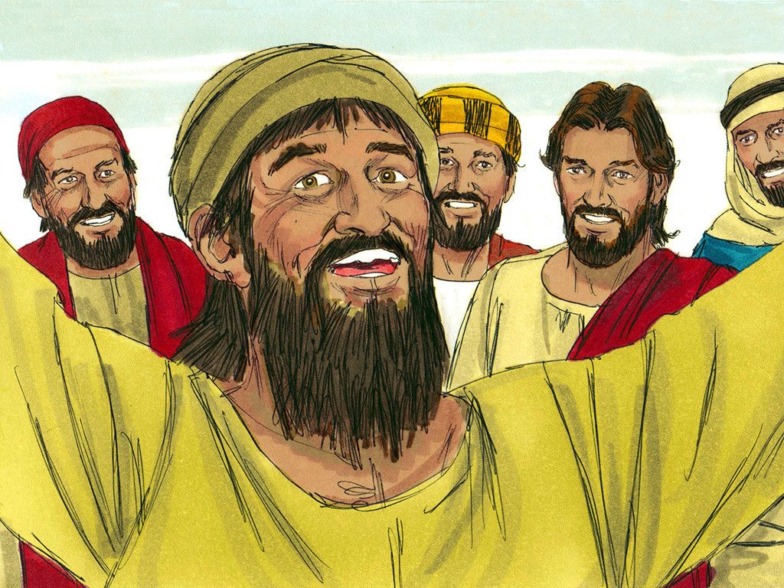
Jesus Heals Blind Bartimaeus
Matthew 10: 46-52

Slide 5
Leader: A reading from
the Holy Gospel
according to Matthew.
All: Glory to You, Oh Lord.

Slide 6
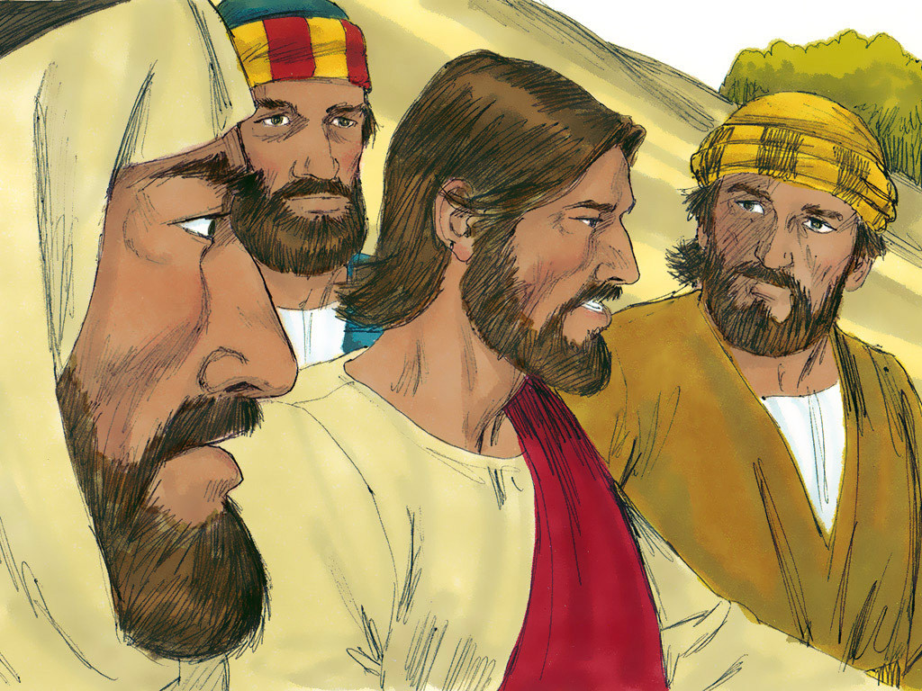
46
They came to Jericho, and as Jesus was leaving with his disciples and a large crowd, a blind beggar named Bartimaeus son of Timaeus was sitting by the road.

Slide 7
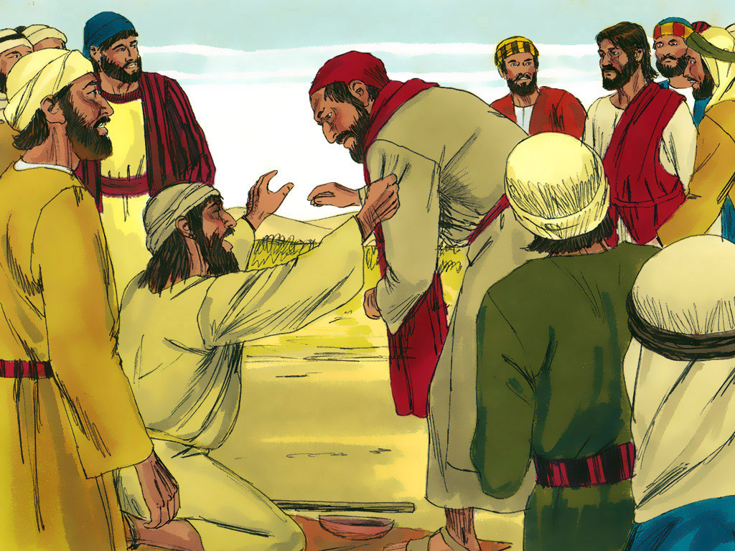
47
When he heard that it was Jesus of Nazareth, he began to shout, “Jesus! Son of David! Have mercy on me!”

Slide 8
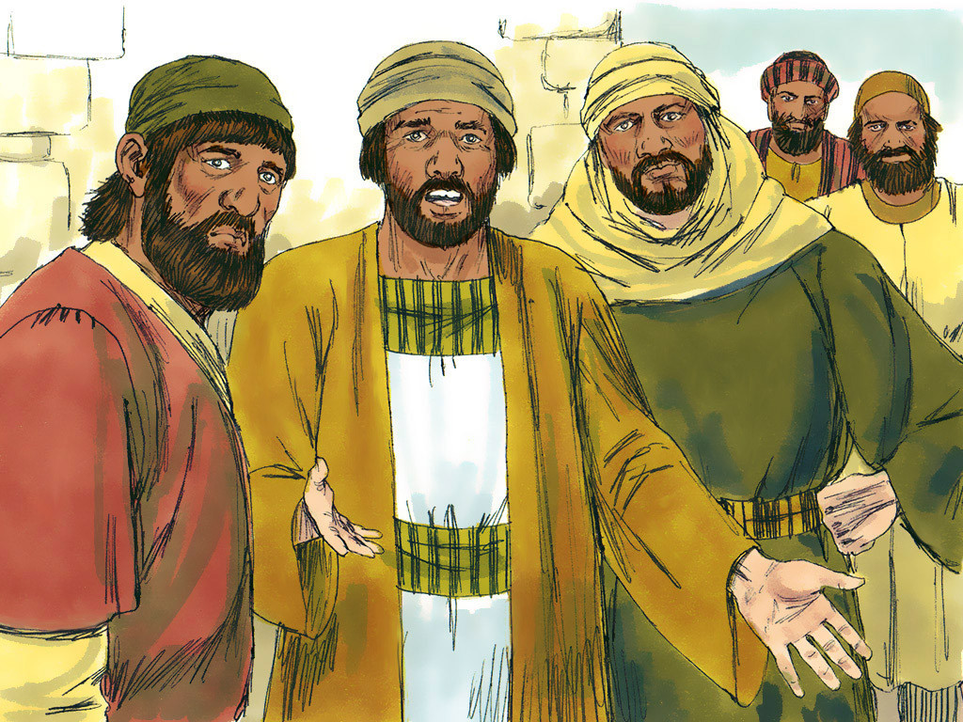
48
Many of the people scolded him and told him to be quiet. But he shouted even more loudly, “Son of David, have mercy on me!”

Slide 9
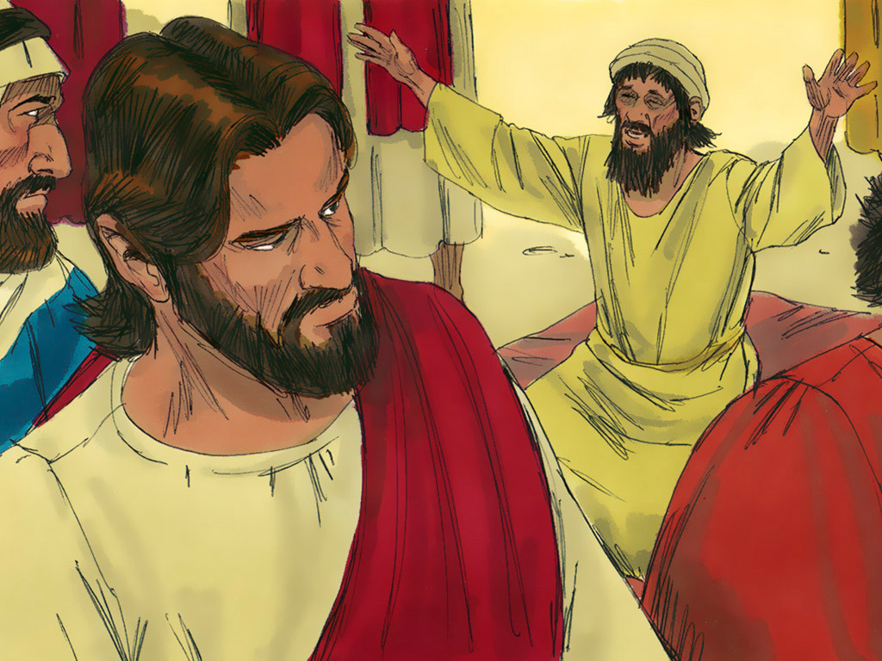
49
Jesus stopped and said, “Call him.”
So they called the blind man. “Cheer up!” they said. “Get up, he is calling you.”

Slide 10
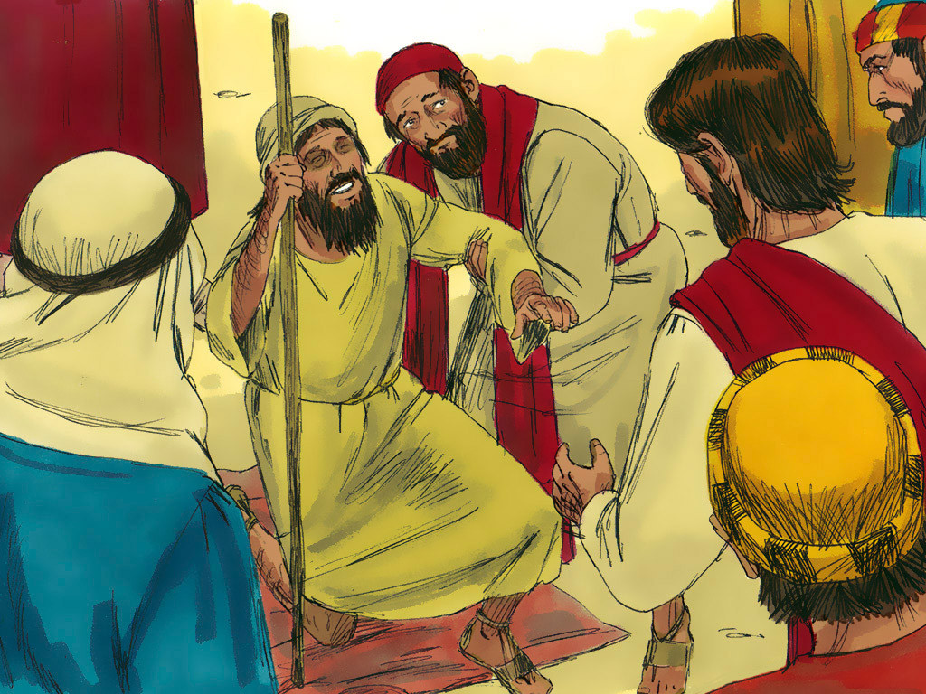
50
So he threw off his cloak, jumped up, and came to Jesus.

Slide 11
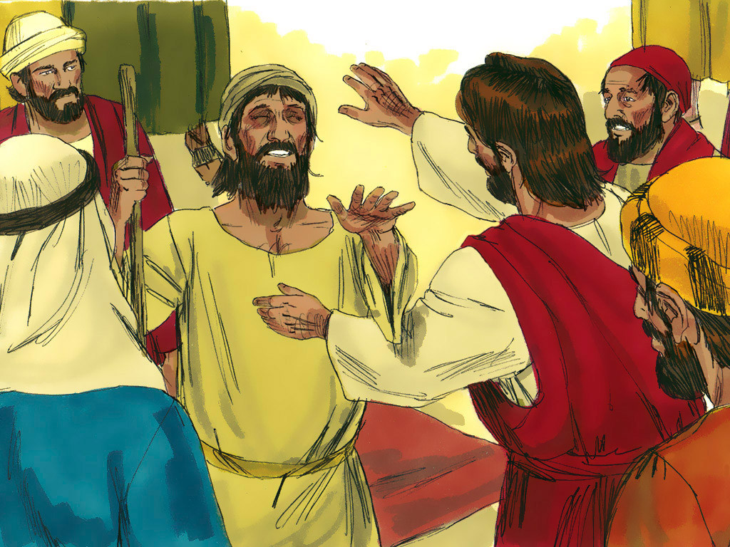
51
“What do you want me to do for you?” Jesus asked him. “Teacher,” the blind man answered, “I want to see again.”

Slide 12
52
“Go,” Jesus told him, “your faith has made you well.”At once he was able to see and followed Jesus on the road.

Slide 13
Leader: The Gospel of the Lord.
All: Praise to You,
Lord Jesus Christ.

Slide 14
GOSPEL MESSAGE

Slide 15
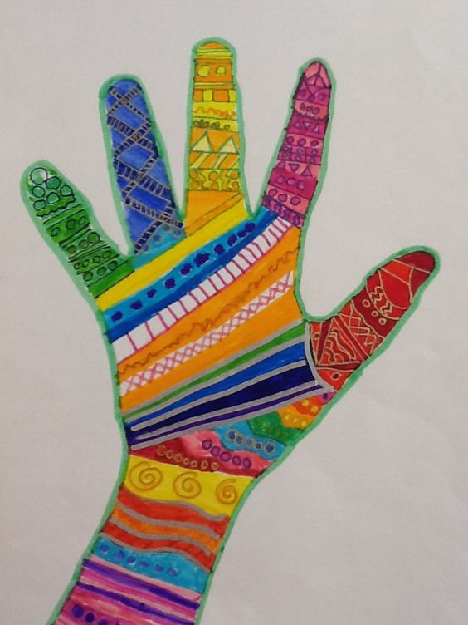
Activity: The Healing Hand of Jesus
“I believe in the Healing Hand of Jesus”
Materials:
Bond Paper
(You can use scratch papers)
Coloring Materials
Marker/Pens

Slide 16
“I believe in the Healing Hand of Jesus”
Objective of the Activity:
This activity aims to develop our creativity and trust the healing hands of Jesus, curing all illnesses even in our differences in race or status.

Slide 17
Procedure:
“I believe in the Healing Hand of Jesus”
Traced your hand on the paper.
Color and decorate your traced hand.
Write the phrase “I believe in the Healing Hand of Jesus”

Slide 18
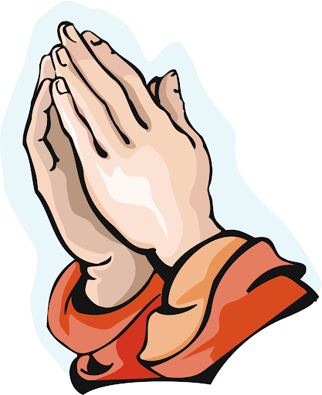
Closing Prayer
Dear God,
Thank you for the gift of faith that you bestowed on each and every one of us. Thank you also for making us safe daily and for providing for our daily needs the same way you provide help to the blind man to the gospel that we learn today.
Thank you, Jesus, for reminding us that everyone is welcome to your vineyard. Also, we thank you O Jesus for healing us when we are sick. We pray to You to keep us safe, healthy, and strong every day.
All we ask in the mighty name of Jesus, Amen

Slide 19
30ᵗʰ Sunday in Ordinary Time | October 27, 2024
CYCLE B – YEAR II

