Slide 2
29ᵗʰ Sunday in Ordinary Time | October 20, 2024
CYCLE B – YEAR II

Slide 3
UNDERSTANDING THE GOSPEL (for facilitators only)
It is truly an honor to feel the presence of Jesus as we walk closely with Him, just as James and John did. However, these two were overwhelmed by Jesus' greatness. They wanted to prolong this sense of power, but their desire was misguided. Humility is needed to recognize that no one is above anyone else. James and John sought to sit at Jesus' right and left hand, but Jesus reminded them that He did not have the authority to grant those positions.
Jesus emphasized that no one is greater than another. We must serve others first before considering our own well-being. Looking out for and helping others is what defines humility, and it is this humility that brings joy to Jesus.

Slide 4
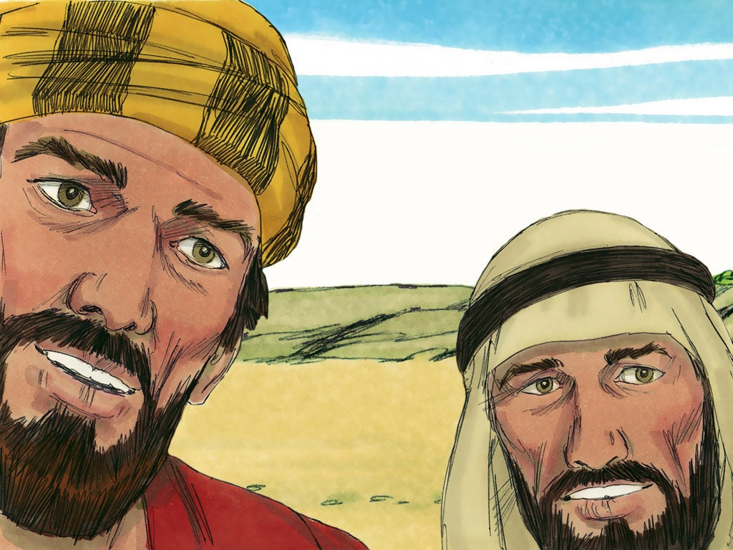
The Request of James and John
Mark 10: 35-45

Slide 5
Leader: A reading from
the Holy Gospel
according to Mark.
All: Glory to You, Oh Lord.

Slide 6
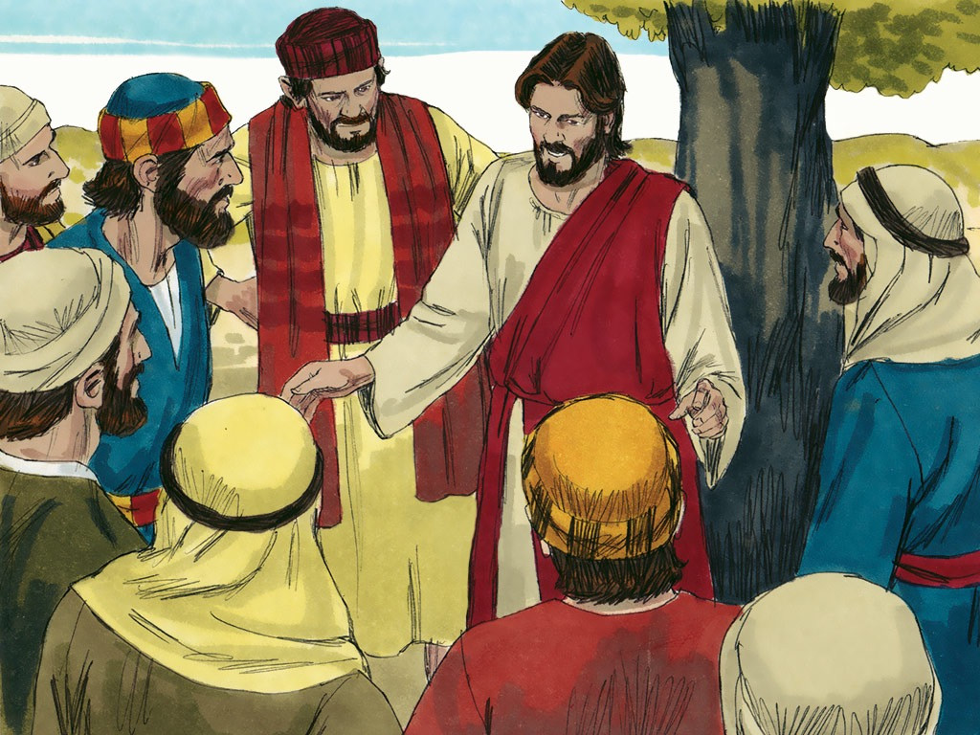
35
Then James and John, the sons of Zebedee, came to Jesus. “Teacher,” they said, “there is something we want you to do for us.”

Slide 7
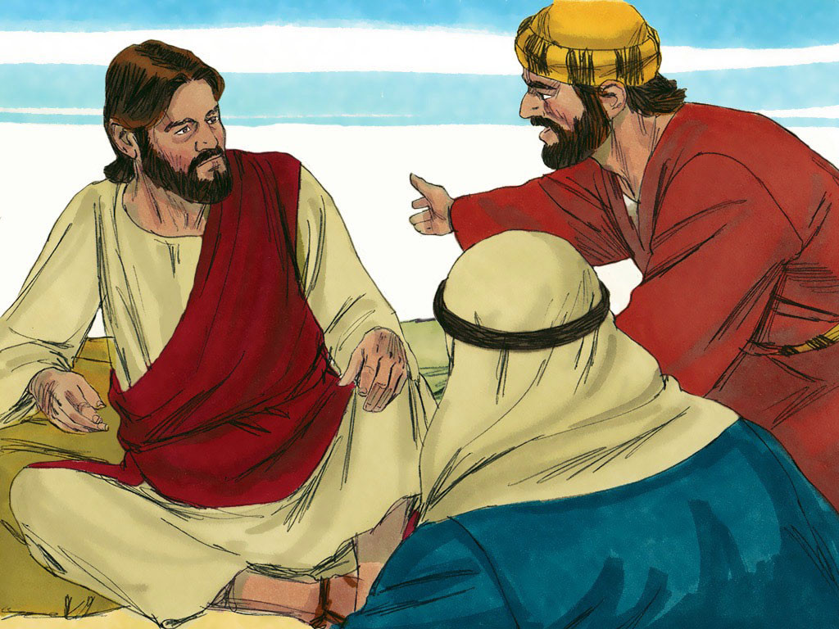
36 - 37
“What is it?” Jesus asked them. They answered, “When you sit on your throne in your glorious Kingdom, we want you to let us sit with you, one at your right and one at your left.”

Slide 8
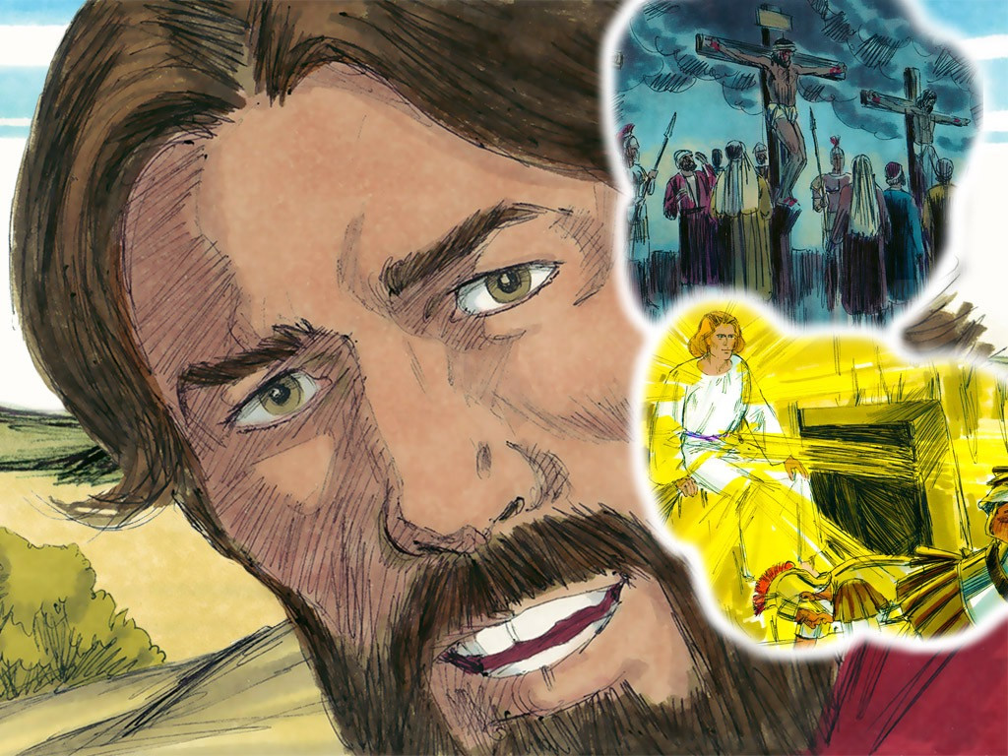
38
Jesus said to them, “You don't know what you are asking for. Can you drink the cup of suffering that I must drink? Can you be baptized in the way I must be baptized?”

Slide 9
39
“We can,” they answered.
Jesus said to them, “You will indeed drink the cup I must drink and be baptized in the way I must be baptized.

Slide 10
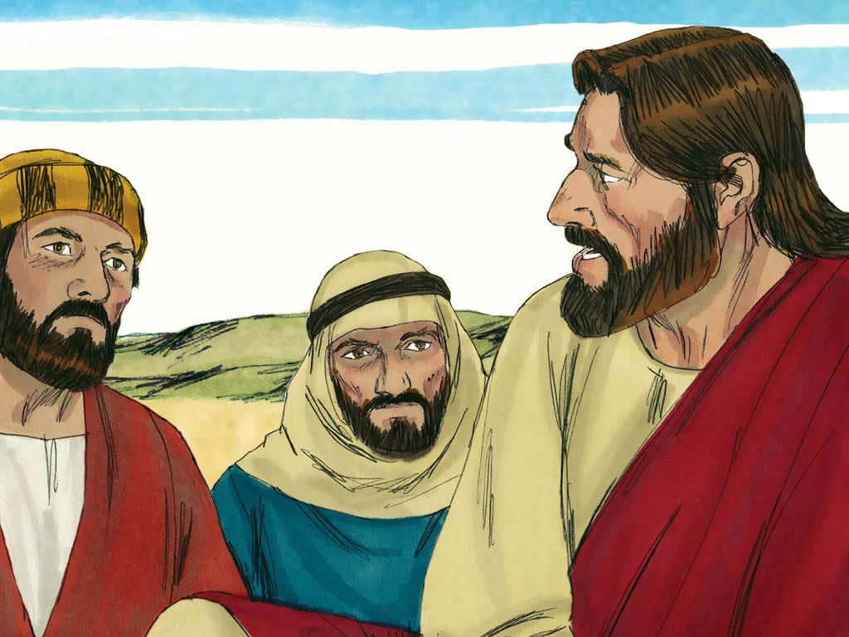
40
But I do not have the right to choose who will sit at my right and my left. It is God who will give these places to those for whom he has prepared them.”

Slide 11
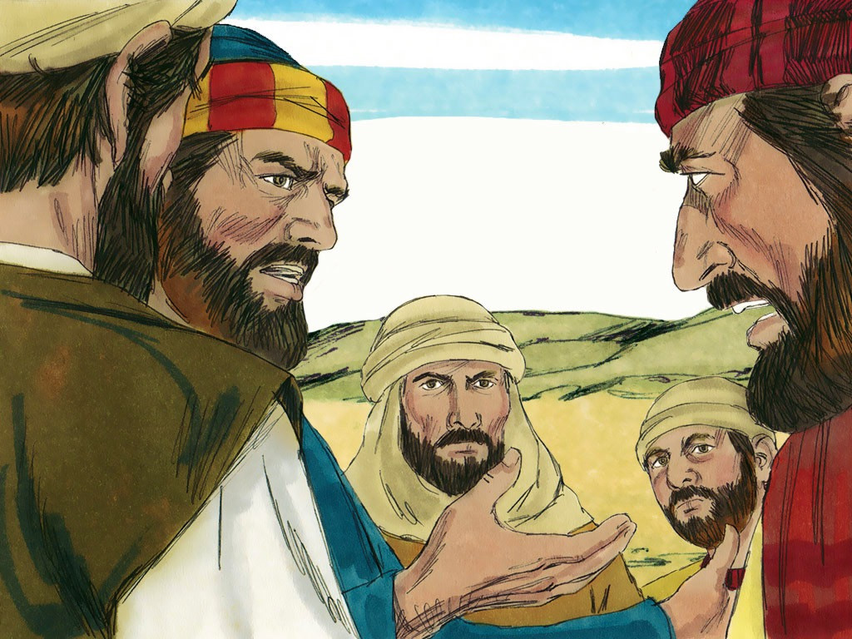
41
When the other ten disciples heard about it, they became angry with James and John.

Slide 12
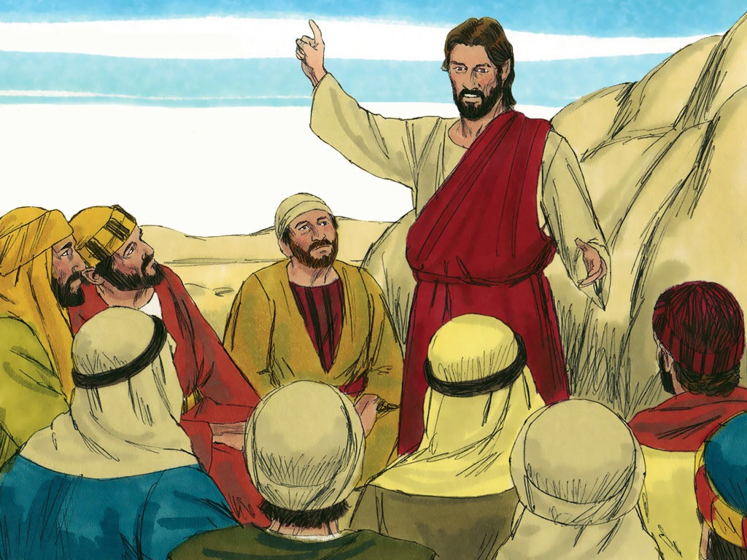
42
So Jesus called them all together to him and said, “You know that those who are considered rulers of the heathen have power over them, and the leaders have complete authority.

Slide 13
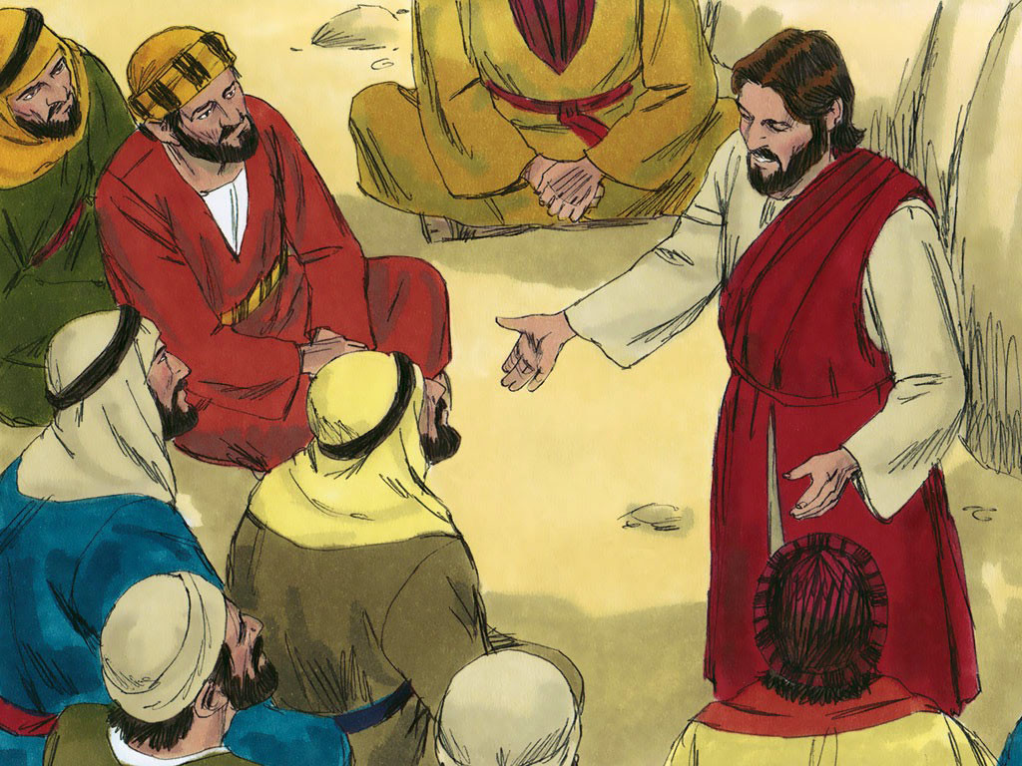
43 - 44
This, however, is not the way it is among you. If one of you wants to be great, you must be the servant of the rest; and if one of you wants to be first, you must be the slave of all.

Slide 14
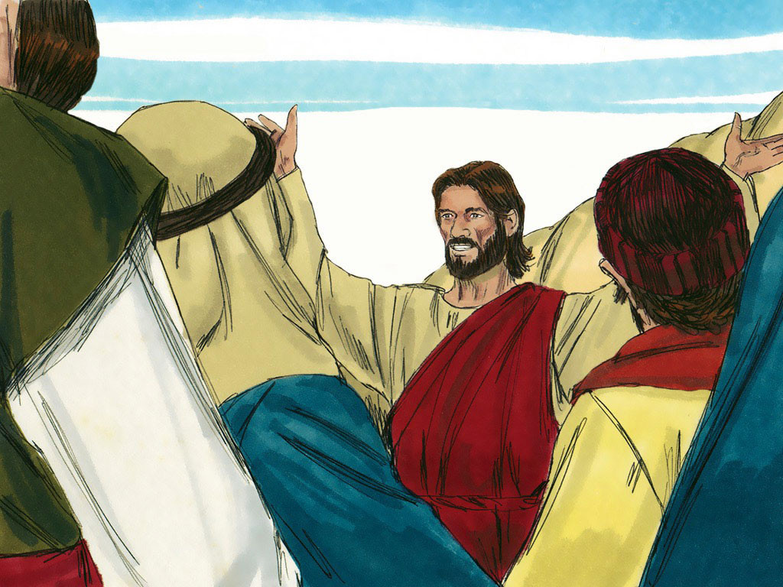
45
For even the Son of Man did not come to be served; he came to serve and to give his life to redeem many people.”

Slide 15
Leader: The Gospel of the Lord.
All: Praise to You,
Lord Jesus Christ.

Slide 16
GOSPEL MESSAGE

Slide 17
Activity: Be Humble!
Materials:
Bond Paper
(You can use scratch papers)
Coloring Materials
Marker/Pens

Slide 18
Objective of the Activity:
This activity aims to develop our creativity and reminds us to be humble in following Jesus. This Activity helps us to Act, Love, and Walk Humbly.

Slide 19
Procedure:
Draw a Hand, Heart, and a Foot
Color each image with a color of your choice.
Write the phrase:
TOP - “Be Humble!”
Hand - “ACT Justly”
Heart - “LOVE Mercy”
FOOT - “WALK Humbly”

Slide 20
Closing Prayer
Dear God,
Thank you for the gospel that we learn today. Thank you for reminding us of the value of humility, to love what we have, and to accept what we do not have. Humility makes us strong, brave, and courageous, and we thank you Lord for letting us understand all of these. We ask for your guidance to make us humble every day and to give us humility in dealing with my family, friends, and community. We ask for all of these in the mighty name of Jesus, Amen.

Slide 21
29ᵗʰ Sunday in Ordinary Time | October 20, 2024
CYCLE B – YEAR II

