Slide 2
28ᵗʰ Sunday in Ordinary Time | October 13, 2024
CYCLE B – YEAR II

Slide 3
Mark 10:17-27 Context | For Facilitators Only
The gospel is about a rich man approaching Jesus, asking what he must do to inherit eternal life. Jesus first reminds him of the commandments, which the man claims to have followed since his youth. Then Jesus, looking at him with love, tells him that he lacks one thing: he should sell all he has, give the money to the poor, and follow Him. The man goes away sad because he has great wealth. Jesus then teaches His disciples about the difficulty of the rich entering the kingdom of God, emphasizing that what is impossible for humans is possible with God.
Key Message:
True discipleship requires more than simply following rules; it demands complete surrender to God.
Wealth can be an obstacle to following Jesus wholeheartedly. The rich man’s attachment to his possessions prevents him from fully committing to Christ.
Moral Lesson:
Detachment: Children can learn the value of not letting possessions or desires rule their hearts. Material wealth is temporary, but following Jesus is eternal.
Generosity: The rich man is asked to give to the poor, teaching children about generosity and helping those in need.
Trust in God: Jesus’ words, "For all things are possible with God," remind children that when they face difficult choices, they can rely on God for guidance and strength.

Slide 4
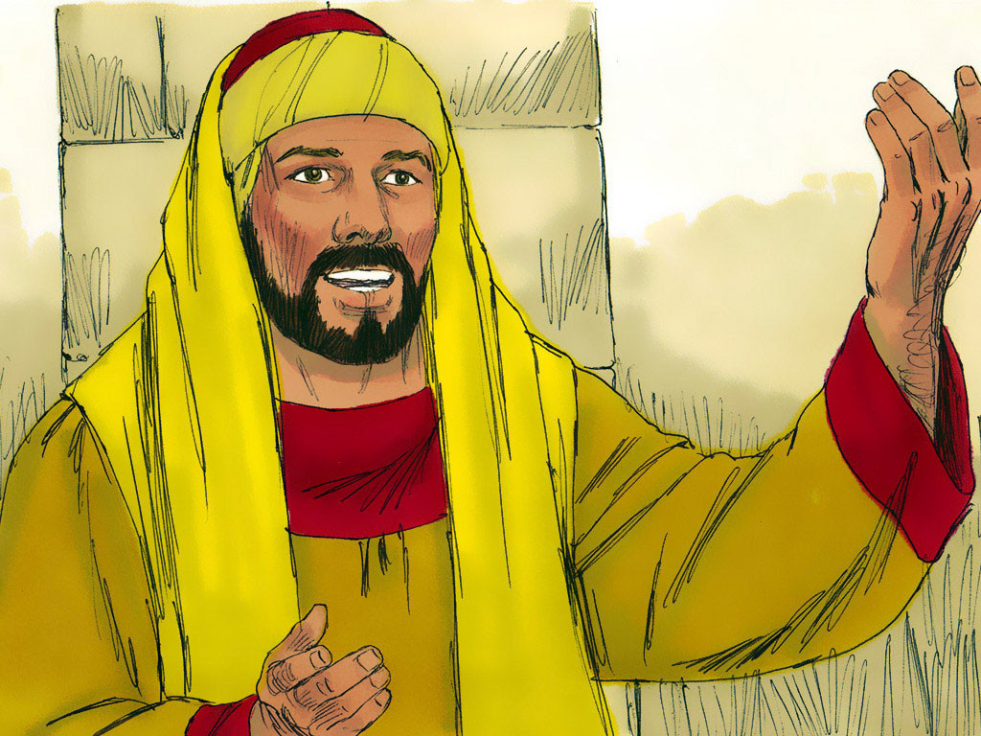
The Rich Man
Mark 10:17-27

Slide 5
Leader: A reading from
the Holy Gospel
according to Mark.
All: Glory to You, Oh Lord.

Slide 6
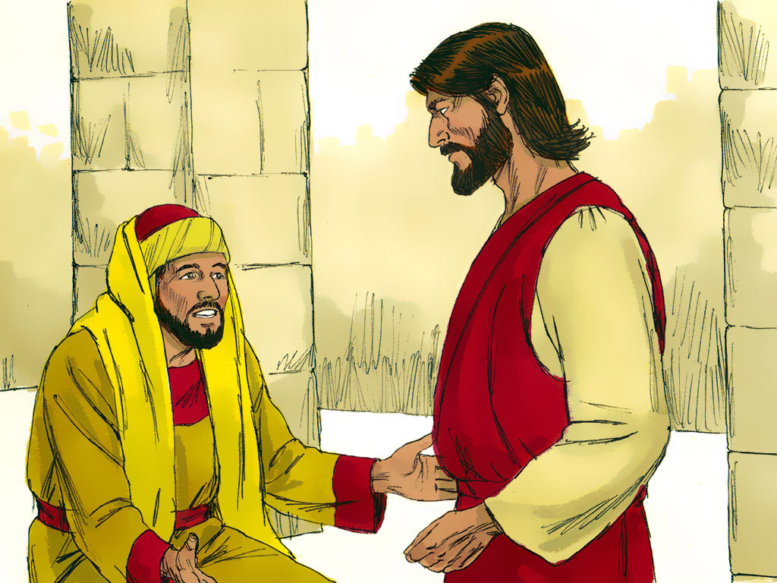
17
As Jesus was starting on his way again, a man ran up, knelt before him, and asked him, “Good Teacher, what must I do to receive eternal life?”

Slide 7
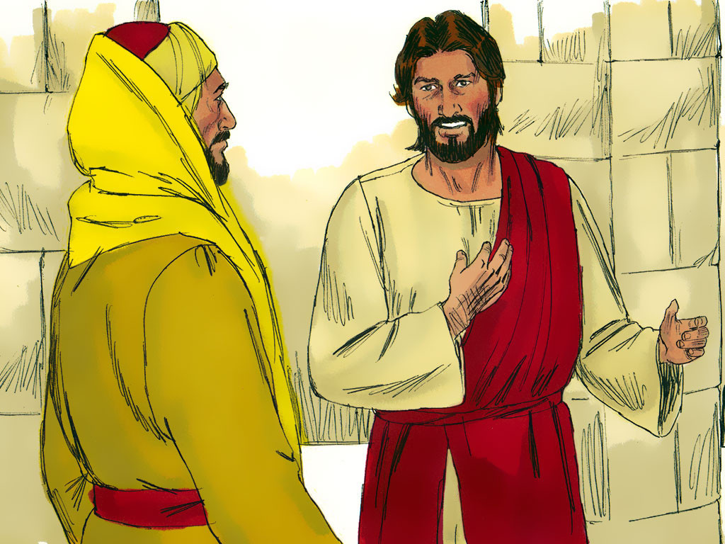
18
“Why do you call me good?” Jesus asked him. “No one is good except God alone.

Slide 8
19
You know the commandments: ‘Do not commit murder; do not commit adultery; do not steal; do not accuse anyone falsely; do not cheat; respect your father and your mother.’”

Slide 9
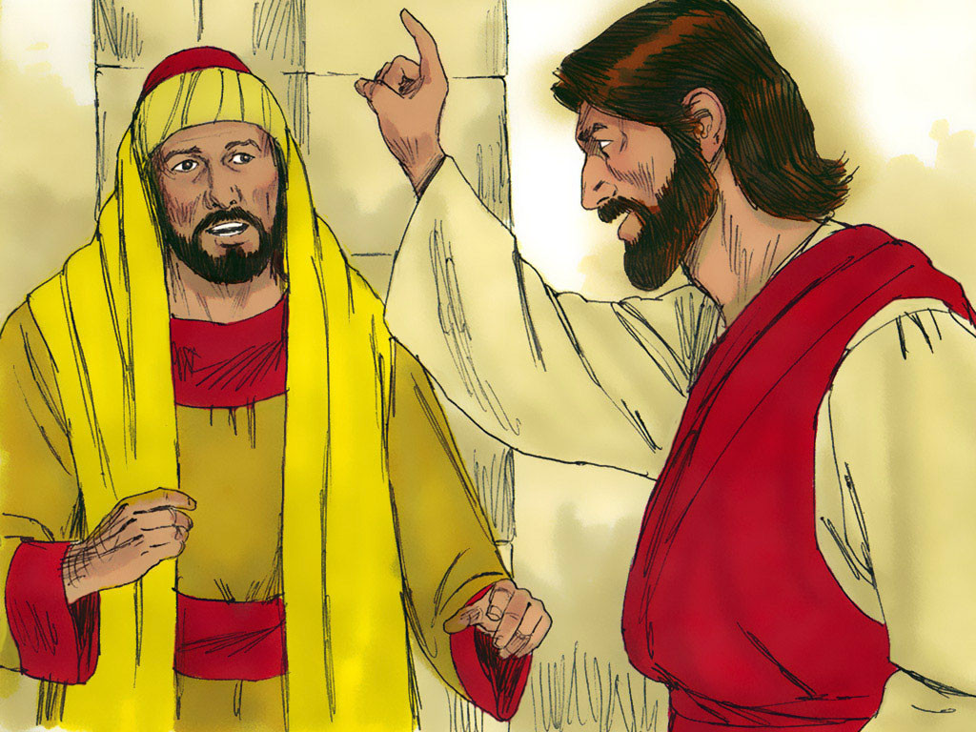
20
“Teacher,” the man said, “ever since I was young, I have obeyed all these commandments.”

Slide 10
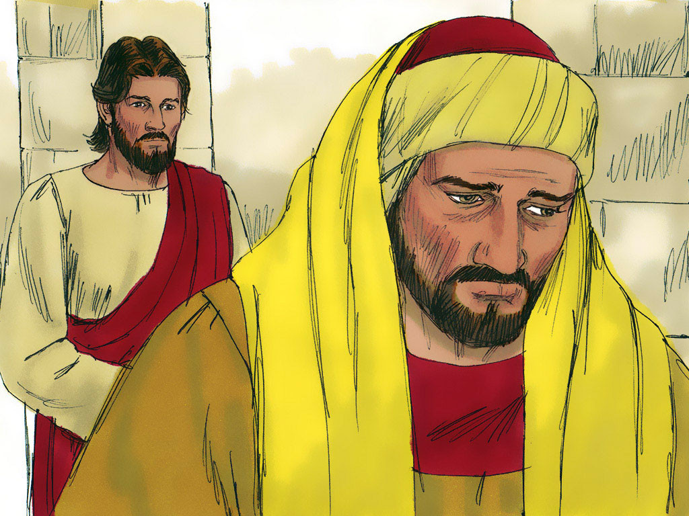
21
Jesus looked straight at him with love and said, “You need only one thing. Go and sell all you have and give the money to the poor, and you will have riches in heaven; then come and follow me.”

Slide 11
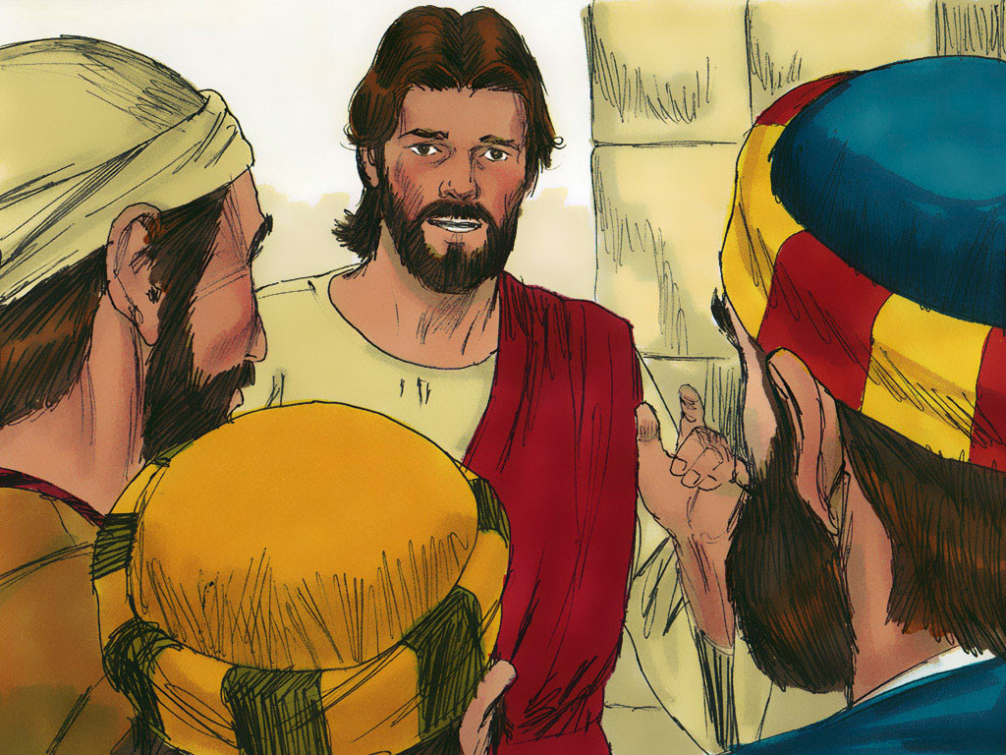
22
When the man heard this, gloom spread over his face, and he went away sad, because he was very rich.

Slide 12
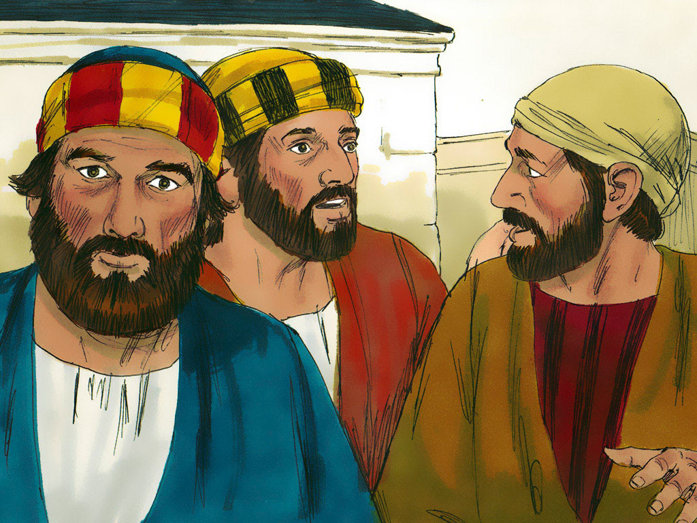
23
Jesus looked around at his disciples and said to them, “How hard it will be for rich people to enter the Kingdom of God!”

Slide 13
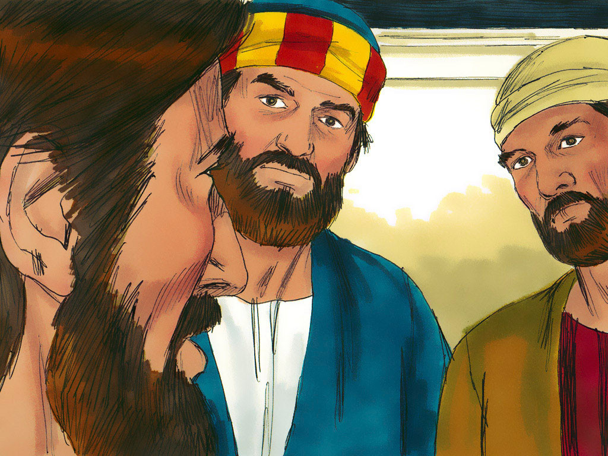
24
The disciples were shocked at these words, but Jesus went on to say, “My children, how hard it is to enter the Kingdom of God!

Slide 14
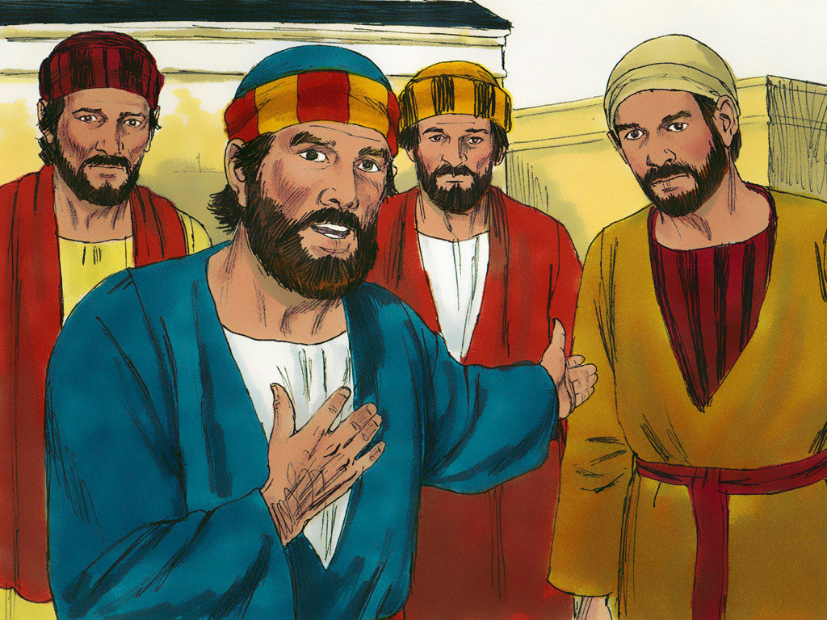
25
It is much harder for a rich person to enter the Kingdom of God than for a camel to go through the eye of a needle.”

Slide 15
26
At this the disciples were completely amazed and asked one another, “Who, then, can be saved?”

Slide 16
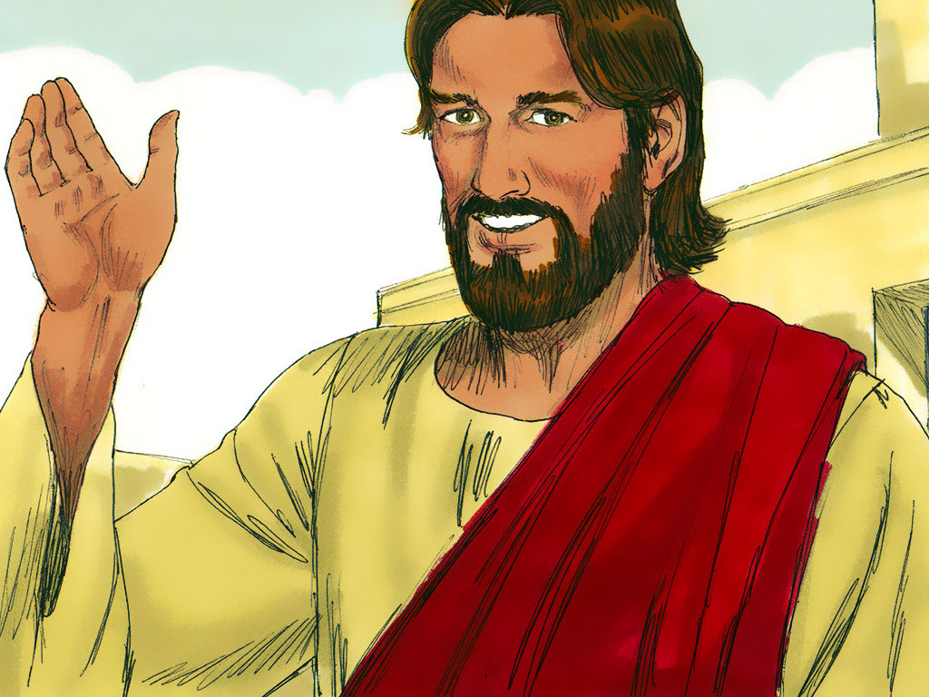
27
Jesus looked straight at them and answered, “This is impossible for human beings but not for God; everything is possible for God.”

Slide 17
Leader: The Gospel of the Lord.
All: Praise to You,
Lord Jesus Christ.

Slide 18
GOSPEL MESSAGE

Slide 19
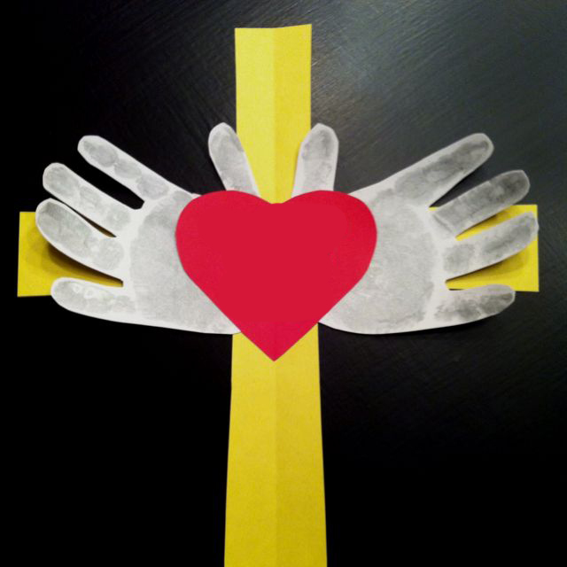
MY HEART IS FOR JESUS ONLY
Materials:
- Colored construction paper
- Scissors
- Ruler
- Pen/Marker
- Glue
- Crayons

Slide 20
Instructions:
1. Using your colored construction paper, cut out the following shapes in your preferred size: a cross, a heart, and your two hands (trace your hands!).
2. Glue the hands onto the cross, and then glue the heart over the hands, placing everything at the center.
3. In the middle of the heart, write: "I WILL FOLLOW JESUS WITH MY WHOLE HEART."

Slide 21
Closing Prayer
Dear Jesus,
Thank You for teaching us today about the rich man and how important it is to follow You with all our hearts. Help us to remember that loving You is more important than anything we own. Please teach us to share what we have with others, to be kind, and to trust in You always. We know that with You, anything is possible. Please guide us to be generous, loving, and brave in our faith. We love You, Jesus. Amen.

Slide 22
28ᵗʰ Sunday in Ordinary Time | October 13, 2024
CYCLE B – YEAR II

