Slide 2
34th Sunday in Ordinary Time | November 24, 2024
CYCLE B – YEAR II

Slide 3
CONTEXT:
This Gospel comes from the dialogue between Jesus and Pontius Pilate during Jesus' trial. Pilate questions Jesus about His kingship, trying to determine if Jesus is a political threat to the Roman Empire. Jesus responds by explaining that His kingdom is not of this world. He clarifies that He came into the world to testify to the truth, and those who belong to the truth listen to His voice.
KEY MESSAGES:
- Jesus as King: Jesus is the King of the Universe, but His kingship is not worldly. Unlike earthly kings who rely on power and armies, Jesus' kingship is about truth, love, and service.
- Truth: Jesus emphasizes that His mission is to testify to the truth. Truth in this context refers to God's will, love, and plan of salvation for humanity.
- Listening to Jesus: Those who seek truth and follow God will recognize Jesus' voice and His authority.
LESSON:
1. Jesus is Our King: Teach the kids that Jesus is not like kings in fairy tales or history books. He is a kind and loving King who rules with peace and cares deeply for His people.
2. Living in the Truth: Following Jesus means being honest, kind, and making choices that show love to others because that's what His kingdom is about.
3. Listening to Jesus: We "listen to Jesus" by praying, reading the Bible, and following His teachings in our daily lives.

Slide 4
Christ the King
John 18:33b-37

Slide 5
Leader: A reading from
the Holy Gospel
according to John.
All: Glory to You, Oh Lord.

Slide 6
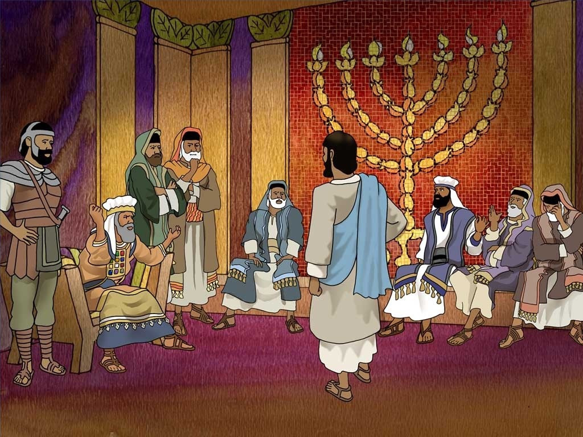
33
Pilate went back into the palace and called Jesus. “Are you the king of the Jews?” he asked him.

Slide 7
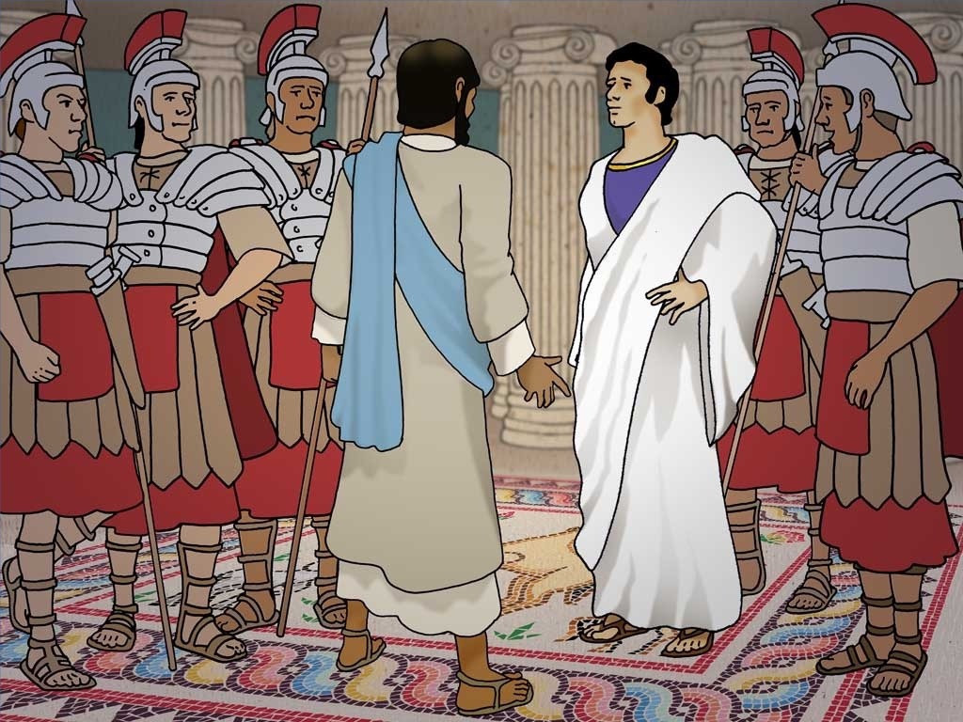
34
Jesus answered, “Does this question come from you or have others told you about me?”

Slide 8
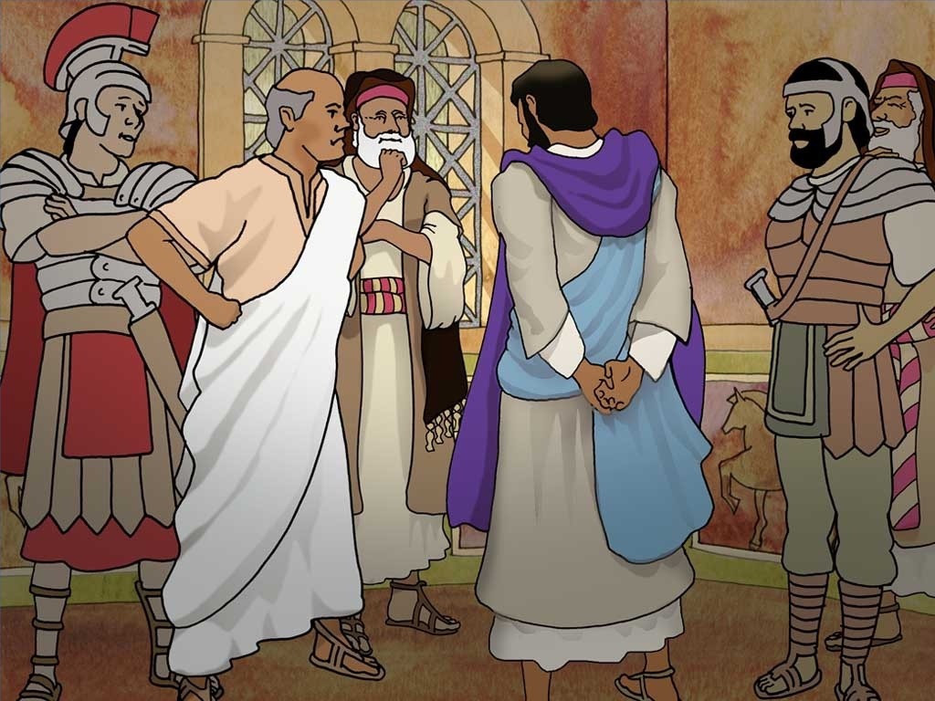
35
Pilate replied, “Do you think I am a Jew? It was your own people and the chief priests who handed you over to me. What have you done?”

Slide 9
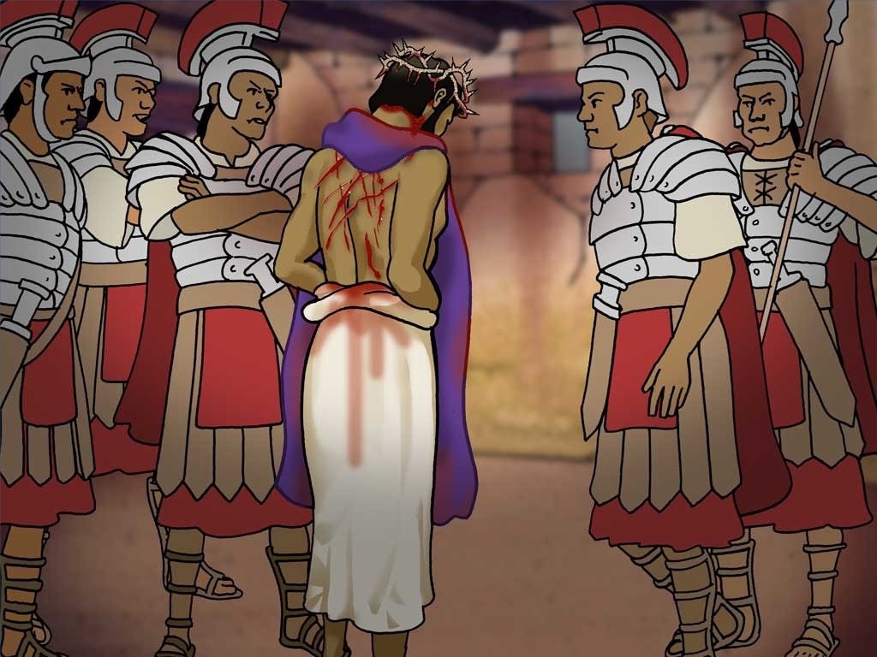
36
Jesus said, “My kingdom does not belong to this world; if my kingdom belonged to this world, my followers would fight to keep me from being handed over to the Jewish authorities. No, my kingdom does not belong here!”

Slide 10
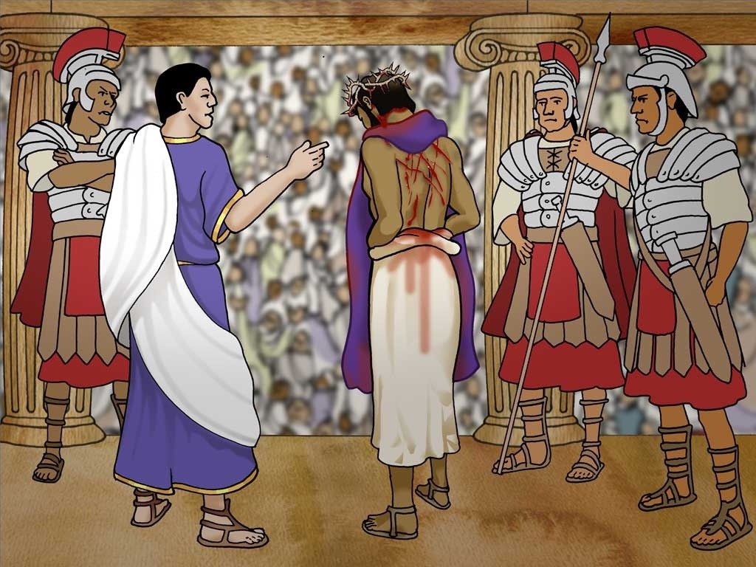
37
So, Pilate asked him, “Are you a king, then?”
Jesus answered, “You say that I am a king. I was born and came into the world for this one purpose, to speak about the truth. Whoever belongs to the truth listens to me.”

Slide 11
Leader: The Gospel of the Lord.
All: Praise to You,
Lord Jesus Christ.

Slide 12
GOSPEL MESSAGE

Slide 13
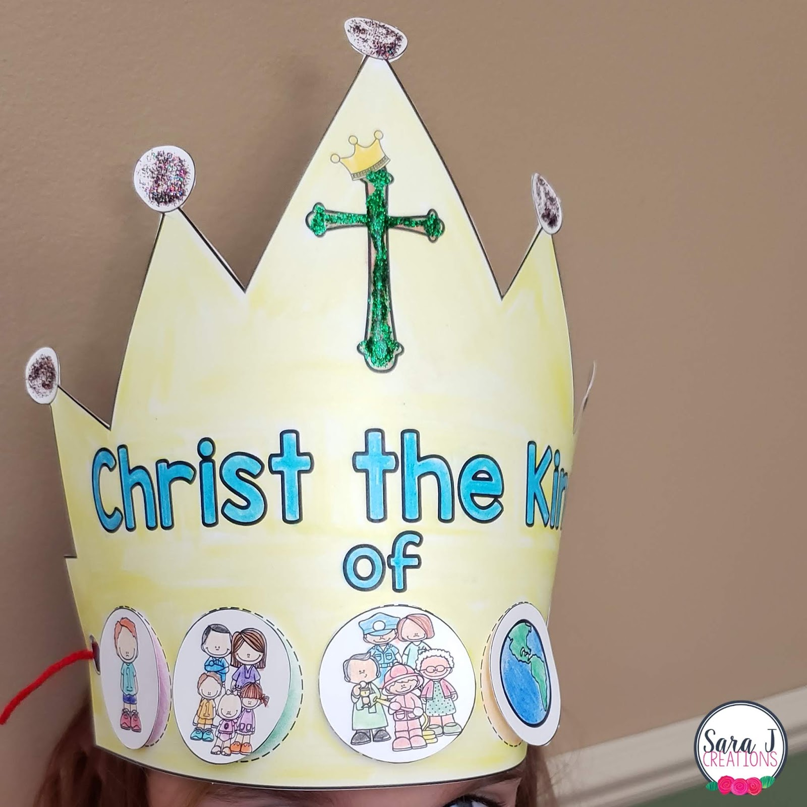
Activity: KING CROWN
Materials:
Decorative markers, crayons, or stickers
Paper or cardboard
Scissors
Stapler
Tape or glue

Slide 14
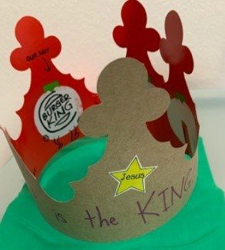
Instructions:
Decorate the paper or cardboard using markers, stickers, and other materials. Be creative!
Cut the paper or cardboard into the shape of a crown.
Write "Jesus is the King" on your crown.
Use tape, glue, or a stapler to attach the edges of the crown, adjusting it to fit the child’s head.
Place the crown on the child's head and enjoy your craft!

Slide 15
Closing Prayer
Dear Jesus, Thank You for being our loving and faithful King. You rule with truth, love, and peace, and You invite us to be part of Your kingdom. Help us to always listen to Your voice and to live in truth every day. Teach us to love others the way You love us, so we can share Your goodness with the world. We offer You our hearts, our thoughts, and our actions, so we may always honor You as our King. In Your holy name, we pray. Amen.

Slide 16
34th Sunday in Ordinary Time | November 24, 2024
CYCLE B – YEAR II

