Slide 2
33rd Sunday in Ordinary Time | November 17, 2024
CYCLE B – YEAR II

Slide 3
CONTEXT:
The passage from Mark 13:24-32, which talks about "The Lesson of the Fig Tree," is part of a larger discourse where Jesus is teaching about the signs of the end times and His second coming. This teaching is given by Jesus as He is speaking to His disciples on the Mount of Olives, overlooking the temple in Jerusalem. Jesus had just spoken about the coming destruction of the temple (which later happened in 70 AD) and the trials and tribulations that would come before the end of the world. In this passage, He uses the fig tree as a symbol of signs that can help believers recognize when the final events of God's plan are drawing near.
MESSAGE:
- The Fig Tree Lesson (Mk 13:28-29): Jesus compares the coming of the end times to the budding of a fig tree. Just as people can tell that summer is near when the fig tree begins to sprout leaves, so can we know that the coming of God's Kingdom is near when we see the signs Jesus described (wars, natural disasters, false prophets, etc.). The key idea here is that just as nature has its signs of change, the world will also have signs that tell us when the end is near.
- Certainty of His Word (Mk 13:31): Jesus reassures His disciples that His words are trustworthy and will not pass away. He promises that even though the world may change, His words will remain forever.
- The Uncertainty of the Time (Mk 13:32): While there will be signs, Jesus emphasizes that no one, not even He Himself, knows the exact time of His return. Only the Father knows. This teaches us that, while we should be watchful, we should not try to predict the exact time of Christ's return but focus on living faithfully.
LESSON:
- Be Watchful and Prepared: Just as we pay attention to the seasons and the signs in nature, we must also be spiritually alert and prepared for the return of Jesus. This means living a life of faith, love, and service, always ready for when the Lord calls us.
- Trust in God’s Timing: We may not know when Jesus will return, but we trust that God’s plan is perfect and that His timing is right. We should live our lives with this trust and not be swayed by fear or uncertainty.
- Endurance and Faithfulness: This passage encourages us to continue living faithfully, enduring trials and challenges, knowing that the fulfillment of God's promises is certain, even though we don’t know when it will happen.

Slide 4
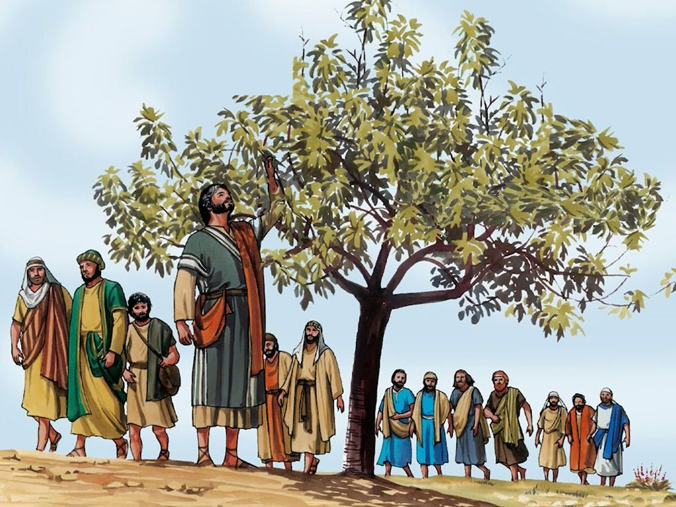
The Lesson of the Fig Tree
Mark 13:24-32

Slide 5
Leader: A reading from
the Holy Gospel
according to Mark.
All: Glory to You, Oh Lord.

Slide 6
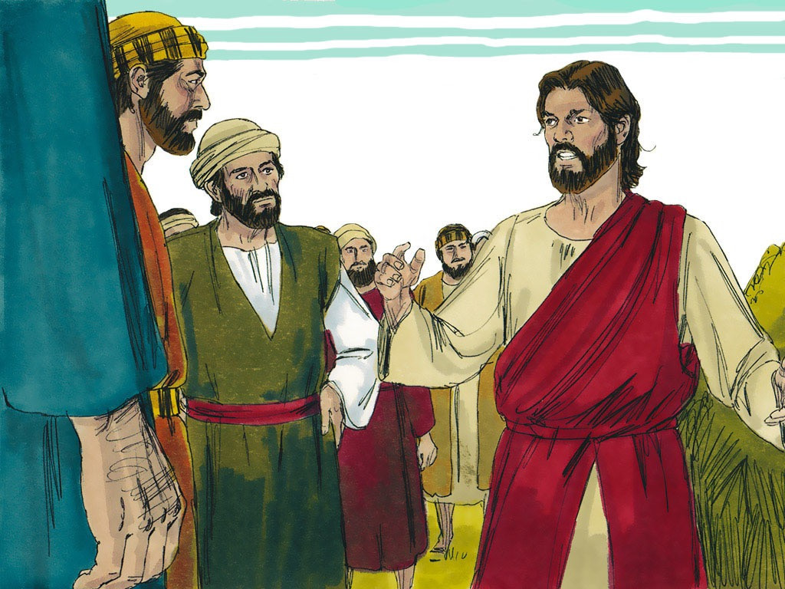
24
“In the days after that time of trouble the sun will grow dark, the moon will no longer shine,

Slide 7
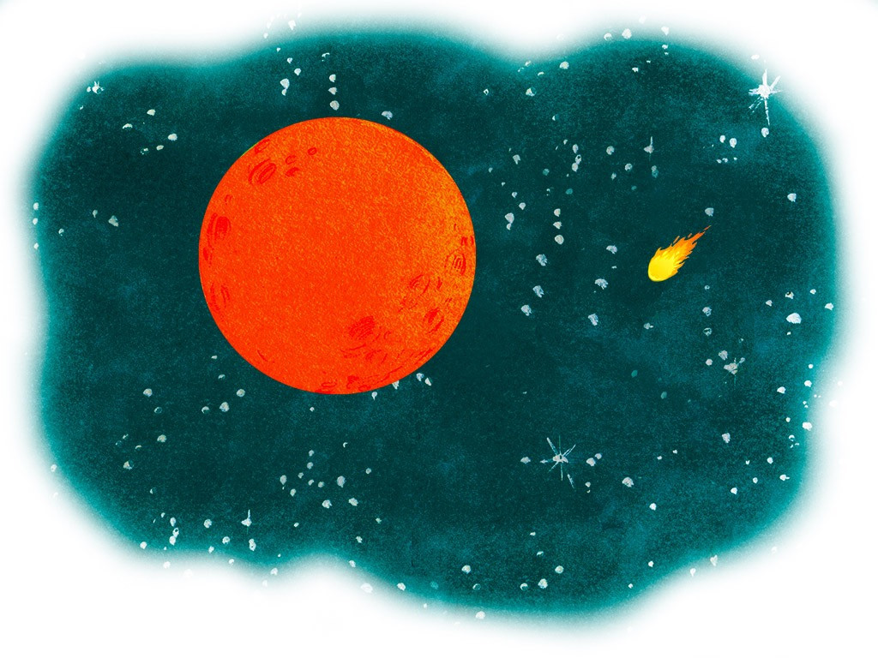
25
the stars will fall from heaven, and the powers in space will be driven from their courses.

Slide 8
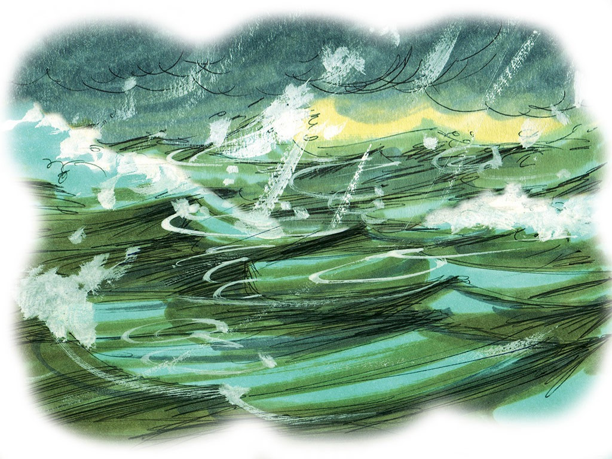
26
Then the Son of Man will appear, coming in the clouds with great power and glory.

Slide 9
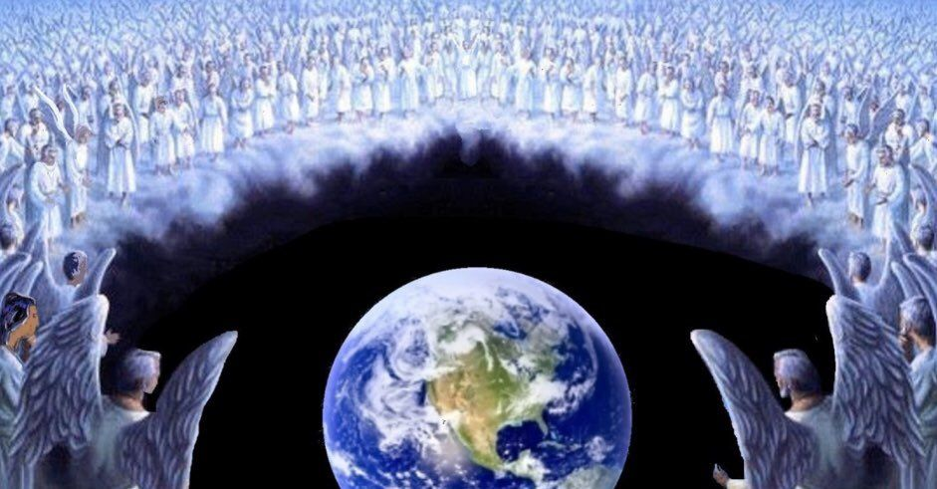
27
He will send the angels out to the four corners of the earth to gather God's chosen people from one end of the world to the other.

Slide 10
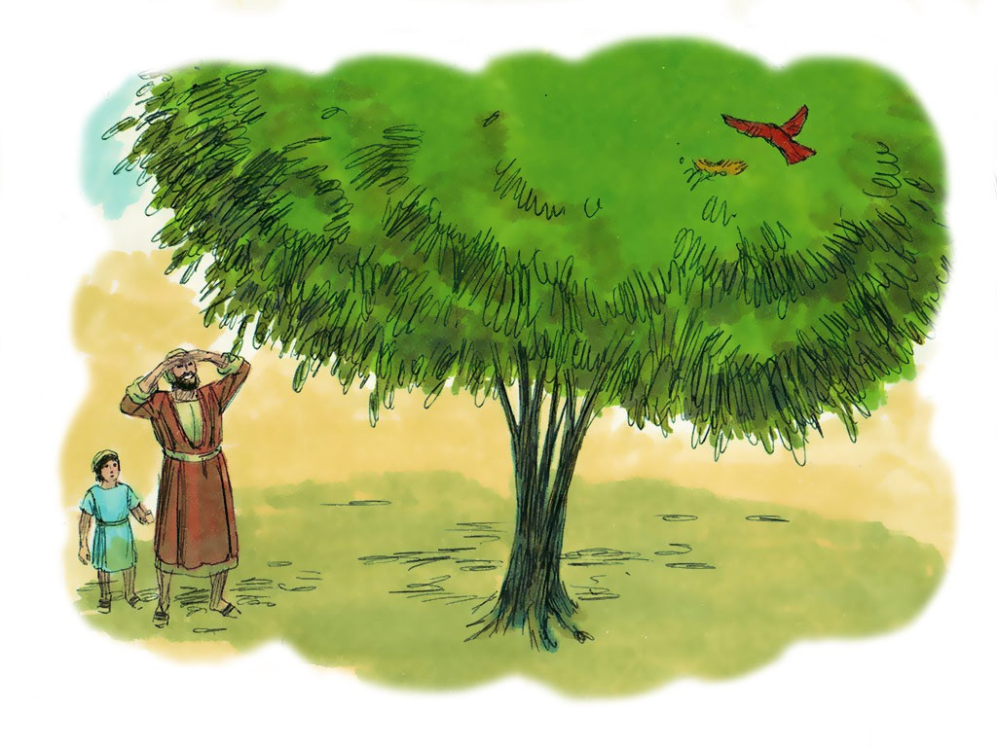
28
“Let the fig tree teach you a lesson. When its branches become green and tender and it starts putting out leaves, you know that summer is near.

Slide 11
29
In the same way, when you see these things happening, you will know that the time is near, ready to begin.

Slide 12
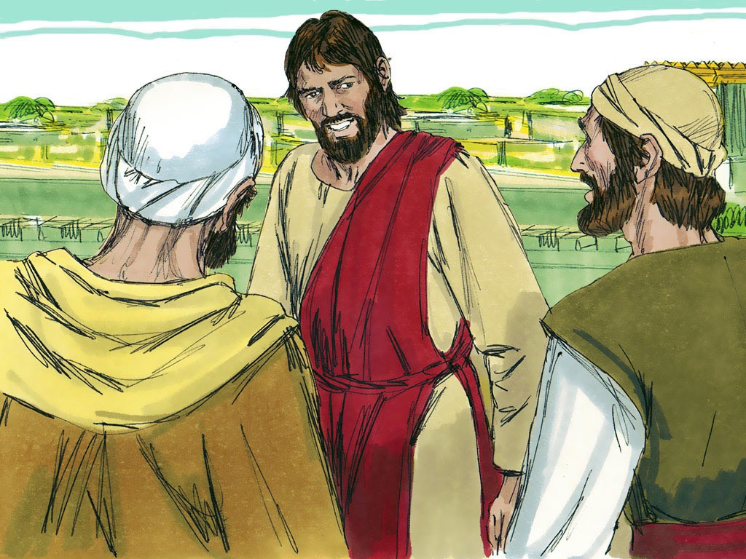
30
Remember that all these things will happen before the people now living have all died.

Slide 13
31
Heaven and earth will pass away, but my words will never pass away.

Slide 14
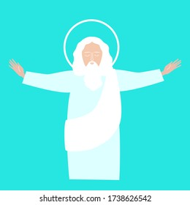
32
“No one knows, however, when that day or hour will come—neither the angels in heaven, nor the Son; only the Father knows.

Slide 15
Leader: The Gospel of the Lord.
All: Praise to You,
Lord Jesus Christ.

Slide 16
GOSPEL MESSAGE

Slide 17
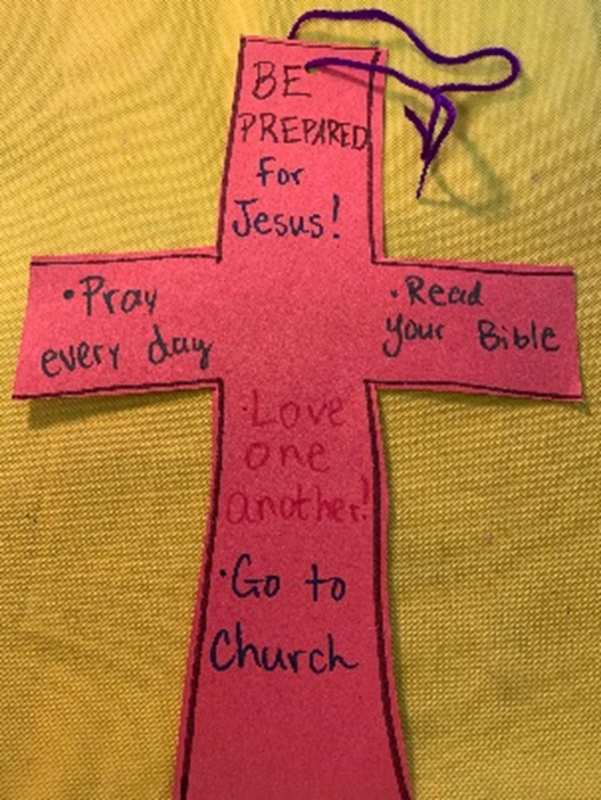
Activity: BE READY!
Materials:
- Colored paper
- Markers or crayons
- String or yarn
- Scissors
- Hole punch

Slide 18
Instructions:
1. Decorate the paper by drawing a cross shape as the base.
2. Write notes or verses about ways to be prepared for Christ, and feel free to add extra decorations if you’d like. (See the sample picture for ideas.)
3. Cut out the cross shape.
4. Punch a hole at the top and add a string or ribbon so it can be hung as a decoration.

Slide 19
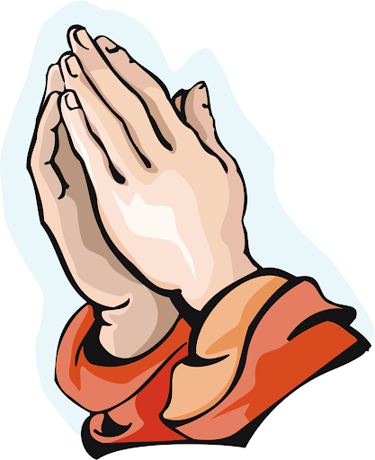
Closing Prayer
Dear Jesus, Thank You for gathering us today and for teaching us about Your promises and the signs of Your coming. Help us to always be watchful, ready, and full of hope, trusting in Your perfect timing. May we live each day with faith, love, and kindness, so that when You return, You will find us faithful. We trust in Your word and Your plan for our lives. Keep us close to You, now and always. In Your name, we pray. Amen.

Slide 20
33rd Sunday in Ordinary Time | November 17, 2024
CYCLE B – YEAR II

