Slide 2
Sixth Sunday of Easter | May 5, 2024
CYCLE B – YEAR II

Slide 3
UNDERSTANDING THE GOSPEL (for facilitators only)
Today the Church celebrates the Feast of the Epiphany. On Epiphany we recognize that Jesus, the light of the world, was made visible to the magi who searched for him. On today’s feast we celebrate that God’s saving love is offered to all people.
Today's gospel relates the story of the Three Kings. The word used in Matthew 2:1 ("Magi") referred to Persian priest-astrologers who saw the divine will written in the stars of the night skies. Through their studies, they believed someone great was born. So, they searched for someone new, someone who would enlighten a dark world. Matthew used the story of the traveling stargazers to present a theme. Even the infant Jesus was a light to all people, just not his own.
These wise men from the east find the Christ child by following the light of a star. These magi are foreigners, travelers from a different country. They are Gentiles who have never learned about the Law or the prophets. However, they find their way to Jesus and honor him. The wise men follow a star, which leads them to Jesus Christ, the light of salvation.

Slide 4
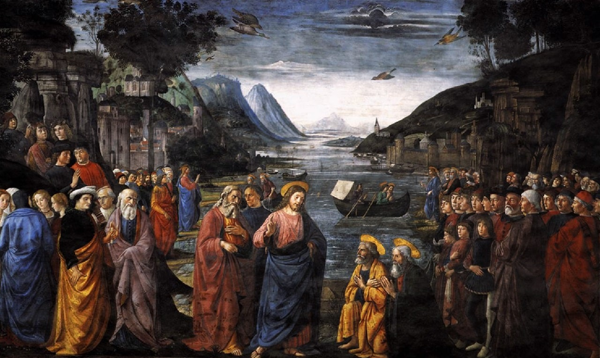
Love one another
John 15:9-17

Slide 5
Leader: A reading from
the Holy Gospel
according to John.
All: Glory to You, Oh Lord.

Slide 6
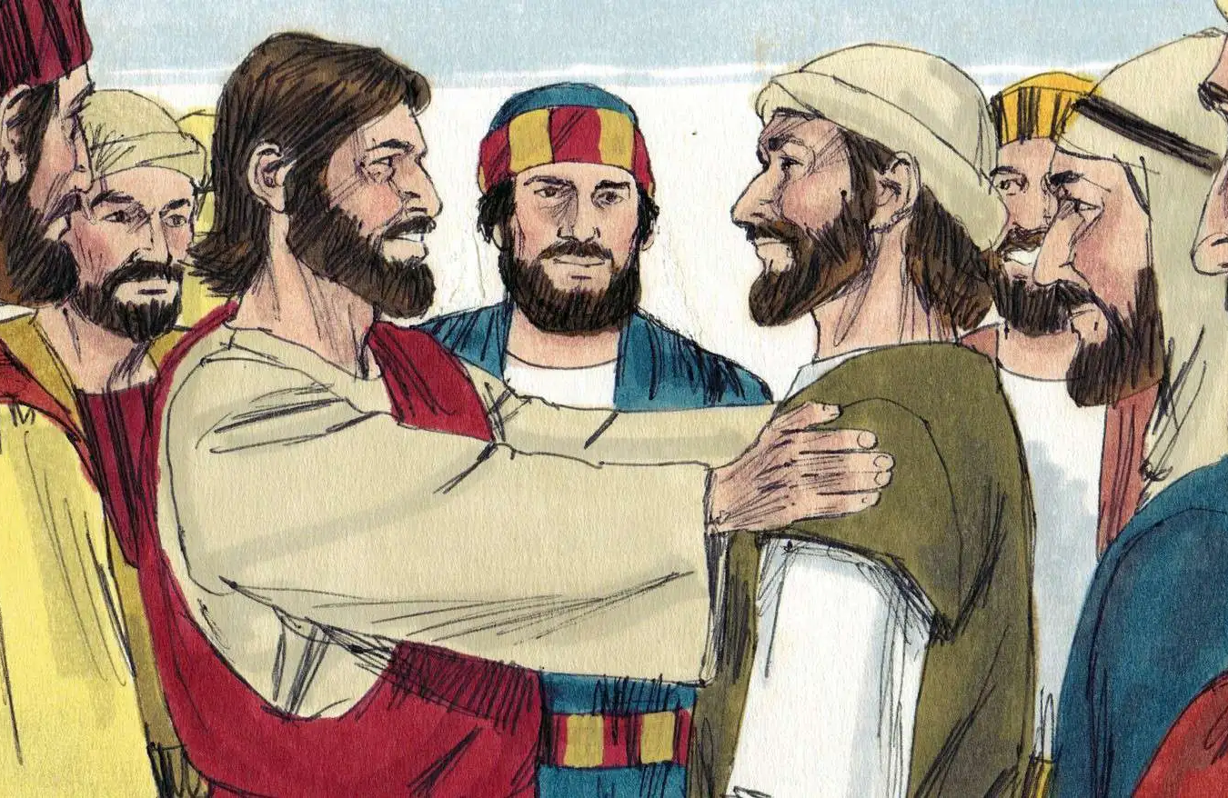
9
I love you just as the Father loves me; remain in my love.

Slide 7
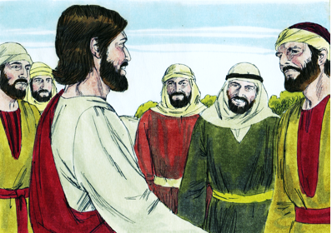
10
If you obey my commands, you will remain in my love, just as I have obeyed my Father's commands and remain in his love.

Slide 8
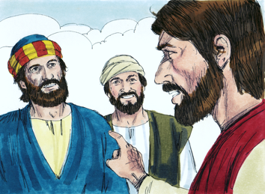
11
“I have told you this so that my joy may be in you and that your joy may be complete.

Slide 9
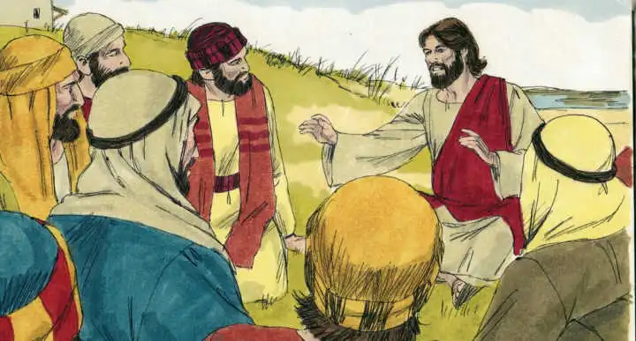
12
My commandment is this: love one another, just as I love you.

Slide 10
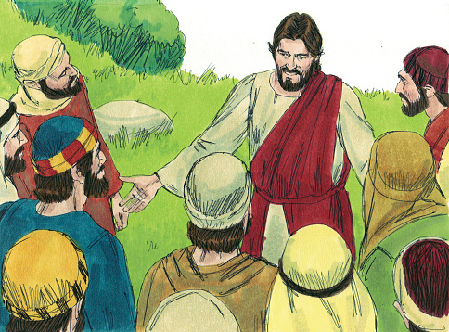
13
The greatest love you can have for your friends is to give your life for them.

Slide 11
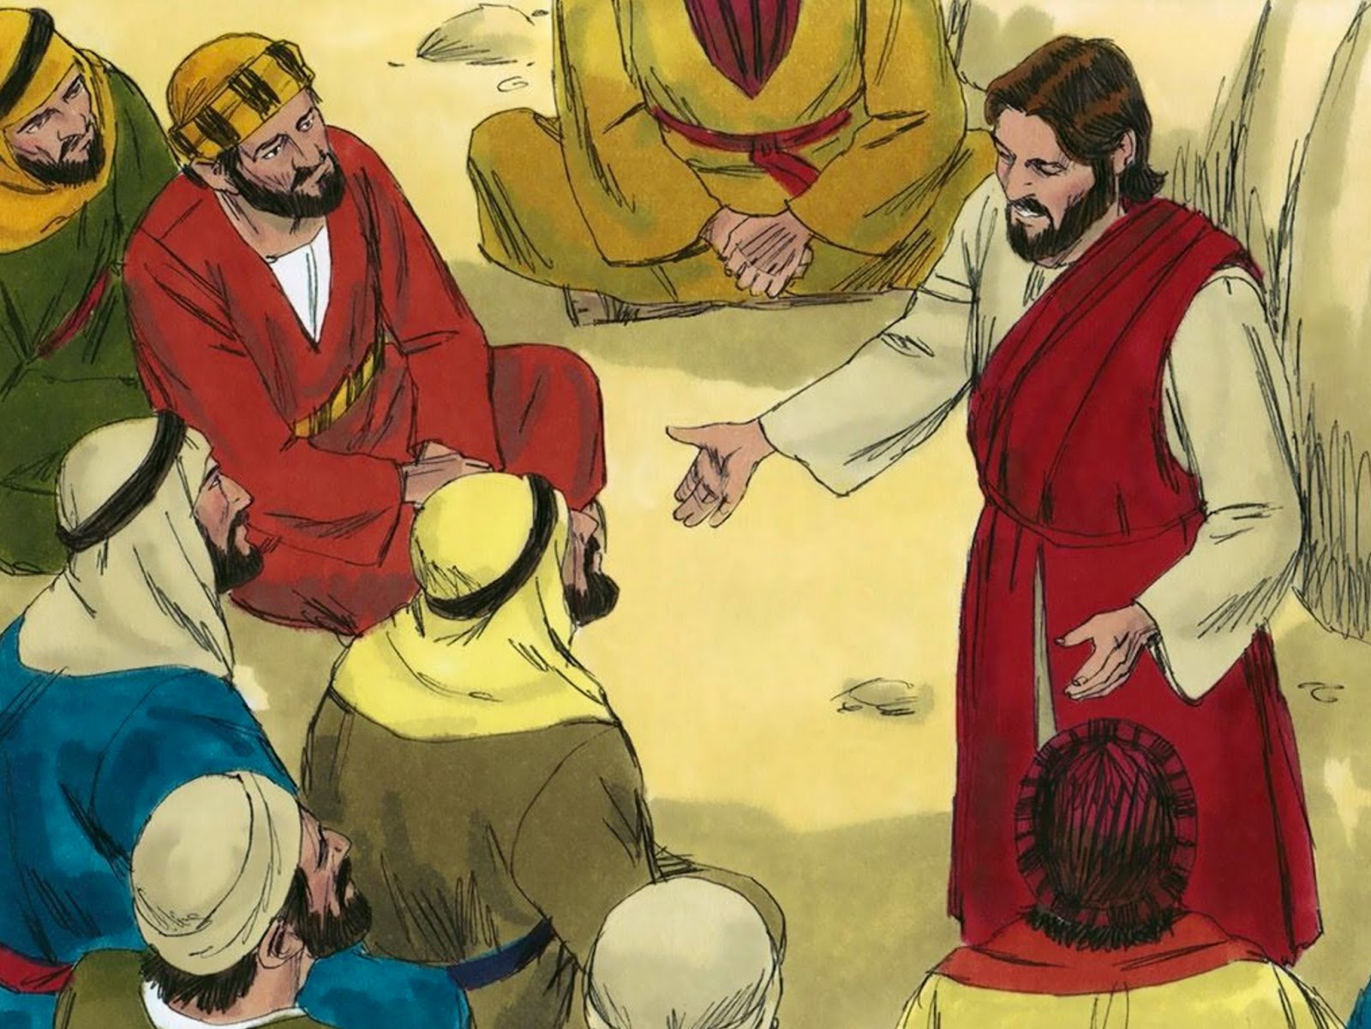
14
And you are my friends if you do what I command you.

Slide 12
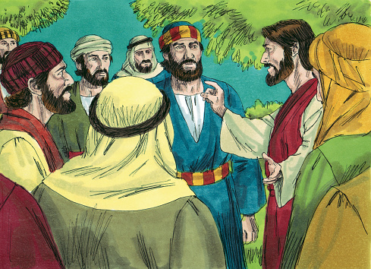
15
I do not call you servants any longer, because servants do not know what their master is doing. Instead, I call you friends, because I have told you everything I heard from my Father.

Slide 13
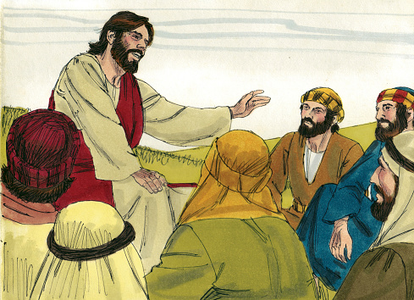
16
You did not choose me; I chose you and appointed you to go and bear much fruit, the kind of fruit that endures. And so the Father will give you whatever you ask of him in my name.

Slide 14
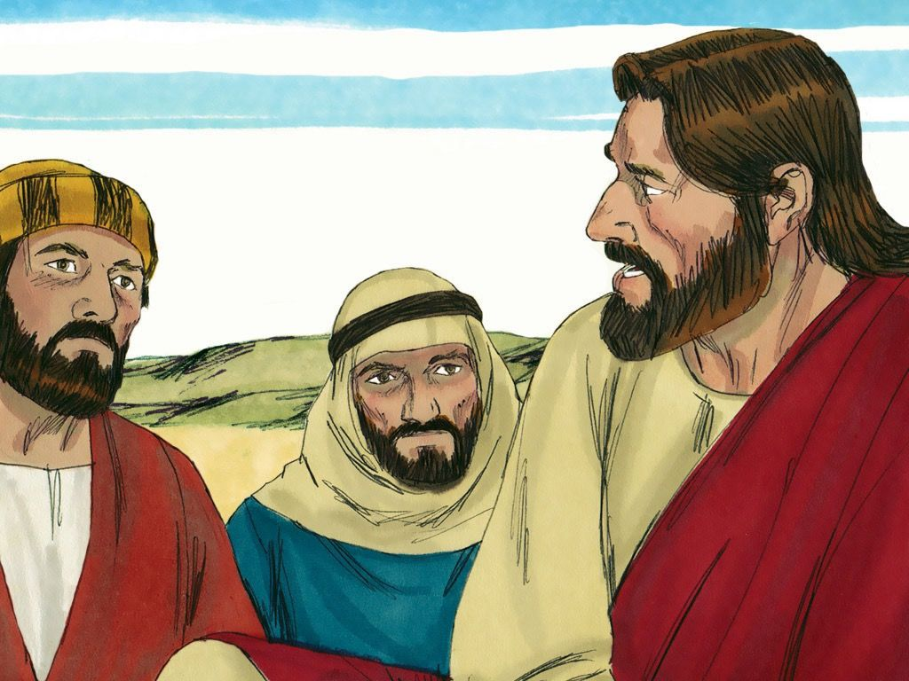
17
This, then, is what I command you: love one another.

Slide 15
Leader: The Gospel of the Lord.
All: Praise to You,
Lord Jesus Christ.

Slide 16
GOSPEL MESSAGE

Slide 17
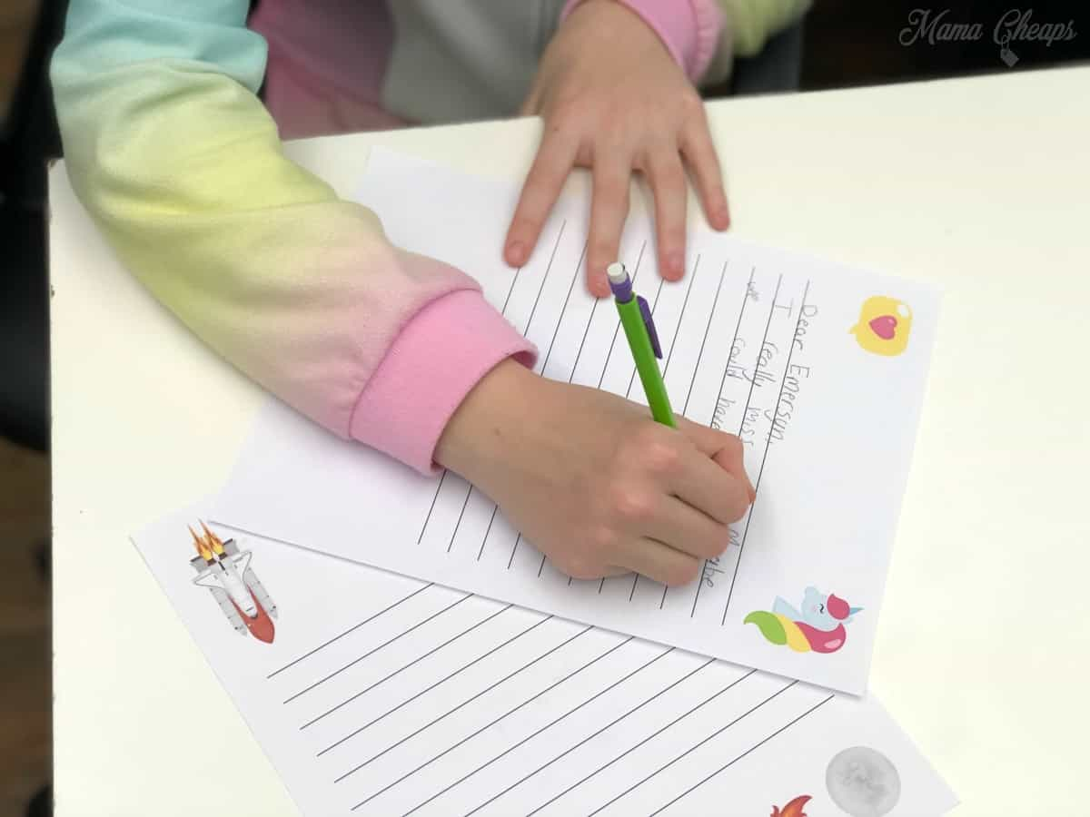
Activity: Friendship Letter
Materials:
Colored Paper:
Coloring Materials
Pen/Marker
Stickers
Reference: Last minute White Paper Friendship Day Card | DIY Friendship day card | Easy Friendship Day Card (youtube.com)

Slide 18
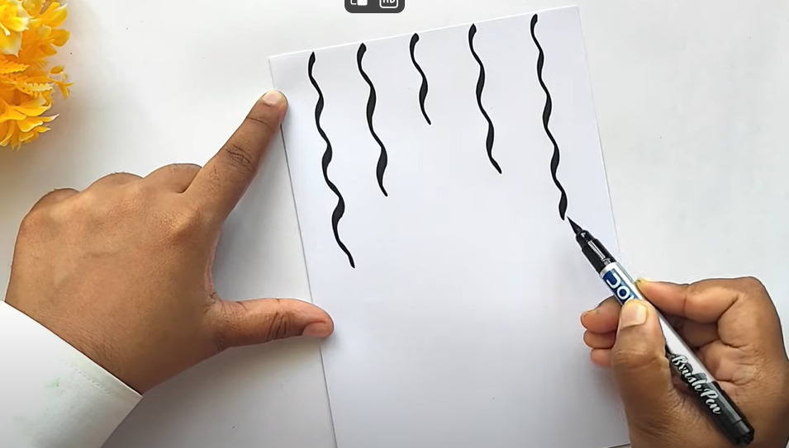
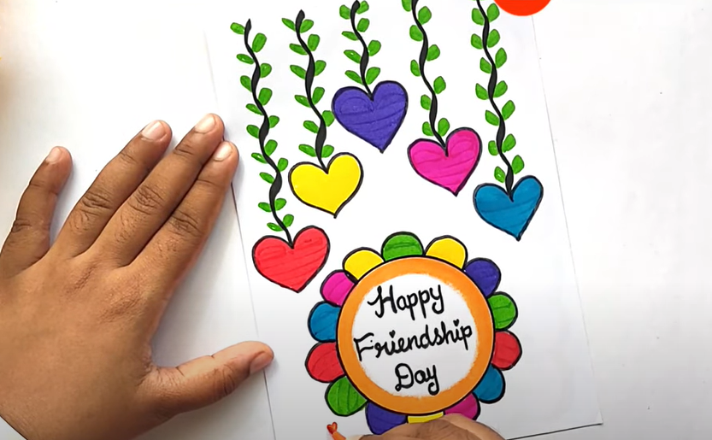
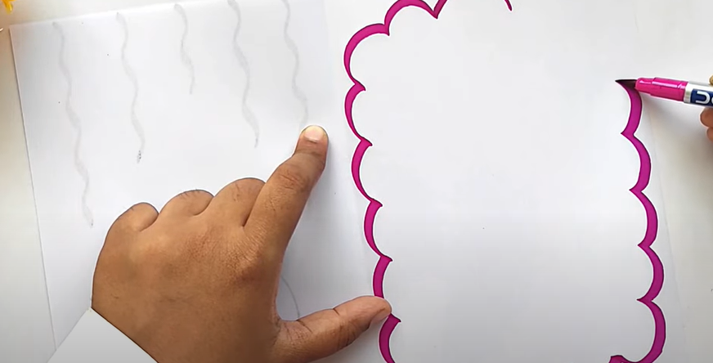
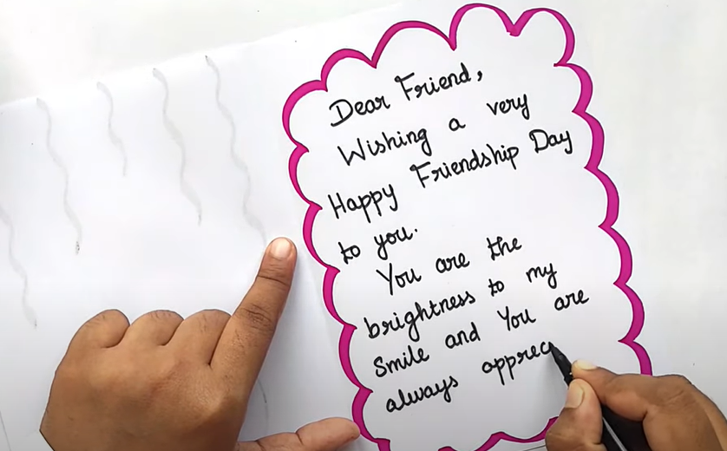
Instructions:
Prepare your materials.
Fold your colored paper into half. Add designs using your stickers and coloring materials both on the Cover page and inner page of your letter.
Write your message to your friend.
Send/give this activity to your friend as a way af appreciating them.

Slide 19
Closing Prayer
Dear God,
Thank you for the gift of friendship. Thank you for the laughter, comfort, strength, encouragement, unity, forgiveness, grace, celebration, and joy we share with one another. Lord, watch over me and my friends and lead us onto hope and blessings, Amen.
In Jesus' name we pray.
Amen.

Slide 20
Sixth Sunday of Easter | May 5, 2024
CYCLE B – YEAR II

