Slide 2
Pentecost Sunday | May 19, 2024
CYCLE B – YEAR II

Slide 3
UNDERSTANDING THE GOSPEL (for facilitators only)
kjdnfjkn vk nsdv

Slide 4
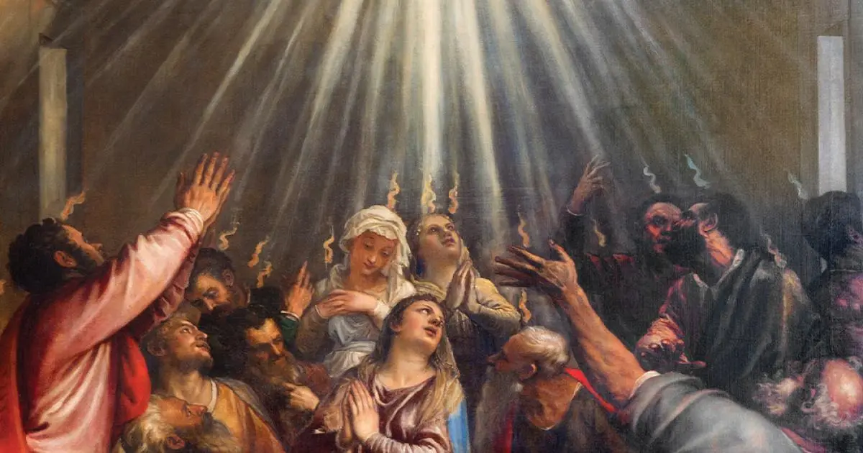
The Pentecost
John 7:37-39

Slide 5
Leader: A reading from
the Holy Gospel
according to John.
All: Glory to You, Oh Lord.

Slide 6
37
On the last and most important day of the festival Jesus stood up and said in a loud voice, “Whoever is thirsty should come to me, and

Slide 7
38
whoever believes in me should drink. As the scripture says, ‘Streams of life-giving water will pour out from his side.”

Slide 8
39
Jesus said this about the Spirit, which those who believed in him were going to receive. At that time the Spirit had not yet been given, because Jesus had not been raised to glory.

Slide 9
Leader: The Gospel of the Lord.
All: Praise to You,
Lord Jesus Christ.

Slide 10
GOSPEL MESSAGE

Slide 11
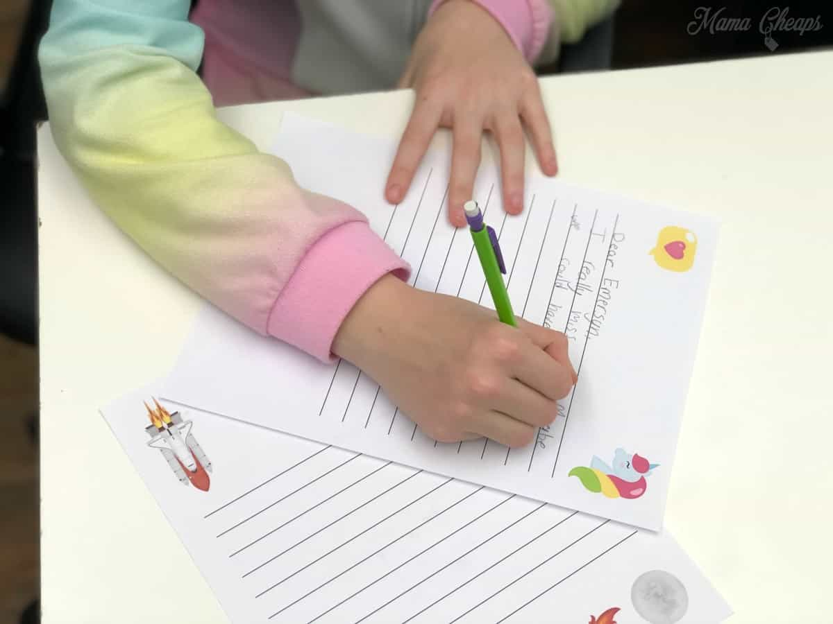
Activity: Friendship Letter
Materials:
Colored Paper:
Coloring Materials
Pen/Marker
Stickers
Reference: Last minute White Paper Friendship Day Card | DIY Friendship day card | Easy Friendship Day Card (youtube.com)

Slide 12
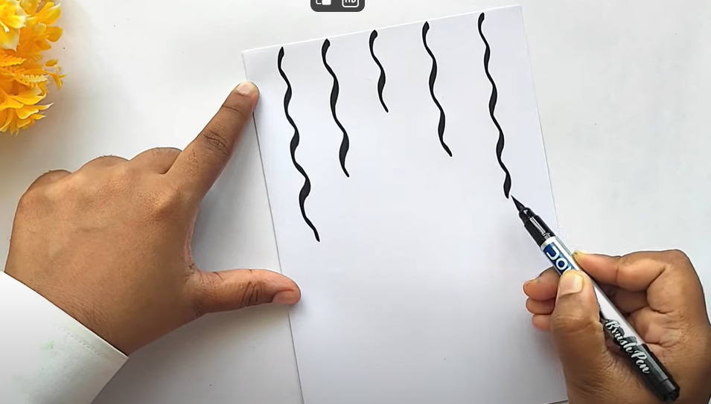
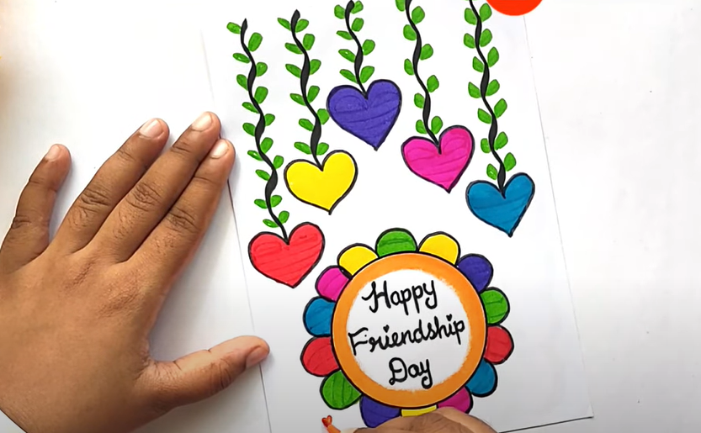
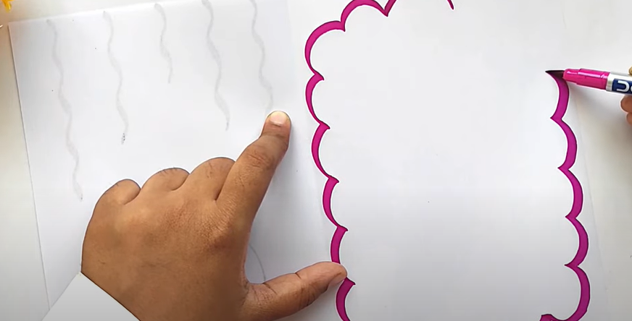
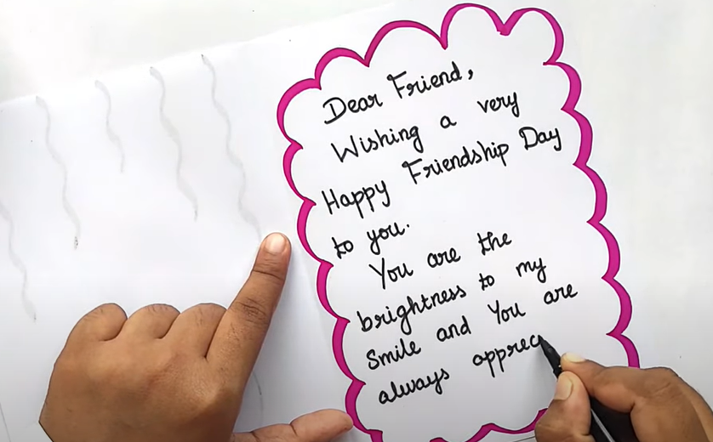
Instructions:
Prepare your materials.
Fold your colored paper into half. Add designs using your stickers and coloring materials both on the Cover page and inner page of your letter.
Write your message to your friend.
Send/give this activity to your friend as a way af appreciating them.

Slide 13
Closing Prayer
Dear God,
Thank you for the gift of friendship. Thank you for the laughter, comfort, strength, encouragement, unity, forgiveness, grace, celebration, and joy we share with one another. Lord, watch over me and my friends and lead us onto hope and blessings, Amen.
In Jesus' name we pray.
Amen.

Slide 14
Sixth Sunday of Easter | May 5, 2024
CYCLE B – YEAR II

