Slide 2
Solemnity of the Ascension of the Lord | May 12, 2024
CYCLE B – YEAR II

Slide 3
UNDERSTANDING THE GOSPEL (for facilitators only)
For today’s gospel, we have witnessed how Jesus was ascended to heaven and fetched by the angels. What makes this event more interesting is about how Jesus enlighten each of His followers to their entrusted task, to share the gospel throughout the nations that they will visit, to share the word of the Lord throughout the whole world. Also, they have been reminded what are the rewards that they can have as long as they have followed His ways and wills.
This promise makes us, His followers, eager to do this things excellently because we all know that He will not let us down nor leave us. He is true to His promise yesterday, today, and forever.
Apart from the rewards that we can receive, we must believe and continuously believing to our Lord Jesus because He has shown us How mighty is He through His life, deat, resurrection and ascension.

Slide 4
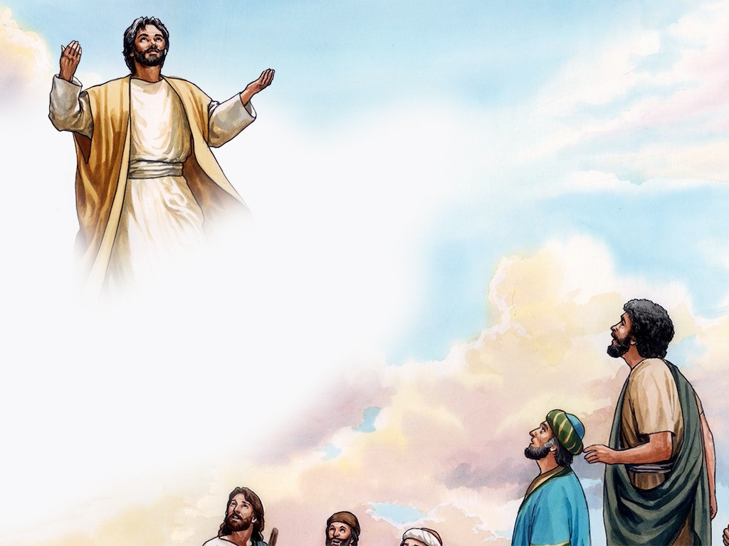
The Ascension of the Lord
Mark 16: 15 - 20

Slide 5
Leader: A reading from
the Holy Gospel
according to Mark.
All: Glory to You, Oh Lord.

Slide 6
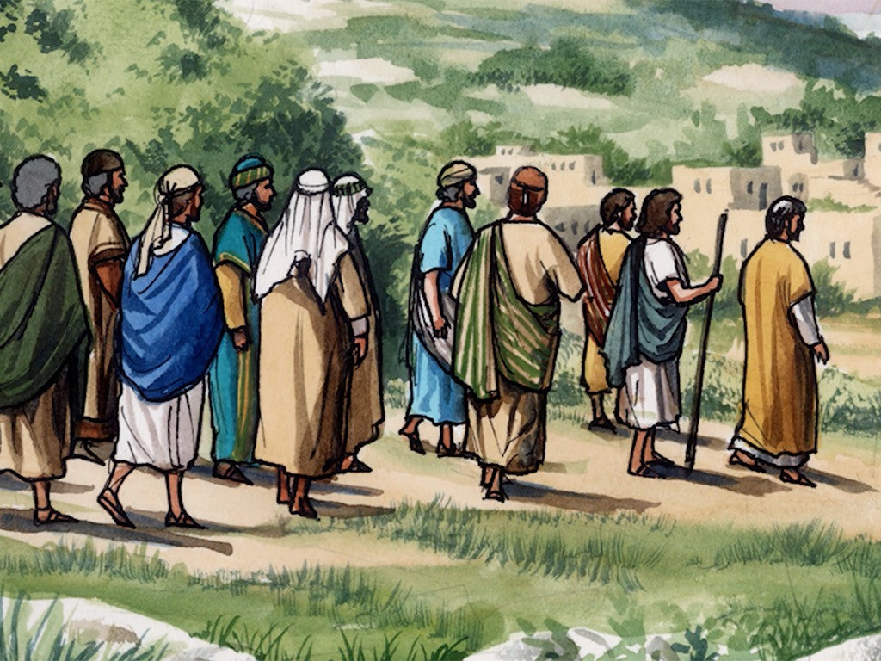
15
He said to them, “Go throughout the whole world and preach the gospel to all people.

Slide 7
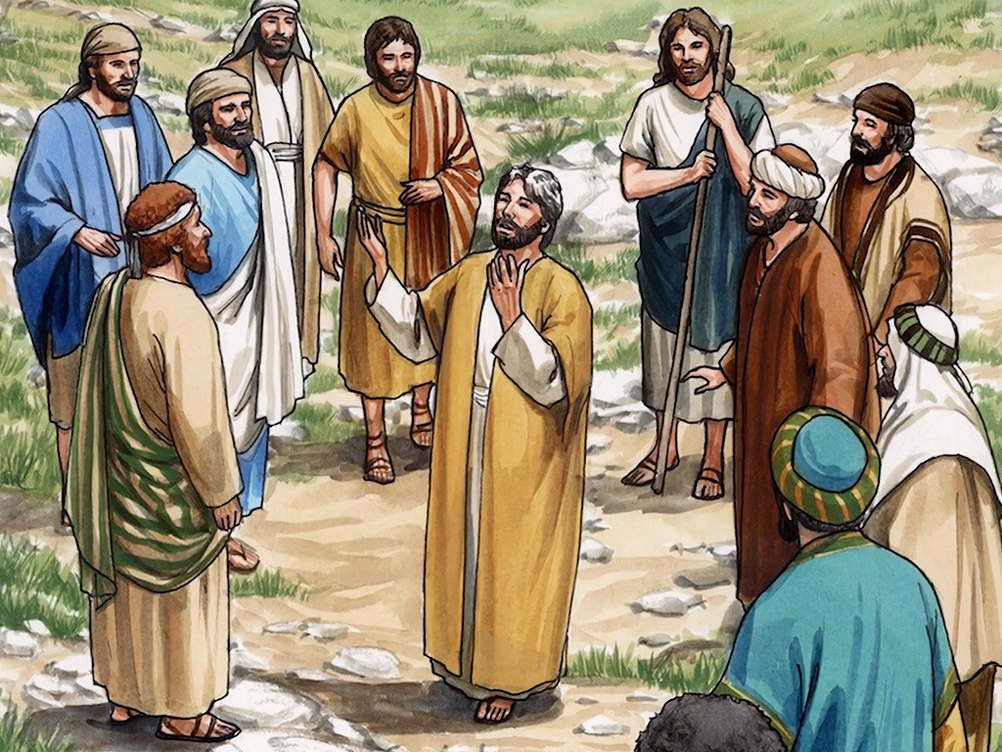
16
Whoever believes and is baptized will be saved; whoever does not believe will be condemned.

Slide 8
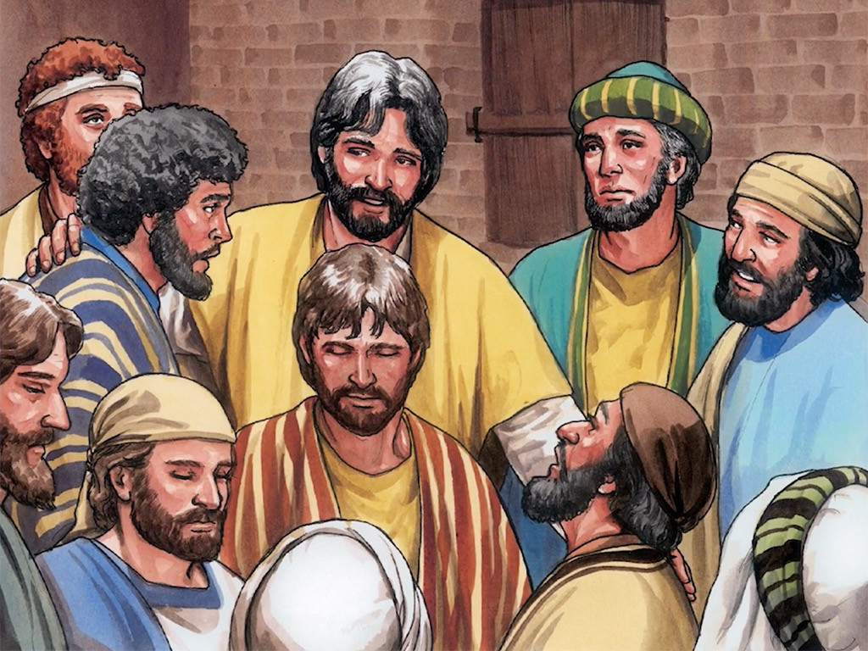
17
Believers will be given the power to perform miracles: they will drive out demons in my name; they will speak in strange tongues;

Slide 9
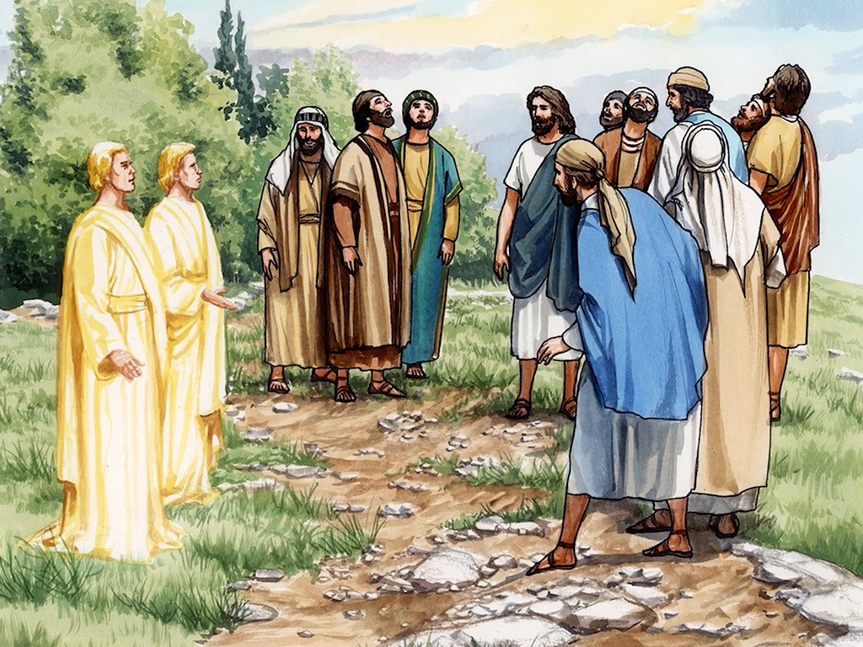
18
if they pick up snakes or drink any poison, they will not be harmed; they will place their hands on sick people, and these will get well.”

Slide 10
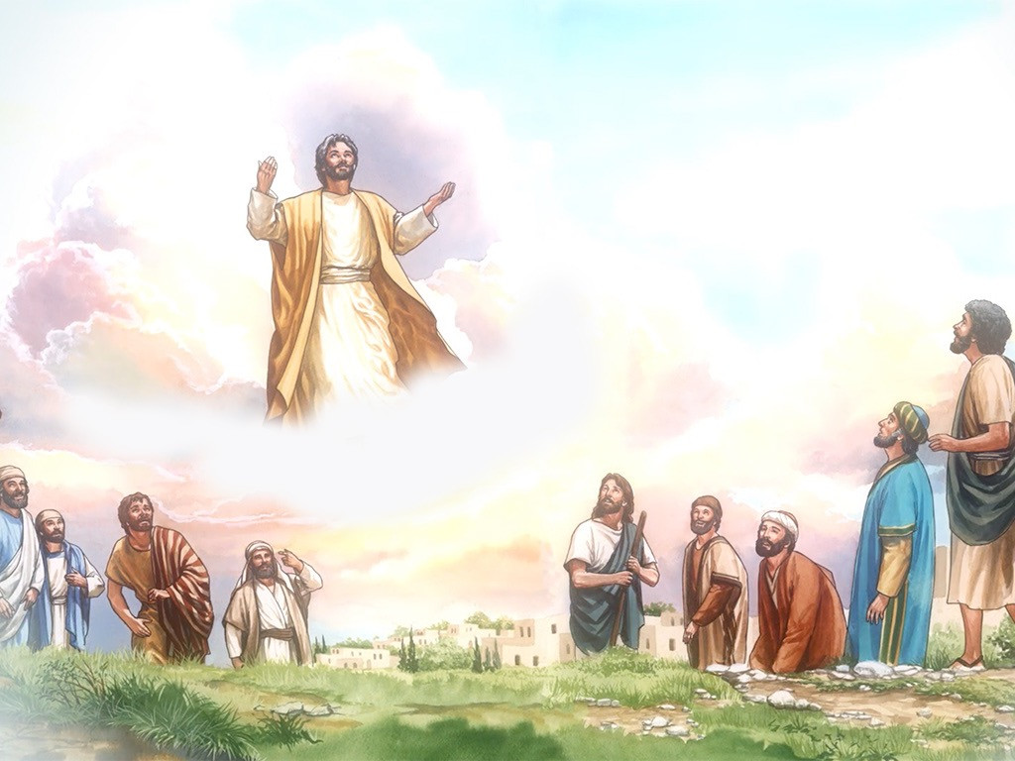
19
After the Lord Jesus had talked with them, he was taken up to heaven and sat at the right side of God.

Slide 11
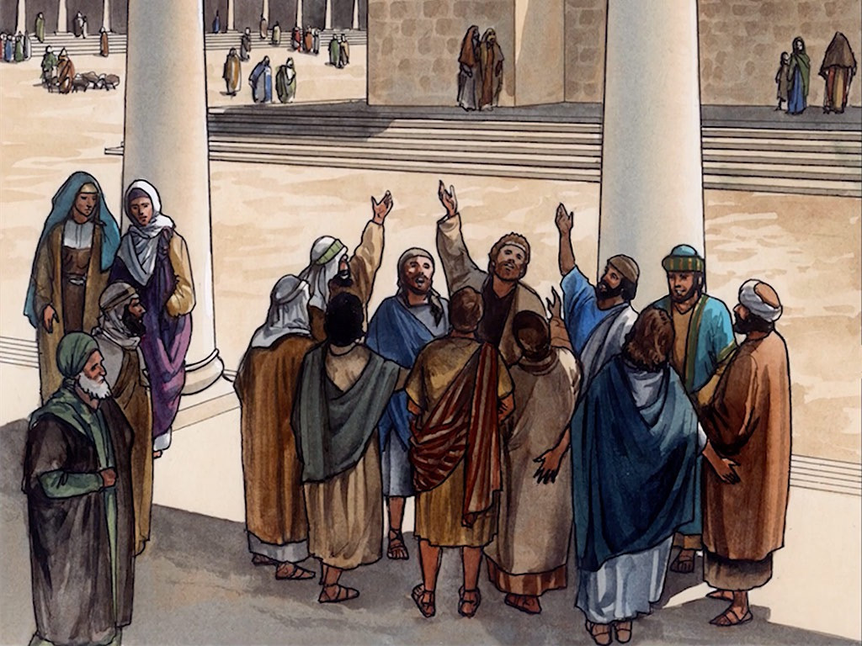
20
The disciples went and preached everywhere, and the Lord worked with them and proved that their preaching was true by the miracles that were performed.

Slide 12
Leader: The Gospel of the Lord.
All: Praise to You,
Lord Jesus Christ.

Slide 13
GOSPEL MESSAGE

Slide 14
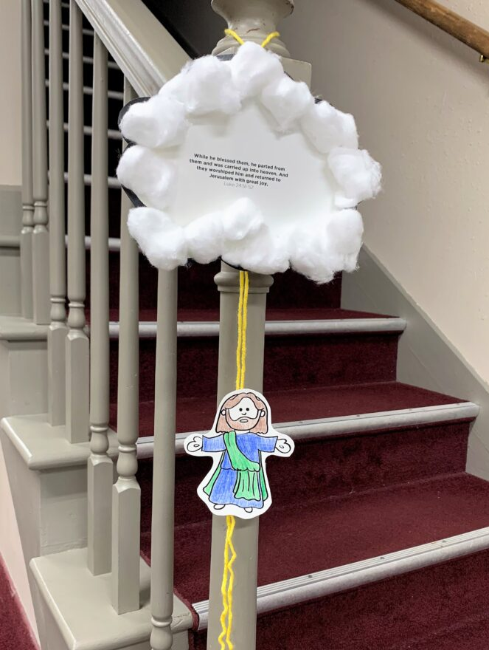
Activity: Jesus ascends to Heaven
Materials:
Yarn
Tape
Coloring materials
Scissors
Optional: Cotton and glue
Printed or Drawn image of Jesus
Reference: Kids Lesson: The Ascension - Summitview Church

Slide 15
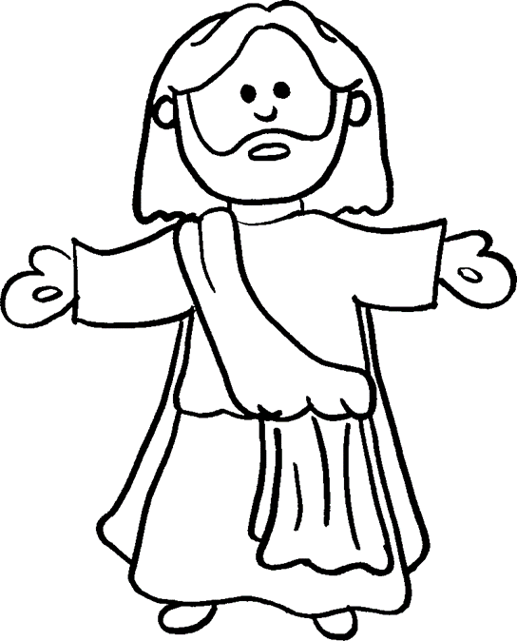
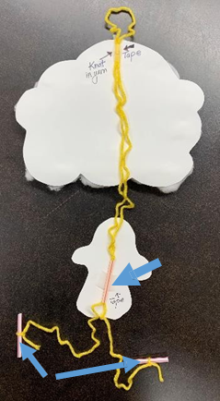
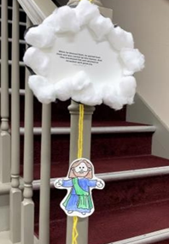
DIRECTIONS:
1. Using your white bond paper, draw and cut out the cloud. Write down Mark 16:19 verse:
“After the Lord Jesus had talked with them, he was taken up to heaven and sat at the right side of God.”
2. If you have a printed image of Jesus, color it and then cut it out. If none, draw and create an image of Jesus.
3. Cut a piece of yarn/string at 10-12 inches long.
4. Tape the bottom of the yarn to Jesus’ back and loop the top of the yarn for hanging purposes and the other higher partition of the yarn to the back of the cloud.
5. Optional: Glue cotton balls onto the cloud leaving the statement: uncovered so it can be referenced and hopefully memorized! (If you do this step, it is best to do it last!)

Slide 16
Closing Prayer
Dear God,
Thank you for sending Your Son Jesus to save us from all of our sins. Lord Jesus, thank You for entrusting us the responsibility to share the good messages of the gospel. Oh Holy Spirit, be with us as we become the sharers of the word of the Lord throughout the whole world, Amen.
In Jesus' name we pray.
Amen.

Slide 17
Solemnity of the Ascension of the Lord | May 12, 2024
CYCLE B – YEAR II

