Slide 2
Sixth Sunday of Easter | May 5, 2024
CYCLE B – YEAR II

Slide 3
UNDERSTANDING THE GOSPEL (for facilitators only)
Jesus reminded us how he loves us all and all of this love is patterned through God’s love for Him. And we are all lucky to be loved by Him as it is anchored to God’s love, a love that is unselfish, revealing, caring, and never-ending. We are all called to “remain” in God’s love. To remain in God’s love is to follow his commandments and will. Our Lord reminds us also to be obedient through God’s love where it becomes our source of true happiness, a great joy. The pathway to joy and happiness is through obedience.
Also, in this gospel Jesus wants us to practice platonic love. A love that is shown to your friends, and this should be patterned to God’s love also and sacrificial love. Love for our brothers and sisters in Christ may mean a lot of things. These may result to our lives in a positive or negative way but may we always allow to love behind these reasons. A love that extends forgiveness to those who have wronged us. Amen

Slide 4
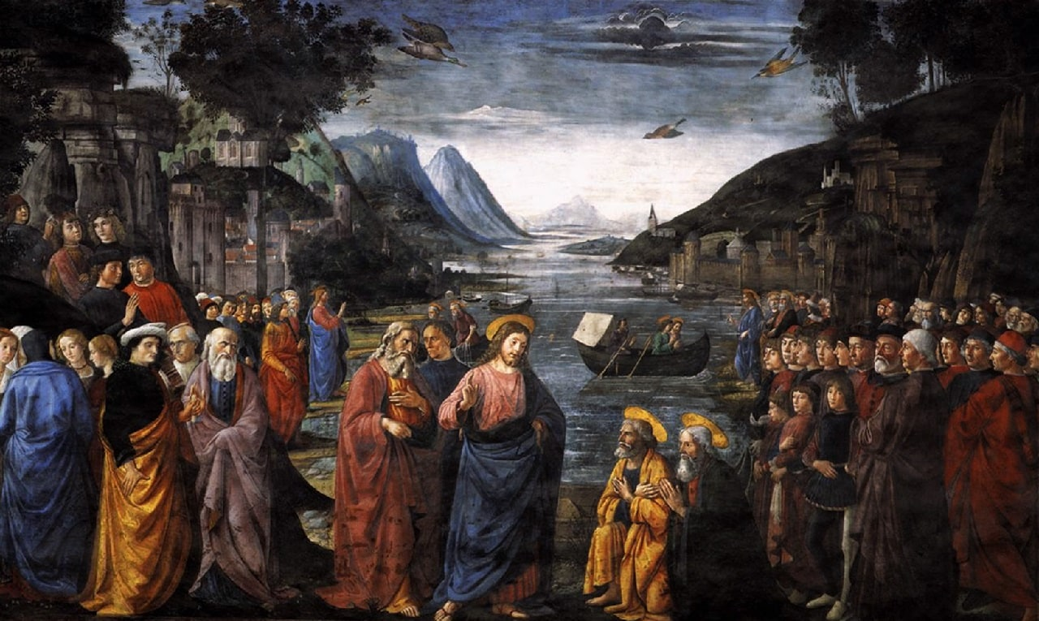
Love one another
John 15:9-17

Slide 5
Leader: A reading from
the Holy Gospel
according to John.
All: Glory to You, Oh Lord.

Slide 6
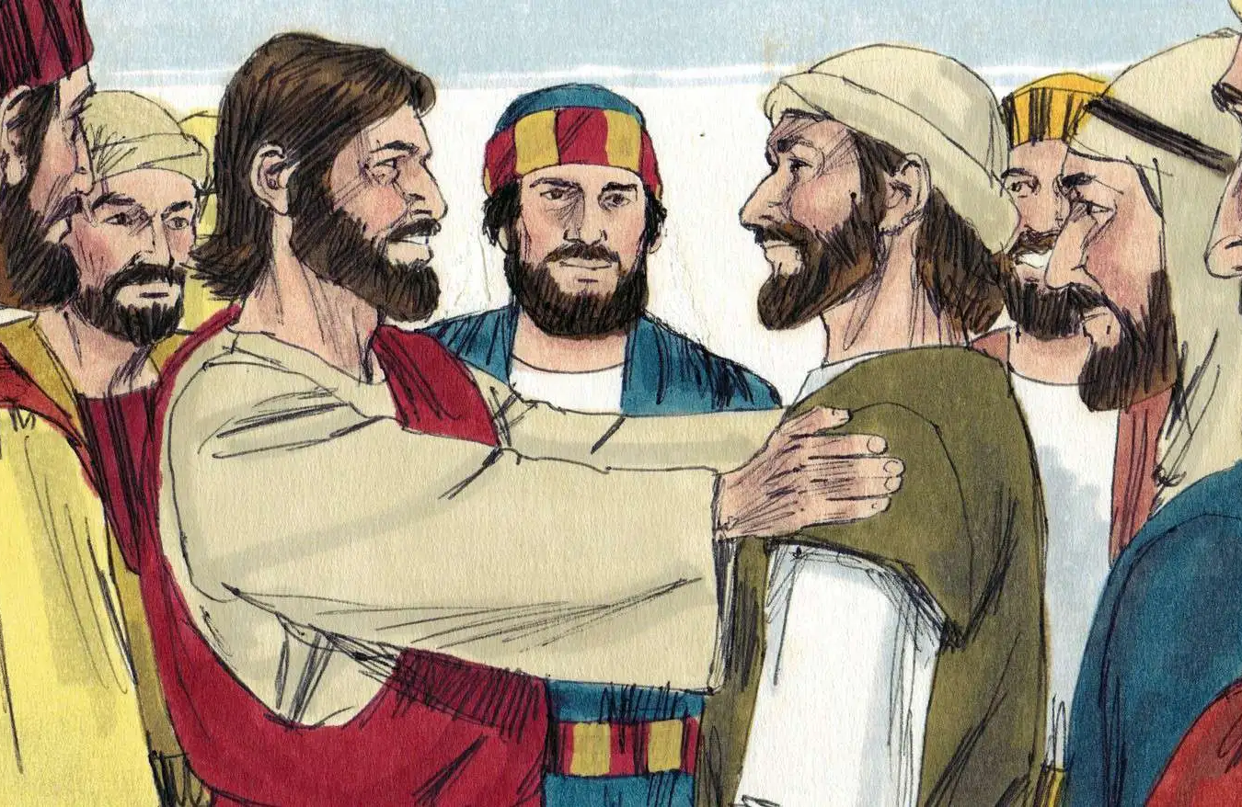
9
I love you just as the Father loves me; remain in my love.

Slide 7
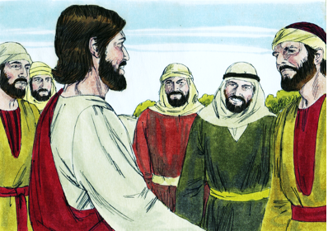
10
If you obey my commands, you will remain in my love, just as I have obeyed my Father's commands and remain in his love.

Slide 8
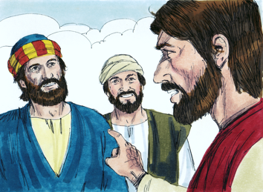
11
“I have told you this so that my joy may be in you and that your joy may be complete.

Slide 9
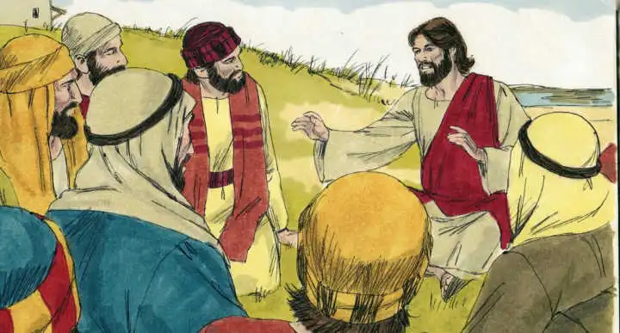
12
My commandment is this: love one another, just as I love you.

Slide 10
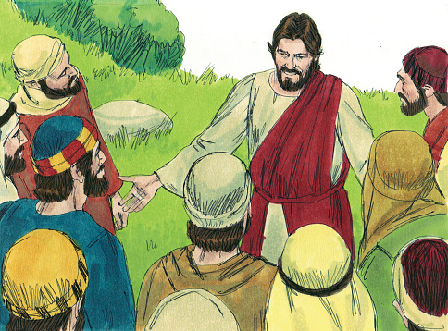
13
The greatest love you can have for your friends is to give your life for them.

Slide 11
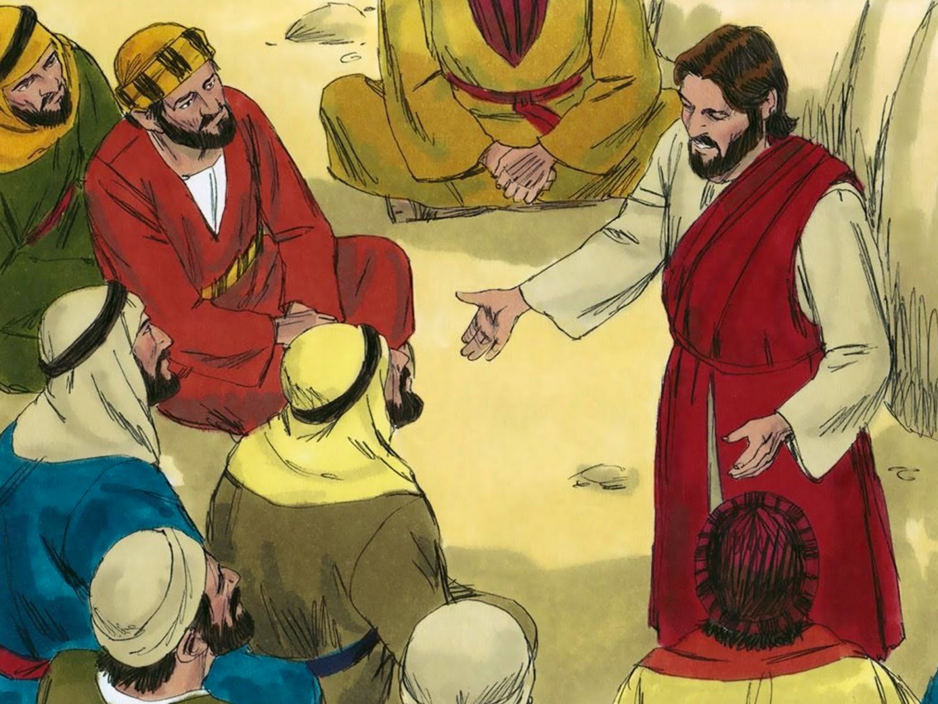
14
And you are my friends if you do what I command you.

Slide 12
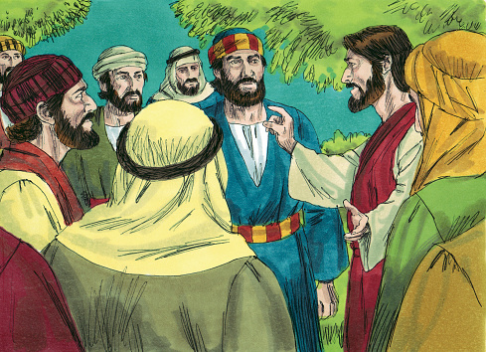
15
I do not call you servants any longer, because servants do not know what their master is doing. Instead, I call you friends, because I have told you everything I heard from my Father.

Slide 13
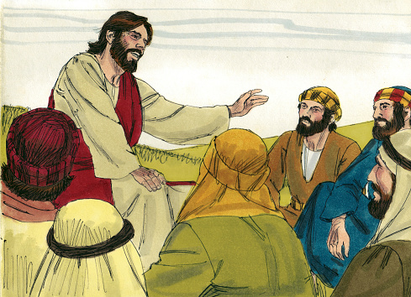
16
You did not choose me; I chose you and appointed you to go and bear much fruit, the kind of fruit that endures. And so the Father will give you whatever you ask of him in my name.

Slide 14
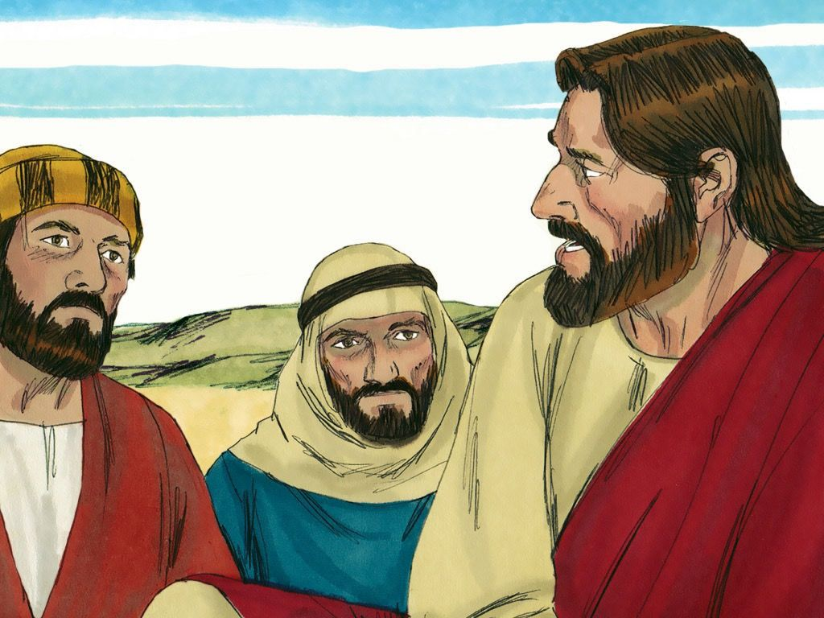
17
This, then, is what I command you: love one another.

Slide 15
Leader: The Gospel of the Lord.
All: Praise to You,
Lord Jesus Christ.

Slide 16
GOSPEL MESSAGE

Slide 17
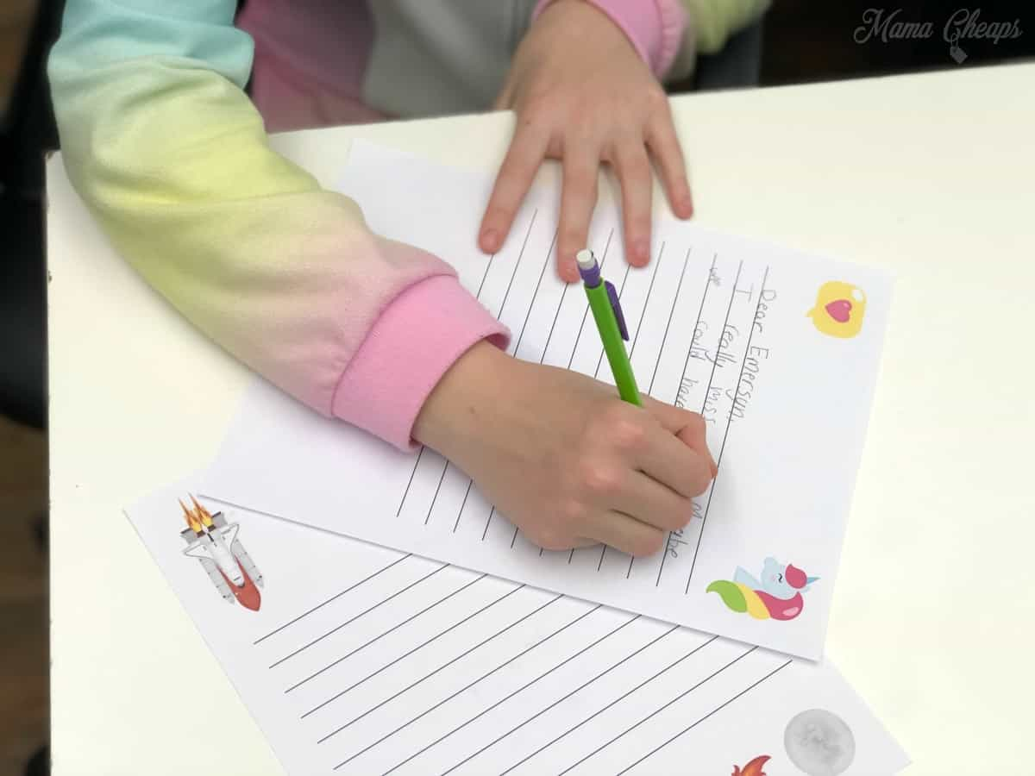
Activity: Friendship Letter
Materials:
Colored Paper:
Coloring Materials
Pen/Marker
Stickers
Reference: Last minute White Paper Friendship Day Card | DIY Friendship day card | Easy Friendship Day Card (youtube.com)

Slide 18
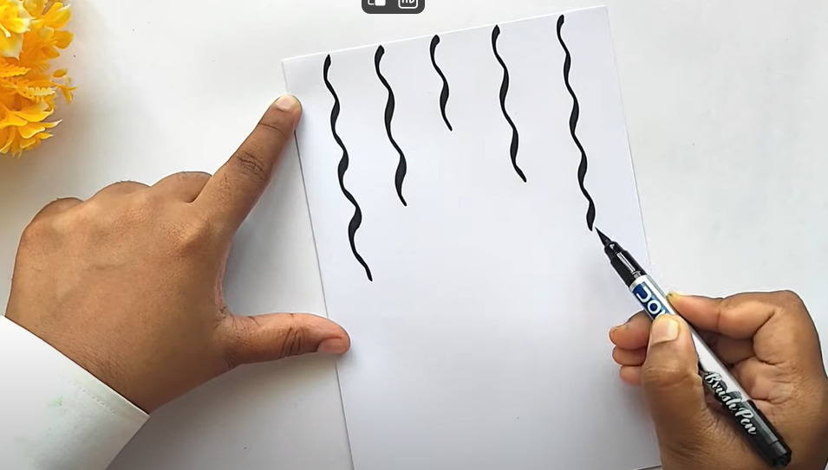
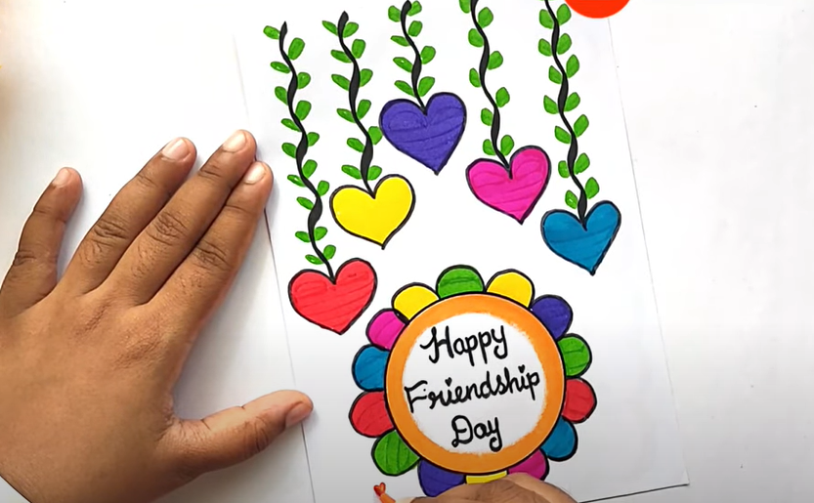
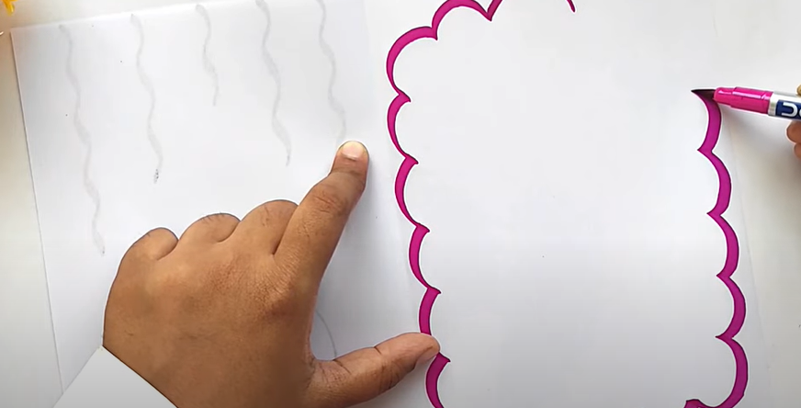
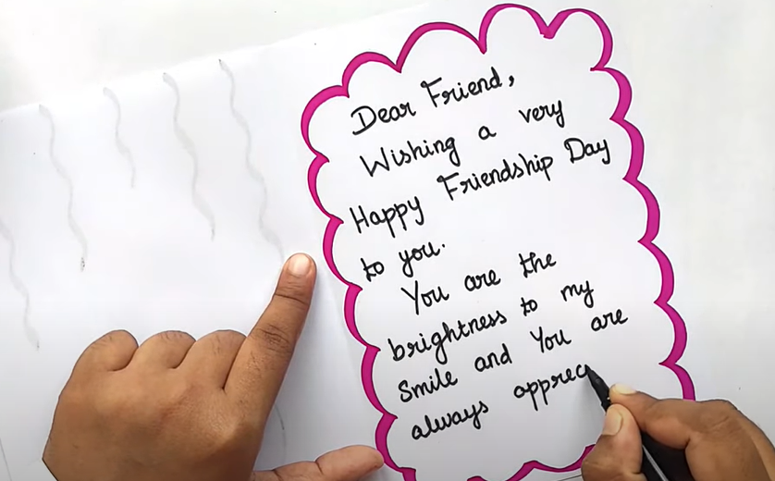
Instructions:
Prepare your materials.
Fold your colored paper into half. Add designs using your stickers and coloring materials both on the Cover page and inner page of your letter.
Write your message to your friend.
Send/give this activity to your friend as a way af appreciating them.

Slide 19
Closing Prayer
Dear God,
Thank you for the gift of friendship. Thank you for the laughter, comfort, strength, encouragement, unity, forgiveness, grace, celebration, and joy we share with one another. Lord, watch over me and my friends and lead us onto hope and blessings, Amen.
In Jesus' name we pray.
Amen.

Slide 20
Sixth Sunday of Easter | May 5, 2024
CYCLE B – YEAR II

