Slide 2
Easter Sunday - March 31, 2024
CYCLE B – YEAR II

Slide 3
UNDERSTANDING THE GOSPEL (for facilitators only)
Today the promise of Jesus that He will rise from the dead comes true. Jesus is risen an He is never to die again. After the anguish of the last few days, it is the time of unbounded joy. The two apostles that seem not to understand the scripture. Jesus told them that that he must rise from the dead and it happened. This is a revelation that Jesus gave us the reason to believe and have faith that we too will rise from the dead.
As we listen to the Easter Sunday Gospel of John 20:1-9, we will bring with us the faith and hope in resurrection. Jesus died on the cross to save us all from eternal damnation of hell. This is the true meaning of Easter. In the hidden power of the resurrection people of all faiths and none struggle to live good lives. In this world we are all the same. We must pray to the Lord, to give us a comfort when life is hard or when death draws near to us. We will all rise in Christ.

Slide 4
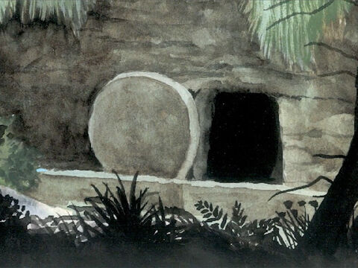
The Empty Tomb
John 20:1-9

Slide 5
Leader: A reading from
the Holy Gospel
according to John.
All: Glory to You, Oh Lord.

Slide 6
1
Early on Sunday morning, while it was still dark, Mary Magdalene went to the tomb and saw that the stone had been taken away from the entrance.

Slide 7
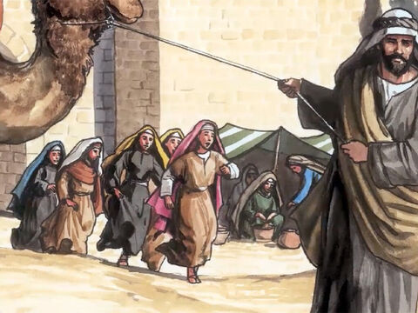
2
She went running to Simon Peter and the other disciple, whom Jesus loved, and told them,
“They have taken the Lord from the tomb, and we don't know where they have put him!”

Slide 8
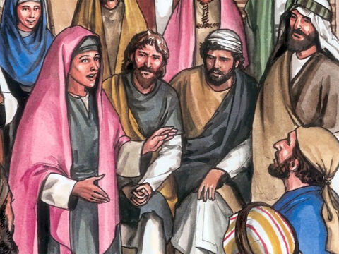
3
Then Peter and the other disciple went to the tomb.

Slide 9
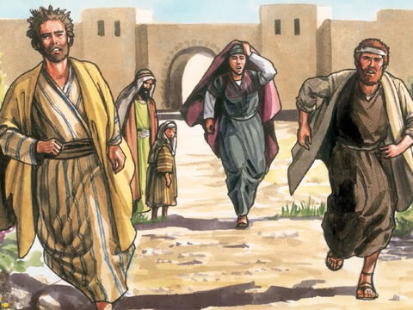
4
The two of them were running, but the other disciple ran faster than Peter and reached the tomb first.

Slide 10
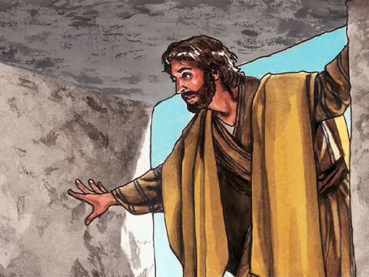
5
He bent over and saw the linen cloths, but he did not go in.

Slide 11
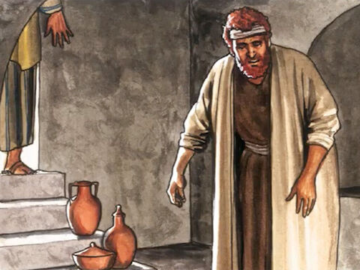
6
Behind him came Simon Peter, and he went straight into the tomb. He saw the linen cloths lying there

Slide 12
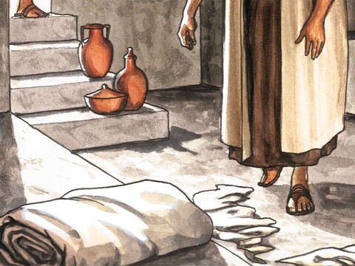
7
And the cloth which had been around Jesus' head. It was not lying with the linen cloths but was rolled up by itself.

Slide 13
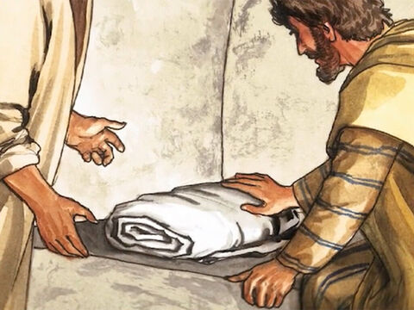
8
Then the other disciple, who had reached the tomb first, also went in; he saw and believed.

Slide 14
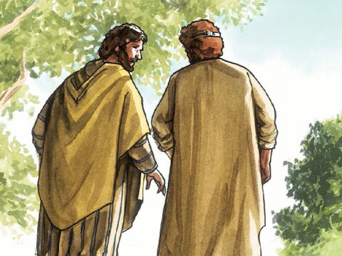
9
(They still did not understand the scripture which said that he must rise from death.)

Slide 15
Leader: The Gospel of the Lord.
All: Praise to You,
Lord Jesus Christ.

Slide 16
GOSPEL MESSAGE

Slide 17
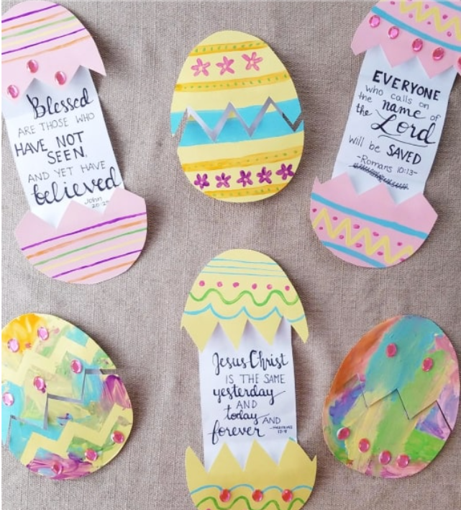
Activity: Easter Egg Craft
Construction Paper
Bond Paper
Decorative materials
White paper
Glue
Scissors
Coloring Materials

Slide 18
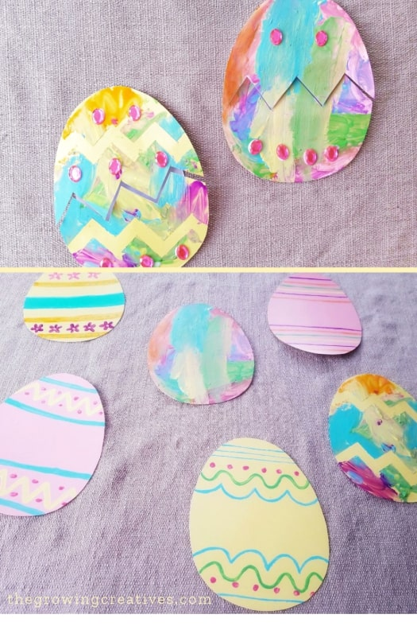
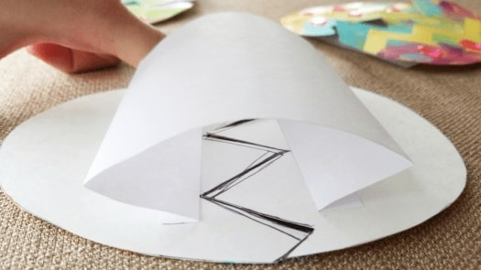
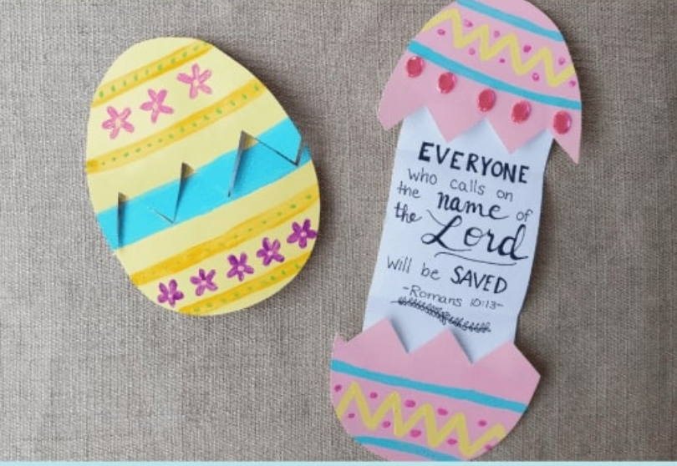
Instructions:
Cut out eggs on your construction paper/bond paper.
Paint or draw on the eggs.
Add any extra decorative touches.
Zigzag cut egg in half.
Measure and glue down white paper.
Bring eggs together and fold paper.
Press folded paper to lay flat.
Write or glue in bible verses.

Slide 19
Closing Prayer
Risen Lord Jesus, we rejoice in the discovery of your empty tomb, a powerful symbol of your victory over death and sin. We thank you for your sacrifice, which has paved the way for our own resurrection and eternal life.
Grant us the gift of faith to recognize your presence and work.
May our lives be a testament to your love and saving grace. Amen.

Slide 21
Easter Sunday - March 31, 2024
CYCLE B – YEAR II

