Slide 2
Sixth Sunday of Lent - March 24, 2024
CYCLE B – YEAR II

Slide 3
UNDERSTANDING THE GOSPEL (for facilitators only)
For this week, we will study and focus in the Gospel reading use for the Blessing of the Palms. Right before this triumphant entry, Jesus had just raised Lazarus from the dead. He brought a dead guy back to life, so it certainly makes sense that people would crowd around to see what He might do next. They wanted to make Jesus a king, to have Him save them from political oppression. They waved palm branches to welcome Him into town and celebrate Him. It was sort of like waving pom-poms at a game or rally. The word “Hosanna” means “Save us.” The people wanted Jesus to save them and be their king. Well, He already was their king, but not exactly in the ways they expected.
And Jesus found a young donkey and sat on it, just as it is written. For one thing, riding a donkey was an indication of peace. Jesus was not storming in on a grand war-horse, ready to swoop in and raise riots. He was coming gently, indicating that His kingdom was one of peace.He was also fulfilling a prophecy.
So why was the crowd so excited about Jesus? As we read here, they were impressed by His miracles, and had seen Him raise Lazarus. They wanted to celebrate Him. This is a joyous and festive occasion, and the people almost realized how important Jesus was…but not quite. They didn’t quite comprehend the kind of King that Jesus was. Not a king who would conquer enemies with swords and rule over others. He was a leader who came to serve, and who lived to die. The enemies He came to conquer were not flesh and blood, but sin, death, and the devil.

Slide 4
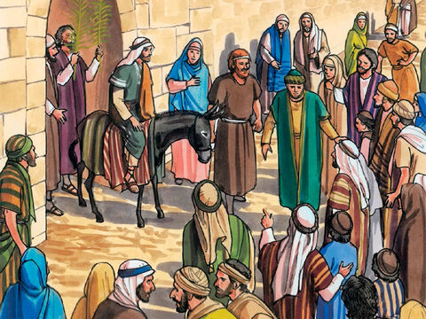
Jesus Triumphant Entry into Jerusalem
John 12: 12-16

Slide 5
Leader: A reading from
the Holy Gospel
according to John.
All: Glory to You, Oh Lord.

Slide 6
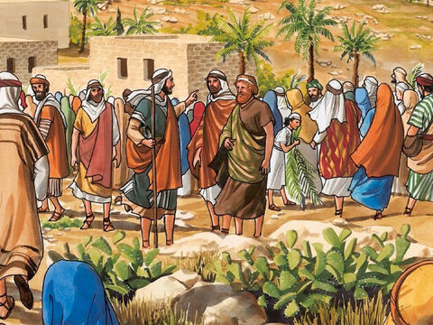
12
The next day the large crowd that had come to the Passover Festival heard that Jesus was coming to Jerusalem.

Slide 7
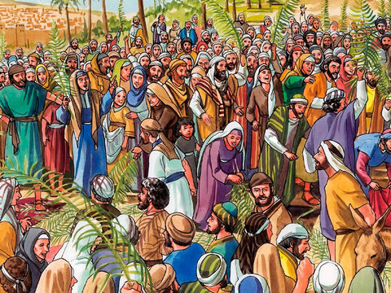
13
So they took branches of palm trees and went out to meet him, shouting,
“Praise God! God bless him who comes in the name of the Lord! God bless the King of Israel!”

Slide 8
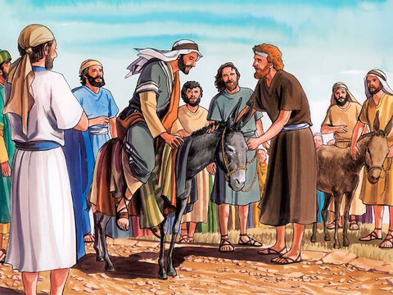
14
Jesus found a donkey and rode on it, just as the scripture says.

Slide 9
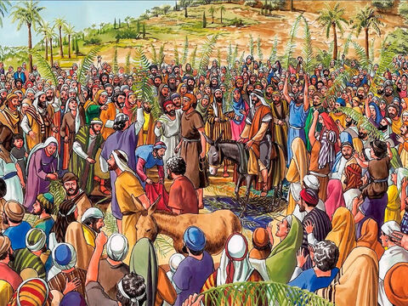
15
“Do not be afraid, city of Zion!
Here comes your king, riding on a young donkey.”

Slide 10
16
His disciples did not understand this at the time; but when Jesus had been raised to glory, they remembered that the scripture said this about him and that they had done this for him.

Slide 11
Leader: The Gospel of the Lord.
All: Praise to You,
Lord Jesus Christ.

Slide 12
GOSPEL MESSAGE

Slide 13
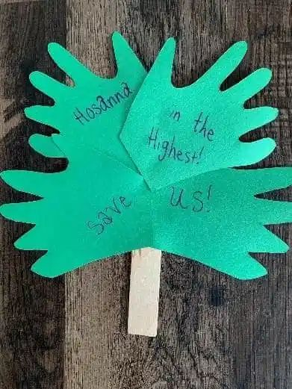
Activity: Palm Palm Stick
Scissors
Construction paper (green)
Markers or decorating materials
Glue or tape
Toilet Paper tube or popsicle stick
Pipe cleaners (optional decoration)

Slide 14
Instructions:
Trace hand prints onto green paper.
Carefully cut the hands out of the paper.
Decorate the hands with words, phrases, or verses.
Glue the hand prints onto the sides of the stick or tube.
Wave, shout “Hosanna,” and enjoy!
Alternate: create a simple “palm branch” by cutting a large leaf shape out of green paper, trimming slits down the side, and adding a pipe cleaner handle.

Slide 15
Closing Prayer
Dear God,
Thank you Jesus for coming into our lives. Thank you for assuring us that there is nothing to be afraid because you are always with us. May we praise your name Jesus and say Hallellujah in everything that we do.
In Jesus’ name we pray, Amen.

Slide 16
Sixth Sunday of Lent - March 24, 2024
CYCLE B – YEAR II

