Slide 2
Fifth Sunday of Lent - March 17, 2024
CYCLE B – YEAR II

Slide 3
UNDERSTANDING THE GOSPEL (for facilitators only)
In our Gospel, Jesus gives a picture here that has some prediction as to His upcoming death. He uses a plant analogy (which He did often) to describe how a grain of wheat has to “die”, in a sense, in order to come up out of the ground and grow and bring plants and food to many. Jesus knew that He was like that wheat, and that He would have to die and give up His life in order to help others. Through His death, we have life.
Everyone who was around heard this voice. They might have been puzzling, wondering what Jesus was talking about. But then they heard a thundering promise from Heaven that God’s name would be glorified. We know that the suffering, death, and resurrection of Jesus brought that glory to God.
Jesus knew that the people around Him would still not fully understand who He was, but that God’s voice had been spoken aloud for their benefit. He knew His purpose, and how powerful it would be for all the world. He came to drive out darkness, death, sin, and the devil, and to do that, He knew He’d have to die. On the cross, Jesus was literally lifted up for all to see. After His death, He was lifted up in resurrection. All who look to Him, then, are lifted up by God and will live with Him forever.

Slide 4
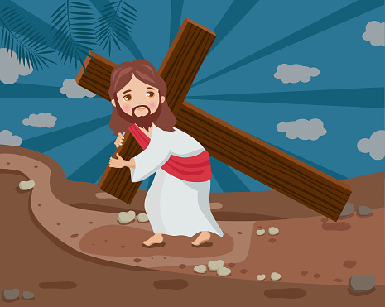
Jesus Speaks About His Death John 12:20-33

Slide 5
Leader: A reading from
the Holy Gospel
according to John.
All: Glory to You, Oh Lord.

Slide 6
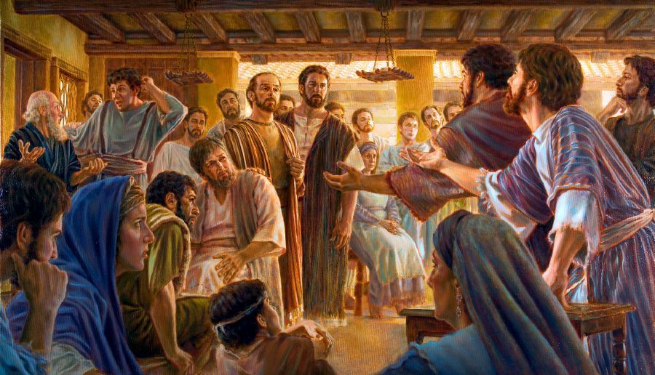
20
Some Greeks were among those who had gone to Jerusalem to worship during the festival.

Slide 7
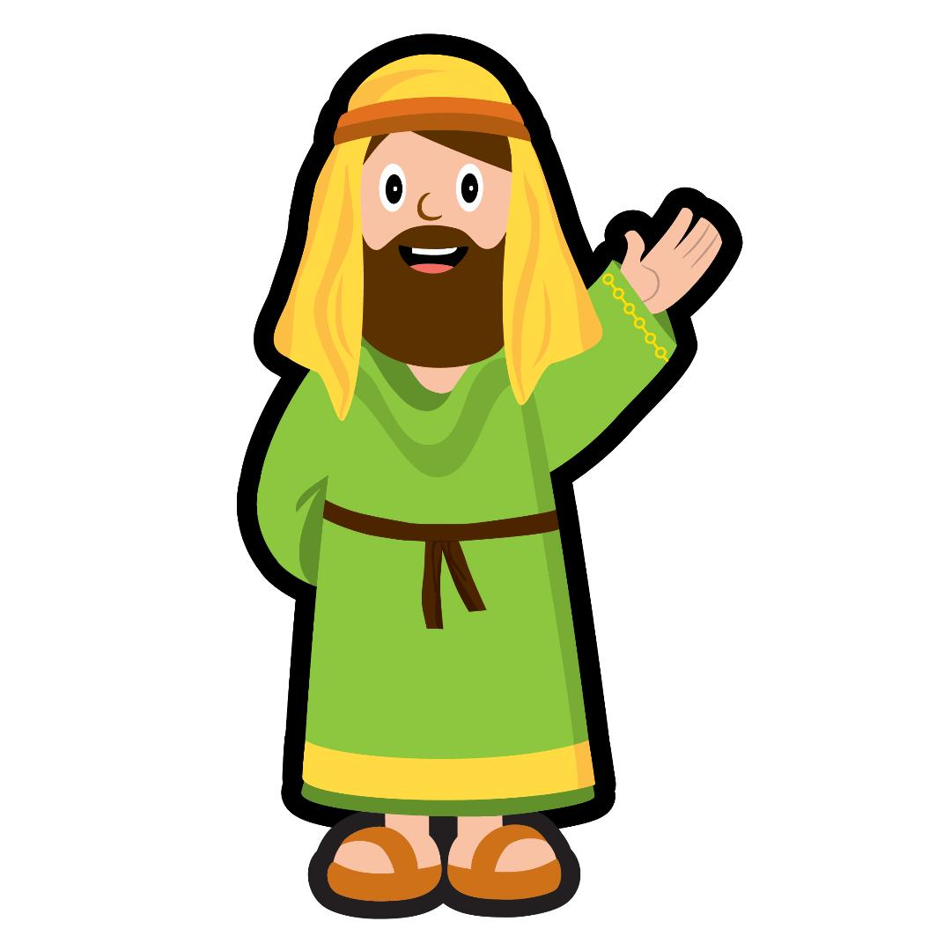
21
They went to Philip (he was from Bethsaida in Galilee) and said,
“Sir, we want to see Jesus.”

Slide 8
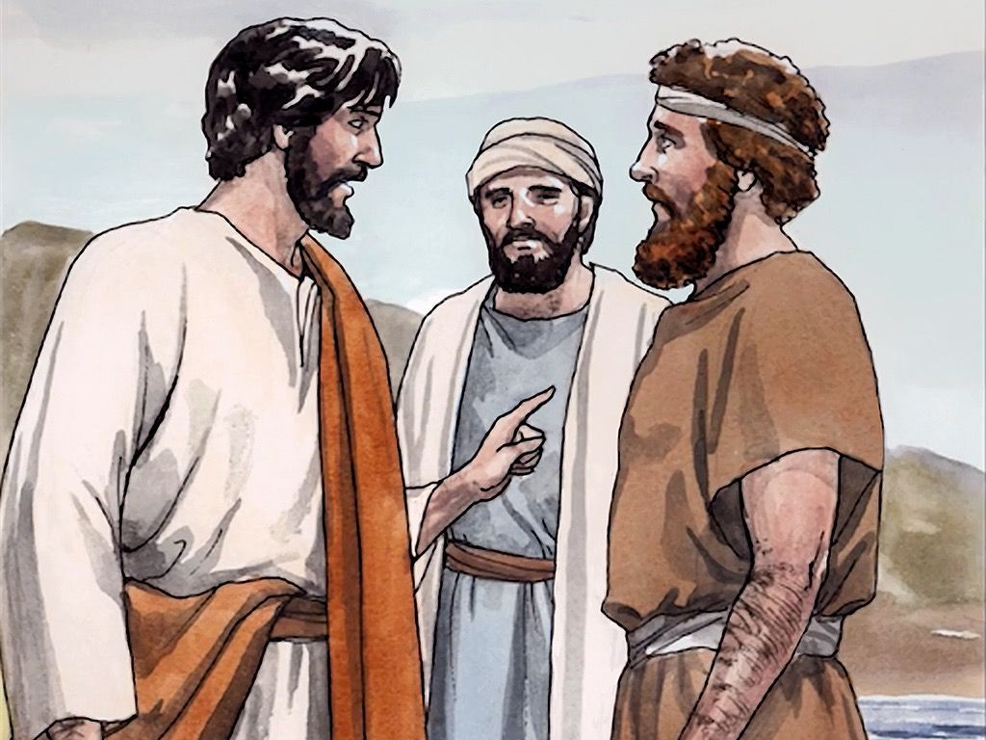
22
Philip went and told Andrew, and the two of them went and told Jesus.

Slide 9
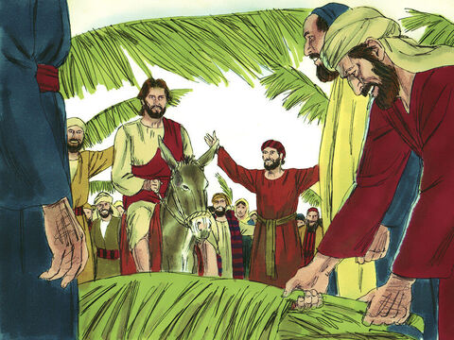
23
Jesus answered them,
“The hour has now come for the Son of Man to receive great glory.

Slide 10
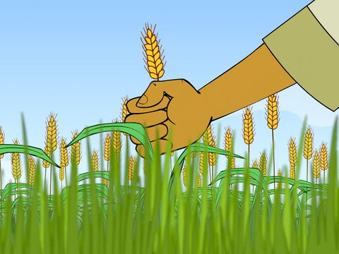
24
I am telling you the truth: a grain of wheat remains no more than a single grain unless it is dropped into the ground and dies. If it does die, then it produces many grains.

Slide 11
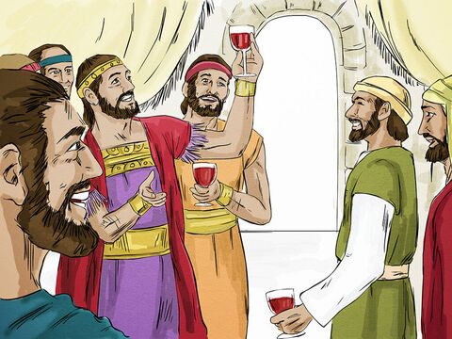
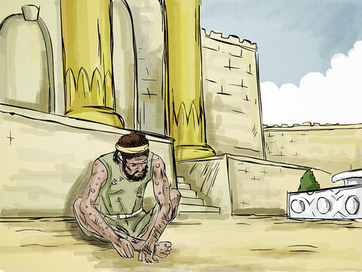
25
Those who love their own life will lose it; those who hate their own life in this world will keep it for life eternal.

Slide 12
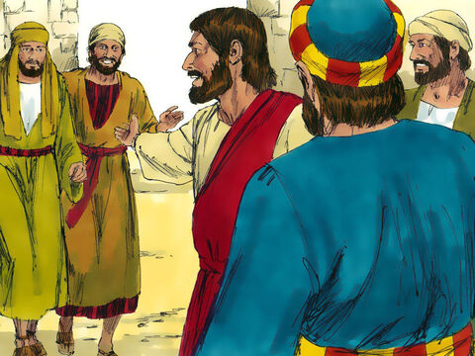
26
Whoever wants to serve me must follow me, so that my servant will be with me where I am. And my Father will honor anyone who serves me.

Slide 13
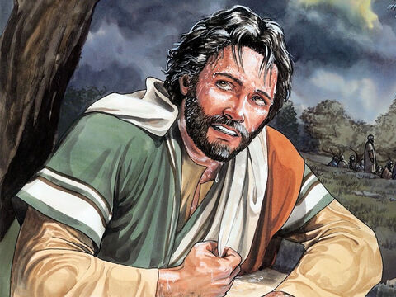
27
“Now my heart is troubled—and what shall I say? Shall I say, ‘Father, do not let this hour come upon me’? But that is why I came—so that I might go through this hour of suffering.

Slide 14
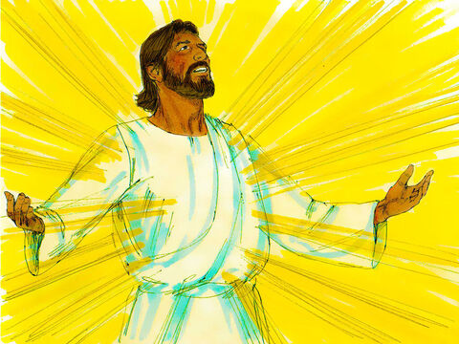
28
Father, bring glory to your name!”
Then a voice spoke from heaven,
“I have brought glory to it, and I will do so again.”

Slide 15
29
The crowd standing there heard the voice, and some of them said it was thunder, while others said,
“An angel spoke to him!”

Slide 16
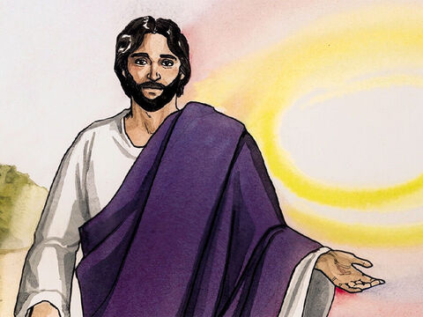
30
But Jesus said to them,
“It was not for my sake that this voice spoke, but for yours.

Slide 17
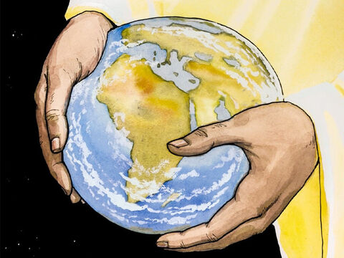
31
Now is the time for this world to be judged; now the ruler of this world will be overthrown.

Slide 18
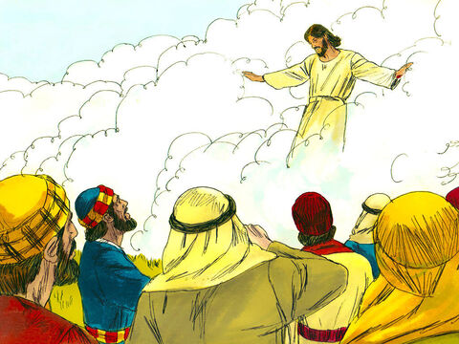
32-33
When I am lifted up from the earth, I will draw everyone to me. (In saying this he indicated the kind of death he was going to suffer.)

Slide 19
Leader: The Gospel of the Lord.
All: Praise to You,
Lord Jesus Christ.

Slide 20
GOSPEL MESSAGE

Slide 21
Activity: My Jesus, My Rock
Learn and dance
My Jesus, My Rock, as we remember how Jesus became our solid foundation. Jesus is so strong that He was able to defeat even death.

Slide 22
Closing Prayer
Dear God,
Thank you for giving us Jesus. He gave His life to give us life. Help us to be willing to make sacrifices for you. And thank you that we have new life in Christ
Thank you for your love
We love you, God!
In Jesus’ Name, we pray. Amen.

Slide 23
Third Sunday of Lent - March 03, 2024
CYCLE B – YEAR II

