Slide 2
Fourth Sunday of Lent - March 10, 2024
CYCLE B – YEAR II

Slide 3
UNDERSTANDING THE GOSPEL (for facilitators only)
This passage is a part of Jesus’ conversation with Nicodemus. Jesus says that just as Moses lifted up the bronze snake for healing, the Son of Man must also be lifted up to give eternal life to all who believe in Him. God so loved the world so much that He sent His only Son so that whoever believes in Him will have eternal life.
Jesus did not come into the world to bring judgement. Yet everyone who rejects Him rejects the light and loves darkness. Therefore they are judged by their actions for loving evil and rejecting truth. Jesus came into the world to save sinners. Everybody is invited to the Feast of Salvation. There are no prerequisites for eternity. But we have to choose. Jesus is the way to eternal life. If we reject that way we say that we prefer the darkness, the way of satan.So, in coming to save the world, Jesus condemns those who reject His way.

Slide 4
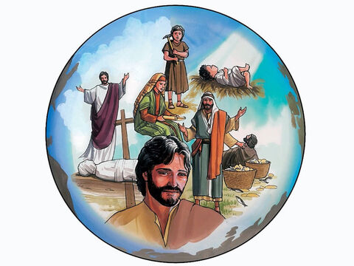
The Greatest Love Story
John 3:14-21

Slide 5
Leader: A reading from
the Holy Gospel
according to John.
All: Glory to You, Oh Lord.

Slide 6
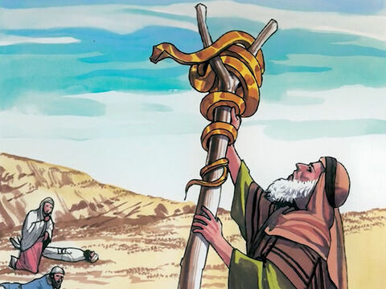
14
As Moses lifted up the bronze snake on a pole in the desert, in the same way the Son of Man must be lifted up,

Slide 7
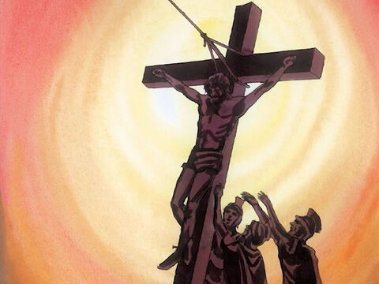
15
so that everyone who believes in him may have eternal life.

Slide 8
16
For God loved the world so much that he gave his only Son, so that everyone who believes in him may not die but have eternal life.

Slide 9
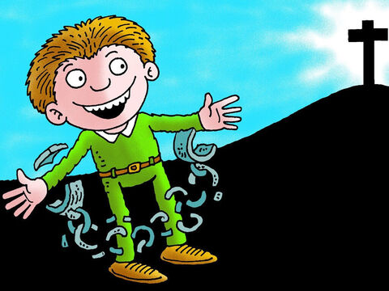
17
For God did not send his Son into the world to be its judge, but to be its savior.

Slide 10
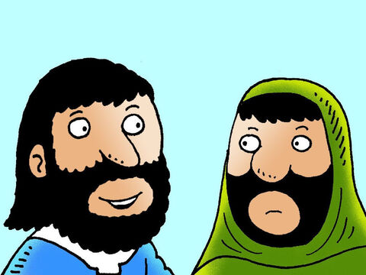
18
Those who believe in the Son are not judged; but those who do not believe have already been judged, because they have not believed in God's only Son

Slide 11
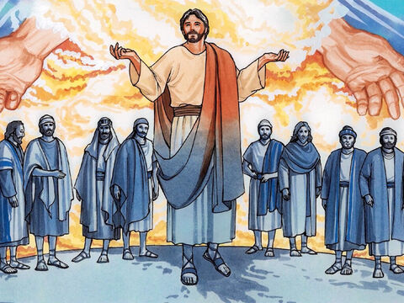
19
This is how the judgment works: the light has come into the world, but people love the darkness rather than the light, because their deeds are evil.

Slide 12
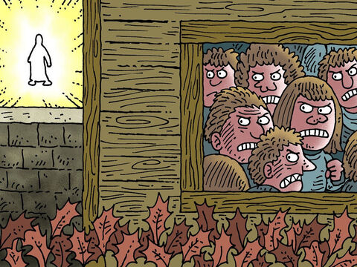
20
Those who do evil things hate the light and will not come to the light, because they do not want their evil deeds to be shown up.

Slide 13
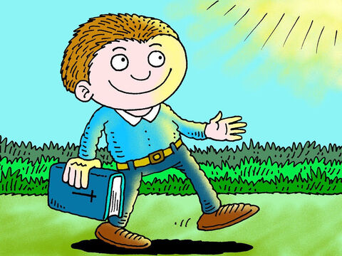
21
But those who do what is true come to the light in order that the light may show that what they did was in obedience to God.

Slide 14
Leader: The Gospel of the Lord.
All: Praise to You,
Lord Jesus Christ.

Slide 15
GOSPEL MESSAGE

Slide 16
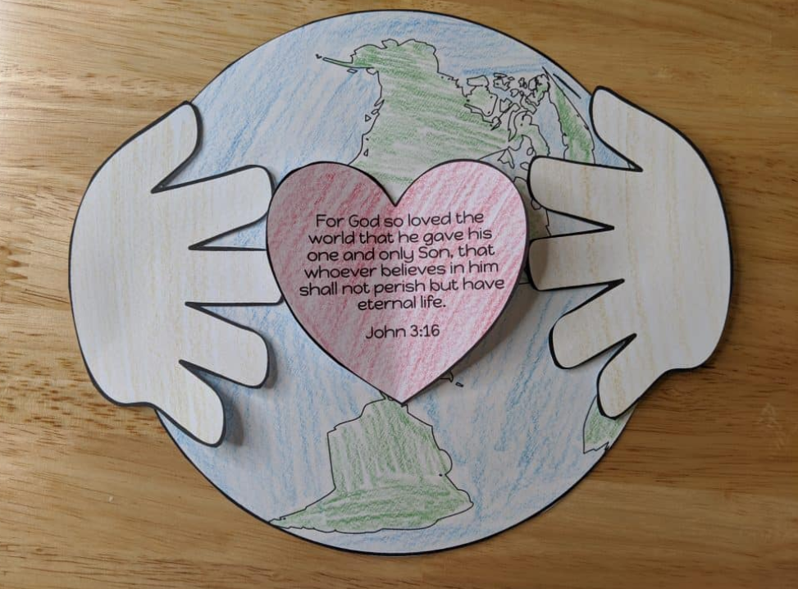
Activity: God loves the World
Bond Paper
Coloring Materials
Glue
Scissor
Pen/Marker

Slide 17
Instructions:
Cut out a big circle on your band paper for the world icon.
Cut out next the heart and hand.
Glue hands onto side of world.
Fold heart and glue down centre. Glue into centre.
Write the verse: John 3: 16
“For God so loved the world so much that he gave his only Son, so that everyone who believes in him may not die but have eternal life.”

Slide 18
Closing Prayer
Dear God,
Thank you for your marvelous plans. You gave your Son to bring us life. You are the true light. Help us to trust in you. Even when we don’t understand things Or when life is really hard. Thank you for your love.
In Jesus’s name, Amen!

Slide 19
Fourth Sunday of Lent - March 03, 2024
CYCLE B – YEAR II

