Slide 2
Third Sunday of Lent - March 03, 2024
CYCLE B – YEAR II

Slide 3
UNDERSTANDING THE GOSPEL (for facilitators only)
It says that Jesus made a whip and started turning tables over and telling everyone to get out of the church, or the Temple. Why was Jesus so mad? What were the people doing?
People were selling things in the church. People were using the church for the wrong thing. They were trying to make money instead of praying or worshipping God or doing any of the other things that we’re supposed to do in church. It was like they were using the church as a store instead of a church. We give money to the church, but the church isn’t supposed to be about making money.
What do you think about Jesus getting mad? Is it okay for us to get mad sometimes? It’s okay to get mad. Jesus was perfect, and even He got mad. It just depends on what you get mad about. If you get mad because somebody is doing something wrong, that’s okay.
It also depends on what you do when you’re mad. You’re not allowed to beat people up when you’re mad or call them names. Jesus didn’t hurt anyone when He got mad, He only scared them and messed up their things. So, you are allowed to let people know that you’re mad at them, but you have to control your temper too.
So, remember, we have to use the church only for the right reasons, and if we get mad at someone,
we have to make sure we’re getting mad for the right reasons. We also have to control our temper and not hit that person.

Slide 4
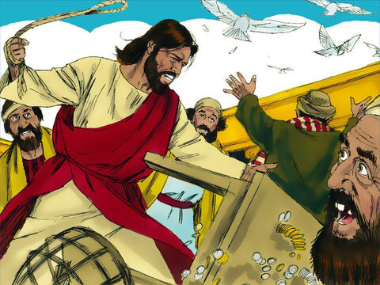
Jesus Goes to the Temple
John 2:13-25

Slide 5
Leader: A reading from
the Holy Gospel
according to John.
All: Glory to You, Oh Lord.

Slide 6
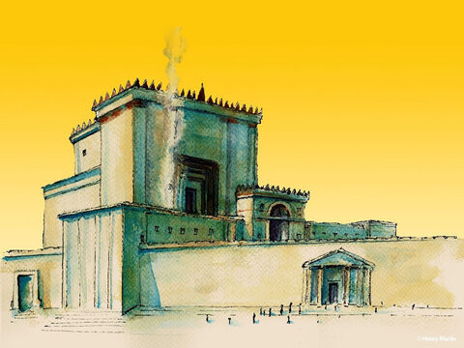
13
It was almost time for the Passover Festival, so Jesus went to Jerusalem.

Slide 7
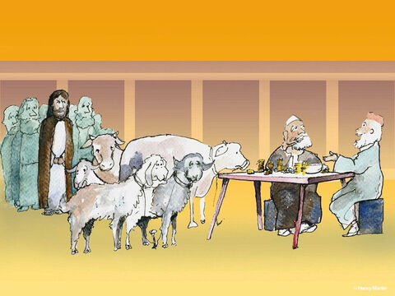
14
There in the Temple he found people selling cattle, sheep, and pigeons, and also the moneychangers sitting at their tables.

Slide 8
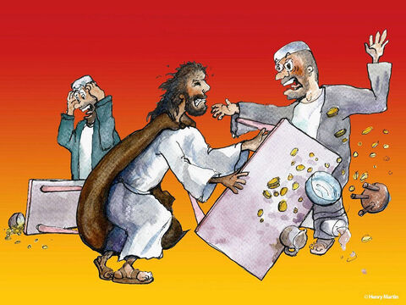
15
So he made a whip from cords and drove all the animals out of the Temple, both the sheep and the cattle; he overturned the tables of the moneychangers and scattered their coins;

Slide 9
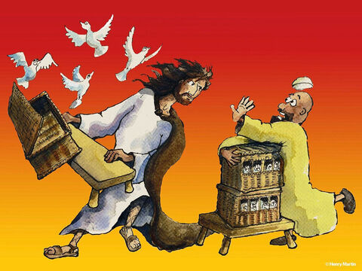
16
And he ordered those who sold the pigeons,
“Take them out of here! Stop making my Father's house a marketplace!”

Slide 10
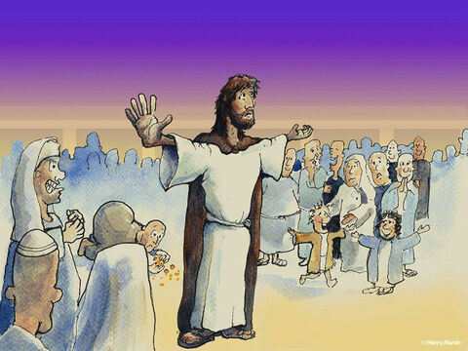
17
His disciples remembered that the scripture says,
“My devotion to your house, O God, burns in me like a fire.”

Slide 11
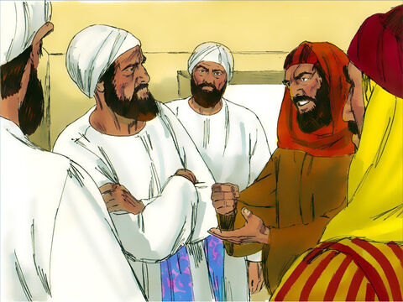
18
The Jewish authorities came back at him with a question,
“What miracle can you perform to show us that you have the right to do this?”

Slide 12
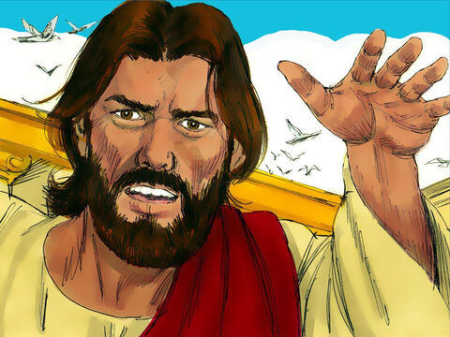
19
Jesus answered,
“Tear down this Temple, and in three days I will build it again.”

Slide 13
20
“Are you going to build it again in three days?” they asked him. “It has taken forty-six years to build this Temple!”

Slide 14
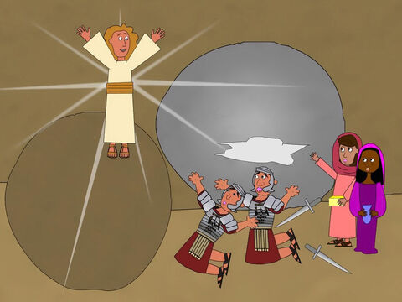
21
But the temple Jesus was speaking about was his body.

Slide 15
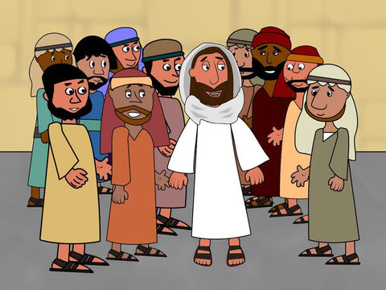
22
So when he was raised from death, his disciples remembered that he had said this, and they believed the scripture and what Jesus had said.

Slide 16
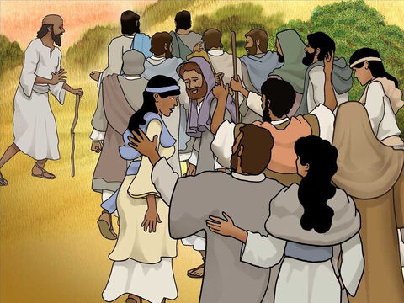
23
While Jesus was in Jerusalem during the Passover Festival, many believed in him as they saw the miracles he performed.

Slide 17
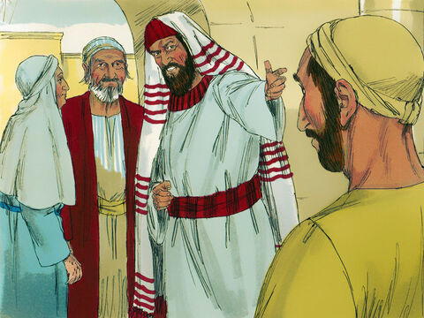
24
But Jesus did not trust himself to them, because he knew them all.

Slide 18
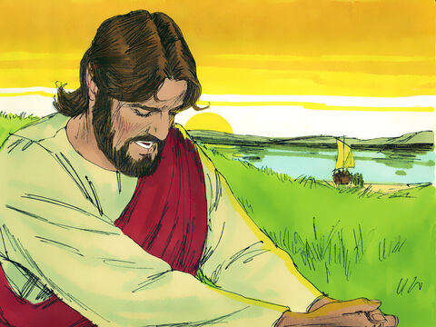
25
There was no need for anyone to tell him about them, because he himself knew what was in their hearts.

Slide 19
Leader: The Gospel of the Lord.
All: Praise to You,
Lord Jesus Christ.

Slide 20
GOSPEL MESSAGE

Slide 21
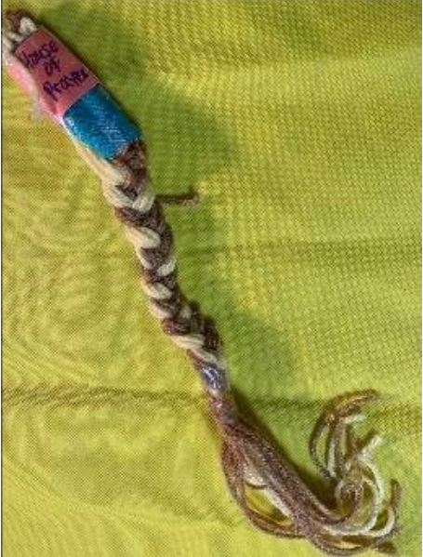
Activity: Temple Clearing Whip
Yarn or string
Markers
Fabric (optional)
Construction paper
Markers or crayons
Scissors
Tape

Slide 22
Instructions:
Choose what kinds and colors of string you prefer for your “whip.”
Cut several strings in similar lengths.
Tie a knot at the top of the strings, and secure with paper or fabric and tape (packing tape works best).
Braid your strings together in a twist or traditional braid as desired.
Snip the ends to have a fringe “whip.” Add a caption or verse to your soft lash-giver!
Notes:
Jesus got angry? He knocked over tables? This story can be a surprising one for children to hear, but is a fun one to teach and act out. Of course, the important thing to emphasize is that Jesus had a good reason to get mad. He was not having a selfish temper tantrum, but was defending the integrity of God’s house. The lesson that this craft accompany reminds us that we are made to worship God, and we want to honor Him with our lives and bodies.

Slide 23
Closing Prayer
Lord Jesus, help us treat the church like the special place that it is. And help us to feel angry only about the things You feel angry about. And help us to control our anger as You did. Amen.

Slide 24
Third Sunday of Lent - March 03, 2024
CYCLE B – YEAR II

