Slide 2
June 30, 2024 | Thirteenth Sunday in Ordinary Time
CYCLE B – YEAR II

Slide 3
REFLECTION FROM THE GOSPEL (for facilitators only)
Both Jairus and the woman had a plan that Jesus disrupted. Jairus rightly believed that Jesus could heal his daughter to make her well, needing only to lay His hands on her, but this belief was challenged and produced fear when his daughter died. The woman’s plan was to remain unknown and unseen, retaining her position on the outside and seeking only physical relief from her perpetual bleeding.
Jesus disrupted both their plans because our faith does not reside in a thing, like the laying on of hands or the touch of a garment, but in relationship with the person of Jesus Christ. Jesus challenged Jairus to stop fearing and keep believing in Him, even when it seems impossible. Jesus expanded the woman’s plan by not just healing her physically, but by seeing her and connecting in relational terms, providing wholeness to her healing and addressing her felt need and her actual need of relationship with Him as His child.

Slide 4
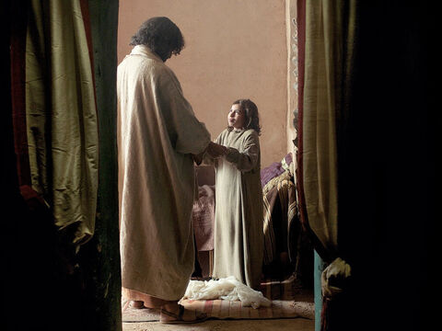
Jairus' Daughter and the Woman Who Touched Jesus' Cloak
Mark 5:21-43

Slide 5
Leader: A reading from
the Holy Gospel
according to Mark.
All: Glory to You, Oh Lord.

Slide 6
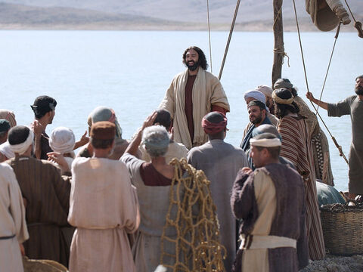
21
Jesus went back across to the other side of the lake. There at the lakeside a large crowd gathered around him.

Slide 7
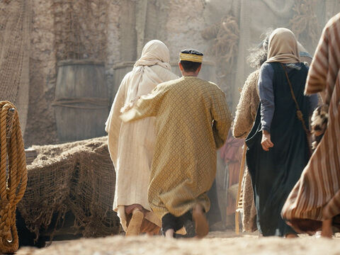
22
Jairus, an official of the local synagogue, arrived, and when he saw Jesus, he threw himself down at his feet

Slide 8
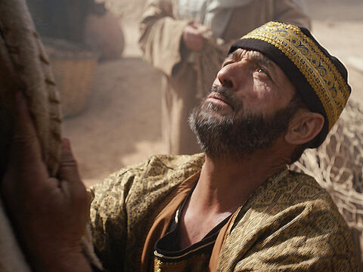
23
and begged him earnestly, “My little daughter is very sick. Please come and place your hands on her, so that she will get well and live!”

Slide 9
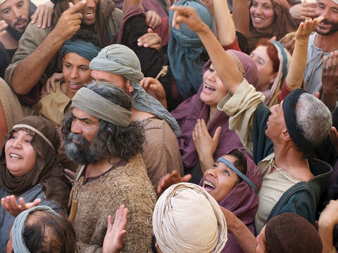
24
Then Jesus started off with him. So many people were going along with Jesus that they were crowding him from every side.

Slide 10
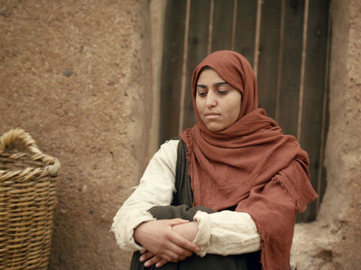
25
There was a woman who had suffered terribly from severe bleeding for twelve years,

Slide 11
26
even though she had been treated by many doctors. She had spent all her money, but instead of getting better she got worse all the time.

Slide 12
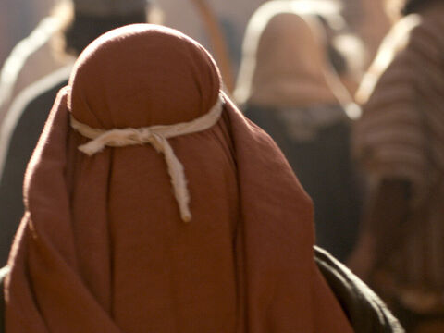
27
She had heard about Jesus, so she came in the crowd behind him,

Slide 13
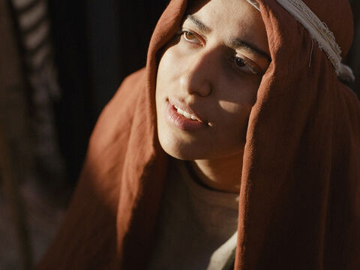
28
saying to herself, “If I just touch his clothes, I will get well.”

Slide 14
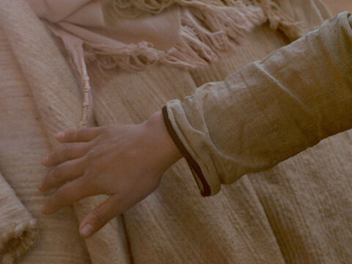
29
She touched his cloak, and her bleeding stopped at once; and she had the feeling inside herself that she was healed of her trouble.

Slide 15
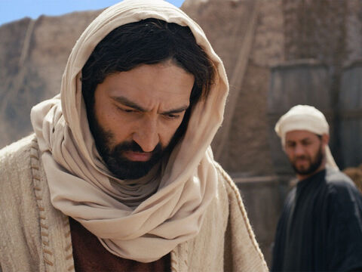
30
At once Jesus knew that power had gone out of him, so he turned around in the crowd and asked, “Who touched my clothes?”

Slide 16
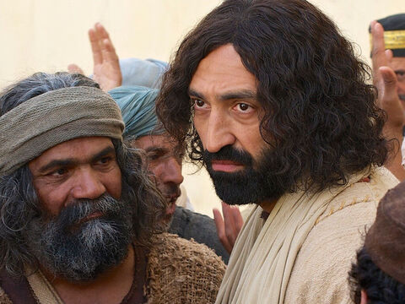
31
His disciples answered, “You see how the people are crowding you; why do you ask who touched you?”

Slide 17
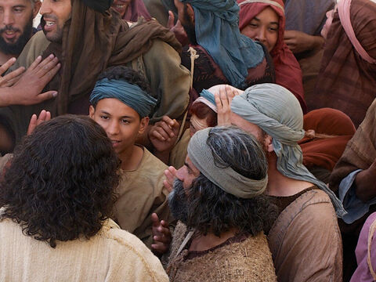
32
But Jesus kept looking around to see who had done it.

Slide 18
33
The woman realized what had happened to her, so she came, trembling with fear, knelt at his feet, and told him the whole truth.

Slide 19
34
Jesus said to her, “My daughter, your faith has made you well.
Go in peace, and be healed of your trouble.”

Slide 20
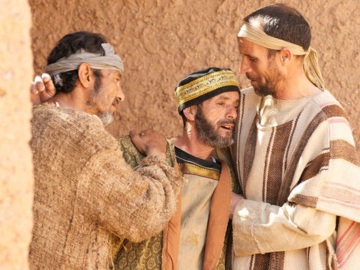
35
While Jesus was saying this, some messengers came from Jairus' house and told him, “Your daughter has died. Why bother the Teacher any longer?”

Slide 21
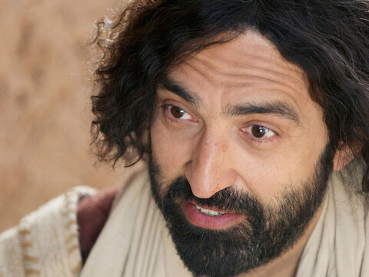
36
Jesus paid no attention to[a] what they said, but told him, “Don't be afraid, only believe.”

Slide 22
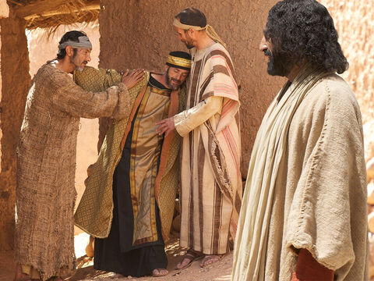
37
Then he did not let anyone else go on with him except Peter and James and his brother John.

Slide 23
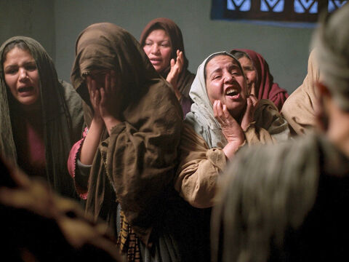
38
They arrived at Jairus' house, where Jesus saw the confusion and heard all the loud crying and wailing.

Slide 24
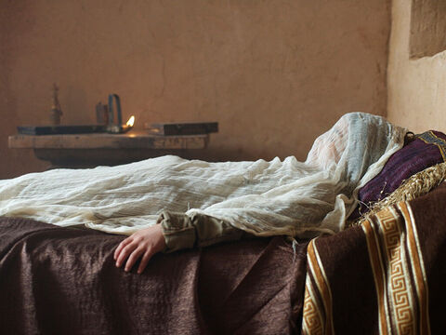
39
He went in and said to them, “Why all this confusion? Why are you crying? The child is not dead—she is only sleeping!”

Slide 25
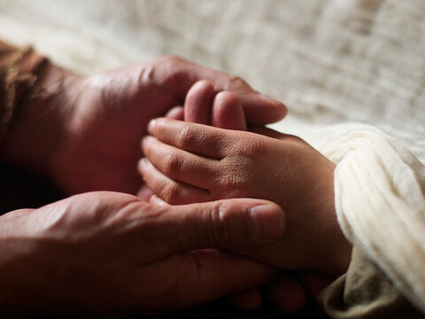
40
They started making fun of him, so he put them all out, took the child's father and mother and his three disciples, and went into the room where the child was lying.

Slide 26
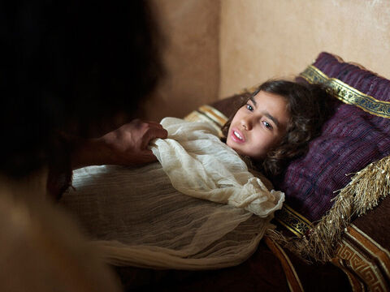
41
He took her by the hand and said to her, “Talitha, koum,” which means, “Little girl, I tell you to get up!”

Slide 27
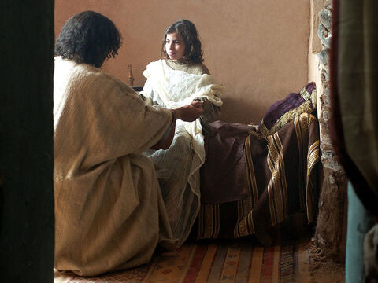
42
She got up at once and started walking around. (She was twelve years old.) When this happened, they were completely amazed.

Slide 28
43
But Jesus gave them strict orders not to tell anyone, and he said, “Give her something to eat.”

Slide 29
Leader: The Gospel of the Lord.
All: Praise to You,
Lord Jesus Christ.

Slide 30
GOSPEL MESSAGE

Slide 31
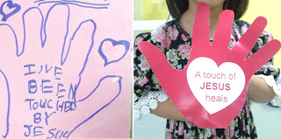
Activity:
A touch of Jesus Heals
Materials:
Colored Paper
Scissor
Glue
Coloring Materials
Pen/Pencil

Slide 32
Instructions:
Get kids trace their palm on multi-colored paper/card.
Cut out a heart-shaped on your paper
Write: A touch of Jesus Heals on the palm

Slide 33
Closing Prayer
Dear Jesus, we thank you for loving us and for keeping us safe always. Watch over us and please touch us with your healing hand. Give us the comfort and peace to get through. We trust you and we believe in your love.
In Jesus’ name, we pray. Amen.

Slide 34
June 30, 2024 | Thirteenth Sunday in Ordinary Time
CYCLE B – YEAR II

