Slide 2
June 23, 2024 | Twelfth Sunday in Ordinary Time
CYCLE B – YEAR II

Slide 3
REFLECTION FROM THE GOSPEL (for facilitators only)
We have the benefit of knowing how the story of Jesus’ calming the storm ends. But imagine the disciples’ amazement when the raging waves instantly became calm. Even today, with our advanced technology, we don’t have any control over the weather and can’t always forecast it very accurately. In Jesus’ day, controlling the weather was known strictly as the domain of God. In the instant the storm ceased, the disciples began to realize more fully who Jesus was. He had demonstrated his power in healing people, but never before had he done anything of this magnitude.
Jesus then asked some pointed questions. He seemed surprised that the disciples’ faith was so weak. After all they had seen, they hadn’t fully grasped who Jesus was or what he was capable of. But now they had seen something so powerful, so awesome, that they were terrified to think about who Jesus really was.
The disciples’ terrified response is understandable when we consider God’s power and purity in light of our own weakness and imperfection. But the disciples came to learn that no matter how bad a situation seemed, the first thing they needed to do was turn to Jesus.

Slide 4
Jesus Calms a Storm
Mark 4:35-41

Slide 5
Leader: A reading from
the Holy Gospel
according to Mark.
All: Glory to You, Oh Lord.

Slide 6
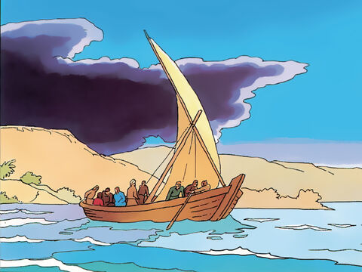
35
On the evening of that same day Jesus said to his disciples, “Let us go across to the other side of the lake.”

Slide 7
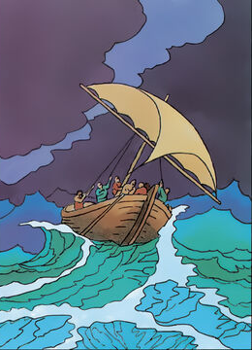
36
So they left the crowd; the disciples got into the boat in which Jesus was already sitting, and they took him with them. Other boats were there too.

Slide 8
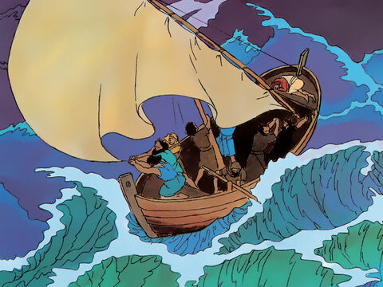
37
Suddenly a strong wind blew up, and the waves began to spill over into the boat, so that it was about to fill with water.

Slide 9
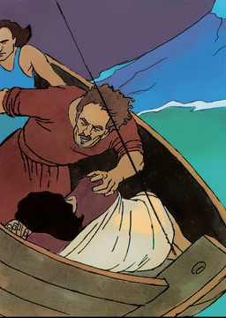
38
Jesus was in the back of the boat, sleeping with his head on a pillow. The disciples woke him up and said, “Teacher, don't you care that we are about to die?”

Slide 10
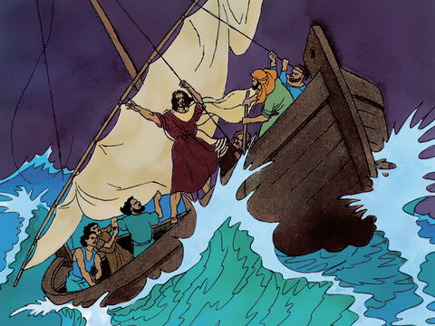
39
Jesus stood up and commanded the wind, “Be quiet!” and he said to the waves, “Be still!” The wind died down, and there was a great calm.

Slide 11
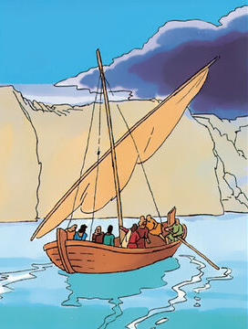
40
Then Jesus said to his disciples, “Why are you frightened? Do you still have no faith?”

Slide 12
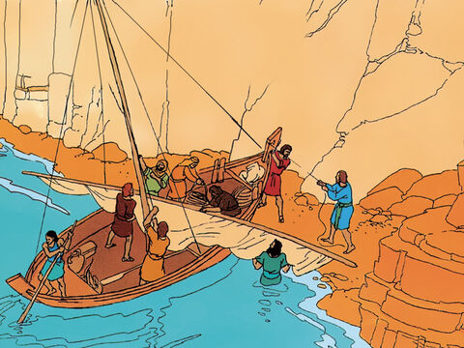
41
But they were terribly afraid and began to say to one another, “Who is this man? Even the wind and the waves obey him!”

Slide 13
Leader: The Gospel of the Lord.
All: Praise to You,
Lord Jesus Christ.

Slide 14
GOSPEL MESSAGE

Slide 15
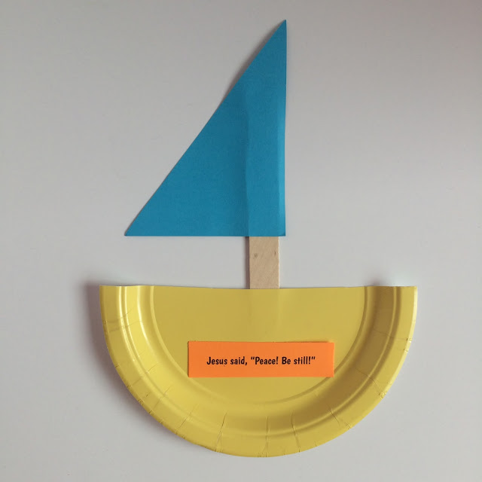
Activity:
Sailboat Craft
Materials:
Paper Plate
Colored Paper
Glue
Scissor
Crayons
Pen or Pencils

Slide 16
Instructions:
Cut the plates in half, and cut the construction paper into triangle sails.
Create a label using your colored paper.
Glue together the pieces to make their own sailboat.

Slide 17
Closing Prayer
Dear Jesus, we thank you for loving us and for keeping us safe always. Thank you for reminding us today that you are powerful, big and strong enough to handle all our fears. Help us to always trust and believe in You.
In Jesus’ name, we pray. Amen.

Slide 18
June 23, 2024 | Twelfth Sunday in Ordinary Time
CYCLE B – YEAR II

