Slide 2
June 15, 2024 | Eleventh Sunday in Ordinary Time
CYCLE B – YEAR II

Slide 3
REFLECTION FROM THE GOSPEL (for facilitators only)
In the Parable of the Growing Seed, Jesus tells of a man who scatters seed on the ground and then allows nature to take its course. As the man who sowed the seed goes about his business day by day, the seed begins to have an effect. First, the seed sprouts; then it produces a stalk and leaves, then a head of grain, and, finally, fully developed kernels in the head. Jesus emphasizes that all of this happens without the man’s help. The man who scattered the seed cannot even fully understand how it happens—it is simply the work of nature. “All by itself the soil produces” (verse 28).
The parable ends with a harvest. As soon as the grain is ripe, the sickle is employed, and the seed is harvested. This happens at just the right time.
Jesus did not explain this parable, as He did some others. Instead, He left it to us to understand its meaning. Taking the seed to be the Word of God, we can interpret the growth of the plants as the working of God’s Word in individual hearts. The fact that the crop grows without the farmer’s intervention means that God can accomplish His purposes even when we are absent or unaware of what He’s doing. The goal is the ripened grain. At the proper time, the Word will bring forth its fruit, and the Lord of the harvest will be glorified.
The truth of this parable is well illustrated in the growth of the early church: “I planted the seed, Apollos watered it, but God made it grow” (1 Corinthians 3:6). Just like a farmer cannot force a crop to grow, an evangelist cannot force spiritual life or growth on others. To summarize the point of the Parable of the Growing Seed: “The way God uses His Word in the heart of an individual is mysterious and completely independent of human effort.” May we be faithful in “sowing the seed,” praying for a harvest, and leaving the results to the Lord!

Slide 4
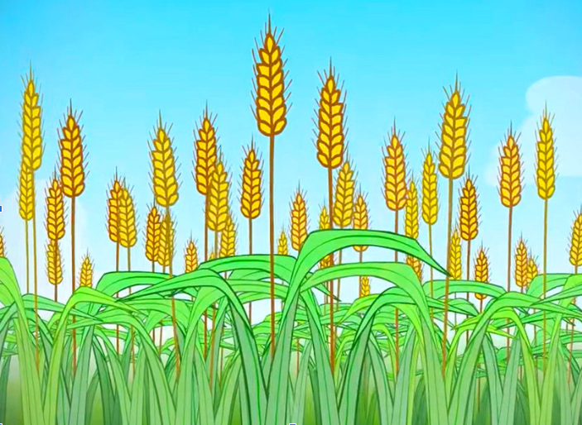
The Parable of the Growing Seed
Mark 4:26-34

Slide 5
Leader: A reading from
the Holy Gospel
according to Mark.
All: Glory to You, Oh Lord.

Slide 6
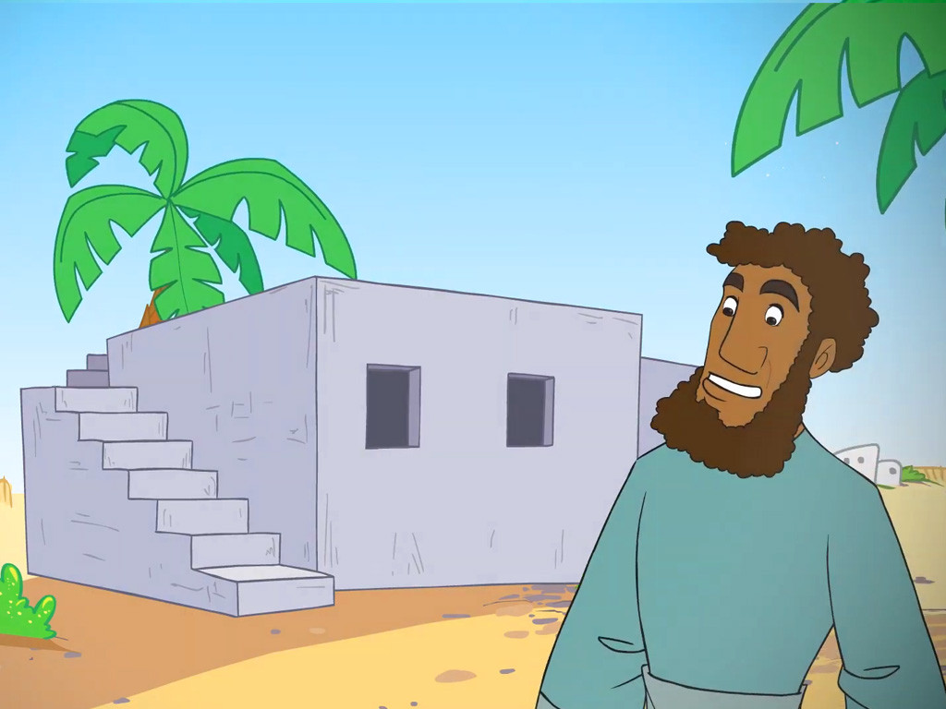
26
Jesus went on to say, “The Kingdom of God is like this. A man scatters seed in his field.

Slide 7
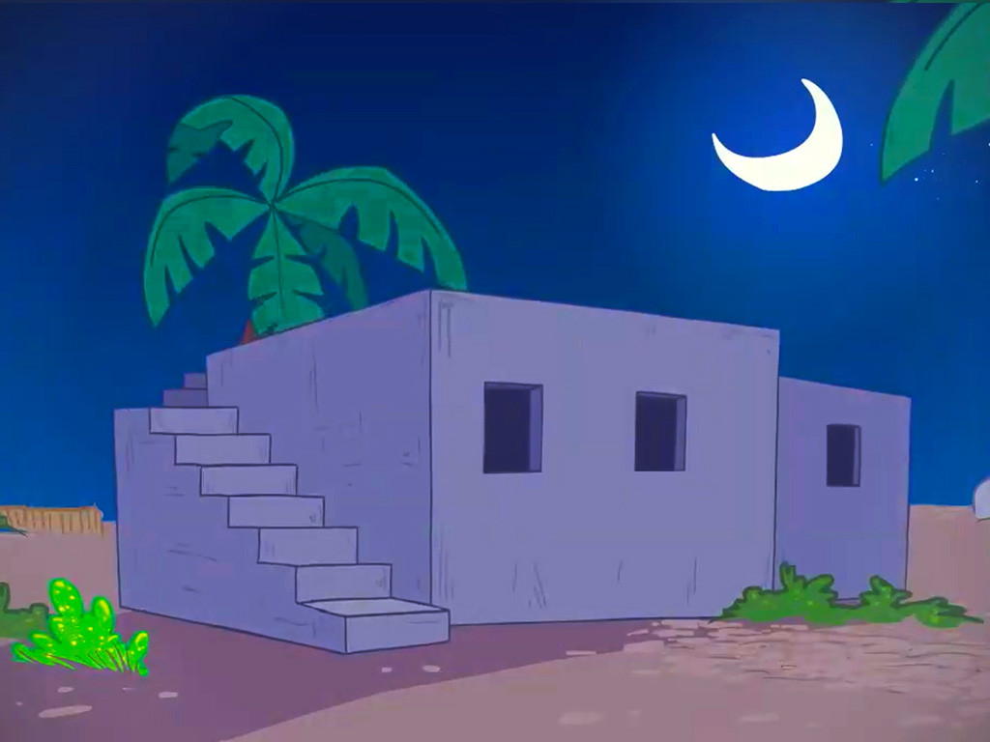
27
He sleeps at night, is up and about during the day, and all the while the seeds are sprouting and growing. Yet he does not know how it happens.

Slide 8
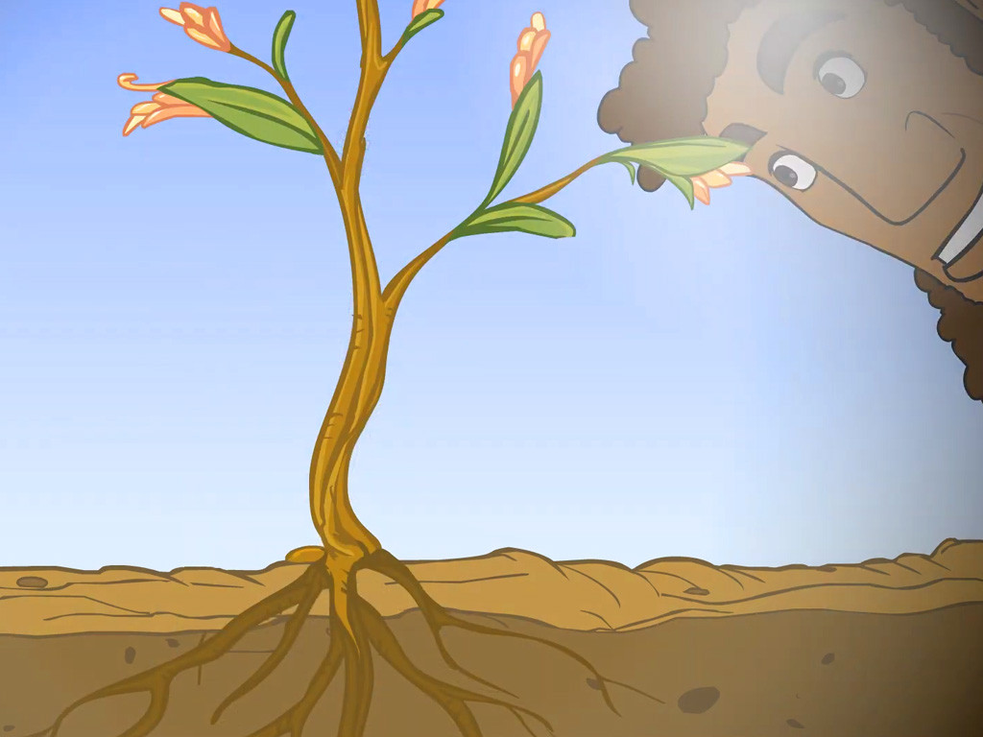
28
The soil itself makes the plants grow and bear fruit; first the tender stalk appears, then the head, and finally the head full of grain.

Slide 9
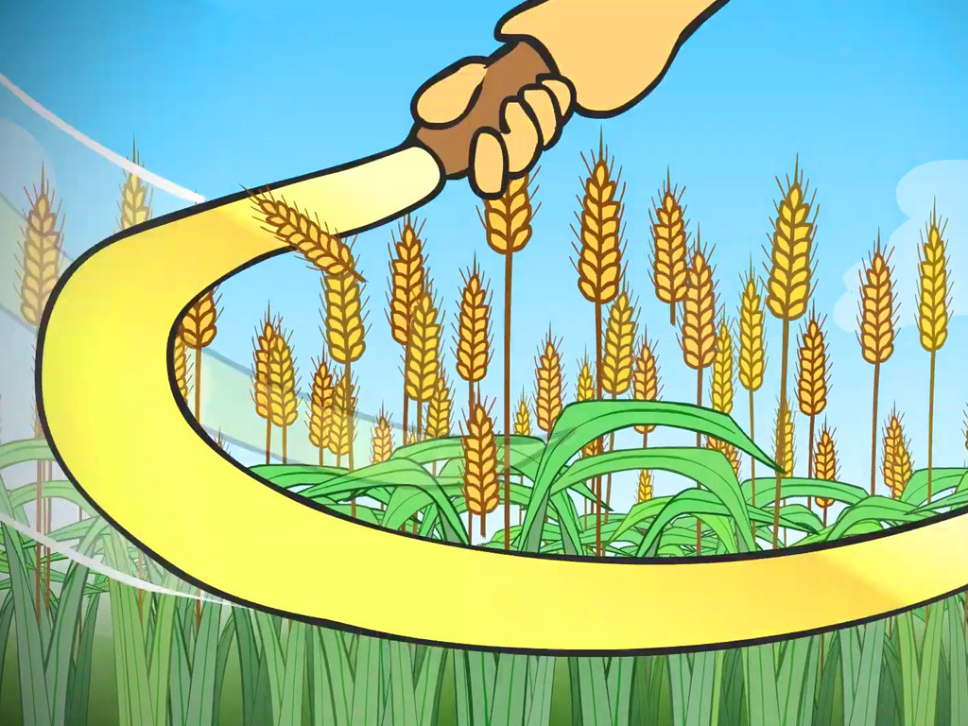
29
When the grain is ripe, the man starts cutting it with his sickle, because harvest time has come.

Slide 10
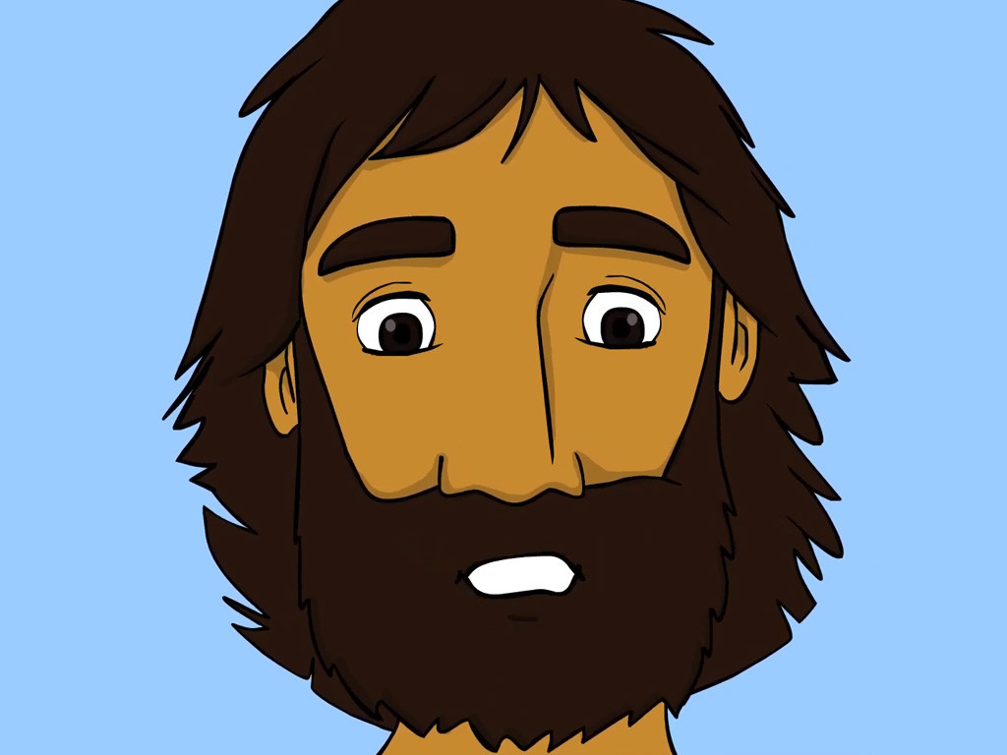
30
“What shall we say the Kingdom of God is like?” asked Jesus. “What parable shall we use to explain it?

Slide 11
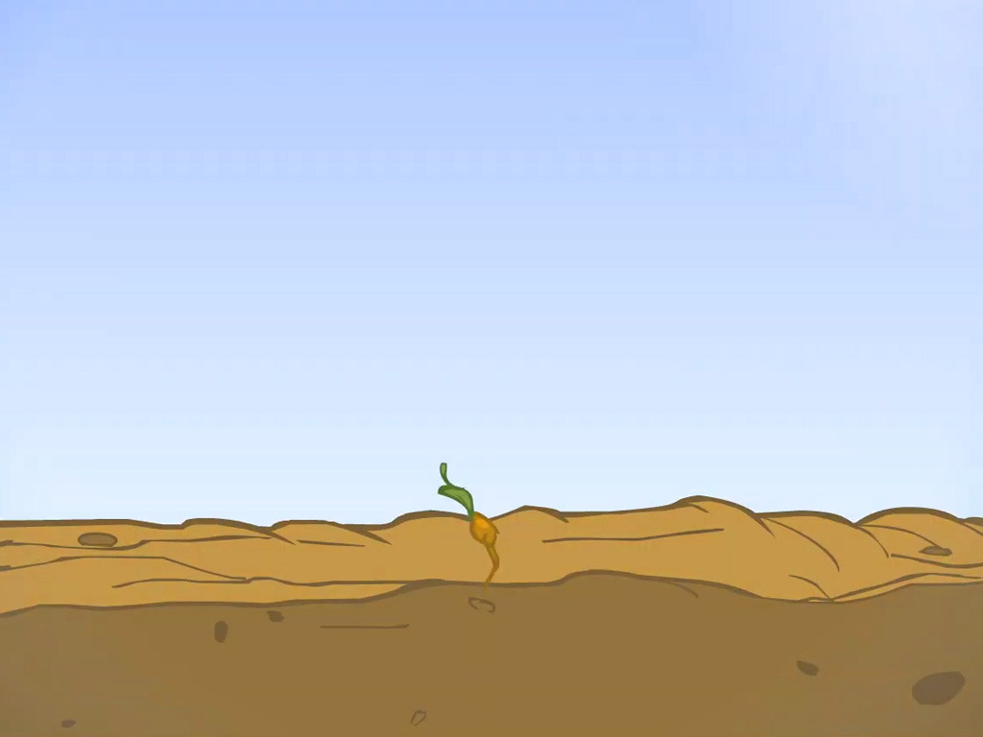
31
It is like this. A man takes a mustard seed, the smallest seed in the world, and plants it in the ground.

Slide 12
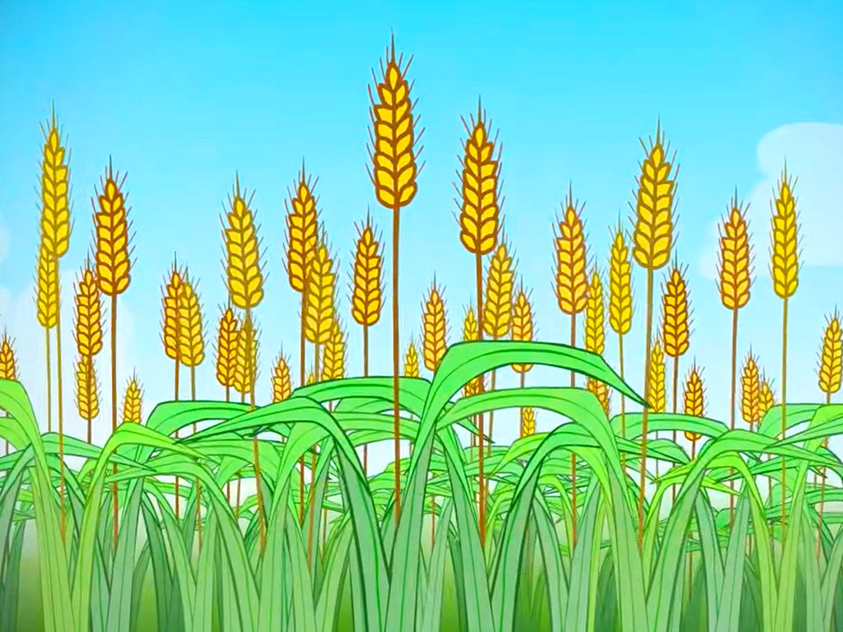
32
After a while it grows up and becomes the biggest of all plants. It puts out such large branches that the birds come and make their nests in its shade.”

Slide 13
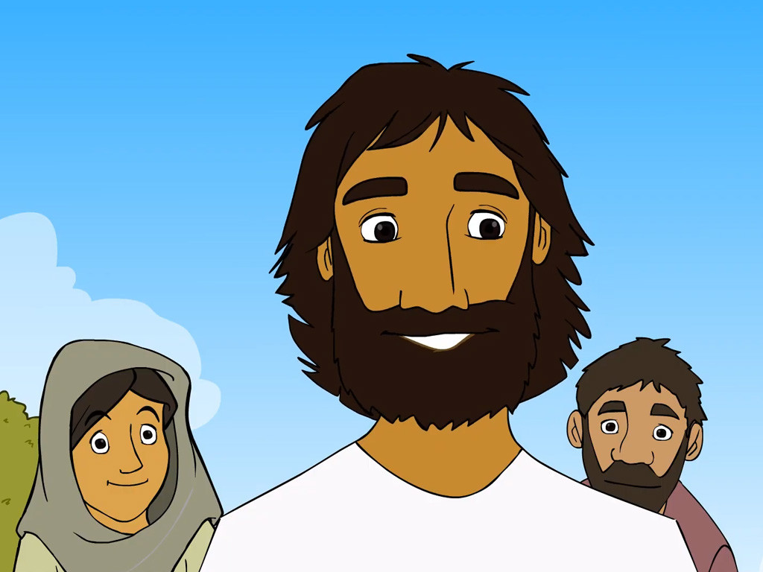
33
Jesus preached his message to the people, using many other parables like these; he told them as much as they could understand.

Slide 14
34
He would not speak to them without using parables, but when he was alone with his disciples, he would explain everything to them.

Slide 15
Leader: The Gospel of the Lord.
All: Praise to You,
Lord Jesus Christ.

Slide 16
GOSPEL MESSAGE

Slide 17
Activity: Growing Paper Plants
1. Colored paper
2. Pen
3. Scissors
4. Glue

Slide 18
Instructions:
1. Trace a child’s hand on construction paper. Cut the tracing out.
2. Curl each of the fingers around a pencil.
3. Using the palm of the handprint, form a cone (with the fingers curling outwards). Glue or tape the cone together.
Staple the flower to a pipe cleaner or a drinking straw.
4. Draw some leaves on green construction paper, then cut them out.
5. Staple or tape the leaves to the straw. Make a few of these flowers for a beautiful bouquet!

Slide 19
Closing Prayer
Dear God,
Thank you for reminding and teaching us how to grow in you so that we can share your love, peace, and kindness with others.
Amen.

Slide 20
June 16, 2024 | Eleventh Sunday in Ordinary Time
CYCLE B – YEAR II

