Slide 2
June 2, 2024 | The Solemnity of the Most Holy Body and Blood of Christ
CYCLE B – YEAR II

Slide 3
REFLECTION FROM THE GOSPEL (for facilitators only)
As we gather to celebrate Corpus Christi, the Solemnity of the Most Holy Body and Blood of Christ, we are reminded of the profound and transformative gift Jesus bestowed upon us in the Eucharist. Our Gospel reading takes us to the heart of this mystery, the Last Supper, where Jesus instituted the sacrament that is the source and summit of our faith.
In the narrative, Jesus, knowing His hour had come, gathered with His disciples in the upper room to celebrate the Passover. He took bread, gave thanks, broke it, and gave it to them, saying, “Take it; this is my body.” Then He took a cup, and when He had given thanks, He gave it to them, and they all drank from it. He said, “This is my blood of the covenant, which is poured out for many.” These words, simple yet profound, invite us into a deeper understanding of the Eucharist. Jesus gives Himself entirely—body, blood, soul, and divinity—for our salvation. Each time we partake in the Eucharist, we are not just remembering a past event; we are entering into a living, dynamic encounter with Christ Himself.
The Eucharist is more than a ritual; it is a communion that nourishes our souls and strengthens us to be Christ’s presence in the world. As we receive His body and blood, we are called to become what we receive — Christ’s hands and feet, His love and mercy, His compassion and grace in our daily lives. On this Corpus Christi Sunday, let us renew our devotion to the Eucharist. Let us approach the altar with hearts full of gratitude, recognizing the immeasurable love Jesus has for each one of us. May our participation in this sacred meal inspire us to live as true disciples, bearing witness to the hope and joy of the Gospel.
As we celebrate, let us also remember that the Eucharist calls us to unity. It is a sacrament of love that breaks down barriers and brings us together as one body in Christ. In a world often divided, may our shared faith in the Eucharist be a source of healing and reconciliation.
May the Body and Blood of Christ strengthen us to live out our faith with courage and conviction, bringing the light of Christ to all we meet.

Slide 4
Jesus eats with his friends (The Last Supper)
Mk 14:12-16, 22-26

Slide 5
Leader: A reading from
the Holy Gospel
according to Mark.
All: Glory to You, Oh Lord.

Slide 6
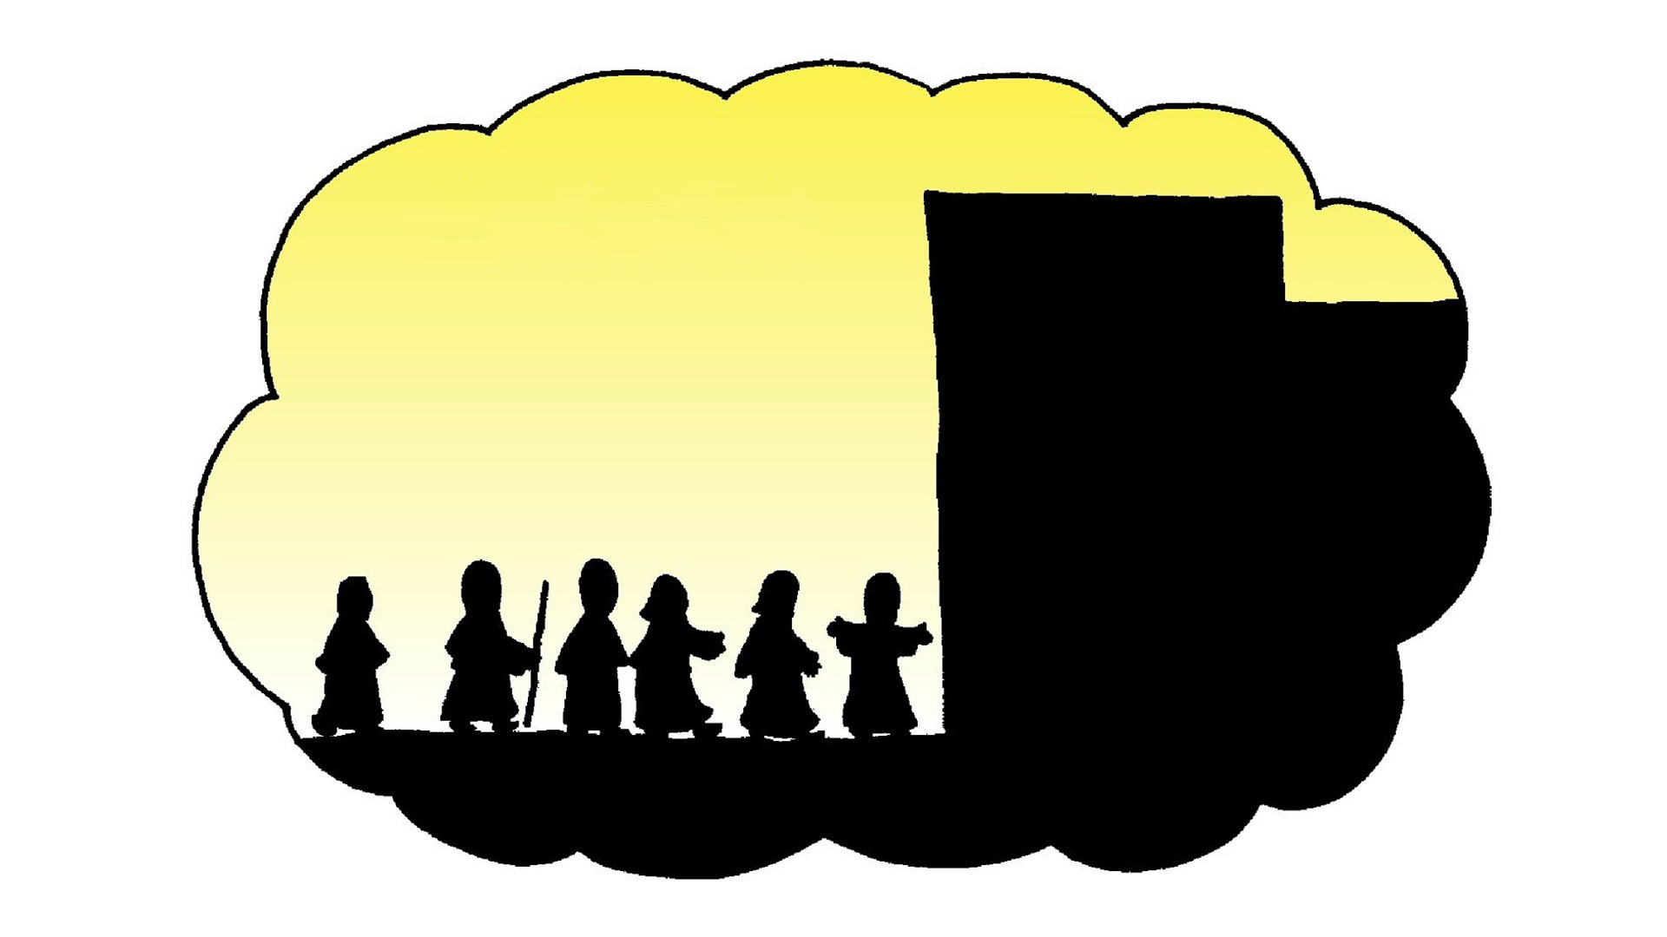
12
On the first day of the Festival of Unleavened Bread, the day the lambs for the Passover meal were killed, Jesus' disciples asked him, “Where do you want us to go and get the Passover meal ready for you?”

Slide 7
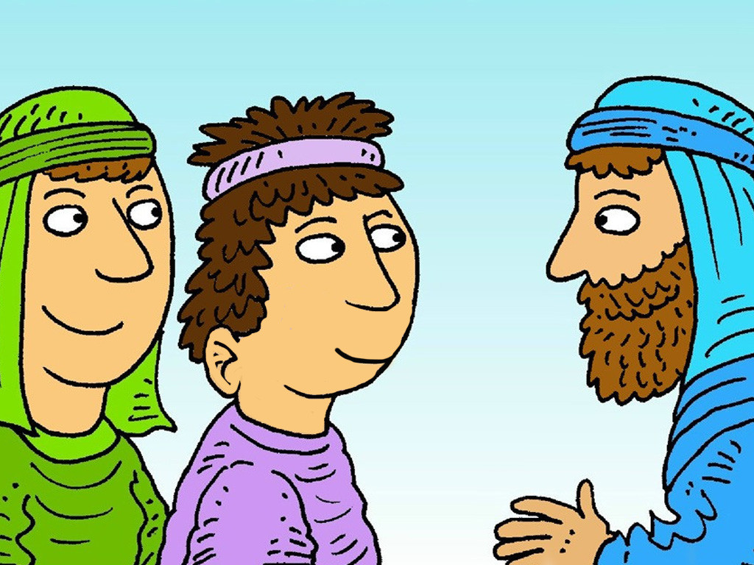
13
Then Jesus sent two of them with these instructions: “Go into the city, and a man carrying a jar of water will meet you. Follow him

Slide 8
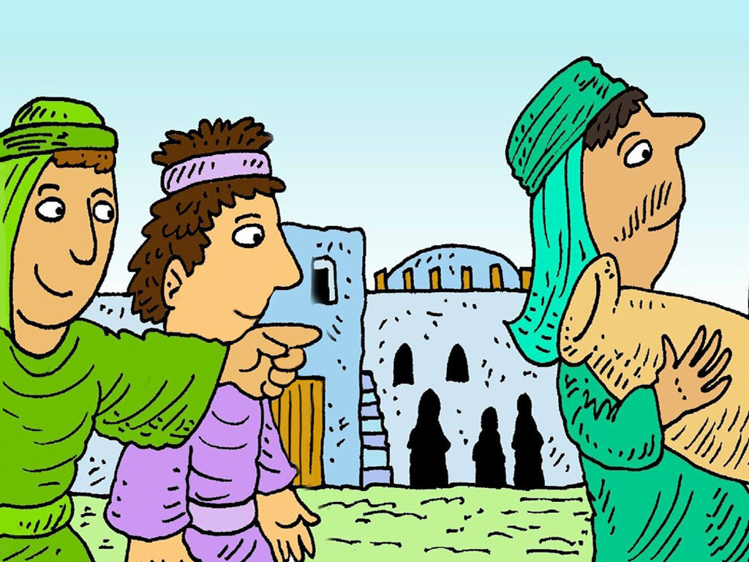
14
to the house he enters, and say to the owner of the house: ‘The Teacher says, Where is the room where my disciples and I will eat the Passover meal?’

Slide 9
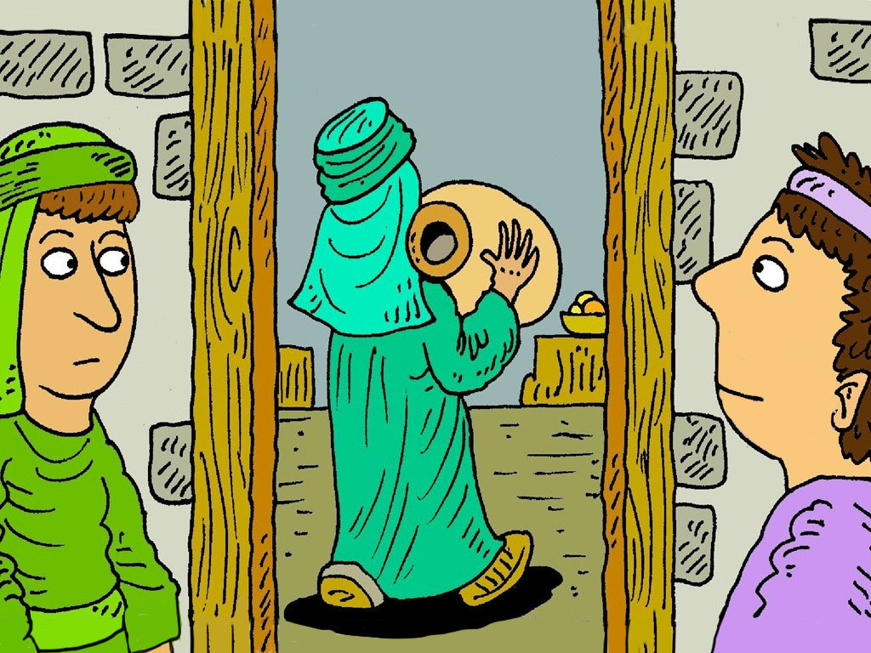
15
Then he will show you a large upstairs room, fixed up and furnished, where you will get everything ready for us.”

Slide 10
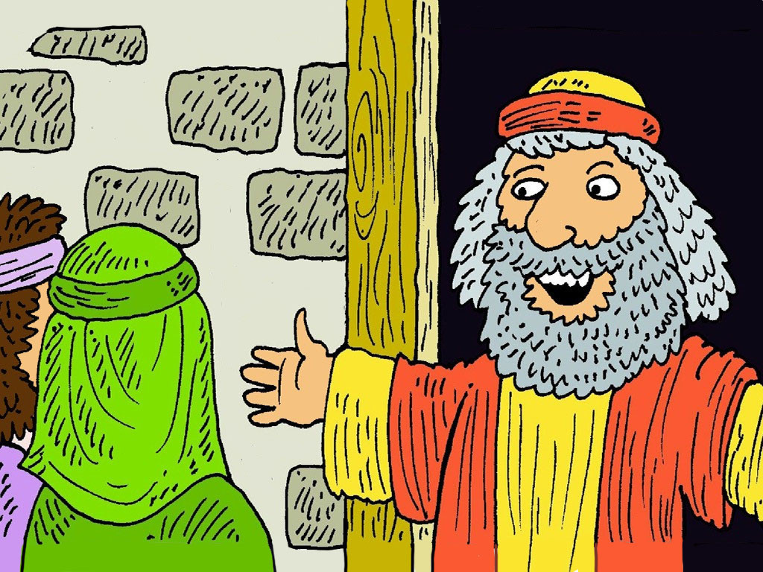
16
The disciples left, went to the city, and found everything just as Jesus had told them; and they prepared the Passover meal.

Slide 11
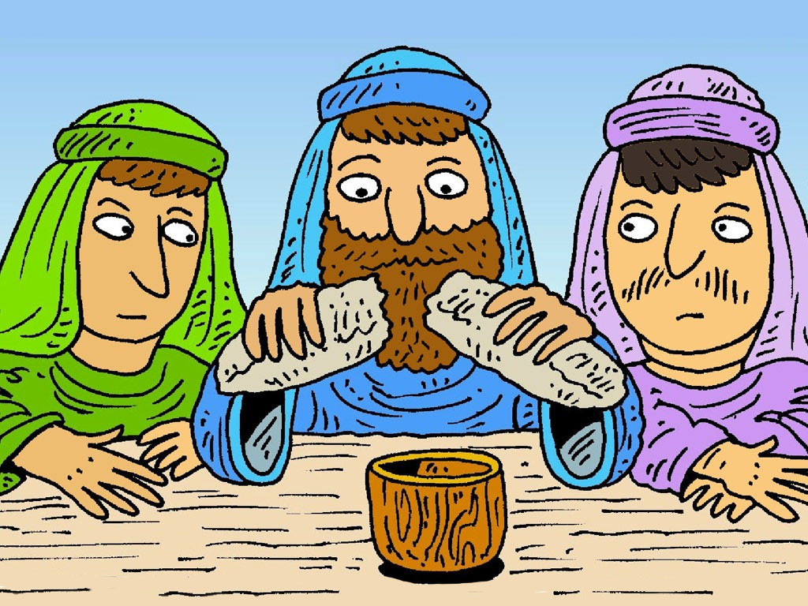
22
While they were eating, Jesus took a piece of bread, gave a prayer of thanks, broke it, and gave it to his disciples. “Take it,” he said, “this is my body.”

Slide 12
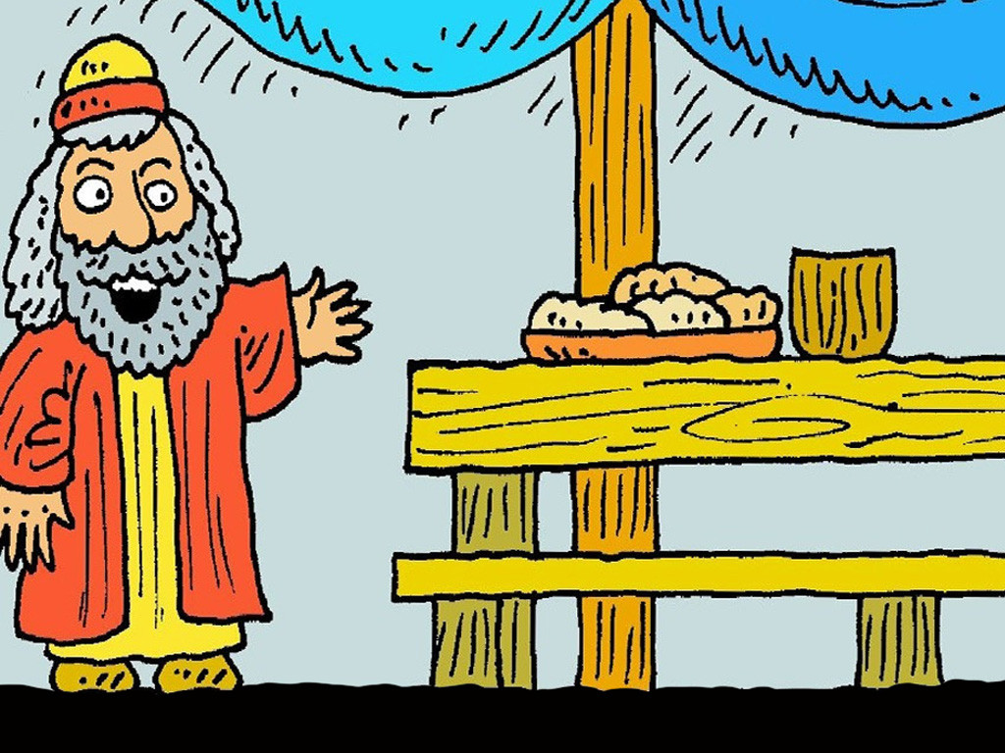
23
Then he took a cup, gave thanks to God, and handed it to them; and they all drank from it.

Slide 13
24
Jesus said, “This is my blood which is poured out for many, my blood which seals God's covenant.

Slide 14
25
I tell you, I will never again drink this wine until the day I drink the new wine in the Kingdom of God.”

Slide 15
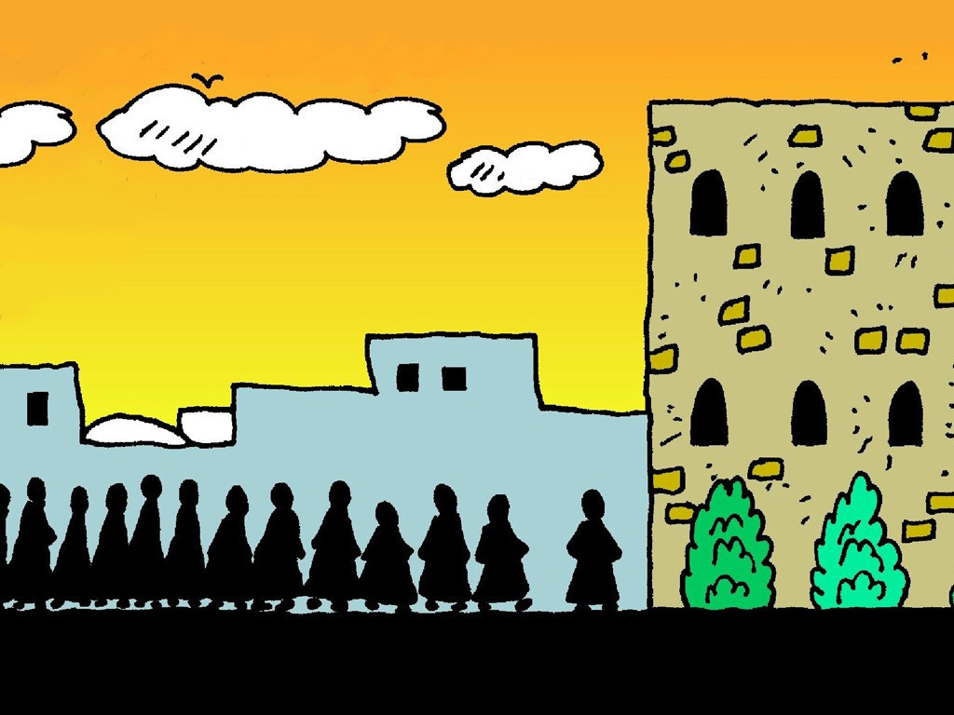
26
Then they sang a hymn and went out to the Mount of Olives.

Slide 16
Leader: The Gospel of the Lord.
All: Praise to You,
Lord Jesus Christ.

Slide 17
GOSPEL MESSAGE

Slide 18
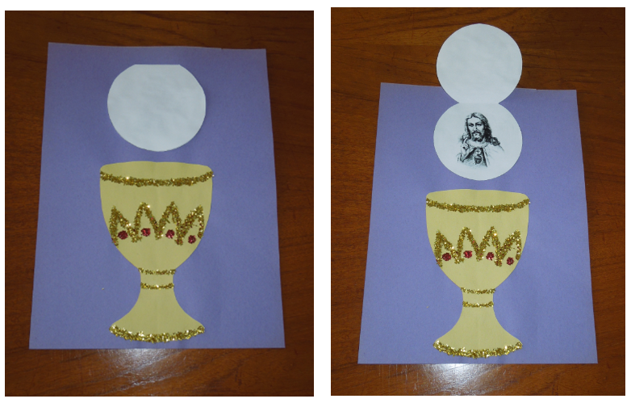
Activity:
Jesus in the Eucharist
Materials:
Blue, White and Yellow Colored Paper
Glue
Scissor
Glitters or Colors

Slide 19
Cut out circle as your host and fold host so that it opens like a door with the picture of Jesus inside.
Cut out Chalice shape. Be sure to draw in the top part of the chalice.
Glue chalice to your background paper and let your child decorate it with crayons, markers, glitter, plastic jewels, sequins, etc.
Glue host above the chalice making sure the door opens the correct way. You can also draw a cross on the outside of the host.

Slide 20
Closing Prayer
Dear Jesus, we thank you for all the gifts you have given us especially your Most precious Body and Blood. Thank you for your unconditional love for us. Help us always to choose what is right and to do good every day. Protect and guide us always in everything that we do.
In Jesus’ name we pray. Amen.

Slide 21
June 2, 2024 | The Solemnity of the Most Holy Body and Blood of Christ
CYCLE B – YEAR II

