Slide 2
Seventeenth Sunday in Ordinary Time - July 28, 2024
CYCLE B – YEAR II

Slide 3
UNDERSTANDING THE GOSPEL (for facilitators only)
Word of Jesus’ miracles and life-changing teaching was spreading—he was becoming something of a celebrity. One day, on a hillside near the Sea of Galilee, a massive crowd of over 5,000 people gathered to hear him. In the midst of the crushing mass, a bad situation became obvious to Jesus’ disciples: These people would soon be hungry and clearly there was no possible way to feed them all.
God often works in this way so we realize that only he can provide for our deepest needs and hungers. He wants us to know that he will provide even when it may not seem possible to us, and that he may also want to involve us (our time, our abilities, and so on) in the process of his provision. Are you aware, in this moment, how much you rely on God? That he is the ultimate provider of your food, your water, your shelter, even the air you breathe as you read these words? Take time to give God credit for his provision. Take stock of divine provisions in your life you may have taken for granted. Praise God for the needs he meets and the lessons he seeks to teach you through your dependence upon him.

Slide 4
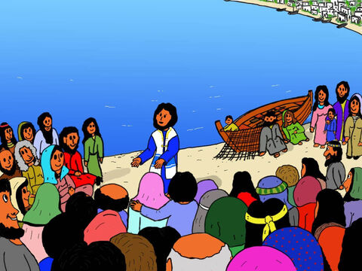
Jesus Feeds Five Thousand
John 6:1-15

Slide 5
Leader: A reading from
the Holy Gospel
according to John.
All: Glory to You, Oh Lord.

Slide 6
1
After this, Jesus went across Lake Galilee (or, Lake Tiberias, as it is also called).

Slide 7
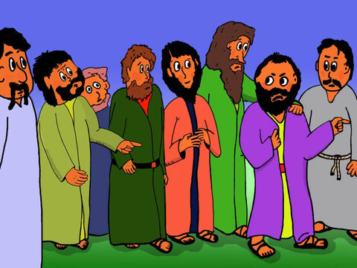
2
A large crowd followed him, because they had seen his miracles of healing the sick.

Slide 8
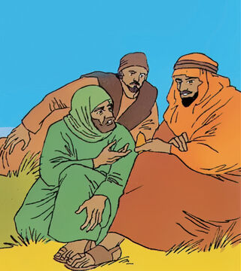
3
Jesus went up a hill and sat down with his disciples.

Slide 9
4
The time for the Passover Festival was near.

Slide 10
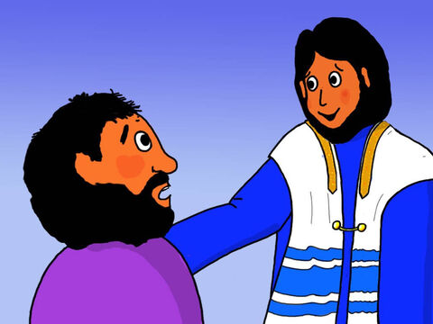
5
Jesus looked around and saw that a large crowd was coming to him, so he asked Philip, “Where can we buy enough food to feed all these people?”

Slide 11
6
(He said this to test Philip; actually he already knew what he would do.)

Slide 12
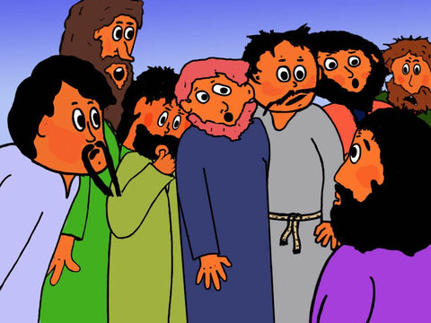
7
Philip answered, “For everyone to have even a little, it would take more than two hundred silver coins[a] to buy enough bread.”

Slide 13
8
Another one of his disciples, Andrew, who was Simon Peter's brother, said,

Slide 14
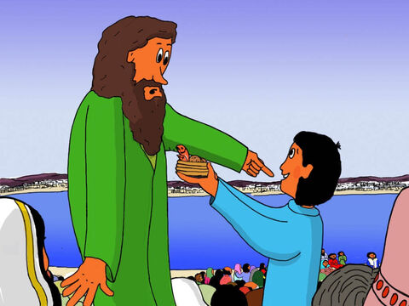
9
There is a boy here who has five loaves of barley bread and two fish. But they will certainly not be enough for all these people.”

Slide 15
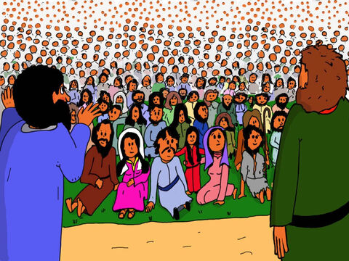
10
“Make the people sit down,” Jesus told them. (There was a lot of grass there.) So all the people sat down; there were about five thousand men.

Slide 16
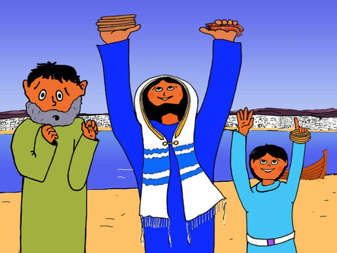
11
Jesus took the bread, gave thanks to God, and distributed it to the people who were sitting there. He did the same with the fish, and they all had as much as they wanted.

Slide 17
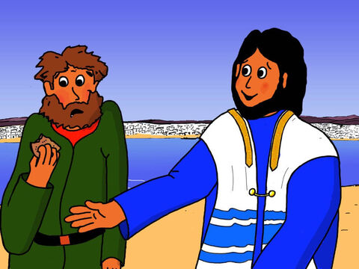
12
When they were all full, he said to his disciples, “Gather the pieces left over; let us not waste a bit.”

Slide 18
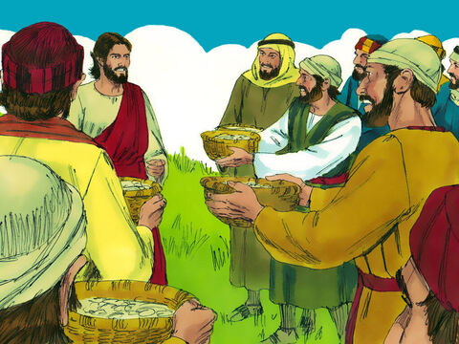
13
So they gathered them all and filled twelve baskets with the pieces left over from the five barley loaves which the people had eaten.

Slide 19
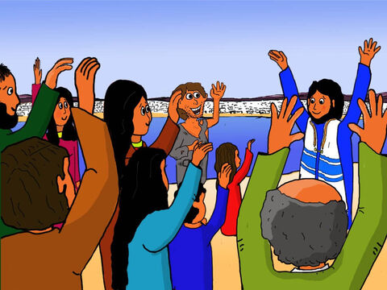
14
Seeing this miracle that Jesus had performed, the people there said, “Surely this is the Prophet[b] who was to come into the world!”

Slide 20
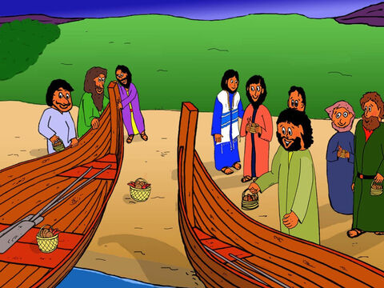
15
Jesus knew that they were about to come and seize him in order to make him king by force; so he went off again to the hills by himself.

Slide 21
Leader: The Gospel of the Lord.
All: Praise to You,
Lord Jesus Christ.

Slide 22
GOSPEL MESSAGE

Slide 23
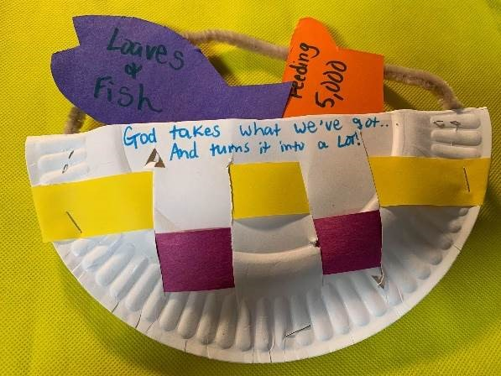
Activity: Basket Case
1. Paper plates
2. Markers, stickers,
or other decorating materials
3. Scissors
4. Glue, tape or staples
5. Paper, cut into small strips

Slide 24
Activity: Basket Case
1. Cut the plate in half, and cut vertical slits in each half, about an inch apart.
2. Take one strip of paper at a time and weave it in and out of the slits in the plate.
3. Once the weaving is complete, staple the plates together to make a “basket.”
4. Add decorations as desired. Attach a pipe cleaner handle.
5. Cut the paper into shapes of fish and bread loaves.
6. Add captions and verses.

Slide 25
Closing Prayer
Dear God
We thank you Jesus for speaking to us today! We ask for forgiveness for the times that we don’t share the things that we have to others, Please used us Lord to be a blessing to others. May your will be done in us. Amen.
Oh, Glory be to the Father, into the Son and into the Holy Spirit. As it was in the beginning is now and ever shall be world without end.
Amen!

