Slide 2
Sixteenth Sunday in Ordinary Time - July 21, 2024
CYCLE B – YEAR II

Slide 3
UNDERSTANDING THE GOSPEL (for facilitators only)
In a world today with a busy life, with many people around, there was little opportunity to take a break or even to eat. Jesus saw the need for rest, for some quiet time, and he invited the apostles to a deserted place for a rest. It remains a good message to all who have busy lives. May we have the wisdom to step back and not let work dominate us to the point of exhaustion.
The people observed where Jesus and the apostles were going and hurried there. Jesus assessed the situation, recognised their need and was able to forego his time of rest to reach out to them. Lord, help us to recognise when we are selfish and when there is a genuine call to respond, so that we may be guided by you in our relationships with others.

Slide 4
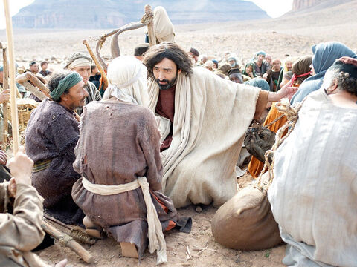
Jesus Feeds Five Thousand
Mark 6:30-34

Slide 5
Leader: A reading from
the Holy Gospel
according to Mark.
All: Glory to You, Oh Lord.

Slide 6
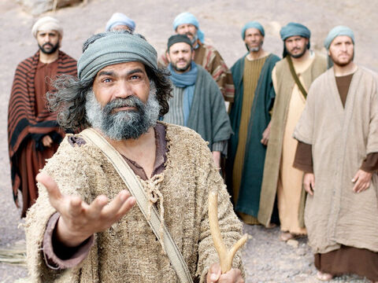
30
The apostles returned and met with Jesus, and told him all they had done and taught.

Slide 7
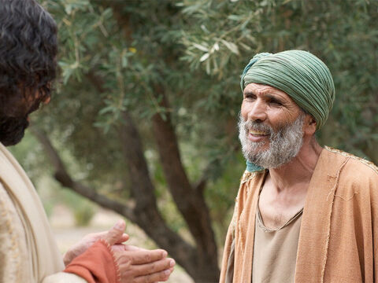
31
There were so many people coming and going that Jesus and his disciples didn't even have time to eat. So he said to them, “Let us go off by ourselves to some place where we will be alone and you can rest a while.”

Slide 8
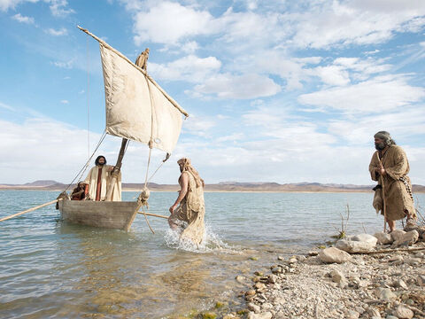
32
So they started out in a boat by themselves to a lonely place.

Slide 9
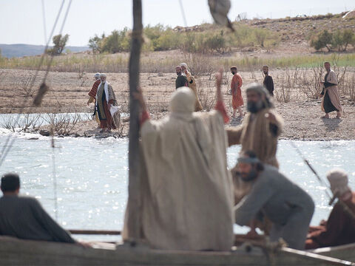
33
Many people, however, saw them leave and knew at once who they were; so they went from all the towns and ran ahead by land and arrived at the place ahead of Jesus and his disciples.

Slide 10
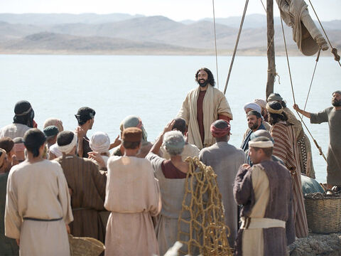
34
When Jesus got out of the boat, he saw this large crowd, and his heart was filled with pity for them, because they were like sheep without a shepherd. So he began to teach them many things.

Slide 11
Leader: The Gospel of the Lord.
All: Praise to You,
Lord Jesus Christ.

Slide 12
GOSPEL MESSAGE

Slide 13
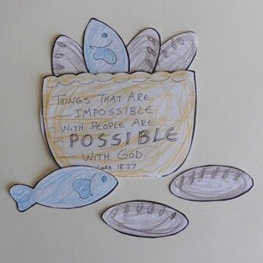
Activity:
Five loaves and two fishes craft
Materials:
Paper
Crayons
Scissors
Tape or Stapler

Slide 14
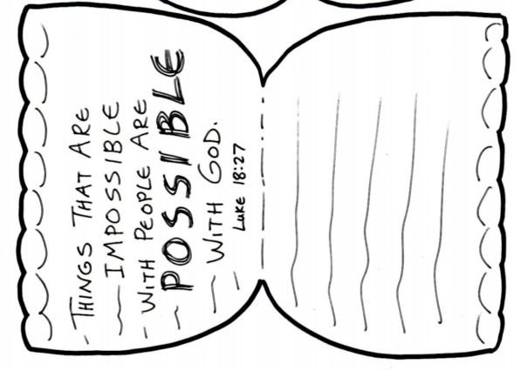
Fold your paper into two and draw a basket shaped. You can write the verse Luke 18:27 or “God is generous” phrase.
Cut it out then use tape or stapler to stick both sides.

Slide 15
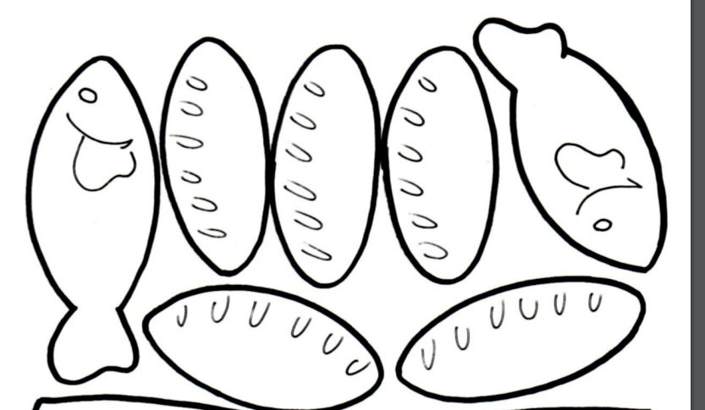
Draw a fish and bread on a separate paper then cut it out.
At the back of each cut outs, write down one blessing that you received from the Lord.
Put your fish in your basket after.

Slide 16
Closing Prayer
Dear God
Our Father, thank you for being generous in our lives. Thank you for blessing us and for your providence in our families. Make us also an instrument of your love. Teach us how to give especially to those people who are in need. May you always protect and guide us.
Amen!

