Slide 2
Fifteenth Sunday in Ordinary Time - July 14, 2024
CYCLE B – YEAR II

Slide 3
UNDERSTANDING THE GOSPEL (for facilitators only)
Here our Lord sends out His apostles – two by two – temporarily equipped with the Holy Spirit’s power which they were to fully receive after His Ascension obviously now here pre His Ascension – seemingly, just a little taste of what was to come! Thus far they had been privy merely to sit at His feet hearing His teaching and being eyewitnesses to His miracles. Yet the Lord Jesus had blessed them to be a blessing. Now they were about to learn the valuable lesson that His power extended beyond His personal presence – some knowledge can be learned better on a fieldtrip rather than in a classroom. The process of sending them out two by two would allow for mutual encouragement of both hands and heart. Most assuredly, two are better than one.
Jesus sent them is to fulfill a specific special commission – His in-depth instructions were pertaining to that particular mission. In other words, these instructions were not to be taken as “Law” for all further mission assignments. He empowered them with His authority over evil spirits so that their message would be authenticated. They were to depend upon God to supply them with life’s necessities through the hospitality of others as God’s Hand moved hearts to meet their needs. They were not to depend upon their own resources and strength.

Slide 4
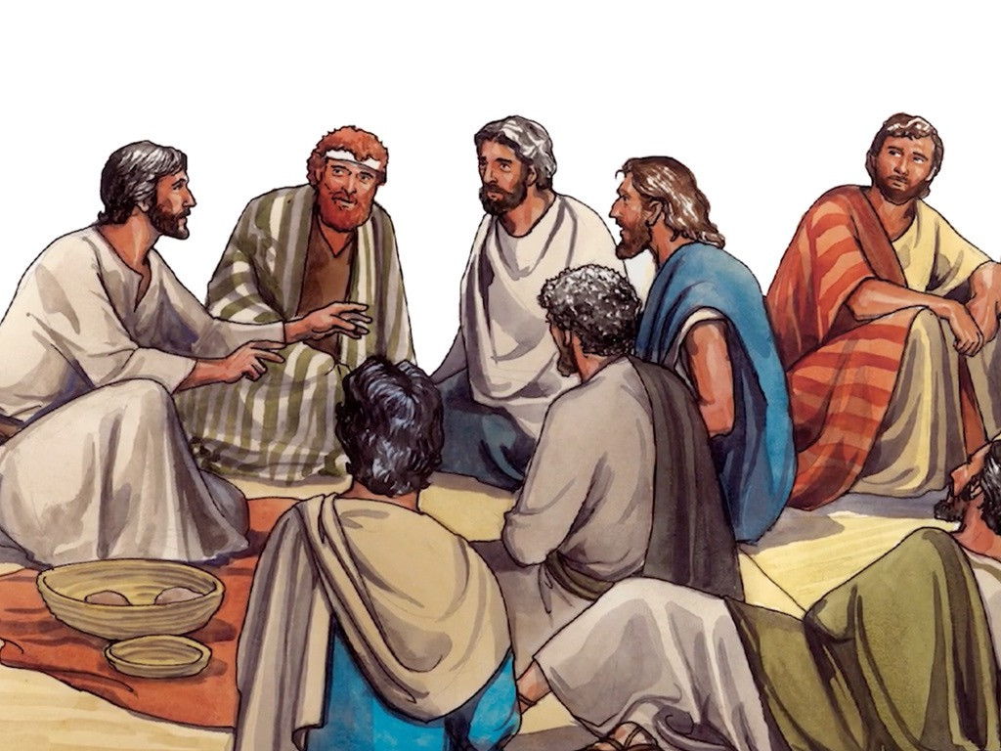
The Mission of the Twelve
Mark 6:7-13

Slide 5
Leader: A reading from
the Holy Gospel
according to Mark.
All: Glory to You, Oh Lord.

Slide 6
7
Jesus summoned the Twelve and began to send them out two by two and gave them authority over unclean spirits.

Slide 7
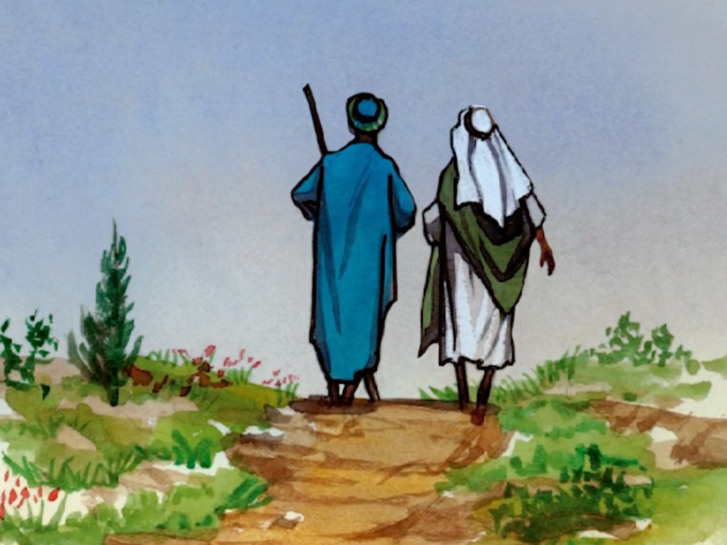
8
He instructed them to take nothing for the journey but a walking stick no food, no sack, no money in their belts.

Slide 8
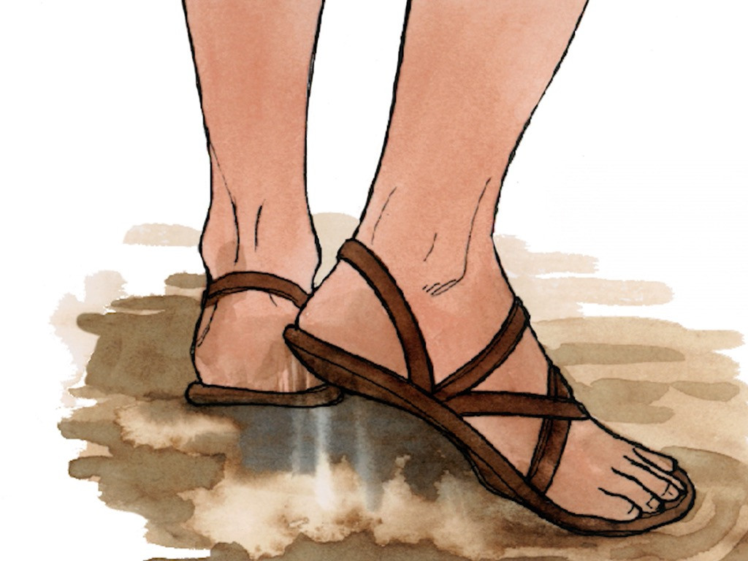
9
They were, however, to wear sandals but not a second tunic.

Slide 9
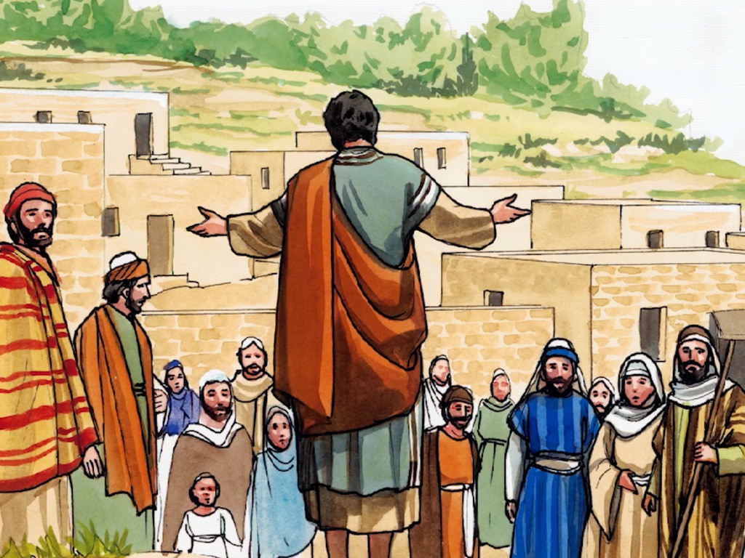
10
He said to them, “Wherever you enter a house, stay there until you leave.

Slide 10
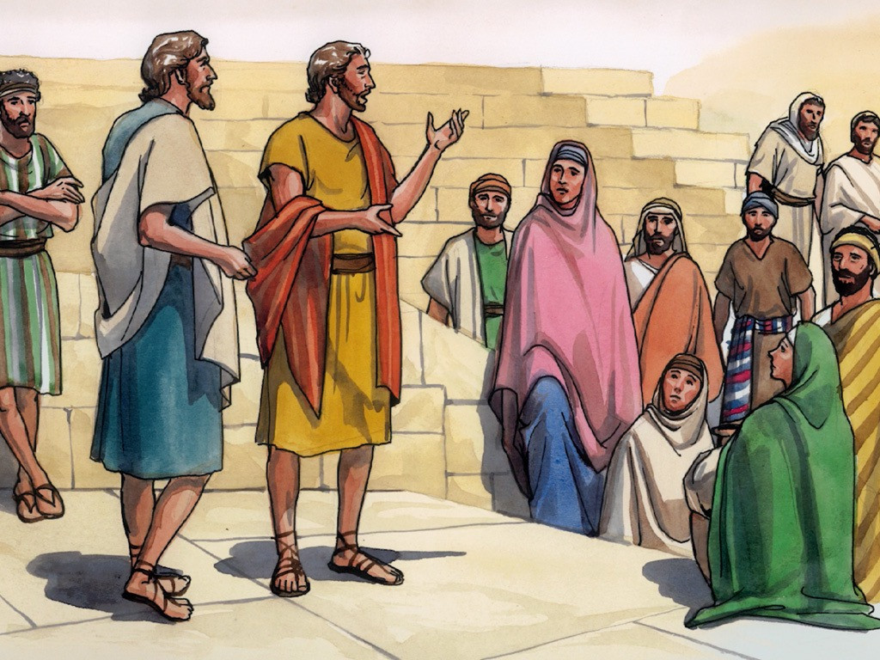
11
Whatever place does not welcome you or listen to you, leave there and shake the dust off your feet in testimony against them.”

Slide 11
12
So they went off and preached repentance.

Slide 12
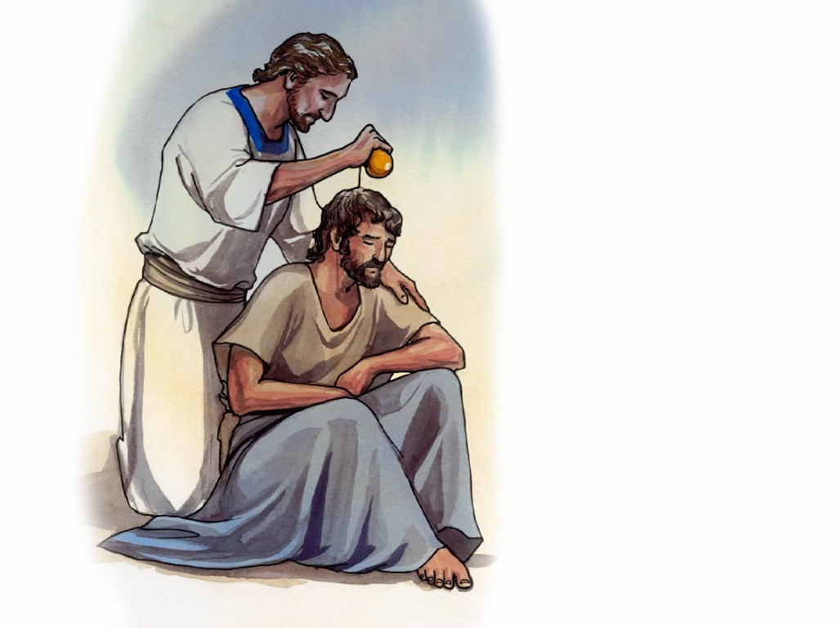
13
The Twelve drove out many demons, and they anointed with oil many who were sick and cured them.

Slide 13
Leader: The Gospel of the Lord.
All: Praise to You,
Lord Jesus Christ.

Slide 14
GOSPEL MESSAGE

Slide 15
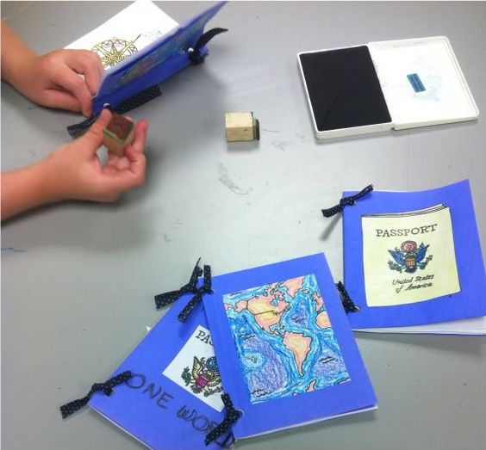
Activity:
Passport of mission
1. Colored papers
2. Pen
3. Scissors
4. Crayons
5. Ribbon
6. Puncher

Slide 16
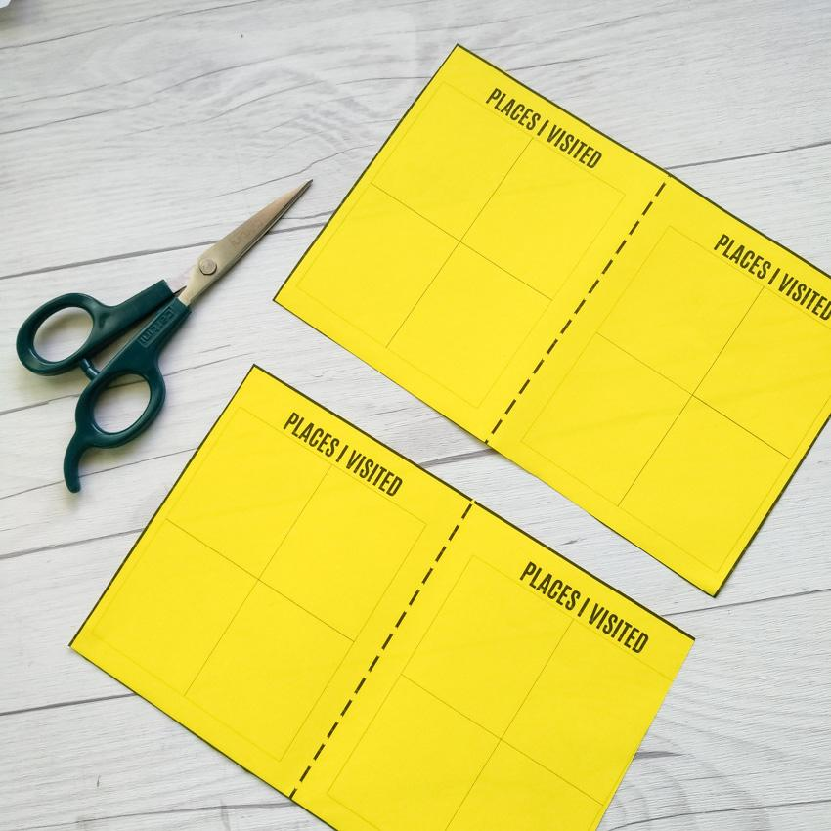
Cut the colored paper in half, crosswise.
Fold the halfed paper to make a passport, then combine all the pages.
Make a hole at the side using the puncher
Tie the ribbon in the hole to bind the pages of the passport.
Write the school works or household chores per page, if you finished the chores your parents will put a stamp.

Slide 17
Closing Prayer
Dear God
We thank you Jesus for speaking to us today! We ask for forgiveness for the times that we don’t listen to you, Lord. Please strengthen our faith and remove our doubts. May your will be done in us. Amen.
Oh, Glory be to the Father, into the Son and into the Holy Spirit. As it was in the beginning is now and ever shall be world without end.
Amen!

