Slide 2
Solemnity of the Epiphany of the Lord | January 7, 2023
CYCLE B – YEAR II

Slide 3
UNDERSTANDING THE GOSPEL (for facilitators only)
Today the Church celebrates the Feast of the Epiphany. On Epiphany we recognize that Jesus, the light of the world, was made visible to the magi who searched for him. On today’s feast we celebrate that God’s saving love is offered to all people.
Today's gospel relates the story of the Three Kings. The word used in Matthew 2:1 ("Magi") referred to Persian priest-astrologers who saw the divine will written in the stars of the night skies. Through their studies, they believed someone great was born. So, they searched for someone new, someone who would enlighten a dark world. Matthew used the story of the traveling stargazers to present a theme. Even the infant Jesus was a light to all people, just not his own.
These wise men from the east find the Christ child by following the light of a star. These magi are foreigners, travelers from a different country. They are Gentiles who have never learned about the Law or the prophets. However, they find their way to Jesus and honor him. The wise men follow a star, which leads them to Jesus Christ, the light of salvation.

Slide 4
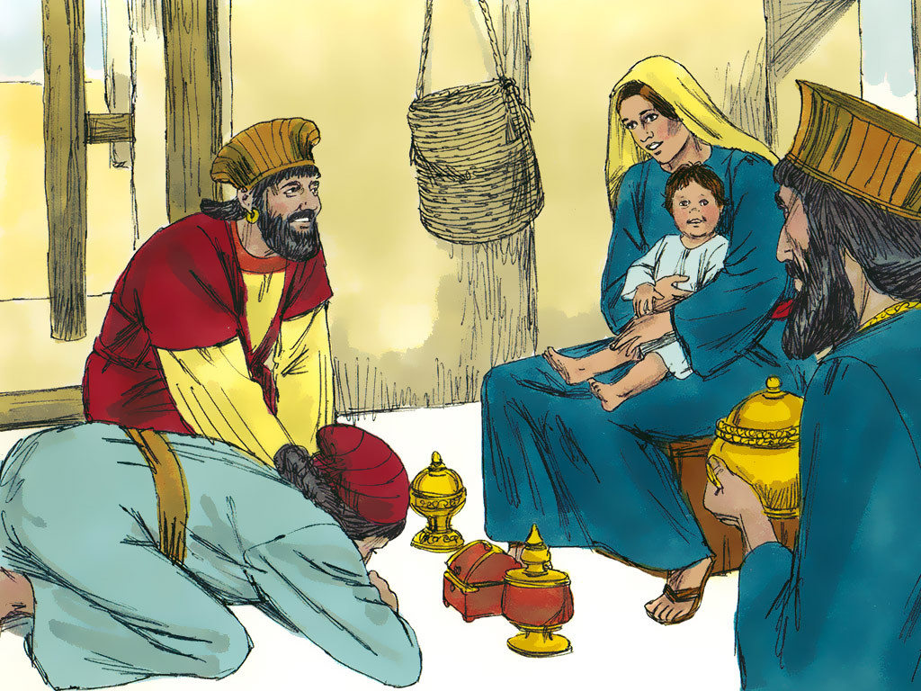
The Visit of the Magi
Matthew 2:1-12

Slide 5
Leader: A reading from
the Holy Gospel
according to Matthew.
All: Glory to You, Oh Lord.

Slide 6
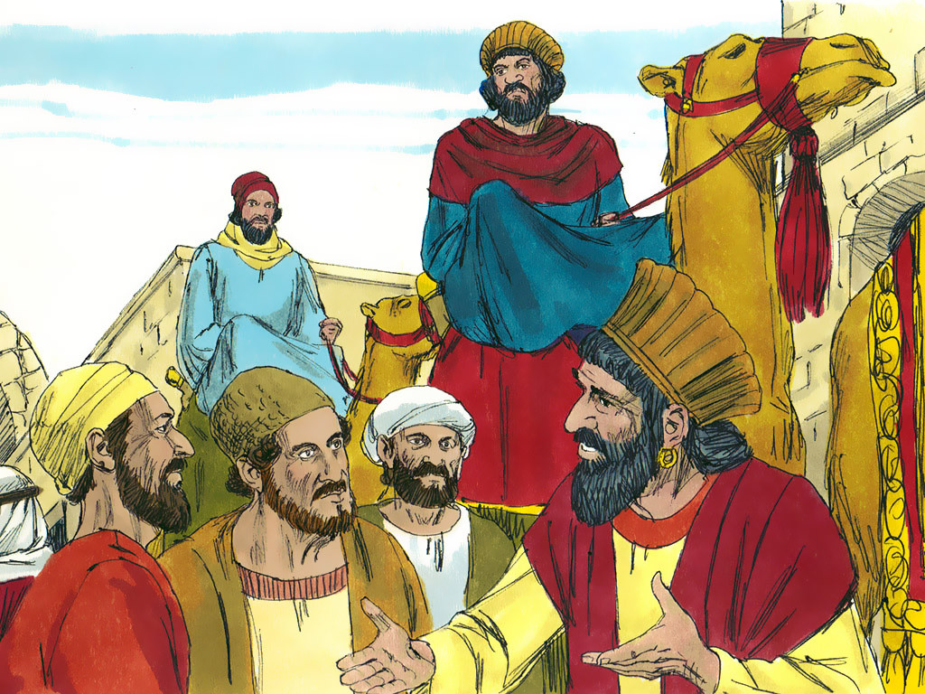
1
Jesus was born in the town of Bethlehem in Judea, during the time when Herod was king. Soon afterward, some men who studied the stars came from the East to Jerusalem

Slide 7
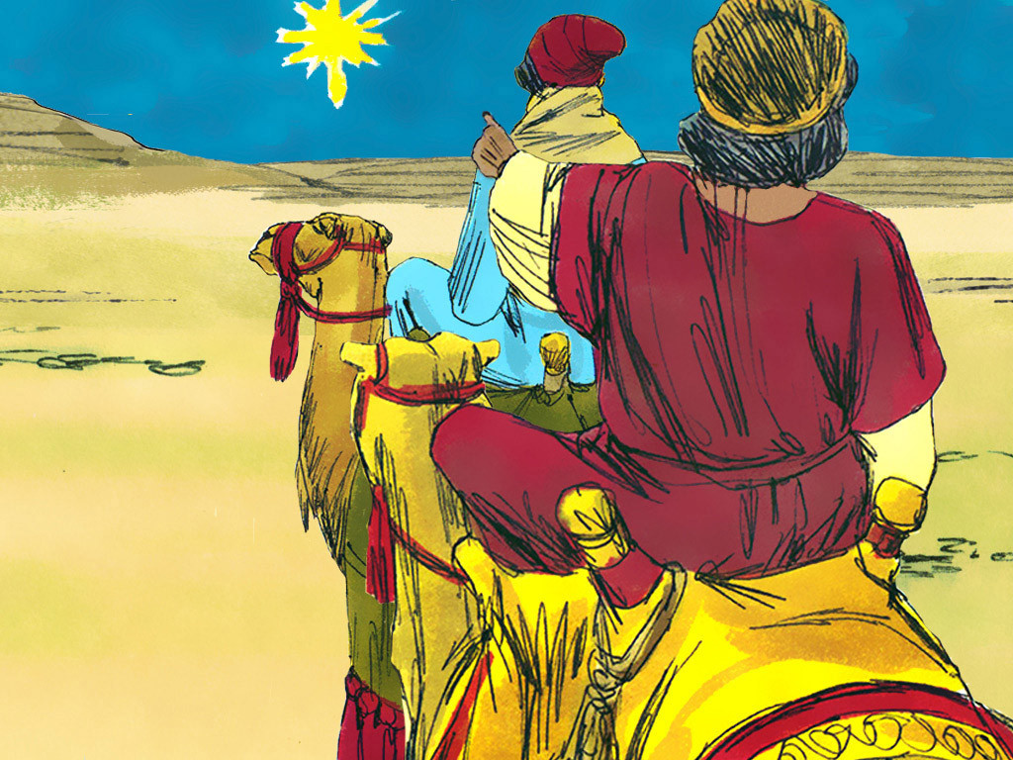
2
and asked, “Where is the baby born to be the king of the Jews? We saw his star when it came up in the east, and we have come to worship him.”

Slide 8
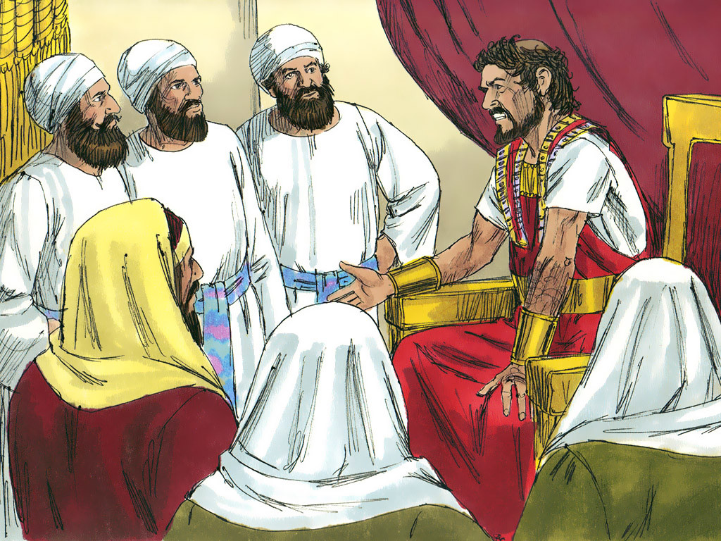
3
When King Herod heard about this, he was very upset, and so was everyone else in Jerusalem.

Slide 9
4
He called together all the chief priests and the teachers of the Law and asked them, “Where will the Messiah be born?”

Slide 10
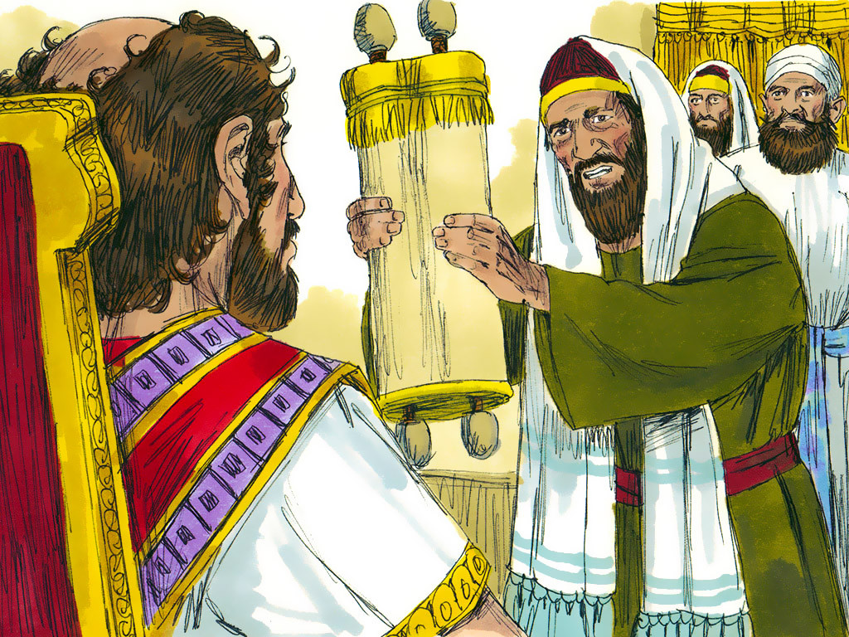
5
“In the town of Bethlehem in Judea,” they answered. “For this is what the prophet wrote:

Slide 11
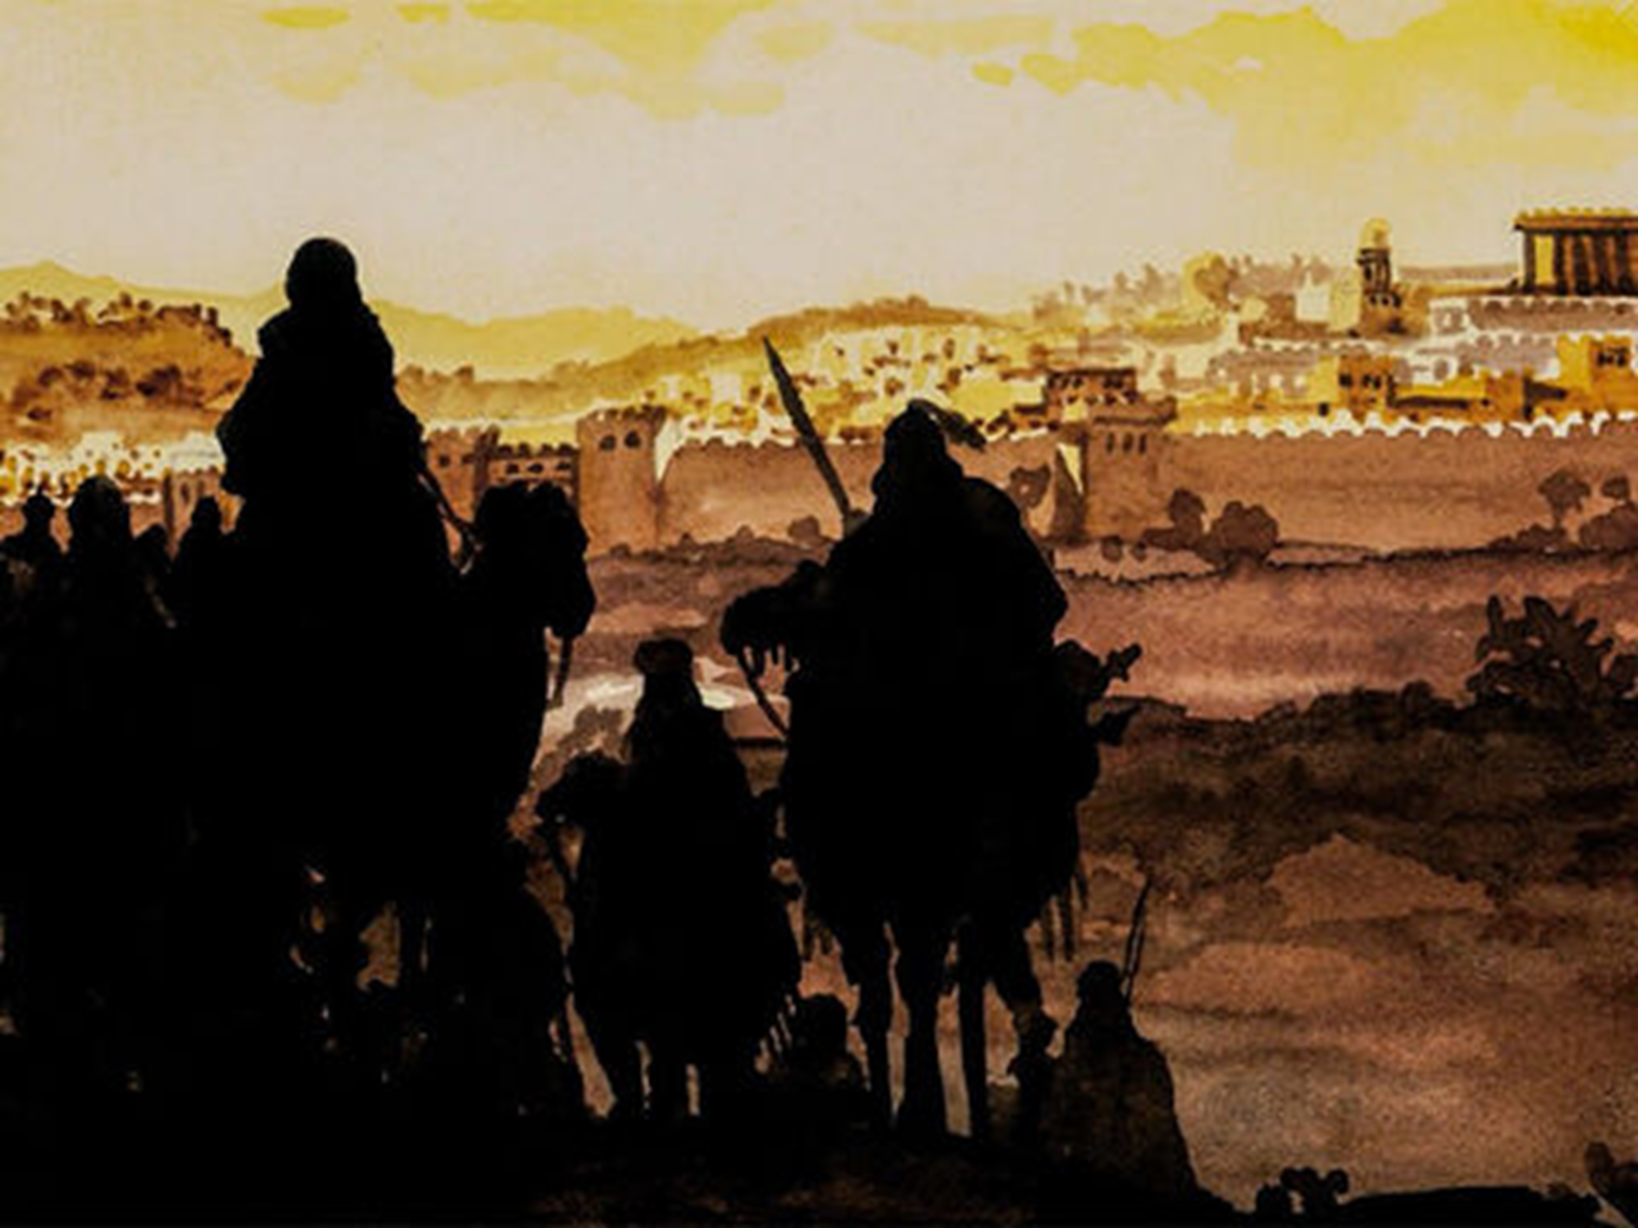
6
‘Bethlehem in the land of Judah, you are by no means the least of the leading cities of Judah; for from you will come a leader who will guide my people Israel.’”

Slide 12
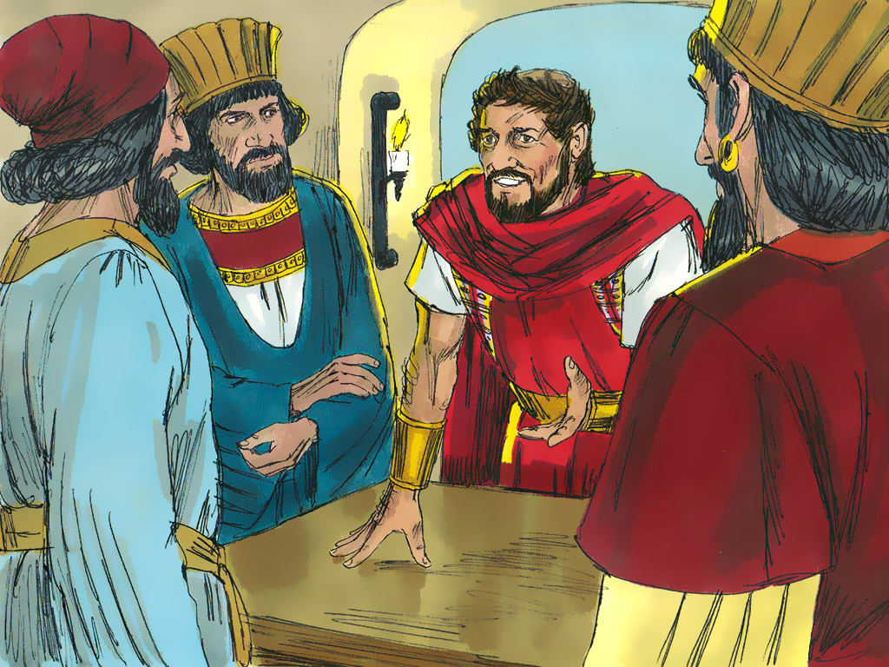
7
So, Herod called the visitors from the East to a secret meeting and found out from them the exact time the star had appeared.

Slide 13
8
Then he sent them to Bethlehem with these instructions: “Go and make a careful search for the child; and when you find him, let me know, so that I too may go and worship him.”

Slide 14
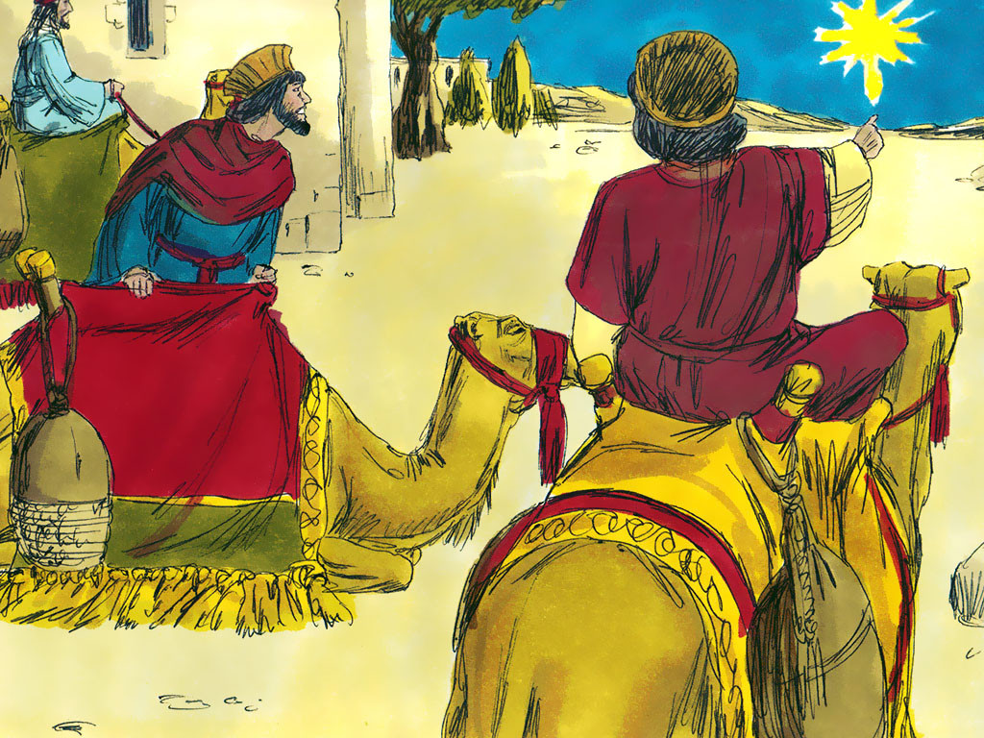
9-10
And so they left, and on their way they saw the same star they had seen in the East. When they saw it, how happy they were, what joy was theirs! It went ahead of them until it stopped over the place where the child was.

Slide 15
11
They went into the house, and when they saw the child with his mother Mary, they knelt down and worshiped him. They brought out their gifts of gold, frankincense, and myrrh, and presented them to him.

Slide 16
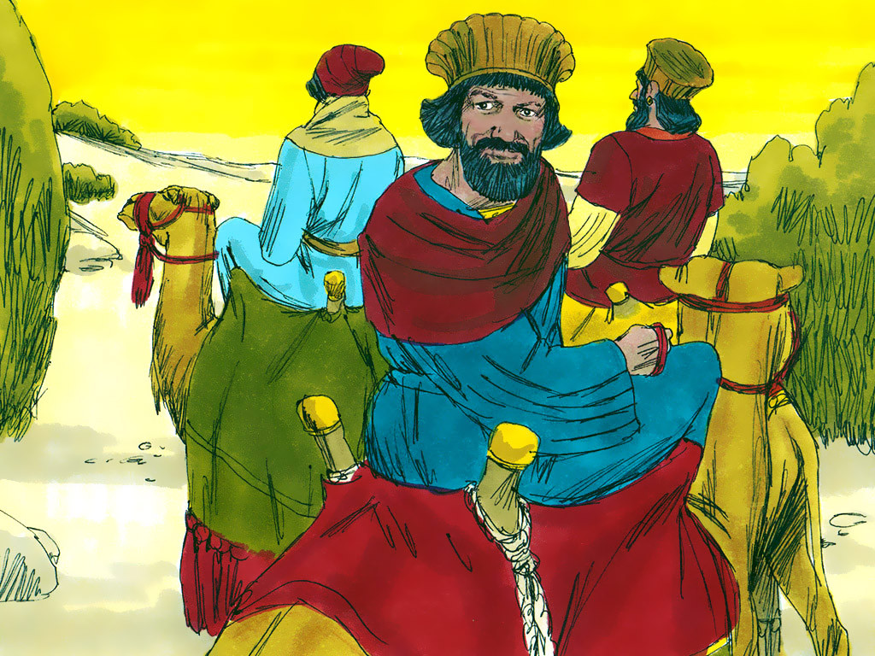
12
Then they returned to their country by another road, since God had warned them in a dream not to go back to Herod.

Slide 17
Leader: The Gospel of the Lord.
All: Praise to You,
Lord Jesus Christ.

Slide 18
GOSPEL MESSAGE

Slide 19
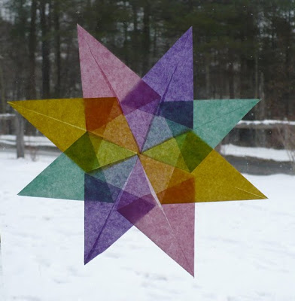
Activity: Guiding Star
Colored Paper
Coloring Materials
Pen/Marker
Scissors
Glue

Slide 20
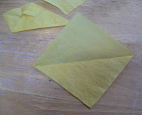
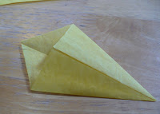
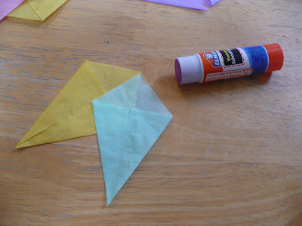
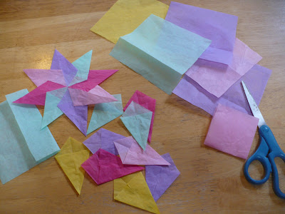
Instructions:
Cut paper into square. Make 8 pieces of square paper.
Fold each square diagonally.
Fold both side over and glue it.
Put it together to make it a star.
Write names who always guides you (ie. Your parents, Siblings, Teacher, Friends, etc.)

Slide 21
Closing Prayer
Dear God,
Thank you for all the gifts you have given to us. Thank you for always guiding us and lightning our path to the greatest gift who is Jesus. And may we share this light and gift to others. Be the treasure in our hearts.
Be the gift that we give.
In Jesus' name we pray.
Amen.

Slide 22
Solemnity of the Epiphany of the Lord | January 7, 2023
CYCLE B – YEAR II

