Slide 2
January 28, 2024 | Fourth Sunday in Ordinary Time
CYCLE B – YEAR II

Slide 3
REFLECTION FROM THE GOSPEL (for facilitators only)
The Gospel talks about how Jesus has control over everything. When Jesus was on Earth, He showed His power by getting rid of demons, healing sick and injured people, controlling the weather, and even bringing dead people back to life! He was and still is stronger than anything else. So, we can trust Him and listen to Him because we know He has authority. If we let Him, Jesus has power and control in our lives.
Jesus didn't just share nice ideas; when He spoke, it carried weight because He was God! In the Bible, Jesus proved He had authority and strength. We can still count on that today, knowing He takes care of us and provides for us. Jesus is more powerful and dependable than anything we can think of. That's something we can find hope and comfort in.

Slide 4
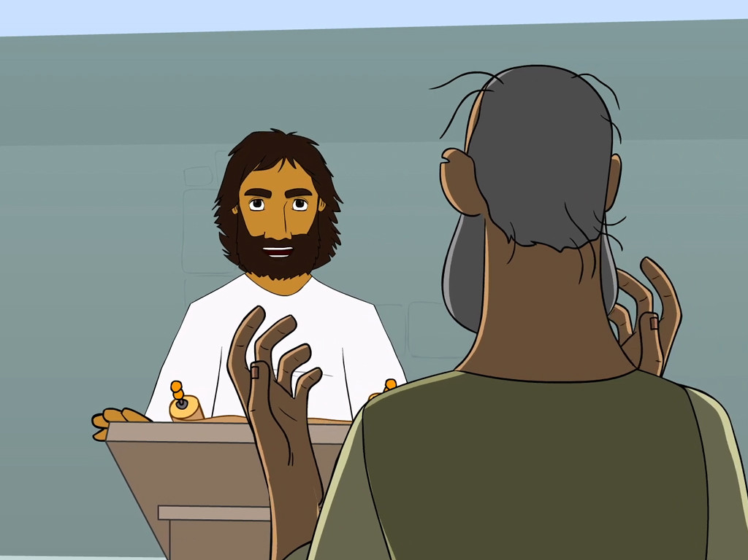
A Man with an Evil Spirit
Mark 1:21-28

Slide 5
Leader: A reading from
the Holy Gospel
according to Mark.
All: Glory to You, Oh Lord.

Slide 6
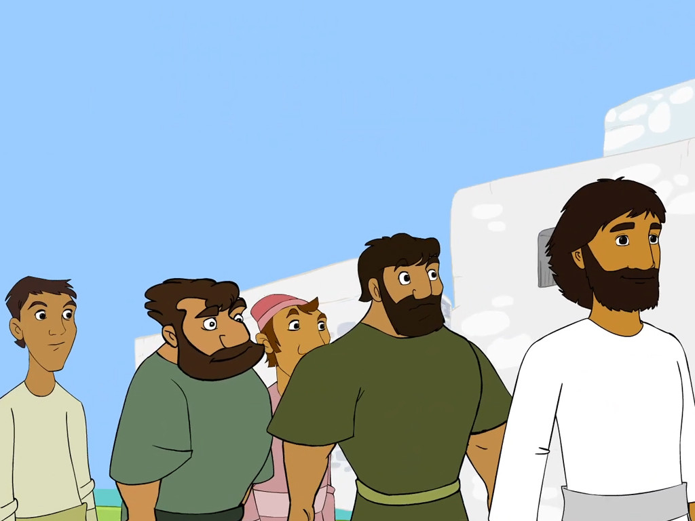
21
Jesus and his disciples came to the town of Capernaum, and on the next Sabbath Jesus went to the synagogue and began to teach.

Slide 7
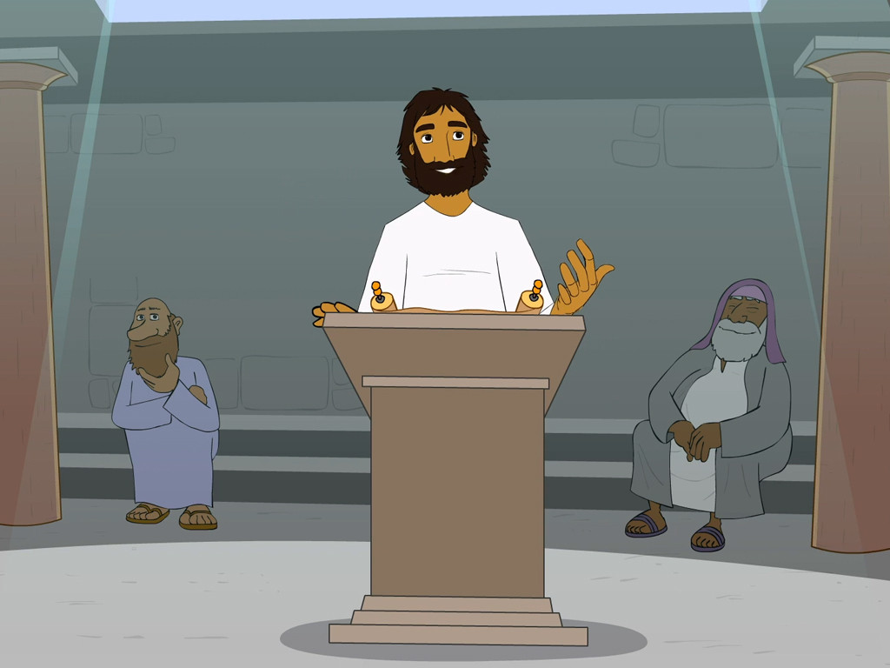
22
The people who heard him were amazed at the way he taught, for he wasn't like the teachers of the Law; instead, he taught with authority.

Slide 8
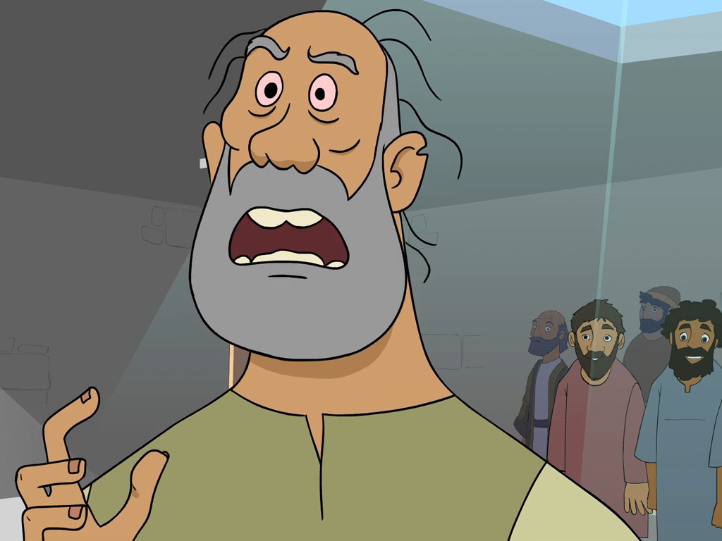
23
Just then a man with an evil spirit came into the synagogue and screamed,

Slide 9
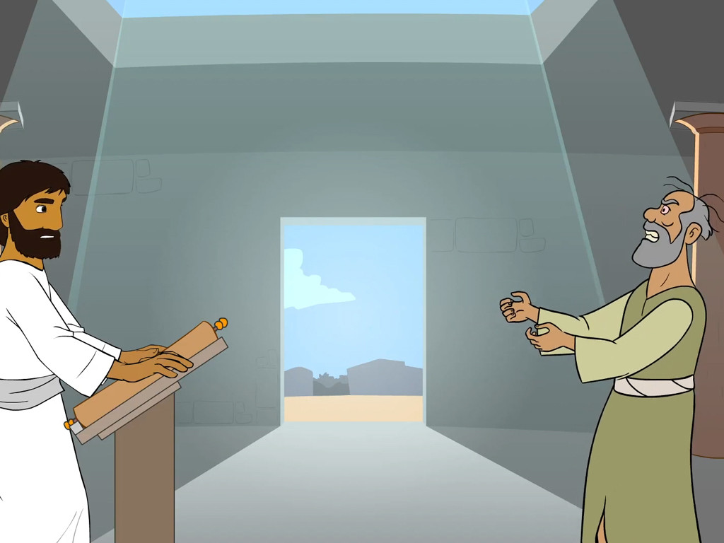
24
“What do you want with us, Jesus of Nazareth? Are you here to destroy us? I know who you are—you are God's holy messenger!”

Slide 10
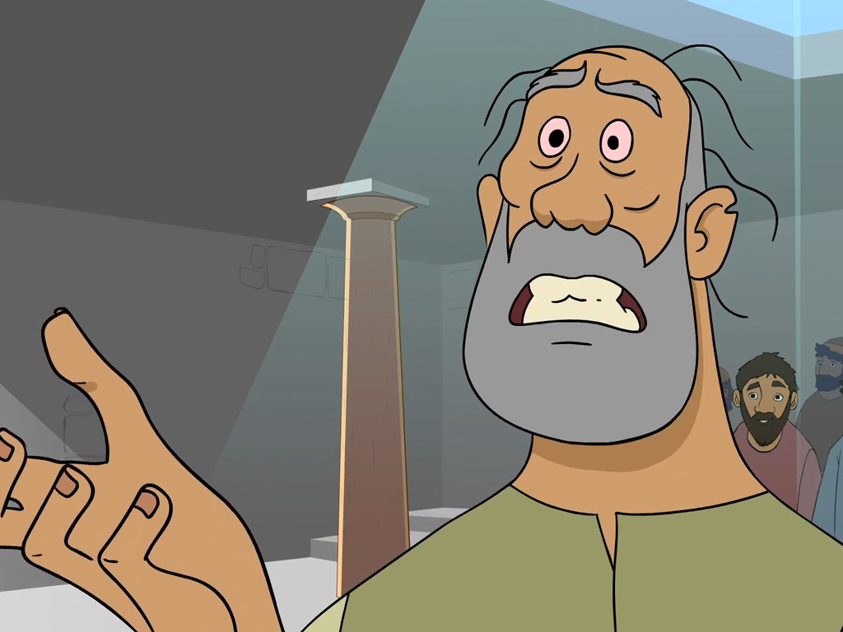
25
Jesus ordered the spirit, “Be quiet, and come out of the man!”

Slide 11
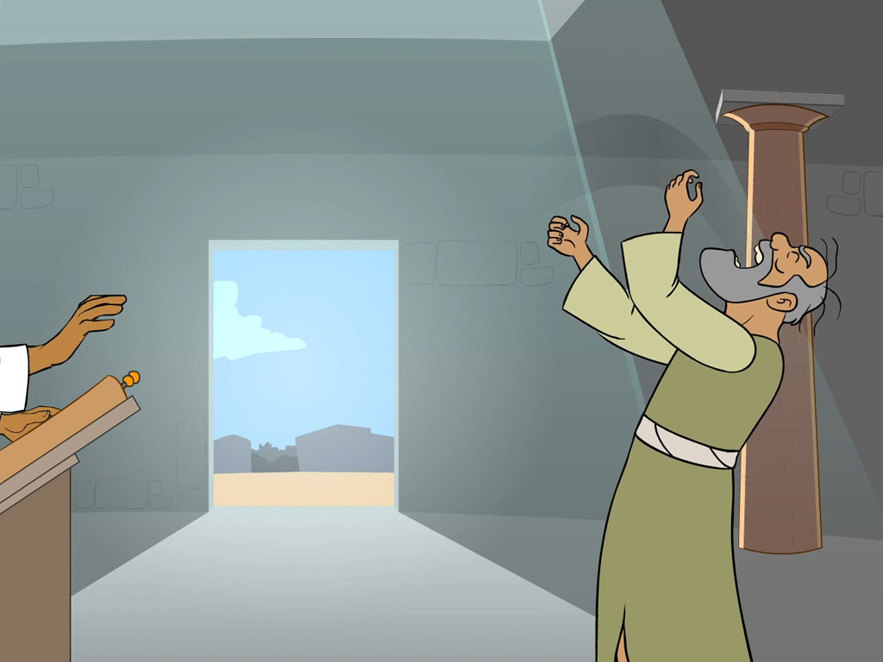
26
The evil spirit shook the man hard, gave a loud scream, and came out of him.

Slide 12
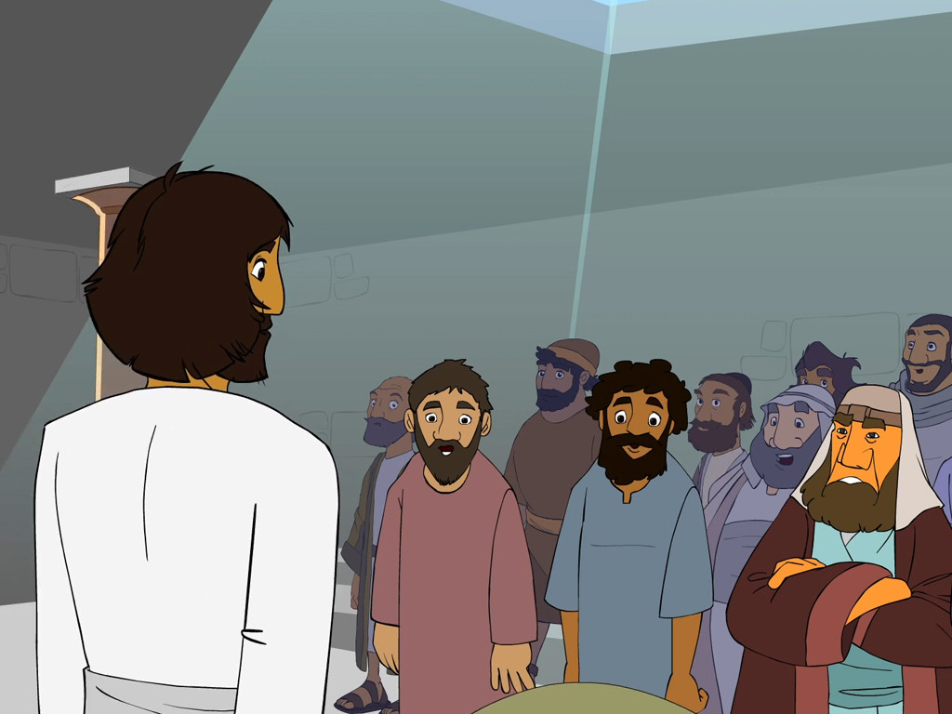
27
The people were all so amazed that they started saying to one another, “What is this? Is it some kind of new teaching? This man has authority to give orders to the evil spirits, and they obey him!”

Slide 13
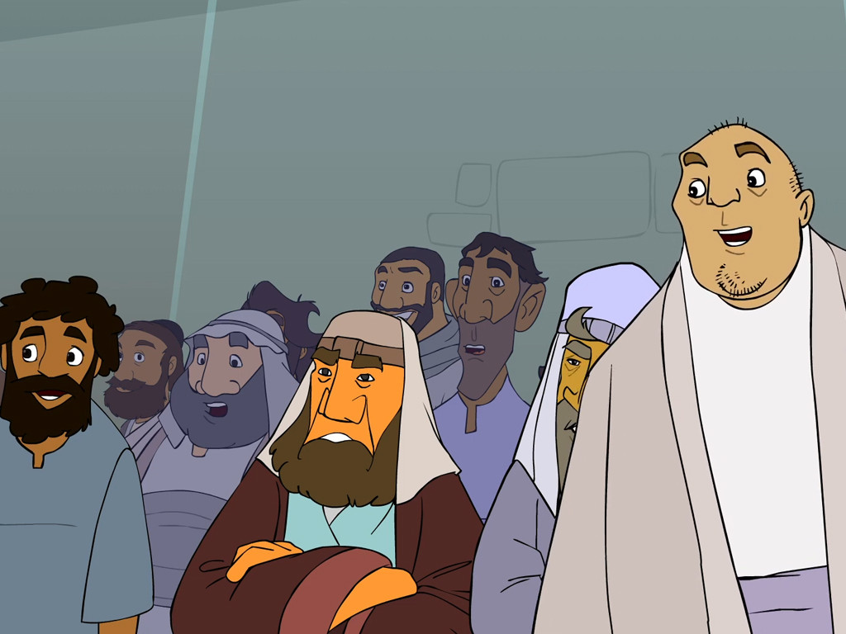
28
And so the news about Jesus spread quickly everywhere in the province of Galilee.

Slide 14
Leader: The Gospel of the Lord.
All: Praise to You,
Lord Jesus Christ.

Slide 15
GOSPEL MESSAGE

Slide 16
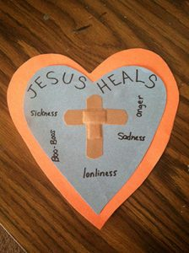
Activity:
First Aid for the Soul
Materials:
Construction papers
(at least 2 different colors)
Scissors
Crayons
Markers / Pens
Glue
Band-aids (at least 2)

Slide 17
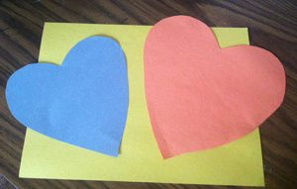

Slide 18
Instructions:
1. Make two paper hearts, one large and one smaller using the construction paper.
2. Have children write or copy “Jesus Heals” on the smaller heart. Guide the kids in creating a cross on the heart with their band-aids.
3. Have children glue the smaller heart onto the larger heart. You can encourage children to jot down or draw pictures of things they believe Jesus can heal.

Slide 19
Closing Prayer
Dear God,
We know that You have all power and authority. You are stronger than anything we can imagine. Help us to trust in You. And make you authority in our lives. Thank you for your love. We love you!
In the name of Jesus Christ, we pray.
Amen.

Slide 20
January 28, 2024 | Fourth Sunday in Ordinary Time
CYCLE B – YEAR II

