Slide 2
January 21, 2024 | Feast of Sto. Nino
CYCLE B – YEAR II

Slide 3
REFLECTION FROM THE GOSPEL (for facilitators only)
The Gospel teaches us to love. In this Gospel, Jesus shows how much he cared for children. While he was talking to people, a bunch of kids came around, being loud and full of energy, just having a good time. The apostles tried to send them away, saying they were being too noisy and distracting. Jesus stepped in, invited the children closer, and showed them love by spending time with them and showing affection.
Kids have a special gift of living in the present moment. They find joy in simple things and laughter. Today, take a moment to appreciate the children in your life—whether it's your own kids, those you meet at school, the store, playground, church, or in your neighborhood. Thank God for the childlike joy within you, and enjoy the simple pleasures of life.

Slide 4
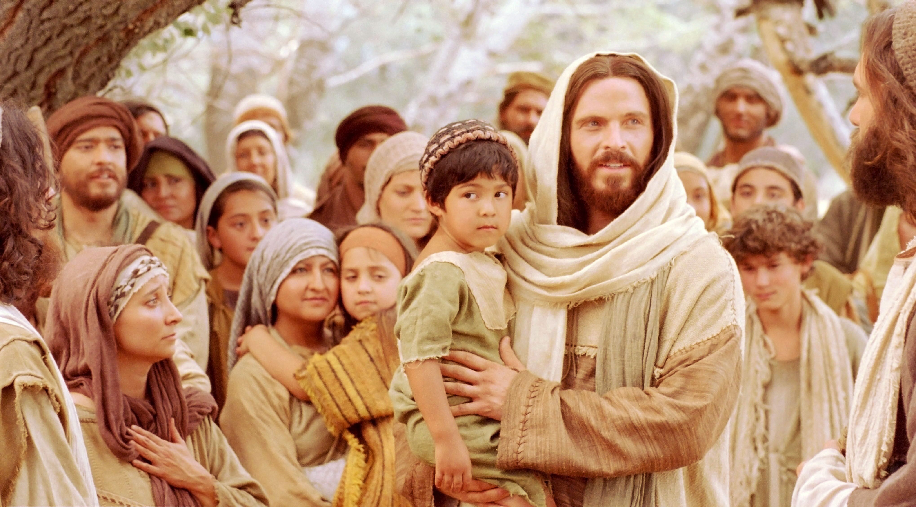
Jesus Blesses Little Children Mark 10:13-16

Slide 5
Leader: A reading from
the Holy Gospel
according to Mark.
All: Glory to You, Oh Lord.

Slide 6
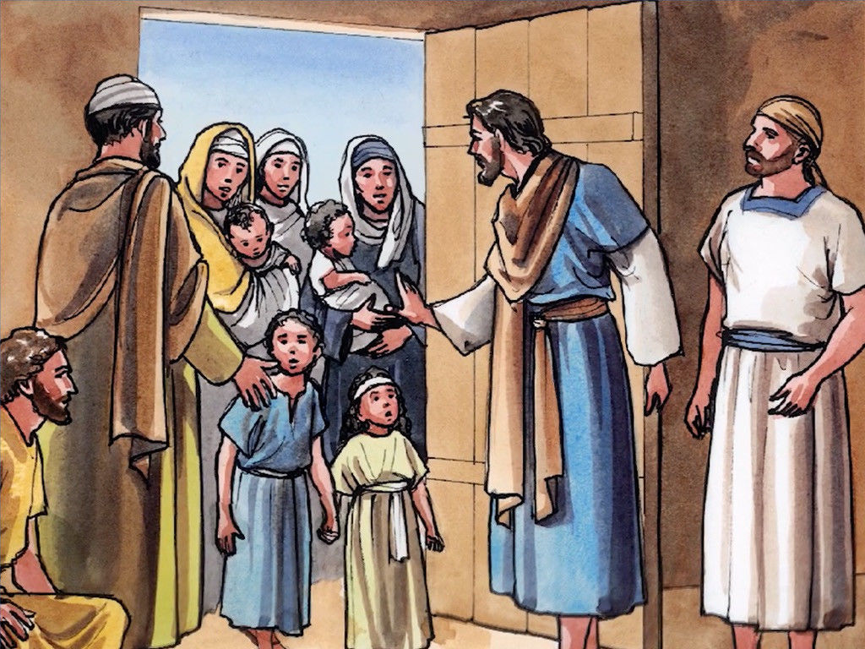
13
Some people brought children to Jesus for him to place his hands on them, but the disciples scolded the people.

Slide 7
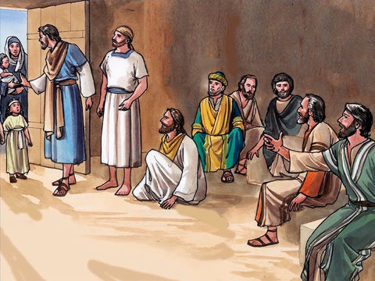
14
When Jesus noticed this, he was angry and said to his disciples, “Let the children come to me, and do not stop them, because the Kingdom of God belongs to such as these.

Slide 8
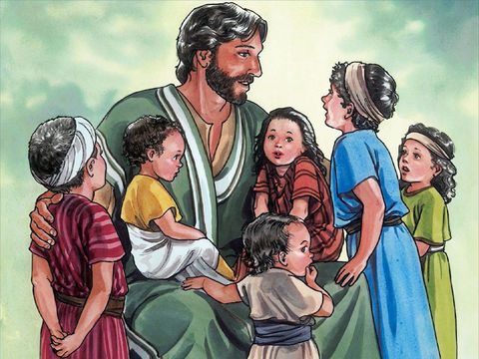
15
I assure you that whoever does not receive the Kingdom of God like a child will never enter it.”

Slide 9
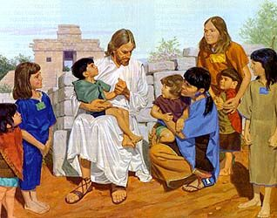
16
Then he took the children in his arms, placed his hands on each of them, and blessed them.

Slide 10
Leader: The Gospel of the Lord.
All: Praise to You,
Lord Jesus Christ.

Slide 11
GOSPEL MESSAGE

Slide 12
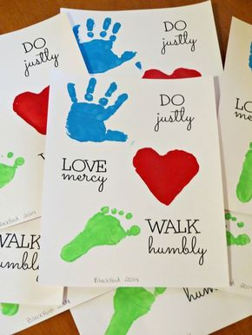
Activity:
Do, Love, Walk for Jesus
Materials:
1. Colored Paper
2. Bond paper
3. Scissors
4. Glue or Tape
5. Pen
6. Paint/Color

Slide 13
2. Trace a hand, heart and foot
3. You can also do this in 3 different paper.
Write this 3 things in your paper

Slide 14
Closing Prayer
Dear God,
We want to learn the lesson that Jesus taught us. Help us to make everyone, from the youngest to the oldest, feel welcome in our homes, in our church, in our schools, and in our circle of friends.
In the name of Jesus Christ, we pray.
Amen.

Slide 15
January 21, 2024 | Feast of Sto. Nino
CYCLE B – YEAR II

