Slide 2
January 14, 2024 | 2nd Sunday in Ordinary Time
CYCLE B – YEAR II

Slide 3
UNDERSTANDING THE GOSPEL (for facilitators only)
In this Gospel, we are reminded of the tremendous grace that God bestows upon us and how He reveals Himself to us. This passage speaks of the signifying title ‘Lamb of God’, a reminder of Jesus as the ultimate sacrifice for our sins. Jesus asked two disciples what they wanted from Him and invited them to stay with Him for a day – a demonstration of His ever-present presence in our lives. Andrew went forth to proclaim to his brother Simon that “We have found the Messiah”. This is an example for us all to take heed and spread the good news about Jesus. Finally, when Jesus saw Peter, He gave him a new name – Cephas – fulfilling prophecy. Through this passage we can be thankful for God’s plan for salvation through His Son and celebrate being able to share it with others.
Today’s gospel is also bout listening to and responding to God’s call. The first disciples are called to follow Jesus. They hear God’s call and respond by following Jesus. Jesus asks his followers, “What are you looking for?” He wants his disciples to listen and respond thoughtfully. The disciples are invited to come and see who Jesus is. Jesus invites them to stay with him. The call of the first disciples in today’s gospel reminds us that we too are called by name to know and follow Jesus.

Slide 4
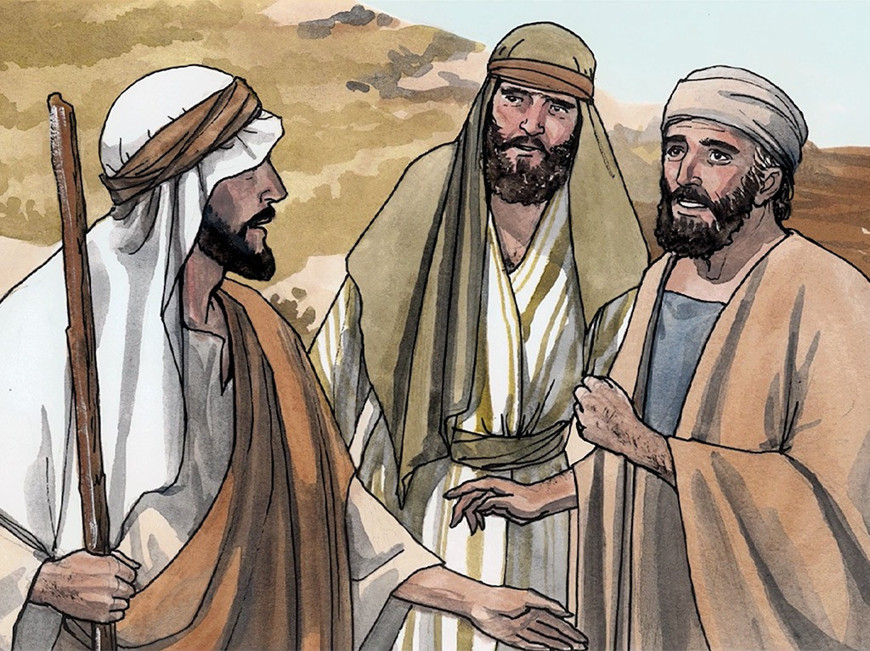
The First Disciples of Jesus
John 1:35-42

Slide 5
Leader: A reading from
the Holy Gospel
according to John.
All: Glory to You, Oh Lord.

Slide 6
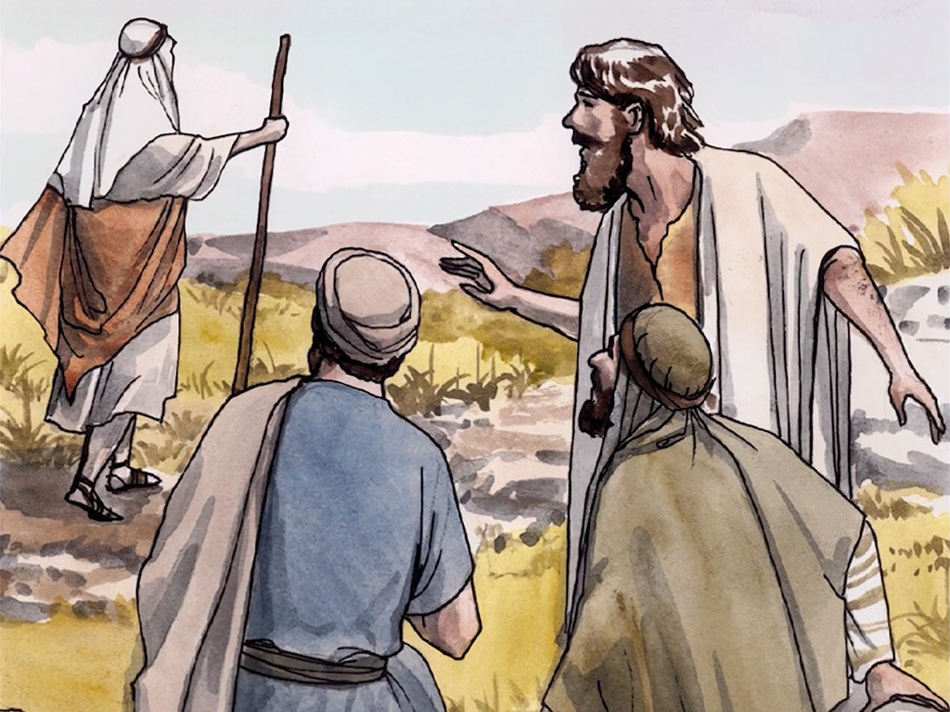
35
The next day John was standing there again with two of his disciples,

Slide 7
36
when he saw Jesus walking by. “There is the Lamb of God!” he said.

Slide 8
37
The two disciples heard him say this and went with Jesus.

Slide 9
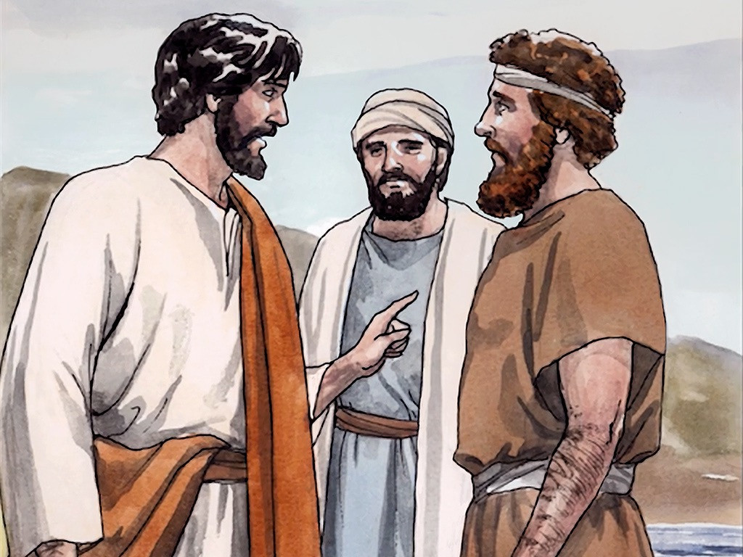
38
Jesus turned, saw them following him, and asked, “What are you looking for?” They answered, “Where do you live, Rabbi?” (This word means “Teacher.”)

Slide 10
39
“Come and see,” he answered. (It was then about four o'clock in the afternoon.) So they went with him and saw where he lived, and spent the rest of that day with him.

Slide 11
40
One of them was Andrew, Simon Peter's brother.

Slide 12
41
At once he found his brother Simon and told him, “We have found the Messiah.” (This word means “Christ.”)

Slide 13
42
Then he took Simon to Jesus. Jesus looked at him and said, “Your name is Simon son of John, but you will be called Cephas.” (This is the same as Peter and means “a rock.”)

Slide 14
Leader: The Gospel of the Lord.
All: Praise to You,
Lord Jesus Christ.

Slide 15
GOSPEL MESSAGE

Slide 16
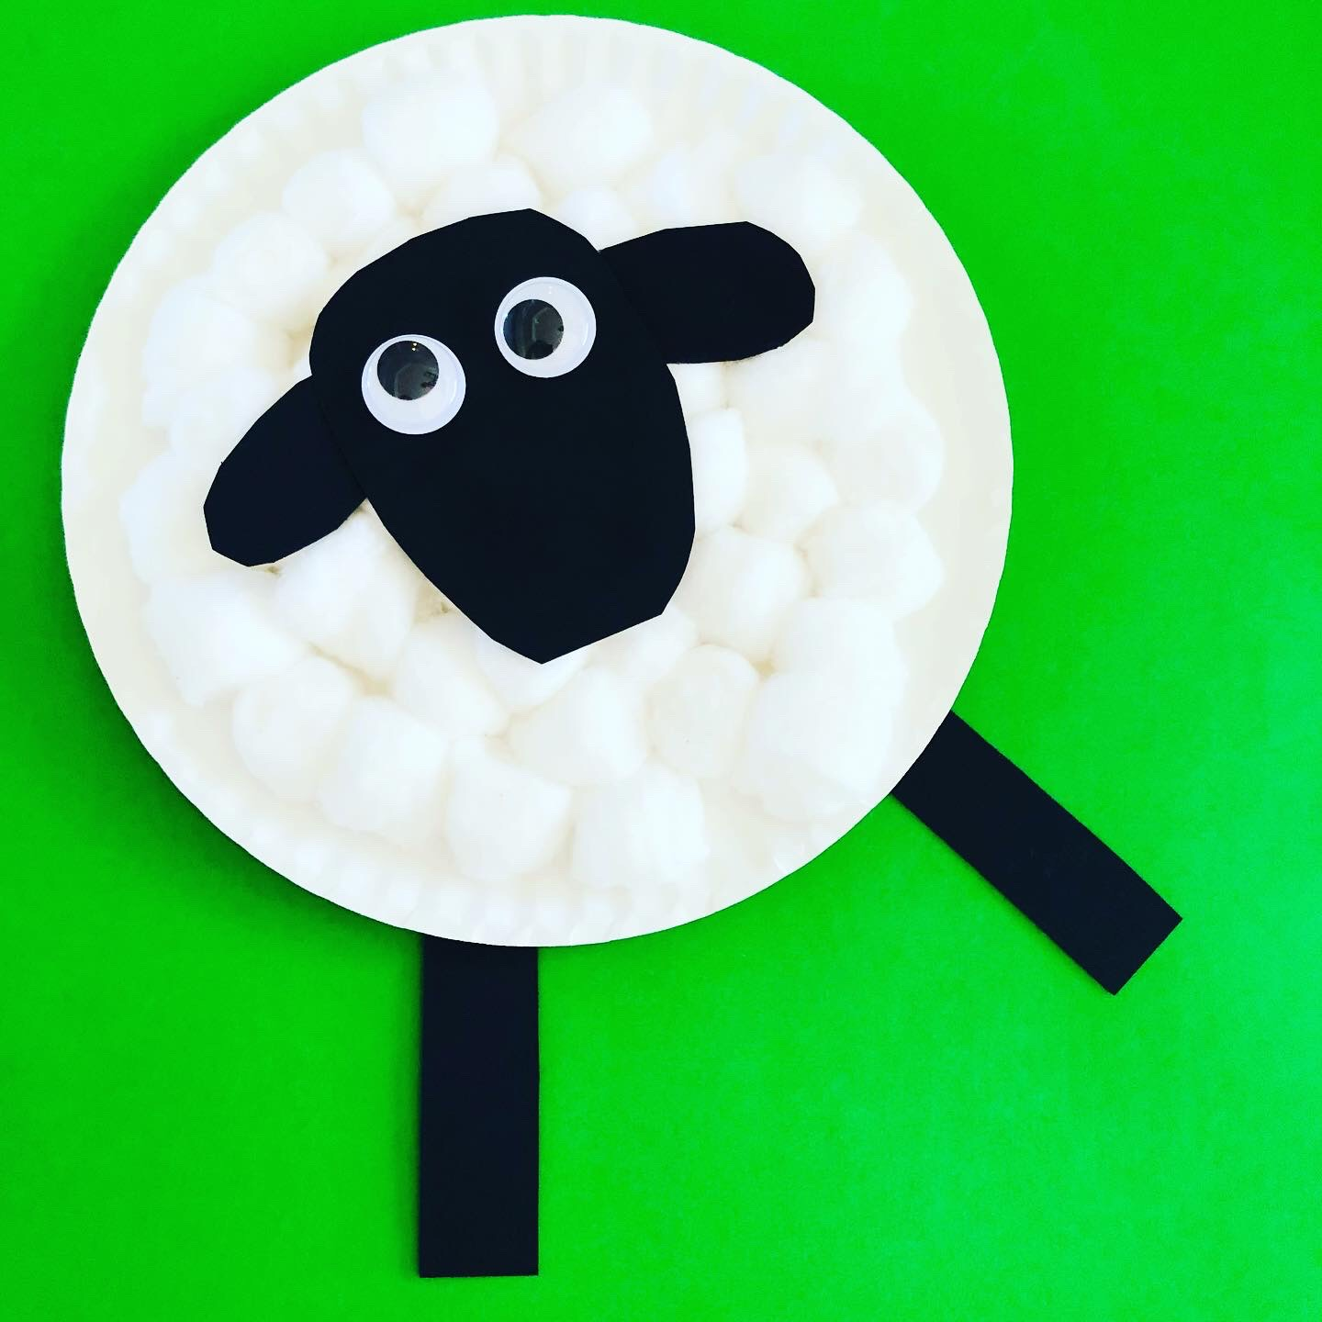
Activity: Paper Plate Lamb Craft
White Paper Plate
Cotton Balls
Glue
Googly Eyes
Black Construction Paper

Slide 17
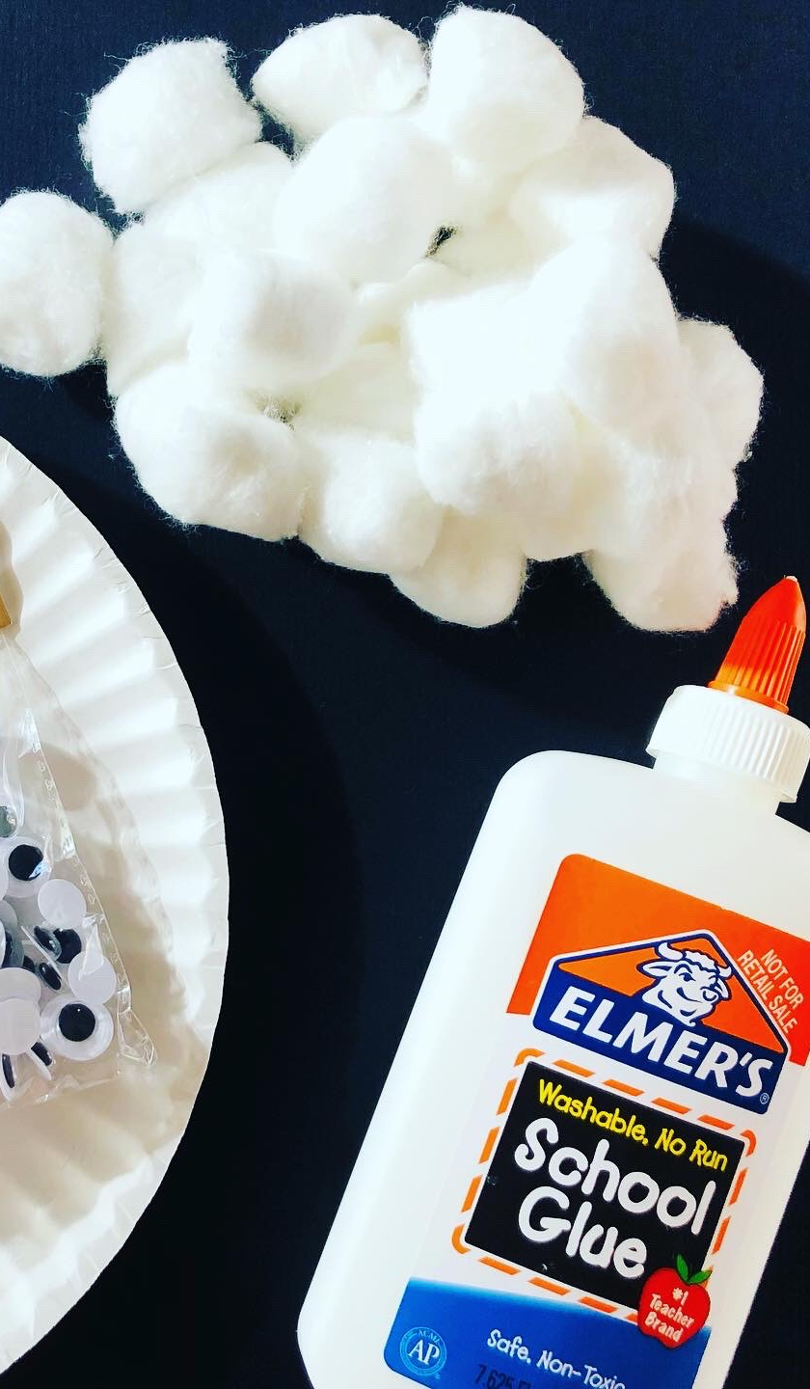
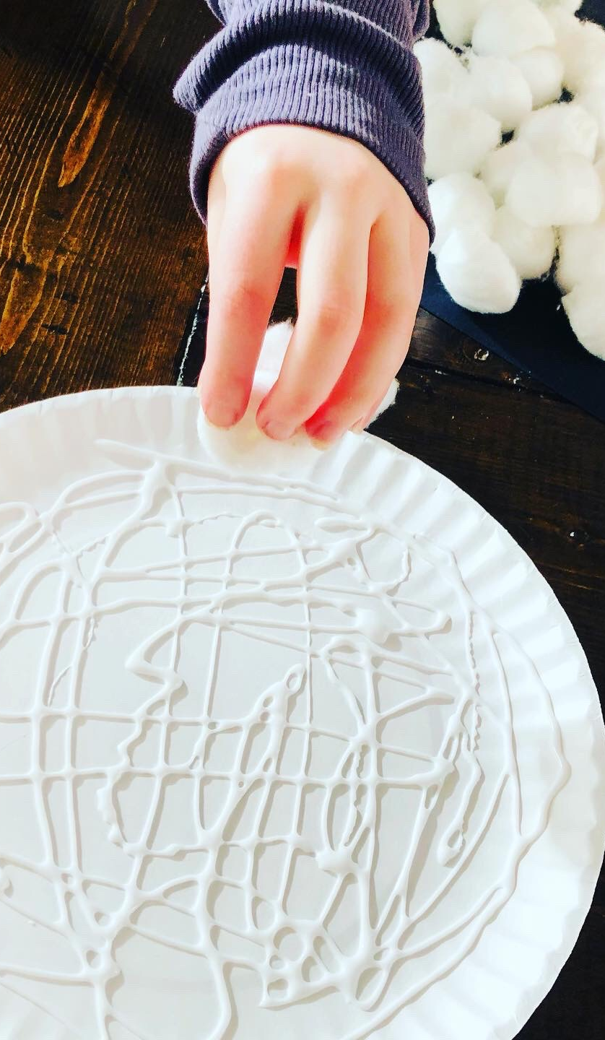
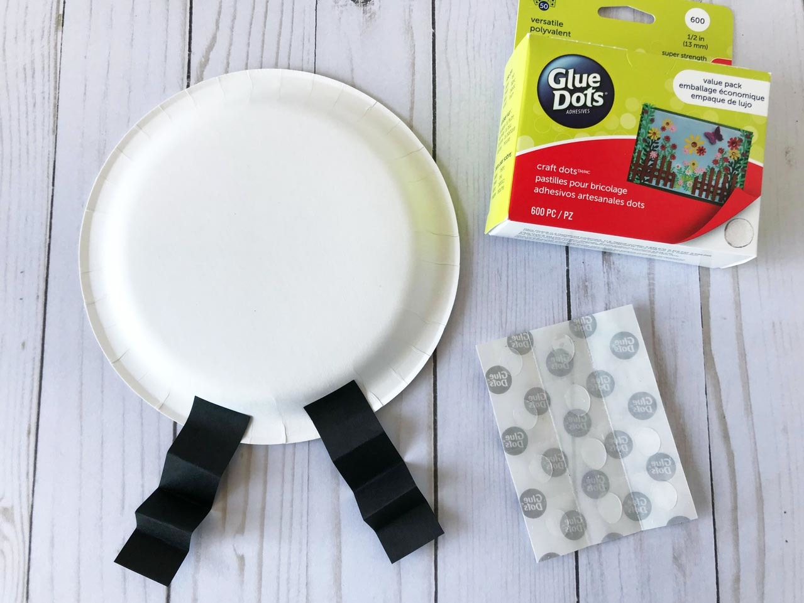
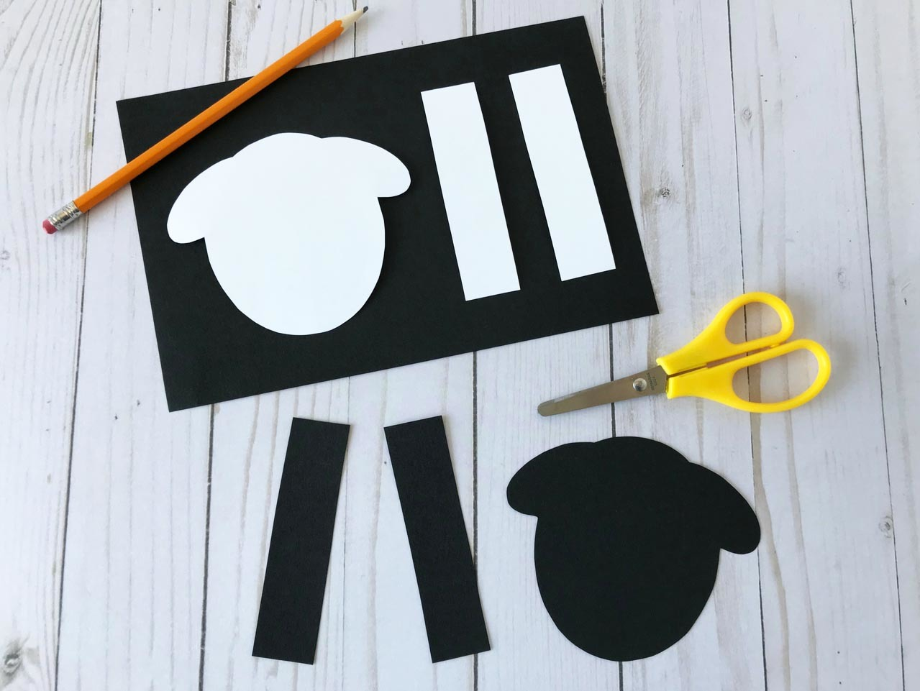

Slide 18
Instructions:
Start this craft by squirting glue all over the paper plate. Then just place the cotton balls on top of the glue.
Once the cotton balls are onto the paper plate, cut out the sheep face, ears and legs from black paper. I just cut a large oval shape for the head, two smaller ovals for the ears, and two long rectangles for the legs.
Once those pieces are in place, it is time to glue on the googly eyes.

Slide 20
Closing Prayer
Dear God,
Thank You for inviting us to be your followers. Help us to listen for Your guidance in our daily lives. In the name of Jesus Christ, we pray.
Amen.

Slide 21
January 14, 2024 | 2nd Sunday in Ordinary Time
CYCLE B – YEAR II

