Slide 2
Second Sunday of Lent - February 25, 2024
CYCLE B – YEAR II

Slide 3
UNDERSTANDING THE GOSPEL (for facilitators only)
In the gospel passage for today, Jesus takes Peter, James and John up the mountain and is “transfigured” before them and “his clothes become dazzling white”. In the Book of Revelation, white clothes come to symbolise the clothing of martyrs, of those who die for their faith. Elijah and Moses, the key prophetic figures of Israel, appear and enter into dialogue with Jesus, God’s definitive prophet. The “transfiguration” seems to point to a time in Jesus’ ministry when he accepts his likely fate. If he continues to challenge oppression and injustice, he is certain to encounter opposition, even death. He struggles with that realisation in the “wilderness” and comes to terms with what it involves on this unidentified mountain.
Peter wants to hold on to the experience of glory, to “make tents” and settle down. He prefers not to face the difficulties involved in fidelity to the mission. But that is not the way of discipleship. Like Jesus and his companions, we too need the occasional glimpse of final victory. We also need the courage and the good sense to return from the mountain and follow through on the path that brings life, despite the pain.

Slide 4
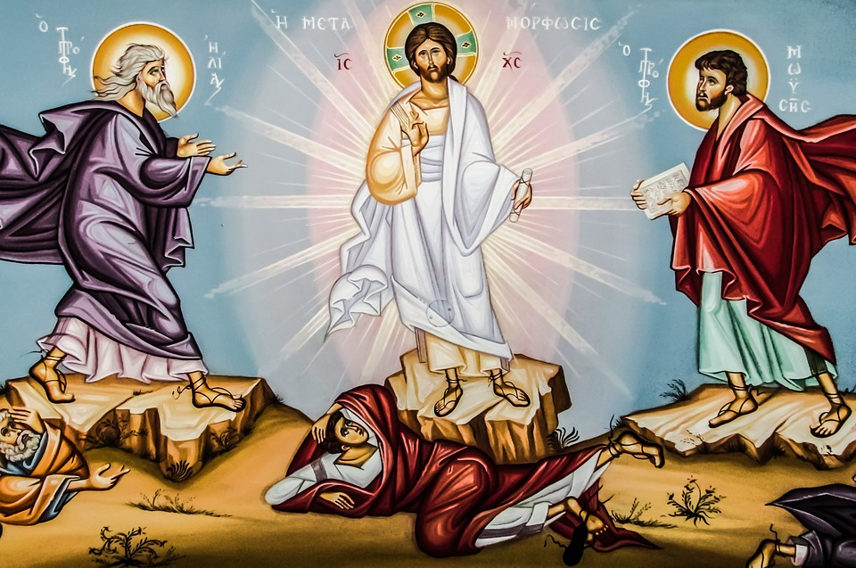
The Transfiguration of Jesus
Mark 9:2-10

Slide 5
Leader: A reading from
the Holy Gospel
according to Mark.
All: Glory to You, Oh Lord.

Slide 6
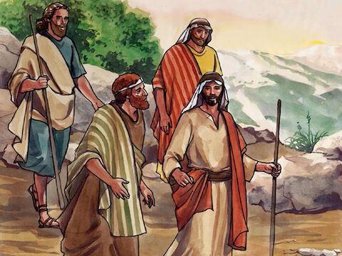
2
Jesus took with him Peter, James, and John, and led them up a high mountain, where they were alone. As they looked on, a change came over Jesus.

Slide 7
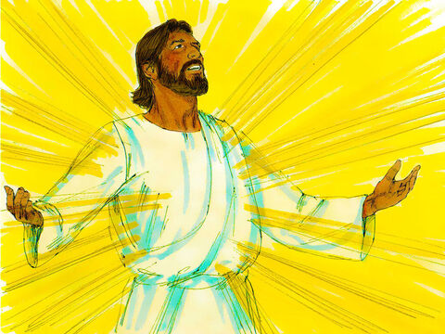
3
His clothes became shining white—whiter than anyone in the world could wash them.

Slide 8
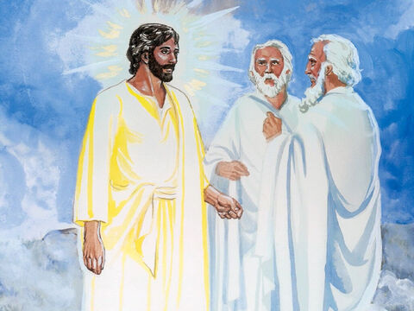
4
Then the three disciples saw Elijah and Moses talking with Jesus.

Slide 9
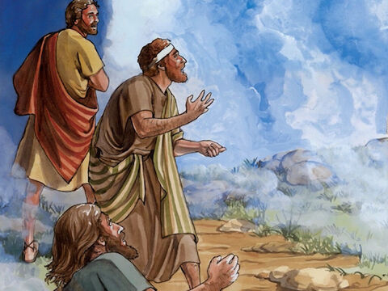
5
Peter spoke up and said to Jesus, “Teacher, how good it is that we are here! We will make three tents, one for you, one for Moses, and one for Elijah.”

Slide 10
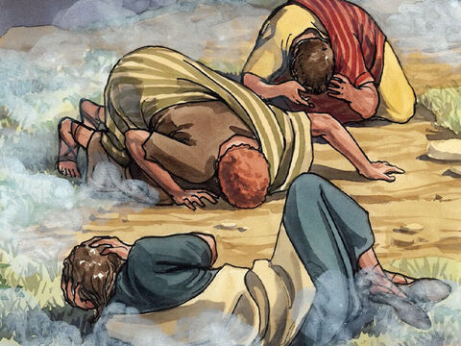
6
He and the others were so frightened that he did not know what to say.

Slide 11
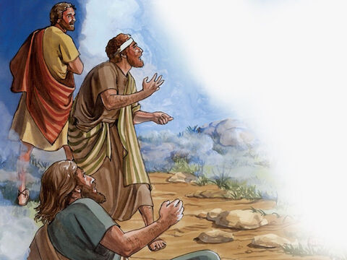
7
Then a cloud appeared and covered them with its shadow, and a voice came from the cloud,
“This is my own dear Son—listen to him!”

Slide 12
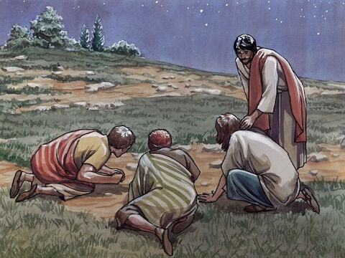
8
They took a quick look around but did not see anyone else; only Jesus was with them.

Slide 13
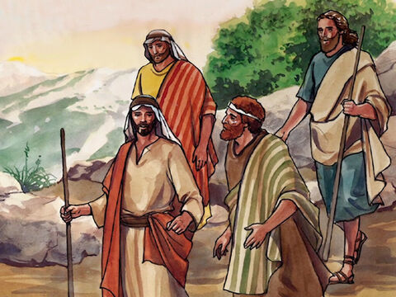
9
As they came down the mountain, Jesus ordered them,
“Don't tell anyone what you have seen, until the Son of Man has risen from death.”

Slide 14
10
They obeyed his order, but among themselves they started discussing the matter,
“What does this ‘rising from death’ mean?”

Slide 15
Second Sunday of Lent - February 25, 2024
CYCLE B – YEAR II

Slide 16
Leader: The Gospel of the Lord.
All: Praise to You,
Lord Jesus Christ.

Slide 17
GOSPEL MESSAGE

Slide 18
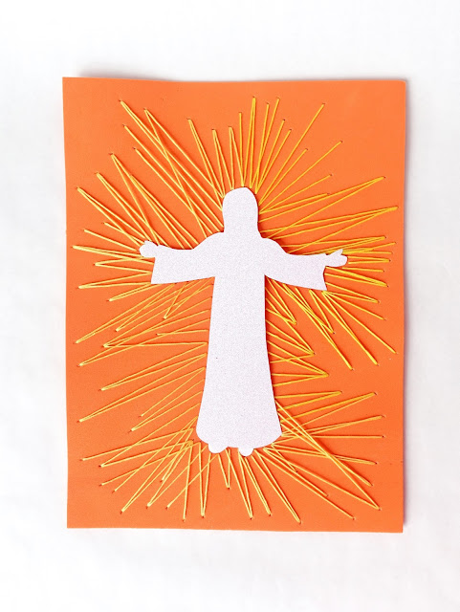
Activity: Transfigured Jesus
Foam Sheets (Optional) / Bond Paper
Pen
Scissors
Glue
Craft Needle
Outline of Jesus Embroidery Floss

Slide 19
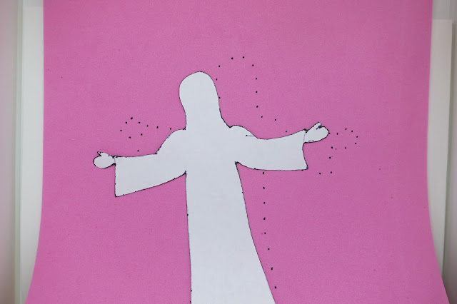
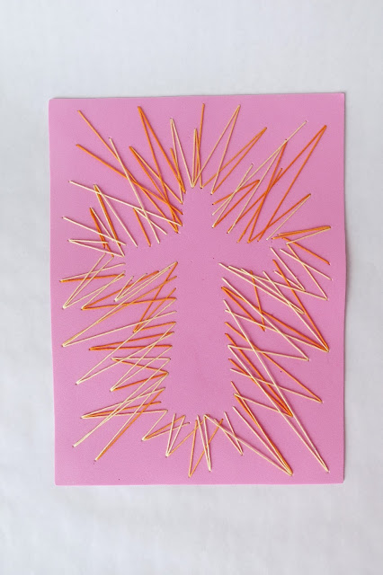
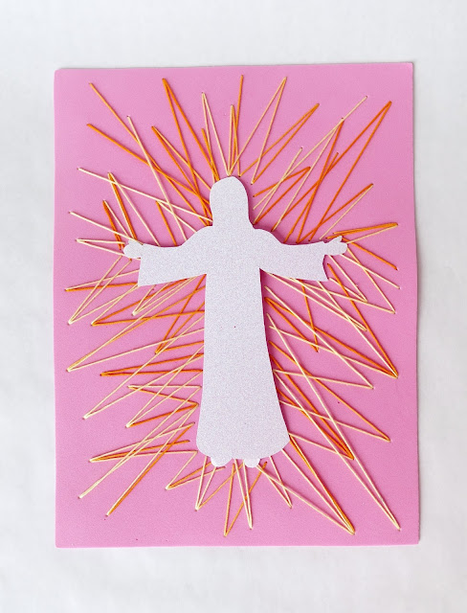
Instructions:
Cut out one Jesus silhouette.
On the back of each Foam Sheet, trace the silhouette with dots. Add random dots, some along the edges and some closer in, all the way around.
Using the dots for needle placement, stitch from the silhouette dots to the surrounding dots.
Glue the silhouette of Jesus in the center.

Slide 20
Closing Prayer
Dear God,
We thank you for all the gifts you have given us. During this Holy Season of Lent, help us to change, to grow and to become the kind of people you created us to be. May we always look to you as our light and guide.
In Jesus' name we pray. Amen.

