Slide 2
First Sunday of Lent - February 18, 2024
CYCLE B – YEAR II

Slide 3
UNDERSTANDING THE GOSPEL (for facilitators only)
It was also that same spirit who came upon ordinary people and led them to be great prophets of God. The spirit who had animated so many people throughout their history was now acting once again to drive Jesus into the desert. In the second verse Mark states that Jesus stayed in the desert for forty days, was tempted by Satan, was in the company of wild beasts, and was ministered to by angels. Without going into the details, Mark is indicating that Jesus has come through his trial and has prevailed. The suggestion that Jesus was among the wild animals and that they did him no harm would also suggest that the original order of creation as in the garden of Eve has been once again established.

Slide 4
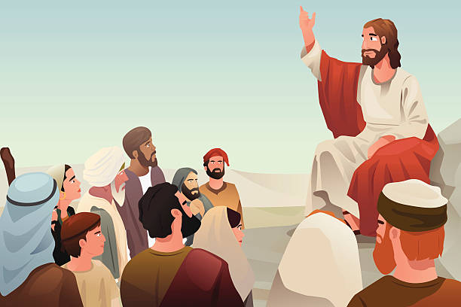
Repent and Believe in the Gospel!
Mark 1:12-15

Slide 5
Leader: A reading from
the Holy Gospel
according to Mark.
All: Glory to You, Oh Lord.

Slide 6
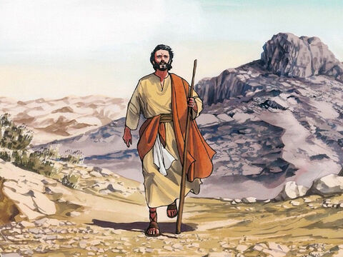
12
At once the Spirit made him go into the desert,

Slide 7
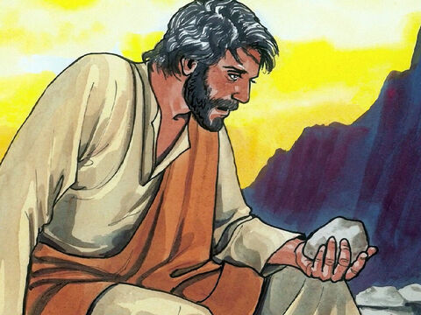
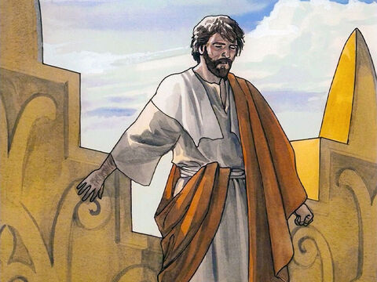
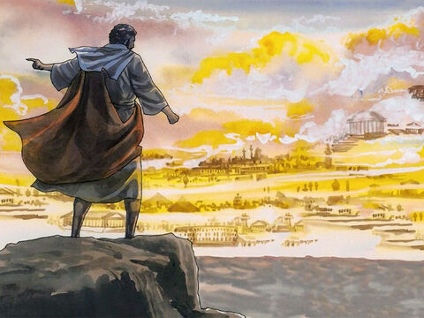
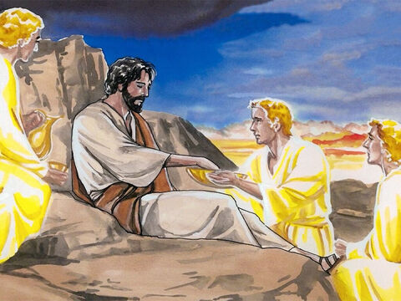
13
where he stayed forty days, being tempted by Satan. Wild animals were there also, but angels came and helped him.

Slide 8
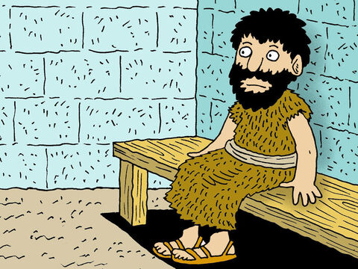
14
After John had been put in prison, Jesus went to Galilee and preached the Good News from God.

Slide 9
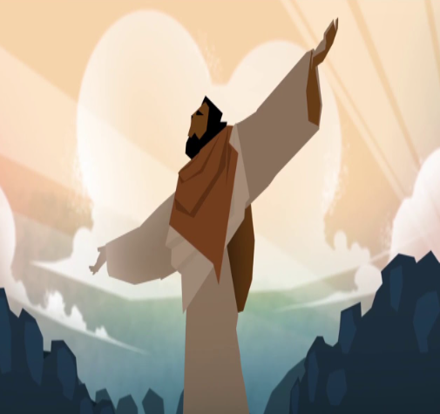
15
“The right time has come,” he said, “and the Kingdom of God is near! Turn away from your sins and believe the Good News!”

Slide 10
Leader: The Gospel of the Lord.
All: Praise to You,
Lord Jesus Christ.

Slide 11
GOSPEL MESSAGE

Slide 12
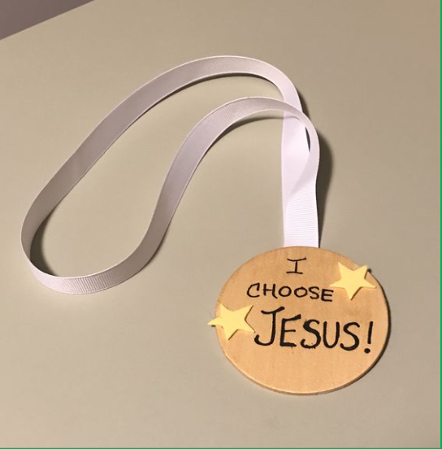
Activity: I Choose Jesus!
Materials:
Card Paper
Ribbon
Pencil / Marker
Decorating Materials

Slide 13
Instructions:
Cut the paper card into one big circle.
Write the statement : “I chose Jesus”.
Staple ribbon onto circle so that you can loop it over their neck like a gold medal.
Let us always choose Jesus because He is a victorious God.
Notes:
Jesus has prevailed over Satan’s Temptation. He is a victorious God. We should also not to be afraid to do the things that Jesus wants us to do because He is with us even if we face a lot of challenges and difficulties. The Lord will never abandon us. He will send angels to help and guard us. Let us always choose Jesus.

Slide 14
Closing Prayer
Angel of God,
my guardian dear,
to whom God’s love
commits me here,
ever this day be at my side,
to light and guard,
to rule and guide.
Amen.

Slide 15
First Sunday of Lent - February 18, 2024
CYCLE B – YEAR II

