Slide 2
Sixth Sunday in Ordinary Time - February 11, 2024
CYCLE B – YEAR II

Slide 3
UNDERSTANDING THE GOSPEL (for facilitators only)
Leprosy is a terrible skin disease. It destroys the physical body through gradual loss of nose and other parts. Not only that, there is also the destruction of emotional well-being. The person afflicted with it is practically an outcast. He is rejected and isolated. People avoid him. Who would like to be near him, much less touch him? To some people, that is more painful than physical pain.
During the time of Jesus, anyone who suffers from leprosy is prevented from interacting with other people. They were banned from going to market or attending temple services. When someone approaches, they have to shout “unclean!” in order to warn him or her. When these lepers were healed, they needed to get some sort of “certification” from a priest before they can be accepted again in society.
The healing of a leper is exactly a kind of restoration or freedom. To be isolated and considered untouchable is a sort of oppression. So when Jesus healed the leper, He did not only restore physical health but also granted emotional wellness as well as spiritual freedom.
After the healing, Jesus instructed the restored man not to tell anyone. He was at the beginning of His ministry and He did not want to get undue attention from many people that could cause Him trouble because it is not yet His “time”. He also asked the man to show himself to the priest to get proof of healing so he could be reintegrated to his family and to the community. Now that is indeed freedom that Jesus can give!

Slide 4
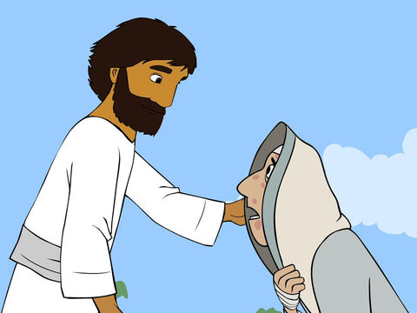
Jesus Heals A Man
Mark 1:40-45

Slide 5
Leader: A reading from
the Holy Gospel
according to Mark.
All: Glory to You, Oh Lord.

Slide 6
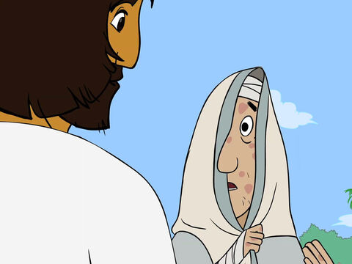
40
A man suffering from a dreaded skin disease came to Jesus, knelt down, and begged him for help. “If you want to,” he said, “you can make me clean.”

Slide 7
41
Jesus was filled with pity, and reached out and touched him.
“I do want to,” he answered. “Be clean!”

Slide 8
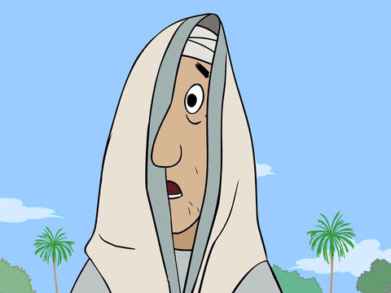
42
At once the disease left the man, and he was clean.

Slide 9
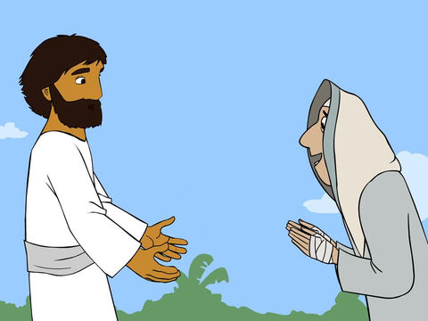
43
Then Jesus spoke sternly to him and sent him away at once,

Slide 10
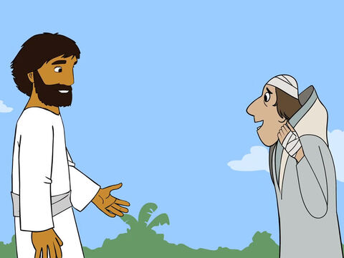
44
after saying to him, “Listen, don't tell anyone about this. But go straight to the priest and let him examine you; then in order to prove to everyone that you are cured, offer the sacrifice that Moses ordered.”

Slide 11
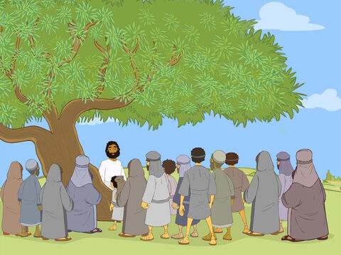
45
But the man went away and began to spread the news everywhere. Indeed, he talked so much that Jesus could not go into a town publicly. Instead, he stayed out in lonely places, and people came to him from everywhere.

Slide 12
Leader: The Gospel of the Lord.
All: Praise to You,
Lord Jesus Christ.

Slide 13
GOSPEL MESSAGE

Slide 14
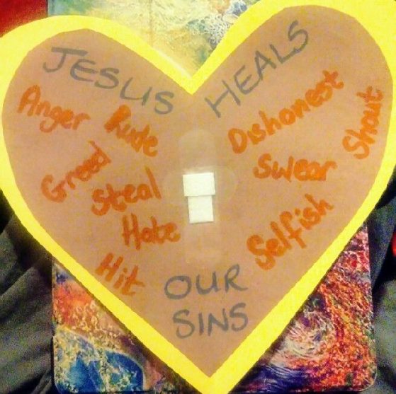
Activity: Healing Heart Craft
Colored Paper or Bond Paper
Pencil/Pen
Scissor
Glue
Coloring Materials

Slide 15
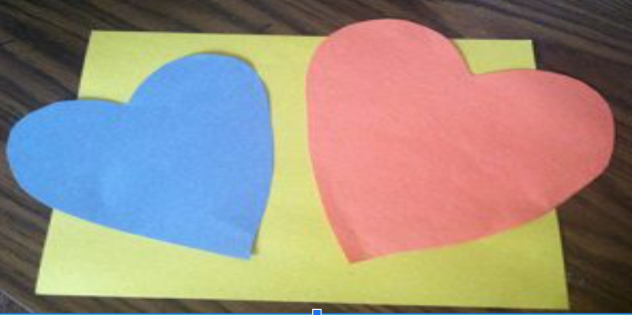
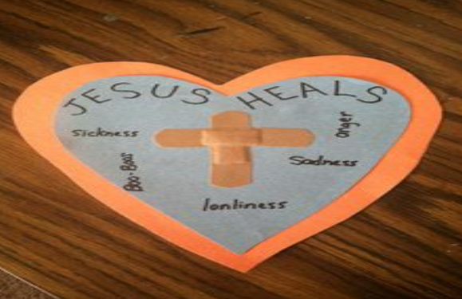
Instructions:
Cut out two heart-shape on your construction paper, one large and one smaller.
Create a cross on the heart with your band-aids.
Write “Jesus Heals” on the smaller heart. Write down or draw pictures of things they believe Jesus can heal.

Slide 16
Closing Prayer
Dear God,
Thank you for Jesus who trust your contagious love more than he fears contagious disease. Help us to do the same.
In Jesus' name we pray.
Amen.

Slide 17
Sixth Sunday in Ordinary Time - February 11, 2024
CYCLE B – YEAR II

