Slide 2
Fifth Sunday in Ordinary Time - February 04, 2024
CYCLE B – YEAR II

Slide 3
UNDERSTANDING THE GOSPEL (for facilitators only)
Jesus provided miracles of healing, but the greatest healing He gives is the salvation of souls. In this lesson, children will recognize how His earthly ministry demonstrated how much He cared for people. Because we know He cares for us still, we should pass that love along to those around us. The Gospel also reminds us that even Jesus took moments to rest and remember His role. We should take time to pray and recall who we are in Christ.

Slide 4
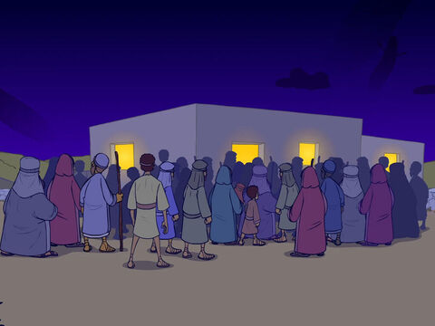
Jesus Heals Many People
Mark 1:29-39

Slide 5
Leader: A reading from
the Holy Gospel
according to Mark.
All: Glory to You, Oh Lord.

Slide 6
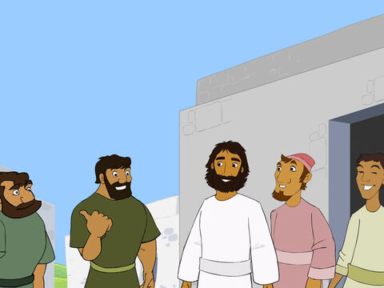
29
Jesus and his disciples, including James and John, left the synagogue and went straight to the home of Simon and Andrew.

Slide 7
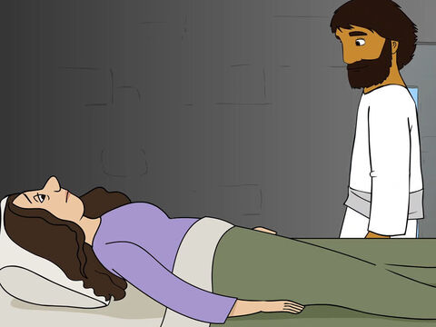
30
Simon's mother-in-law was sick in bed with a fever, and as soon as Jesus arrived, he was told about her.

Slide 8
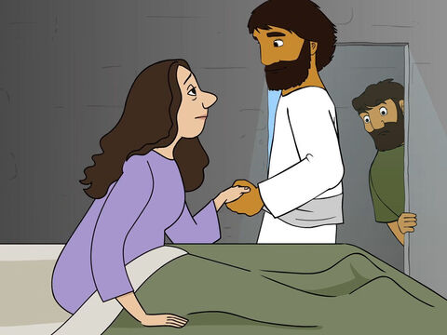
31
He went to her, took her by the hand, and helped her up. The fever left her, and she began to wait on them.

Slide 9
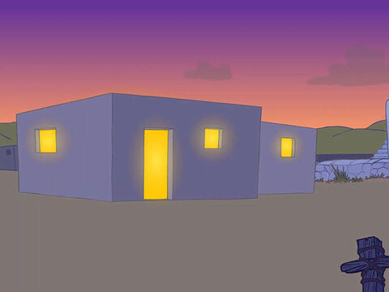
32
After the sun had set and evening had come, people brought to Jesus all the sick and those who had demons.

Slide 10
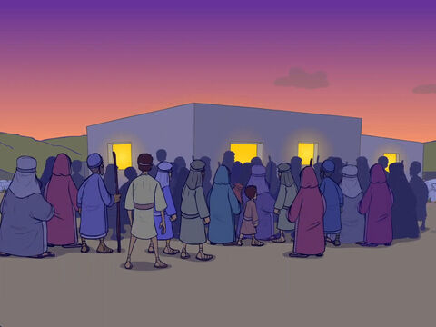
33
All the people of the town gathered in front of the house.

Slide 11
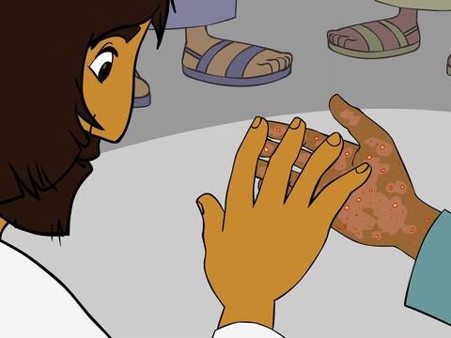
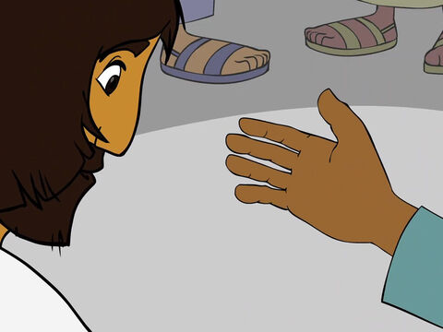
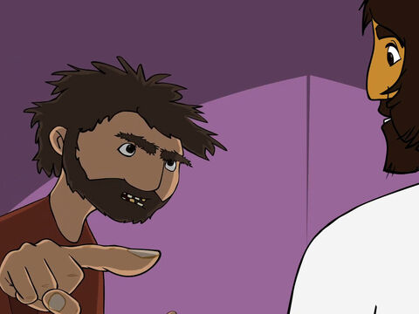
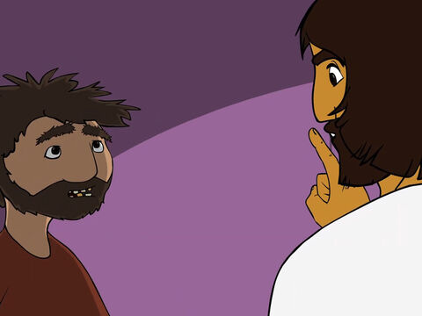
34
Jesus healed many who were sick with all kinds of diseases and drove out many demons. He would not let the demons say anything, because they knew who he was.

Slide 12
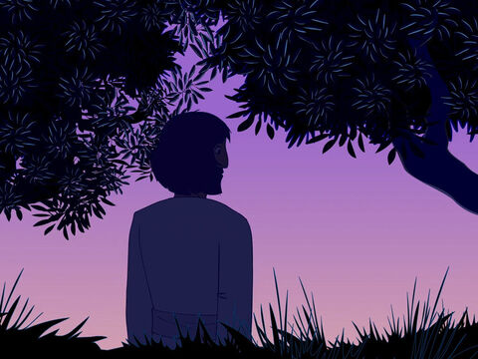
35
Very early the next morning, long before daylight, Jesus got up and left the house. He went out of town to a lonely place, where he prayed.

Slide 13
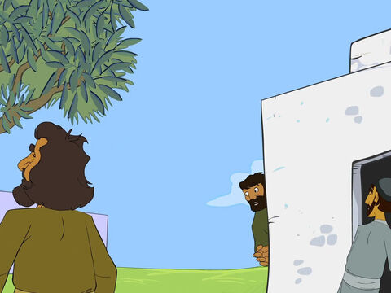
36
But Simon and his companions went out searching for him,

Slide 14
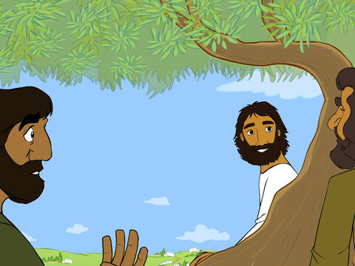
37
and when they found him, they said,
“Everyone is looking for you.”

Slide 15
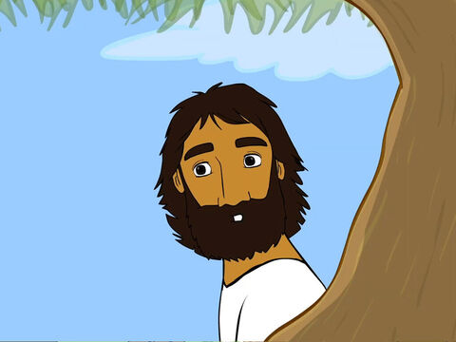
38
But Jesus answered,
“We must go on to the other villages around here. I have to preach in them also, because that
is why I came.”

Slide 16
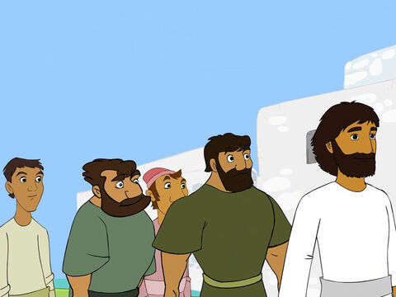
39
So he traveled all over Galilee, preaching in the synagogues and driving out demons.

Slide 17
Leader: The Gospel of the Lord.
All: Praise to You,
Lord Jesus Christ.

Slide 18
GOSPEL MESSAGE

Slide 19
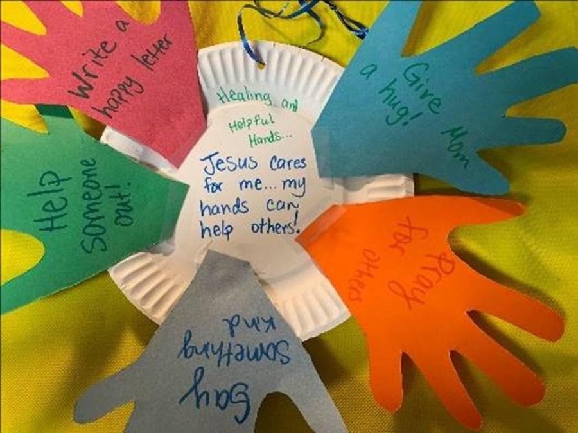
Activity: Helping Hands Wreath
Paper plates
Paper or cardstock
Scissors
String or pipe cleaners (optional)
Glue or tape
Crayons or markers
Stickers or other decorations

Slide 20
Instructions:
Decorate the paper plate with verses and captions to recall how Jesus cared for others. Option: leave the plate as is or cut out the center to make it more “wreath-like.”
Trace a hand on the construction paper or cardstock. Cut out several hands in varying colors. Tip: layer paper to cut multiple hands at once.

Slide 21
Instructions:
3. On each hand, help kids brainstorm and write down ways to care for other people. They might draw a picture to go with the writing, as well.
4. Glue or tape the hands onto the paper plate.
5. Add extra stickers of decorations as desired. Optional: hole punch the plate and add a ribbon or string to hang it up. Another option: glue a magnet to the back of the plate.

Slide 22
Closing Prayer
Dear God,
Thank you for Jesus who received your healing love and then shared it with others. Help us to do the same.
In Jesus' name we pray.
Amen.

Slide 23
Fifth Sunday in Ordinary Time - February 04, 2024
CYCLE B – YEAR II

