Slide 2
December 8, 2024
2nd Sunday of Advent

Slide 3
CONTEXT:
This passage introduces John the Baptist as the one preparing the way for Jesus, fulfilling Isaiah's prophecy. The setting is during the reign of key historical figures, rooting the story in real history. John preaches in the wilderness, a symbolic place of transformation and encounter with God.
KEY MESSAGES:
Preparation for the Lord: John calls people to repentance, emphasizing the need to prepare their hearts for the coming of Jesus.
Fulfilling Prophecy: His role is to make the way straight for the Messiah, fulfilling Isaiah 40:3-5. The imagery of leveling paths and straightening roads symbolizes spiritual renewal and readiness.
Inclusivity of Salvation: The phrase “all flesh shall see the salvation of God” underscores that Jesus' mission is for everyone.
LESSON:
Repentance Leads to Renewal: Turning away from sin and seeking God’s forgiveness is the first step in welcoming Jesus into our lives.
Prepare Your Heart: Like the roads that need straightening and valleys filled, we should strive to remove obstacles in our hearts that prevent us from fully receiving God.
God’s Promise is for Everyone: No one is excluded from the invitation to prepare for and experience the love and salvation of Christ.

Slide 4
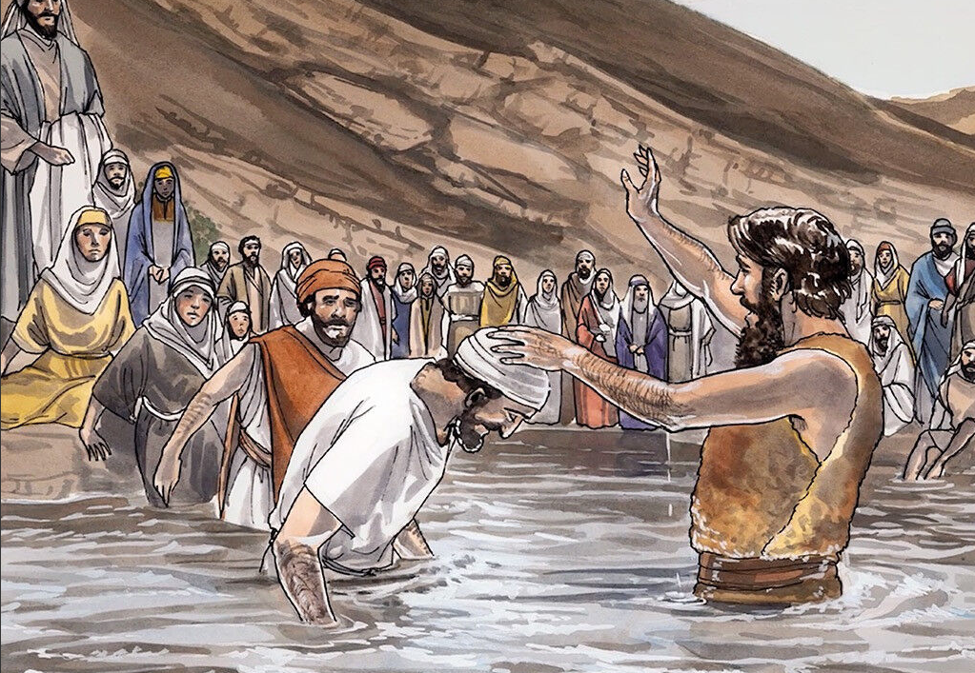
The Preaching of John the Baptist
Luke 3:1-6

Slide 5
Leader: A reading from
the Holy Gospel
according to Luke.
All: Glory to You, Oh Lord.

Slide 6
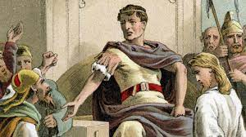
1
It was the fifteenth year of the rule of Emperor Tiberius; Pontius Pilate was governor of Judea, Herod was ruler of Galilee, and his brother Philip was ruler of the territory of Iturea and Trachonitis; Lysanias was ruler of Abilene,

Slide 7
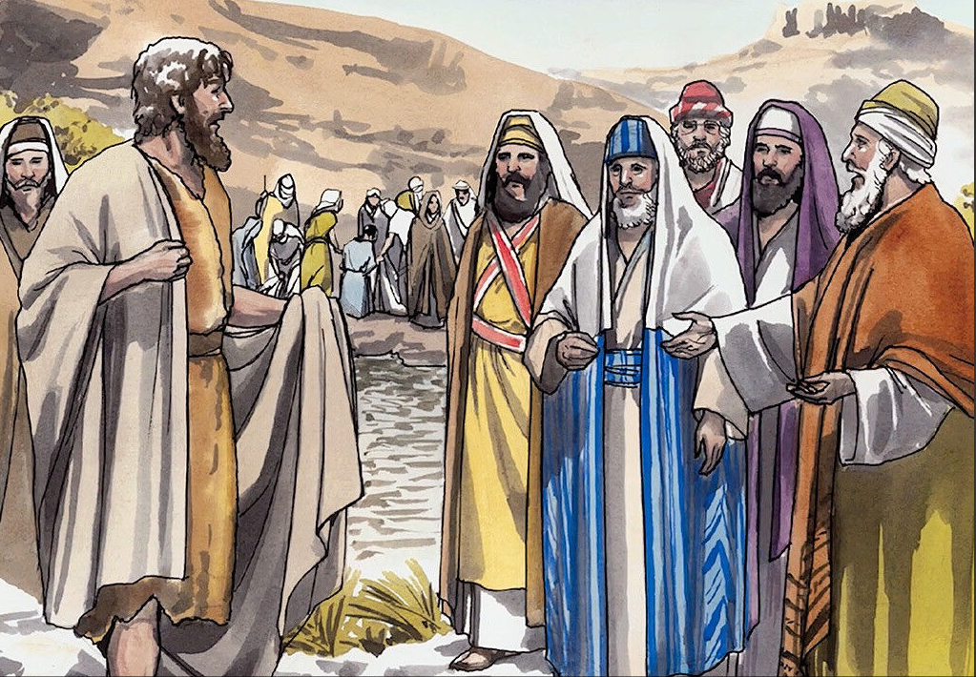
2
and Annas and Caiaphas were High Priests. At that time the word of God came to John son of Zechariah in the desert.

Slide 8
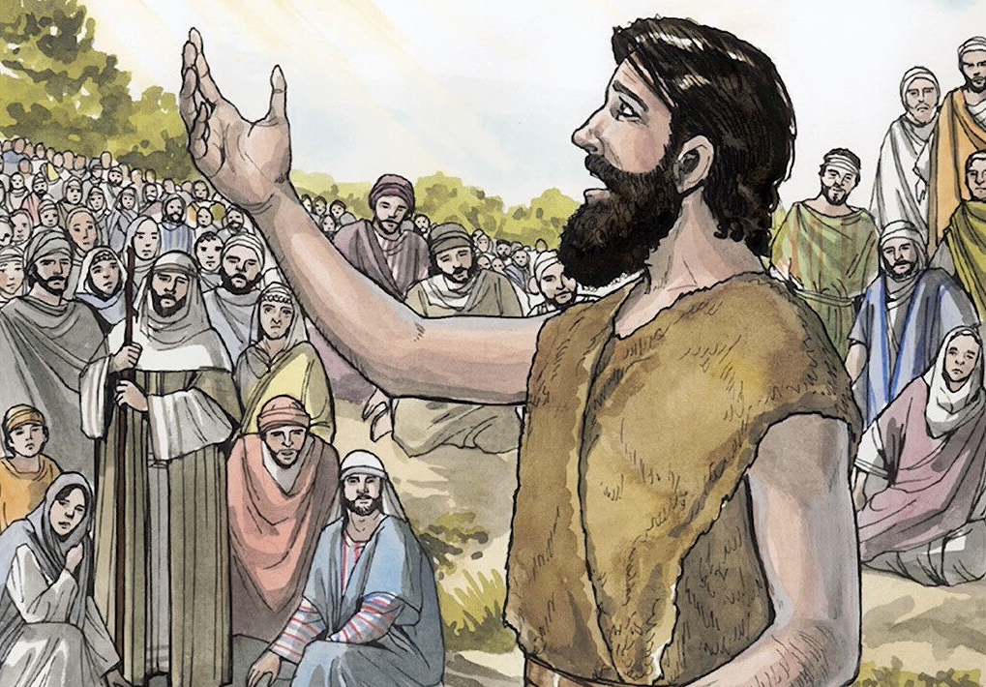
3
So John went throughout the whole territory of the Jordan River, preaching, “Turn away from your sins and be baptized, and God will forgive your sins.”

Slide 9
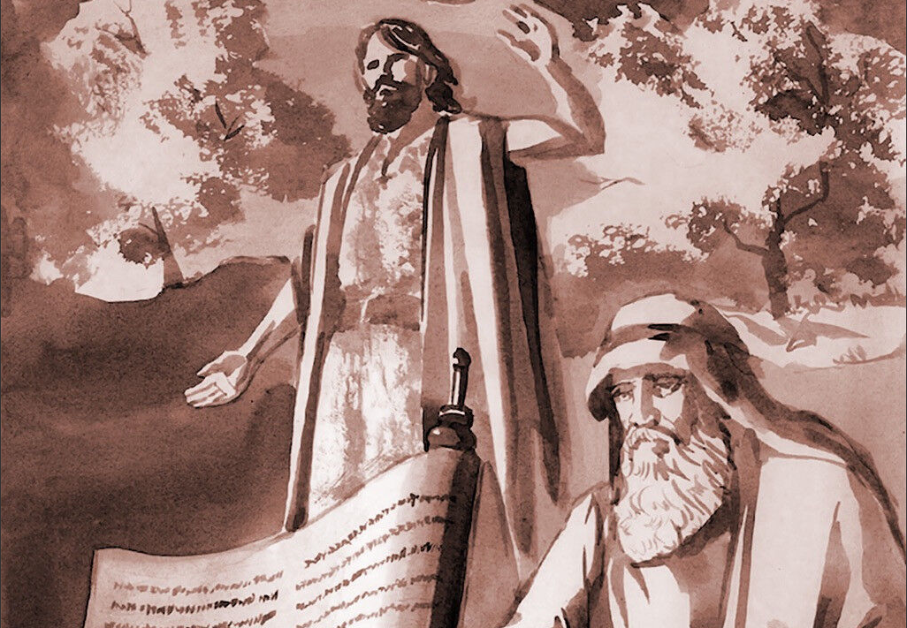
4
As it is written in the book of the prophet Isaiah:
“Someone is shouting in the desert:
‘Get the road ready for the Lord;
make a straight path for him to travel!

Slide 10
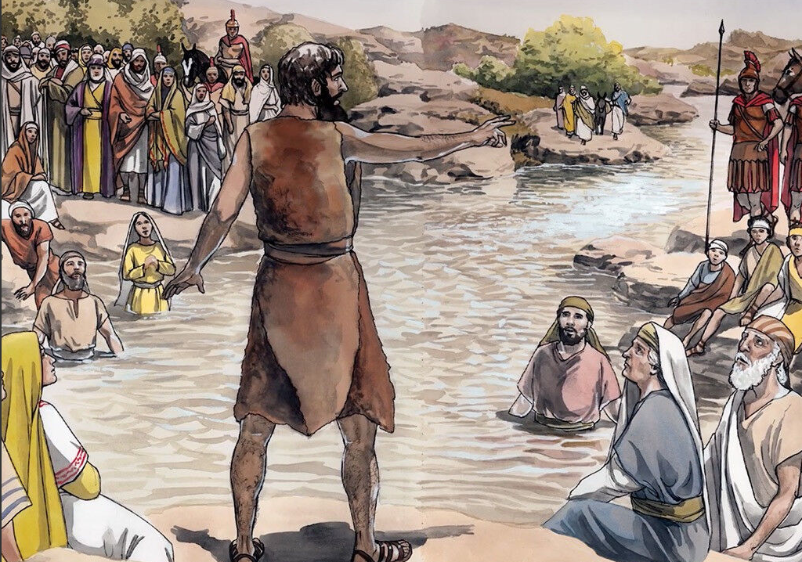
5
Every valley must be filled up,
every hill and mountain leveled off.
The winding roads must be made straight,
and the rough paths made smooth.

Slide 11
6
The whole human race will see God's salvation!’”

Slide 12
Leader: The Gospel of the Lord.
All: Praise to You,
Lord Jesus Christ.

Slide 13
GOSPEL MESSAGE

Slide 14
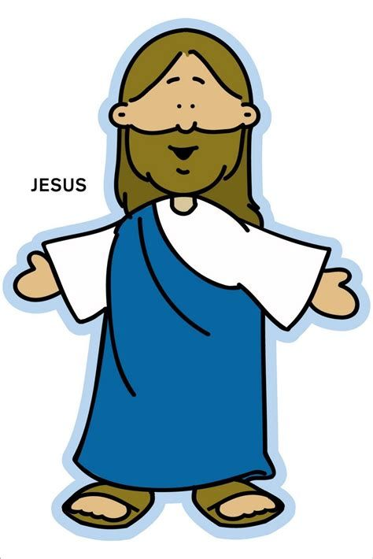
Activity:
STRAIGHT PATH FOR JESUS DRAWING
Bond paper
Marker / Pencil
Crayons
Jesus, come into my heart!
Notes:
Explain to the kids that their giving pail can be use to save money for church, missionaries, and to remind them of ways to give to others without money.

Slide 15
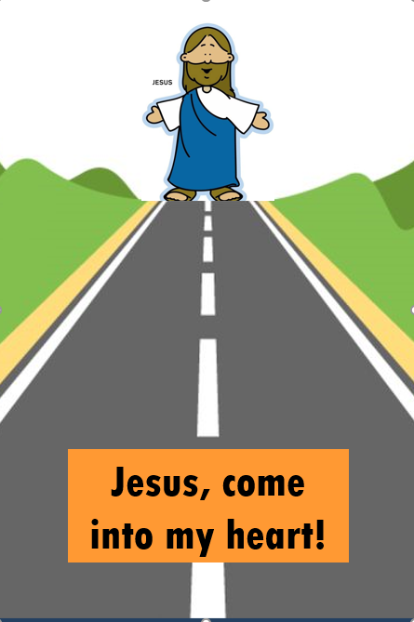
Procedure:
1. Get a sheet of bond paper.
2. Draw Jesus, a straight road, and grass.
3. Write the words: "Jesus, come into my heart."
4. Let’s clear the path as we receive Jesus in our hearts!

Slide 16
Closing Prayer
Dear Jesus, Thank You for reminding us through John the Baptist to prepare our hearts for Your coming. Help us to clear the paths in our lives by choosing what is good, saying sorry for our mistakes, and loving others as You love us. May our hearts always be ready to welcome You. We ask for Your strength and guidance as we journey closer to You this Advent season.
Amen.

Slide 17
December 8, 2024
2nd Sunday of Advent

