Slide 2
December 15, 2024
3rd Sunday of Advent

Slide 3
CONTEXT:
John is preaching in the wilderness and calling people to repentance, baptizing them for the forgiveness of sins. The crowd is curious, and some wonder if John might be the Messiah, but he clarifies that he is only preparing the way for the one who is coming after him, who is mightier. In the passage, John addresses the crowds, urging them to demonstrate true repentance by changing their ways, not merely by performing rituals like baptism. He emphasizes that repentance requires action and fruitfulness in everyday life, including sharing with those in need and practicing fairness. John also speaks of the coming of Jesus, who will baptize with the Holy Spirit and fire, purifying and refining people's hearts.
KEY MESSAGES:
- Repentance and Action: True repentance is not just about words but must lead to changed behavior. John encourages people to share with the poor, act justly, and avoid greed and dishonesty.
- Preparation for Jesus: John emphasizes that the coming of Jesus requires a change of heart and readiness. Jesus will bring a deeper baptism, one of the Holy Spirit, and will bring judgment, separating the wheat from the chaff.
- Humility: John models humility by acknowledging that he is not the Messiah, and that the Messiah will be far greater than he is.
LESSON:
- Repentance Means Change: True repentance means making a difference in the way we live. It's about being kind, generous, and just to others, just like John taught.
- Jesus is Coming: Advent is a time to get ready for the coming of Jesus, not just by preparing our homes but by preparing our hearts, showing love and care for others.
- Being Humble: Like John, we can learn to be humble and recognize that God is the one who gives us strength to live a good life and share with others.

Slide 4
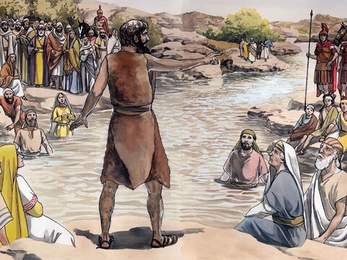
Not Good Enough to Untie His Sandals
Luke 3:10-18

Slide 5
Leader: A reading from
the Holy Gospel
according to Luke.
All: Glory to You, Oh Lord.

Slide 6
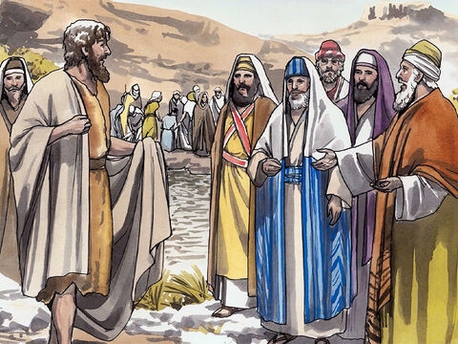
10
The people asked him, “What are we to do, then?”

Slide 7
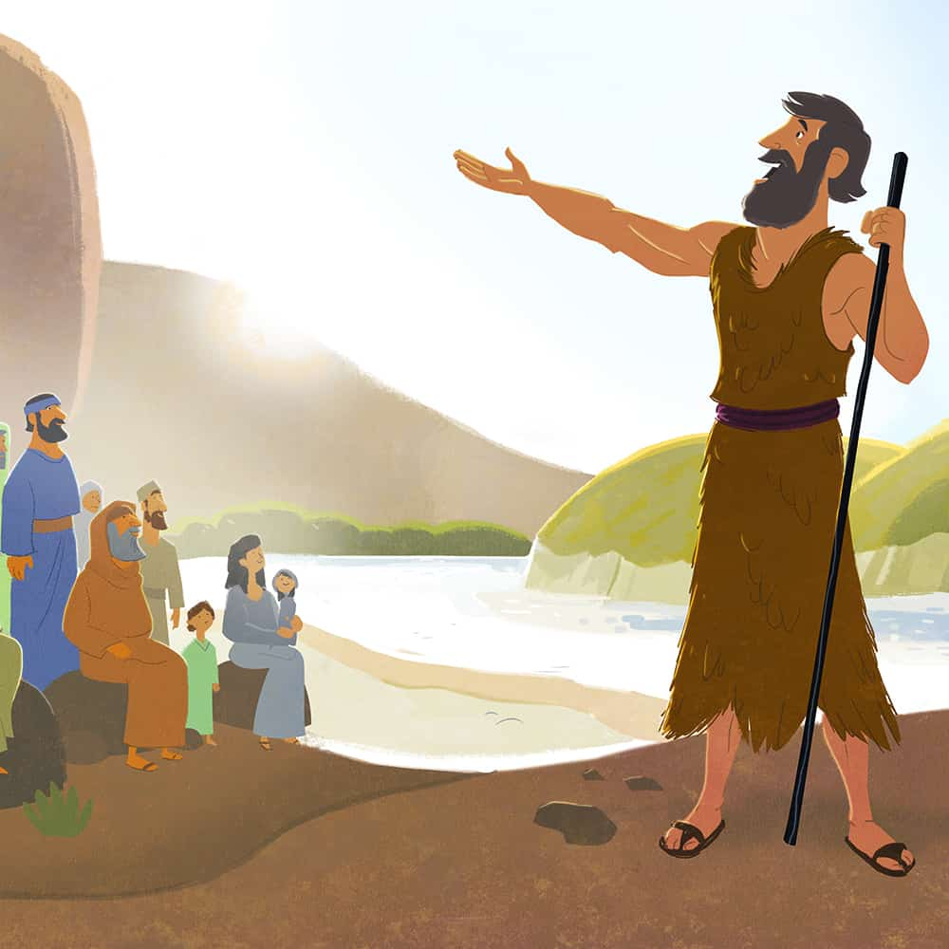
11
He answered, “Whoever has two shirts must give one to the man who has none, and whoever has food must share it.”

Slide 8
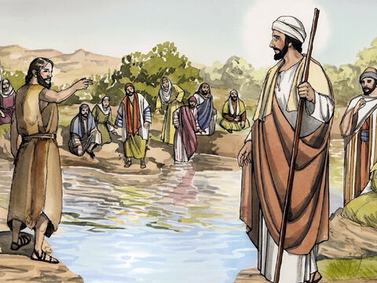
12
Some tax collectors came to be baptized, and they asked him, “Teacher, what are we to do?”

Slide 9
13
“Don't collect more than is legal,” he told them.

Slide 10
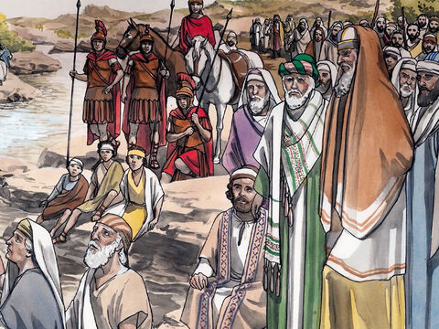
14
Some soldiers also asked him, “What about us? What are we to do?” He said to them, “Don't take money from anyone by force or accuse anyone falsely. Be content with your pay.”

Slide 11
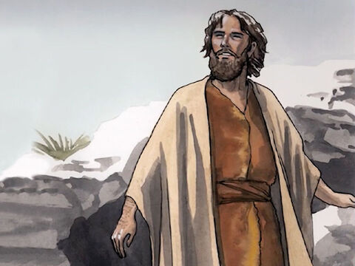
15
People's hopes began to rise, and they began to wonder whether John perhaps might be the Messiah.

Slide 12
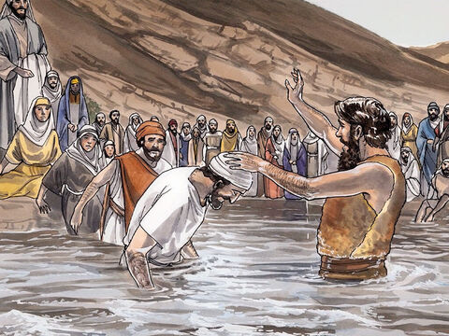
16
So John said to all of them, “I baptize you with water, but someone is coming who is much greater than I am. I am not good enough even to untie his sandals. He will baptize you with the Holy Spirit and fire.

Slide 13
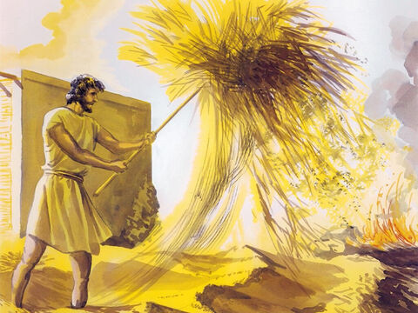
17
He has his winnowing shovel with him, to thresh out all the grain and gather the wheat into his barn; but he will burn the chaff in a fire that never goes out.”

Slide 14
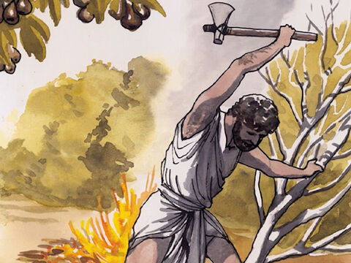
18
In many different ways John preached the Good News to the people and urged them to change their ways.

Slide 15
Leader: The Gospel of the Lord.
All: Praise to You,
Lord Jesus Christ.

Slide 16
GOSPEL MESSAGE

Slide 17
Activity:
GIFT GIVING TIME
This Christmas, let’s share the joy of giving! Prepare a gift that you’re willing to give to other children in need. It could be something like old toys, clothes, books, or anything special that you think will make someone else happy. Let’s spread love and kindness by sharing what we have!
Notes:
Explain to the kids that their giving pail can be use to save money for church, missionaries, and to remind them of ways to give to others without money.

Slide 18
Closing Prayer
Dear Jesus, Thank You for this time to listen to Your Word and learn how we can prepare our hearts for You. Teach us to be kind and generous, to share with others, and to live with honesty and love. Help us to always choose what is right and to grow closer to You each day. As we wait for Your coming, fill our hearts with joy, and guide us to bring light and hope to those around us. We love You, Jesus, and we offer everything we do to glorify You. Amen.

Slide 19
December 15, 2024
3rd Sunday of Advent

