Slide 2
December 1, 2024
1st Sunday of Advent

Slide 3
CONTEXT:
This passage is part of Jesus’ teaching about the end times and His second coming. It is set in the context of His final days before His passion and death, as He prepares His disciples for what is to come. Jesus speaks of signs in the heavens and on the earth, warning that the world will experience upheaval. Despite these frightening events, He encourages His followers to remain steadfast and watchful. Verses 25-28 describe cosmic signs and the fear that will grip people as the end approaches. However, for believers, these signs are not cause for despair but hope, as they signal that redemption is near. Verses 34-36 are a call to vigilance and prayer, reminding the disciples not to be consumed by worldly distractions or anxieties. Instead, they are to stay alert and ready for the coming of the Son of Man.
KEY MESSAGES:
Hope Amidst Turmoil - Jesus assures His followers that even when the world is in chaos, God’s plan is unfolding. His second coming is a promise of salvation, not destruction, for those who trust in Him.
Be Watchful and Prepared - Christians are called to live lives of holiness and readiness, avoiding sin and being faithful to God’s commandments.
Pray and Trust in God - Jesus emphasizes the importance of prayer as a means of staying spiritually vigilant and connected to God during uncertain times.
LESSON:
Jesus Will Come Again - Advent reminds us that we are preparing not just for Christmas (His first coming) but also for His return. This is a joyful promise because Jesus will bring peace and happiness.
Be Ready for Jesus - Just like we prepare for a guest at home, we prepare our hearts for Jesus by being good, kind, and prayerful.
Trust God Even When Things Are Scary - Even when things seem hard or confusing, we can always trust Jesus because He loves us and is always with us.

Slide 4
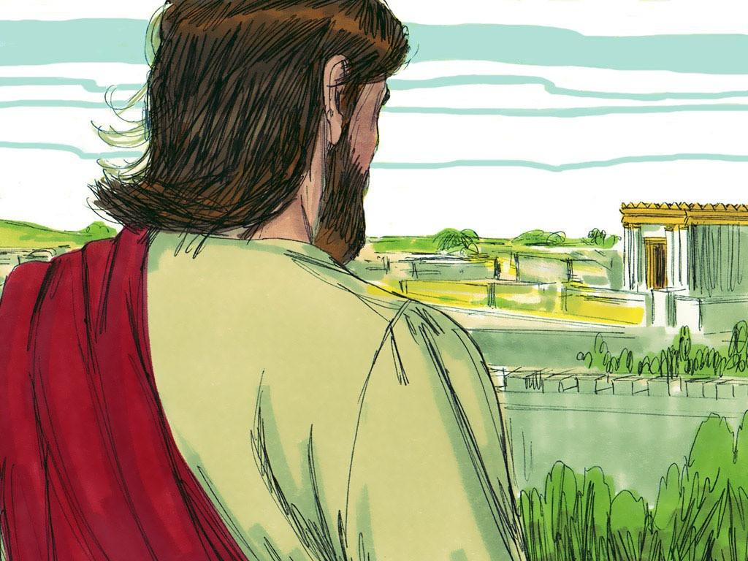
Jesus is Coming
Luke 21:25-28, 34-36

Slide 5
Leader: A reading from
the Holy Gospel
according to Luke.
All: Glory to You, Oh Lord.

Slide 6
25
“There will be strange things happening to the sun, the moon, and the stars. On earth whole countries will be in despair, afraid of the roar of the sea and the raging tides.

Slide 7
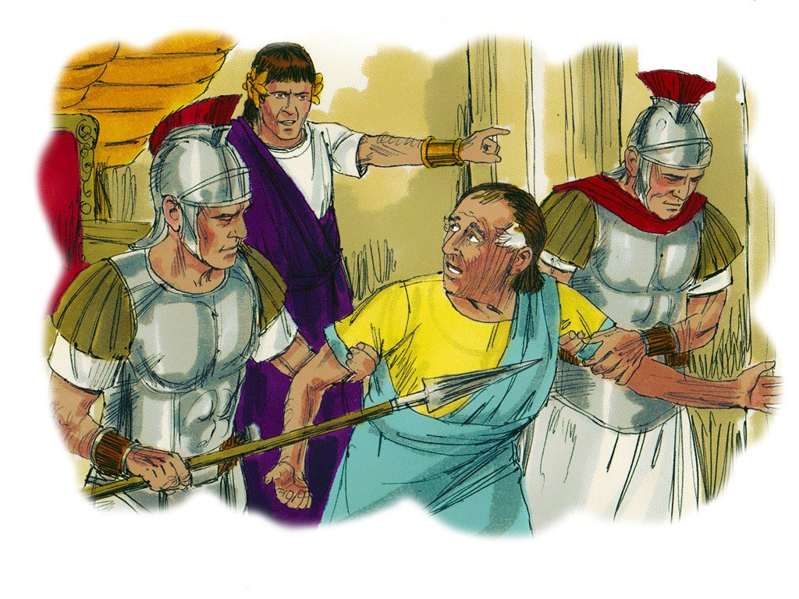
26
People will faint from fear as they wait for what is coming over the whole earth, for the powers in space will be driven from their courses.

Slide 8
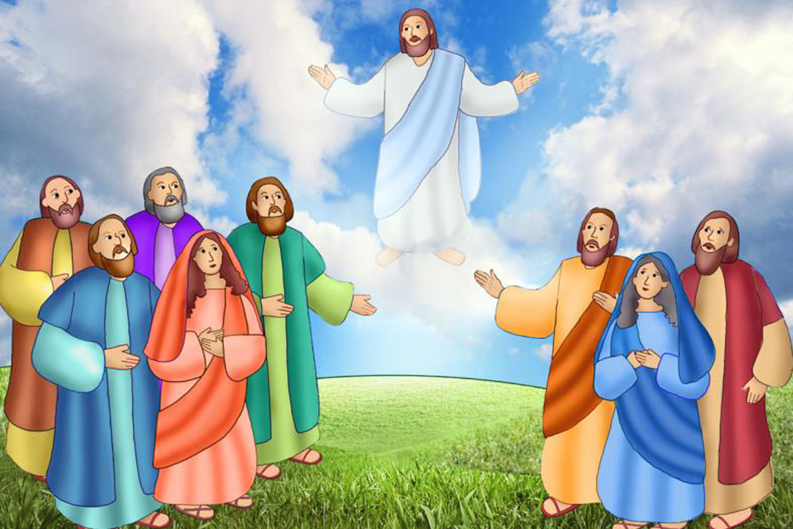
27
Then the Son of Man will appear, coming in a cloud with great power and glory.

Slide 9
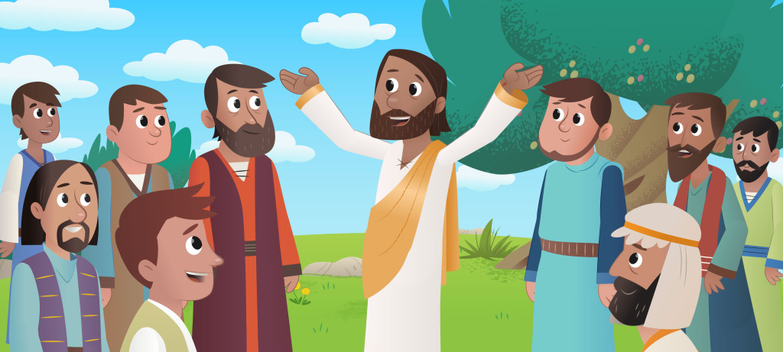
28
When these things begin to happen, stand up and raise your heads, because your salvation is near.”

Slide 10
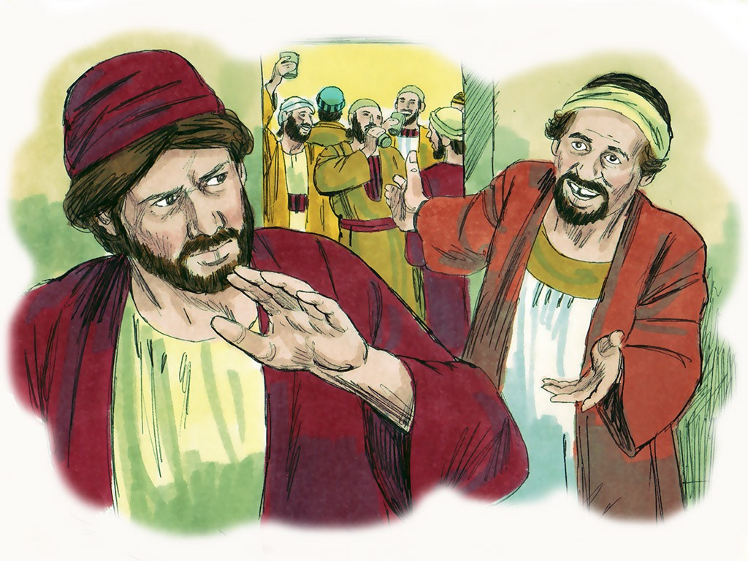
34
“Be careful not to let yourselves become occupied with too much feasting and drinking and with the worries of this life, or that Day may suddenly catch you like a trap.

Slide 11
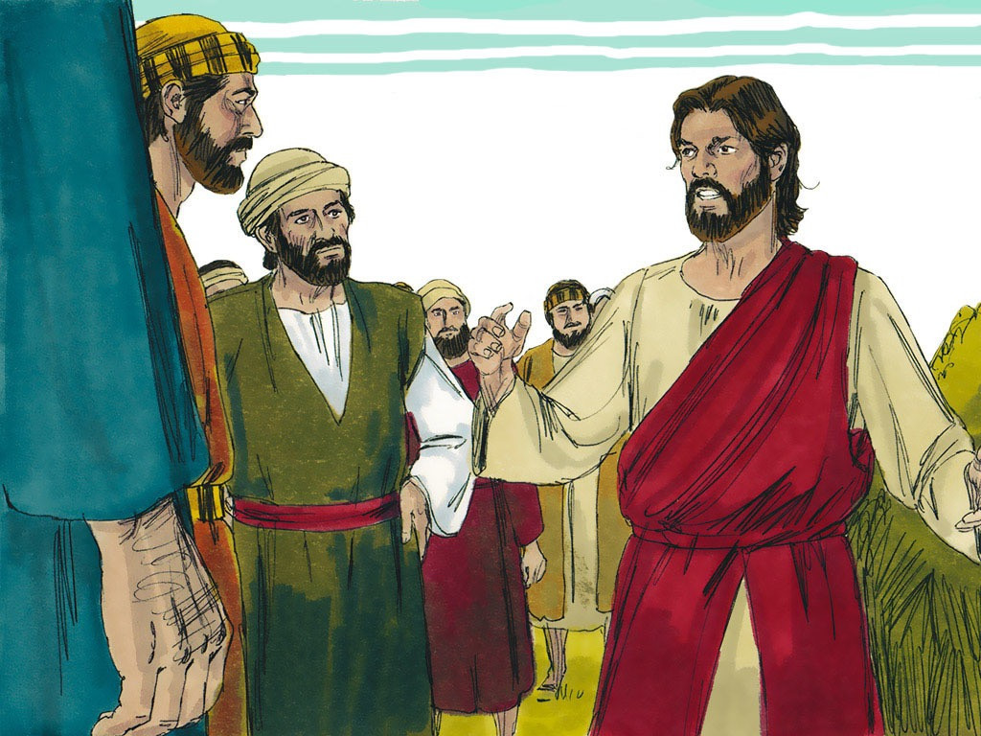
35
For it will come upon all people everywhere on earth.

Slide 12
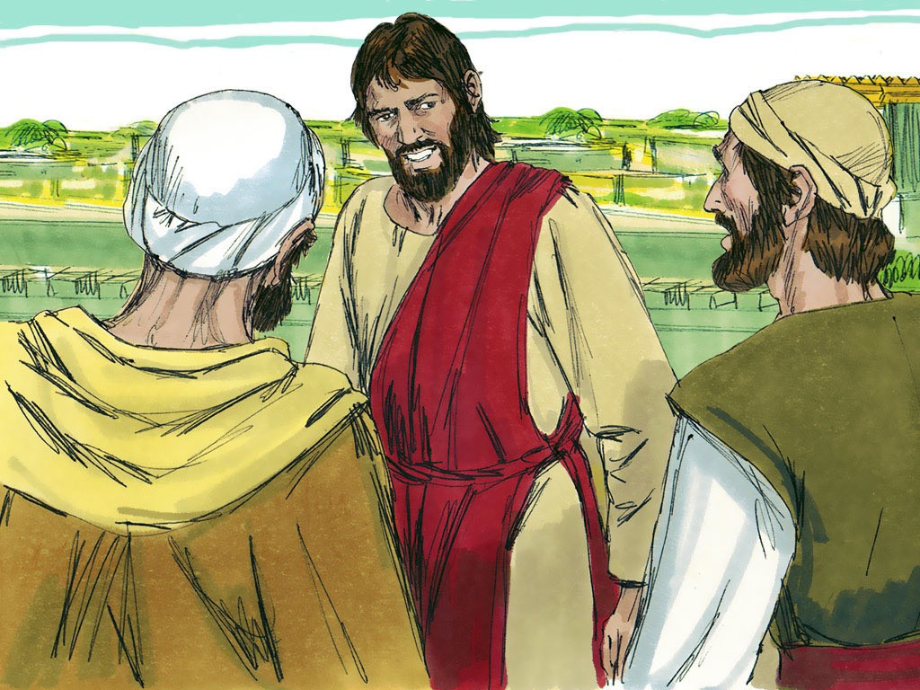
36
Be on watch and pray always that you will have the strength to go safely through all those things that will happen and to stand before the Son of Man.”

Slide 13
Leader: The Gospel of the Lord.
All: Praise to You,
Lord Jesus Christ.

Slide 14
GOSPEL MESSAGE

Slide 15
Activity: Advent Candle
Materials:
- Purple, pink, yellow, orange, and green art paper (or any paper in these colors)
- Cardboard or white bond paper
- Scissors
- Markers or ballpens
- Glue

Slide 16
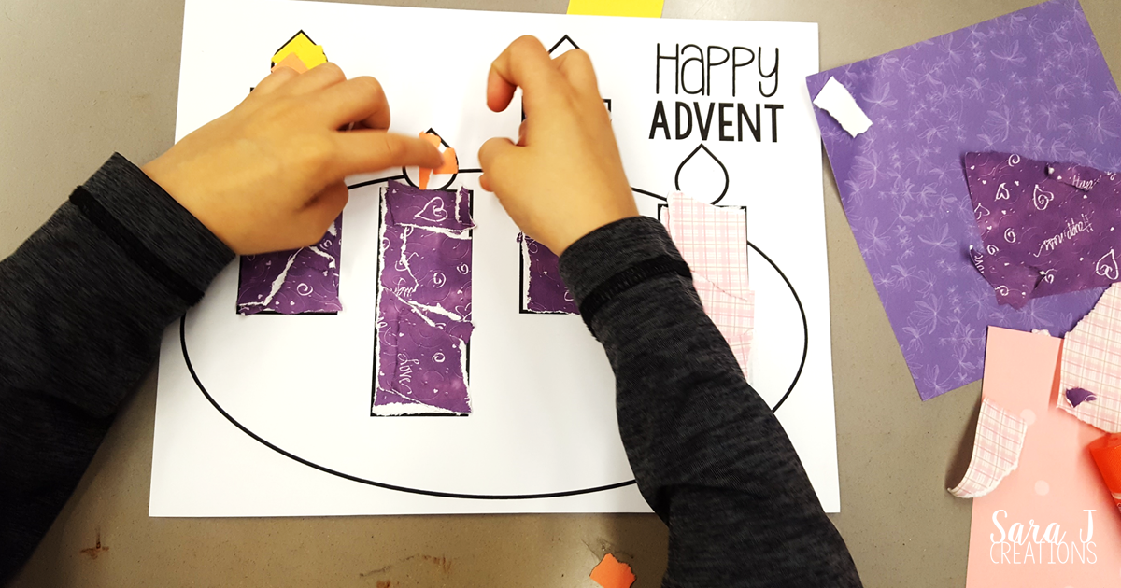
Instructions:
1. Draw a simple picture of four candles on your bond paper (refer to the example picture provided).
2. Work on one color at a time. Add a small amount of glue to the area you are working on (avoid applying glue to too much of the picture at once, as it may dry before you can finish).

Slide 17
3. Tear small pieces of the colored paper and randomly glue them onto the corresponding areas. Overlap the pieces slightly so the background is completely covered.
4. Continue this process, moving through the colors in order: start with purple for the candles, then pink for one candle, yellow/orange for the flames, and green for the greenery.
5. Once the artwork is complete, glue it onto cardboard or another sheet of bond paper to give it a framed look.

Slide 18
Closing Prayer
Dear Jesus, Thank You for reminding us today that You will come again to bring us hope and salvation. Help us to prepare our hearts during this Advent season by staying close to You through prayer, kindness, and love. Teach us to trust You, even when things seem uncertain, and to always look forward with joy to Your promises. May we always be ready to welcome You into our hearts and our lives. Bless each of us and our families and guide us to live in a way that makes You proud. In Your holy name, we pray. Amen.

Slide 19
December 1, 2024
1st Sunday of Advent

