Slide 2
UNDERSTANDING THE GOSPEL (for facilitators only)
Our Gospel is from John 6:41-51. There are some points at which we have to pay attention. First, when Jesus said “I am the living bread that came down from heaven.” What does this mean? Not all people can understand the depth of the meaning of what He meant. It is of big faith that we must adhere to the true meaning of this message.
The Living Bread – Jesus is the only one who can claim it. It means that Jesus is the spiritual nourishment for us to eternal life. For that, we need to nourish our soul with the presence of God for us to prepare for the afterlife. Physical bread which we eat will feed us but we will still be hungry after how many hours. The living bread who is Christ Jesus is the eternal bread that will nurture our souls for eternity. He is always drawing us into divine life because we are important to Him. Jesus loves us more than anything that He gave His life for us.
Turn to John 6 and find the three times that Jesus said that He was the bread of life. (Verses 35, 48, and 51.) When Jesus told them three times that He was the bread of life and that He had come down from heaven to do God's will, they did not understand. The Jews and the Pharisees, who were educated men, tried to find fault with Jesus because He had said He was the bread of life. Jesus knew that some did not believe He was the Son of God. Some of His disciples left Jesus and did not walk with Him anymore.

Slide 3
Eighteenth Sunday in Ordinary Time - August 04, 2024
CYCLE B – YEAR II
Twentieth Sunday in Ordinary Time - August 18, 2024
CYCLE B – YEAR II

Slide 4
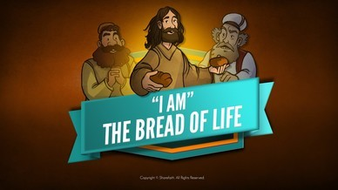
John 6:51-58

Slide 5
Leader: A reading from
the Holy Gospel
according to John.
All: Glory to You, Oh Lord.

Slide 6
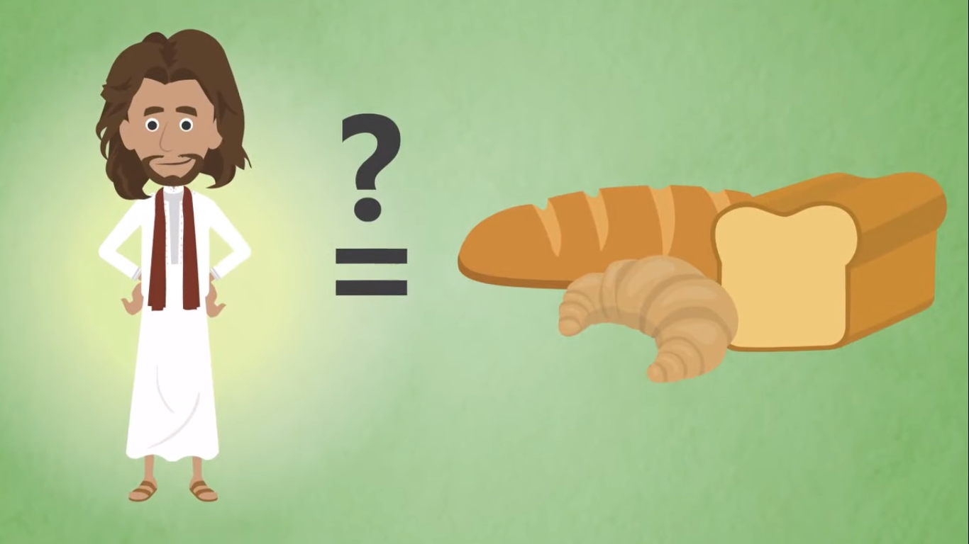
51
I am the living bread that came down from heaven. If you eat this bread, you will live forever. The bread that I will give you is my flesh, which I give so that the world may live.”

Slide 7
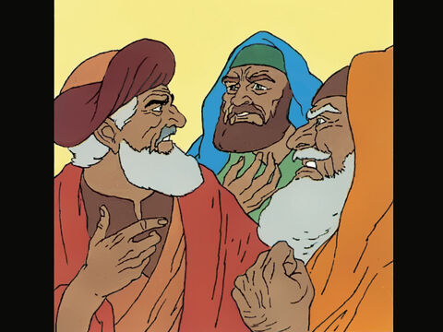
52
This started an angry argument among them.
“How can this man give us his flesh to eat?” they asked.

Slide 8
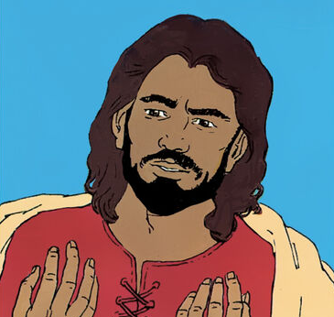
53
Jesus said to them,
“I am telling you the truth: if you do not eat the flesh of the Son of Man and drink his blood, you will not have life in yourselves.

Slide 9
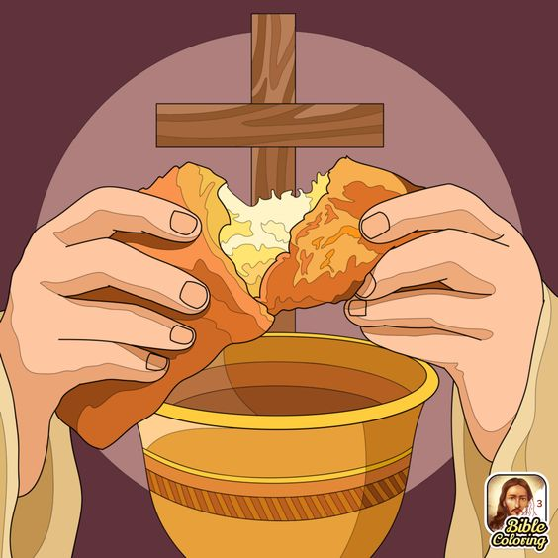
54
Those who eat my flesh and drink my blood have eternal life, and I will raise them to life on the last day.

Slide 10
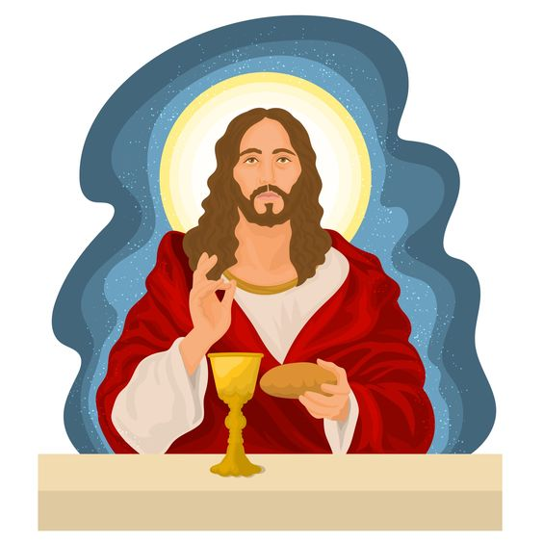
55
For my flesh is the real food; my blood is the real drink.

Slide 11
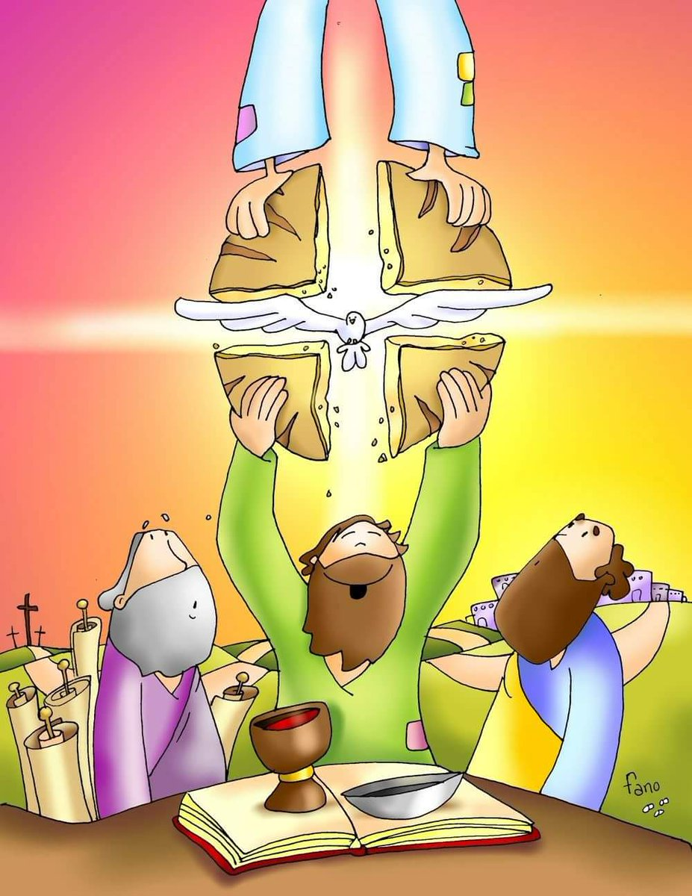
56
Those who eat my flesh and drink my blood live in me, and I live in them.

Slide 12
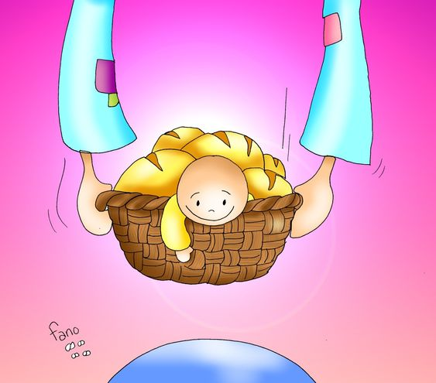
57
The living Father sent me, and because of him I live also. In the same way whoever eats me will live because of me.

Slide 13
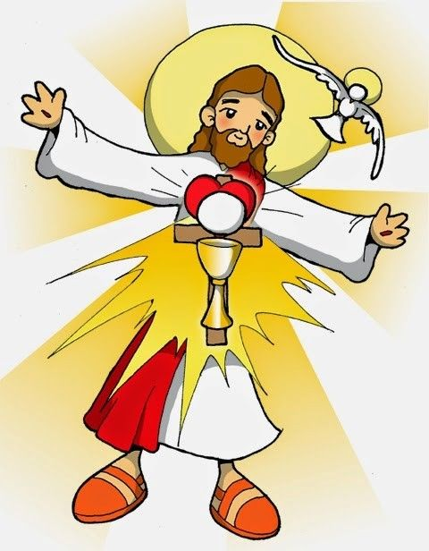
58
This, then, is the bread that came down from heaven; it is not like the bread that your ancestors ate, but then later died. Those who eat this bread will live forever.”

Slide 14
Leader: The Gospel of the Lord.
All: Praise to You,
Lord Jesus Christ.

Slide 15
GOSPEL MESSAGE

Slide 16
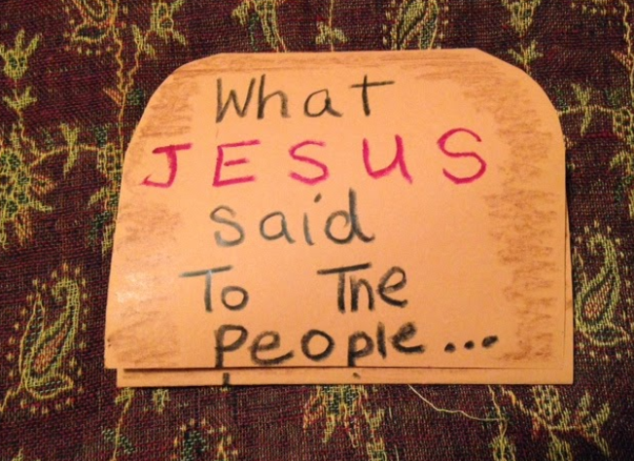
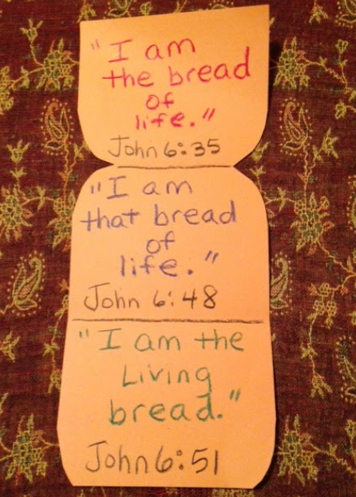
Activity: The Bread of Life
1. Brown paper
2. Pen
3. Scissors
4. Crayons
5. Glue

Slide 17
Instructions:
Fold the brown paper in thirds.
Round top corners only. This should resemble a loaf of bread.
On the outside of the folded up paper, write "What JESUS said to the people..." (See picture above).
Unfold up one 'flap.'
On the bottom flap, write "3 times, He said..."
Unfold paper all the way.
On top flap, write "I am the bread of life." and "John 6:35."
On the middle flap, write "I am that bread of life." and "John 6:48."
On the bottom flap, write "I am the living bread." and "John 6:51."

Slide 18
Closing Prayer
Dear, Jesus, we love you.
Thank you for giving us the bread of life. Thank you for giving us gifts to share.
We pray for everyone who is hungry or thirsting or lonely or sad. Be with them God as we know you are with us.
In Jesus’ name we pray. Amen!

Slide 19
Eighteenth Sunday in Ordinary Time - August 04, 2024
CYCLE B – YEAR II
Twentieth Sunday in Ordinary Time - August 18, 2024
CYCLE B – YEAR II

