Slide 2
Fifth Sunday of Easter – April 28, 2024
CYCLE B – YEAR II

Slide 3
UNDERSTANDING THE GOSPEL (for facilitators only)
This message explains that we need to remain constantly connected to Christ. As a branch needs to be connected to the main part of the plant in order to live, we need to be “attached” to the Lord. What does this mean? Being rooted in prayer and Bible reading should be components of our daily life, providing the fuel we need to grow and stay healthy in our faith. Staying connected to Christ as the “vine” means resting in His presence and recognizing the power of His word, rather than relying on ourselves.

Slide 4
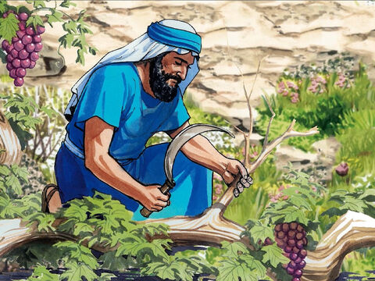
Jesus the Real Vine
John 15:1-8

Slide 5
Leader: A reading from
the Holy Gospel
according to John.
All: Glory to You, Oh Lord.

Slide 6
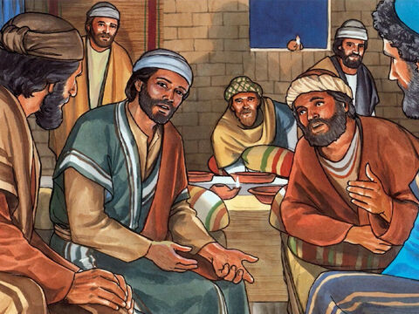
1
“I am the real vine, and my Father is the gardener.

Slide 7
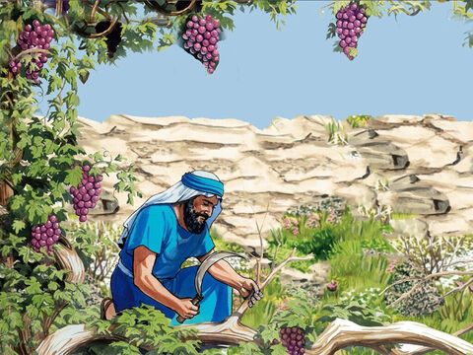
2
He breaks off every branch in me that does not bear fruit, and he prunes every branch that does bear fruit, so that it will be clean and bear more fruit.

Slide 8
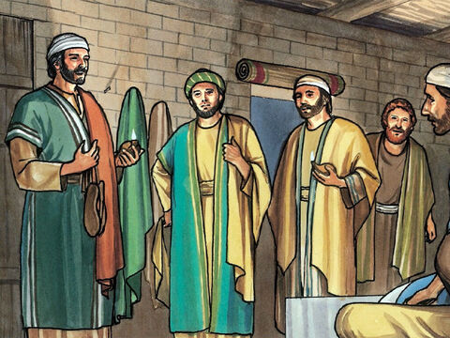
3
You have been made clean already by the teaching I have given you.

Slide 9
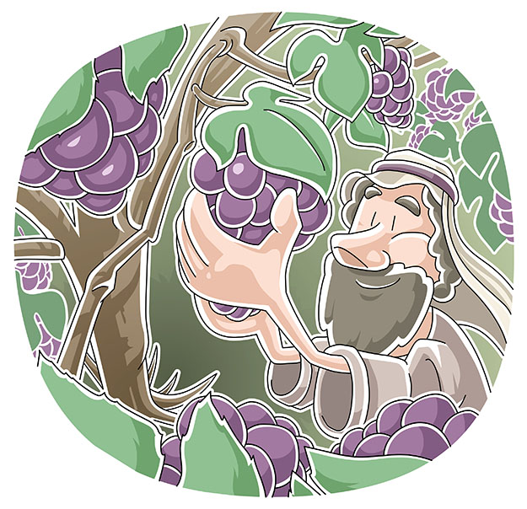
4
Remain united to me, and I will remain united to you. A branch cannot bear fruit by itself; it can do so only if it remains in the vine. In the same way you cannot bear fruit unless you remain in me.

Slide 10
5
“I am the vine, and you are the branches. Those who remain in me, and I in them, will bear much fruit; for you can do nothing without me.

Slide 11
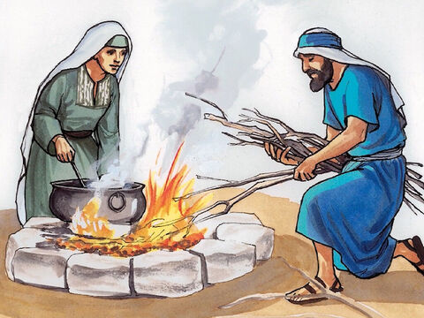
6
Those who do not remain in me are thrown out like a branch and dry up; such branches are gathered up and thrown into the fire, where they are burned.

Slide 12
7
If you remain in me and my words remain in you, then you will ask for anything you wish, and you shall have it.

Slide 13
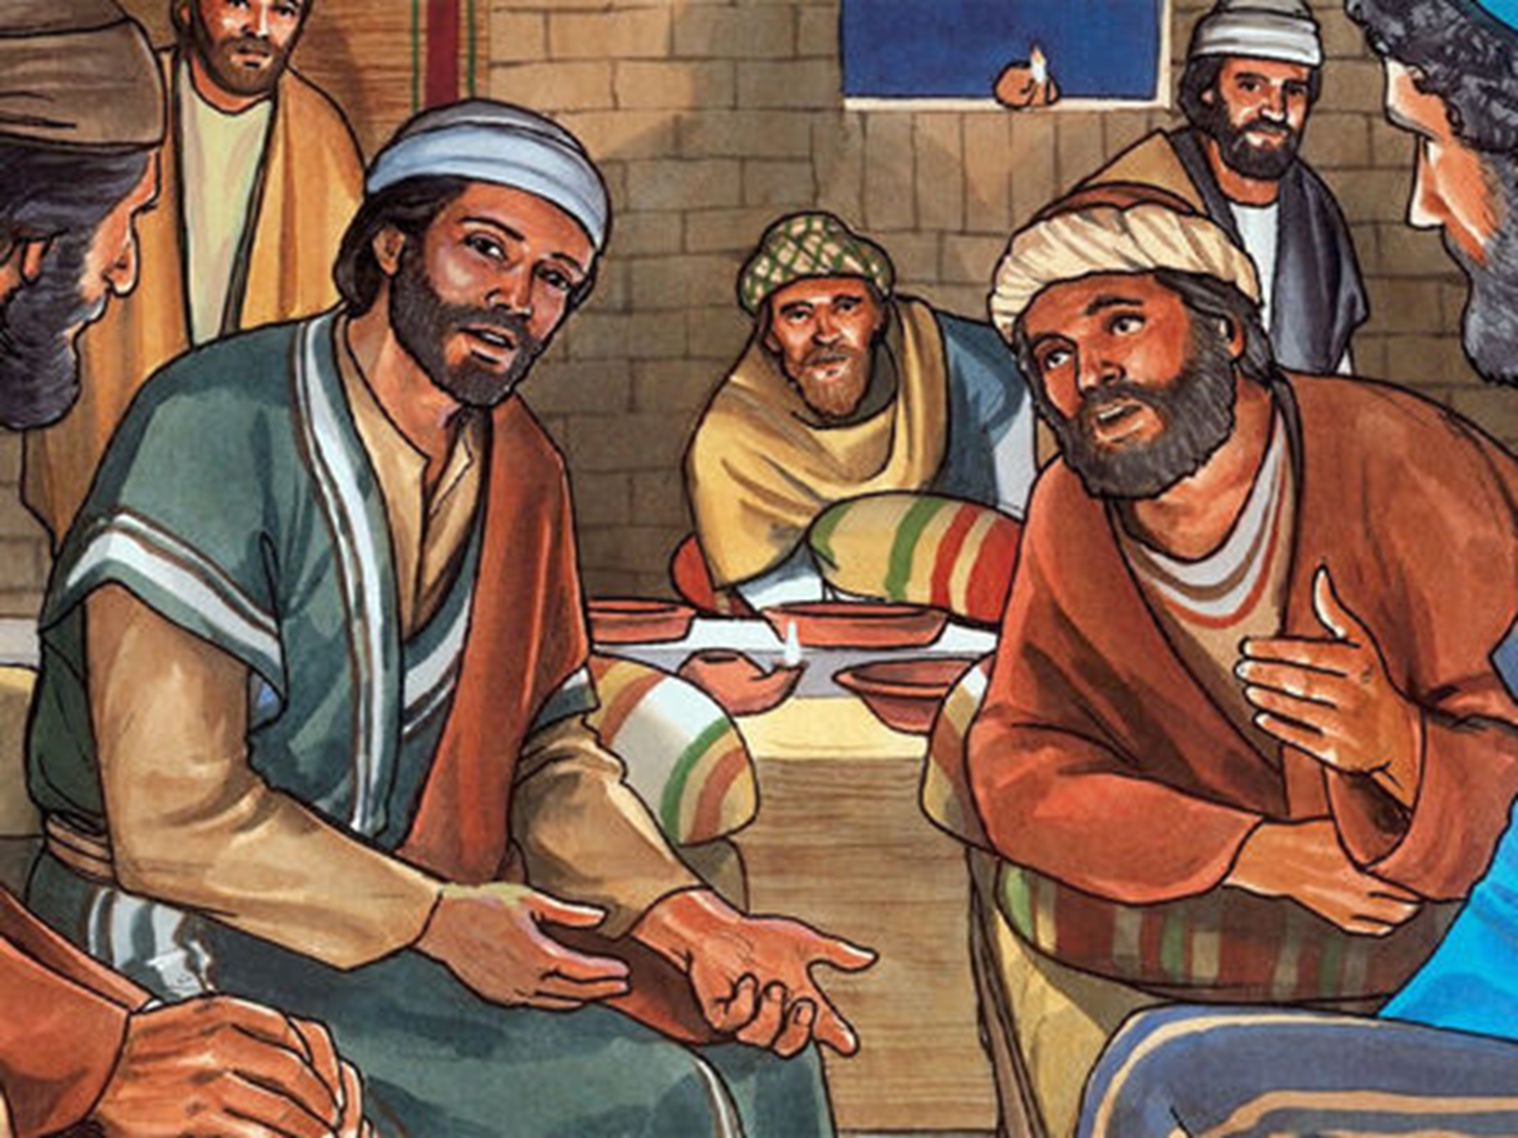
8
My Father's glory is shown by your bearing much fruit; and in this way you become my disciples.

Slide 14
Leader: The Gospel of the Lord.
All: Praise to You,
Lord Jesus Christ.

Slide 15
GOSPEL MESSAGE

Slide 16
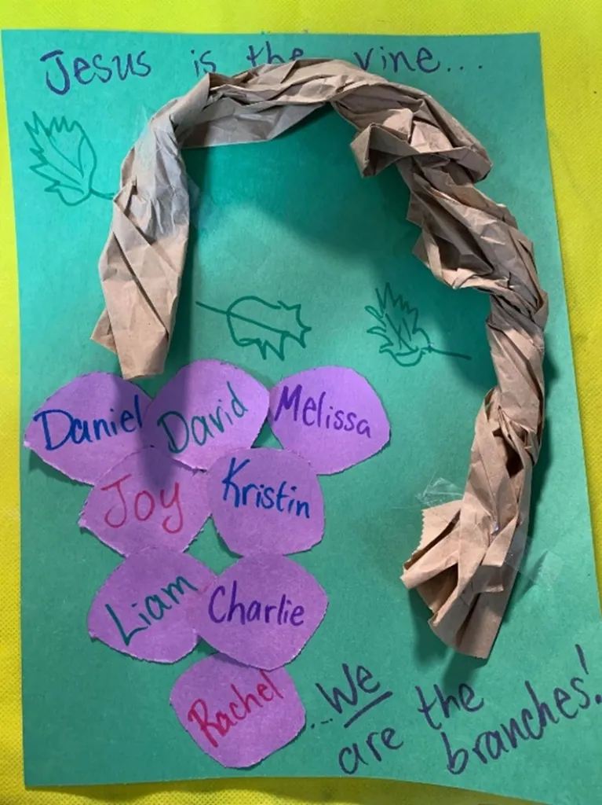
Activity: We are the Branches
Materials:
Markers
Coloring materials
Glue
Construction paper colored paper
Paper bags
Scissors

Slide 17
Instructions:
Decorate a paper with initial drawings and captions (leaves, vines, verses, etc.).
Cut and twist a paper bag to create a threedimensional “vine” effect.
Write your name and your friends on several grape-colored (purple or green) circles.
Glue or tape the grapes and vines to the main paper

Slide 18
Closing Prayer
Dear God,
You are the vine of life
Help us stay connected to you
We are your branches
Help us bear spiritual fruit and share with others around us
Thank you for your love
We love you, God!
In Jesus’s name,
Amen!

Slide 20
Fifth Sunday of Easter – April 28, 2024
CYCLE B – YEAR II

