Slide 2
Fourth Sunday of Easter – April 21, 2024
CYCLE B – YEAR II

Slide 3
UNDERSTANDING THE GOSPEL (for facilitators only)
This message reminds students that God loves and cares for us, and that He protects us at all times. Just as a shepherd watches out for the needs of the lambs and sees that they have what they need, God provides for us. Jesus gave His life for His sheep, willing to sacrifice for those He loves.

Slide 4
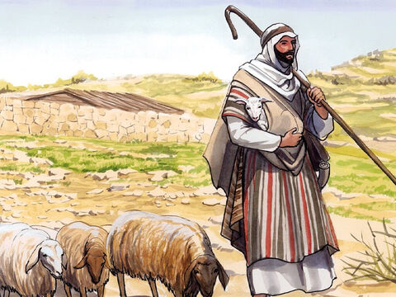
The Good Shepherd
John 10:11-18

Slide 5
Leader: A reading from
the Holy Gospel
according to John.
All: Glory to You, Oh Lord.

Slide 6
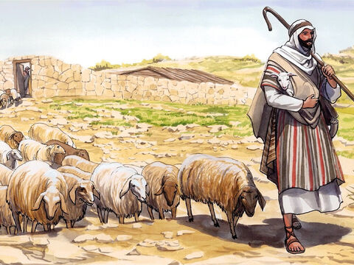
11
“I am the good shepherd, who is willing to die for the sheep.

Slide 7
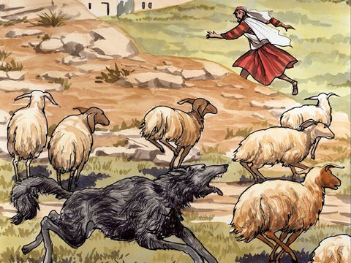
12
When the hired man, who is not a shepherd and does not own the sheep, sees a wolf coming, he leaves the sheep and runs away; so the wolf snatches the sheep and scatters them.

Slide 8
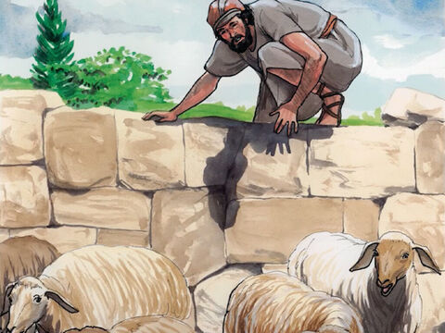
13
The hired man runs away because he is only a hired man and does not care about the sheep.

Slide 9
14
I am the good shepherd. As the Father knows me and I know the Father,

Slide 10
15
in the same way I know my sheep and they know me. And I am willing to die for them.

Slide 11
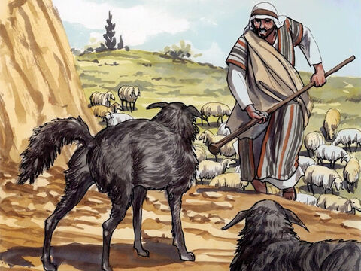
16
There are other sheep which belong to me that are not in this sheep pen. I must bring them, too; they will listen to my voice, and they will become one flock with one shepherd.

Slide 12
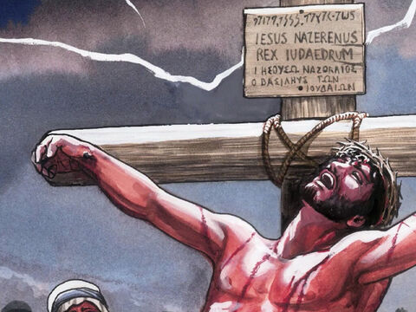
17
“The Father loves me because I am willing to give up my life, in order that I may receive it back again.

Slide 13
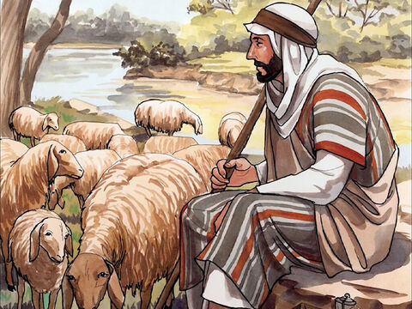
18
No one takes my life away from me. I give it up of my own free will. I have the right to give it up, and I have the right to take it back. This is what my Father has commanded me to do.”

Slide 14
Leader: The Gospel of the Lord.
All: Praise to You,
Lord Jesus Christ.

Slide 15
GOSPEL MESSAGE

Slide 16
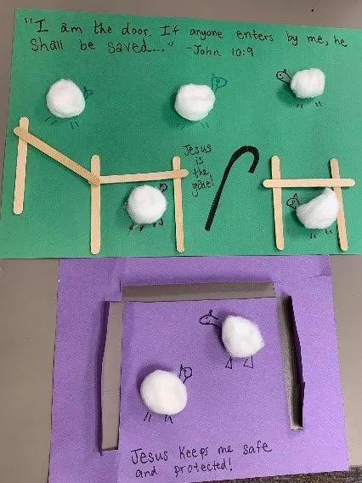
Activity: Sheep in the Pen
Materials:
Popsicle sticks, toothpicks, or Q-tips
Markers, stickers, or other decorating materials
Glue
Cotton Balls
Construction paper or card stock

Slide 17
Instructions:
Build a “fence” on your paper: arrange toothpicks, sticks, or cotton swabs along the perimeter and glue them down to look like a barrier. Create an opening “gate.”
Place cotton ball “sheep” onto the paper within the fence. Glue the sheep down.
Decorate the sheep with legs, heads, and tails, if desired.
Add a verse and/or caption.

Slide 18
Closing Prayer
Dear God,
You are the good shepherd
Thank you for taking care of us
Thank you for providing for us and protecting us
Help us to follow you
Thank you for your love
We love you, God!
In Jesus’s name, Amen!

Slide 20
Fourth Sunday of Easter – April 21, 2024
CYCLE B – YEAR II

